Slide 1
AI-Powered Grocery Management Feature
Innovative technology transforming grocery shopping efficiency
Notes:
AI-generated content may be incorrect. ---

Slide 2
Product Strategy and Feature Overview
Notes:
Product Vision, Problem Statement, Target Users, Solution Overview, AI Receipt Scanning, Smart Inventory Dashboard, Recipe Recommendations, Technical Architecture, Privacy and Trust, Success Metrics

Slide 3
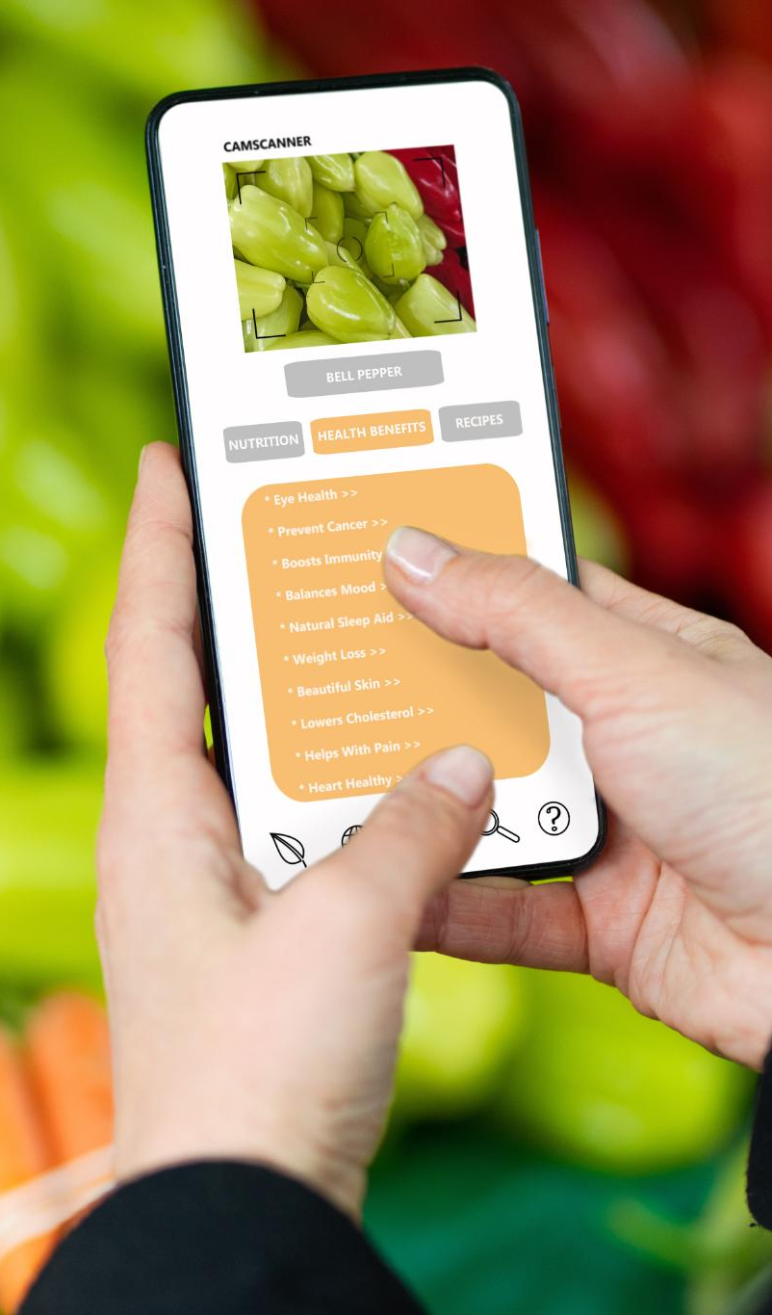
Product Vision
Reducing Food Waste
AI-powered features help users reduce household food waste by tracking items and predicting expiry dates.
User Empowerment
Users gain control and confidence through seamless management and personalized food recommendations.
Sustainability Focus
The product encourages responsible consumption, aligning with sustainability goals to reduce environmental impact.
Long-Term Engagement
The AI system evolves into a trusted personal assistant by learning user behavior over time.
Notes:
The product vision for the AI-powered grocery management feature is centred on helping users actively reduce food waste while saving money and time. Food waste is a persistent household problem driven by poor visibility into purchased items, forgotten expiration dates, and lack of inspiration to use ingredients efficiently. This feature aims to solve these challenges by combining artificial intelligence with a seamless user experience. By allowing users to scan grocery receipts, automatically track inventory, and receive intelligent expiry predictions, the product removes the cognitive burden associated with food management. In addition to operational efficiency, the vision emphasises emotional value: users feel more in control, less guilty about waste, and more confident in their daily food decisions. The feature also aligns with broader sustainability goals by encouraging responsible consumption and reducing environmental impact. From a business perspective, the vision supports long-term engagement by embedding the feature into users’ everyday routines. Over time, as the system learns from user behaviour, it can evolve into a trusted personal food assistant. Ultimately, the vision is not just to manage groceries, but to subtly change habits through intelligent nudges, timely insights, and personalised recommendations that make sustainable choices the easiest choices.

Slide 4

Problem Statement
Grocery Management Challenges
Users struggle with forgotten items, expired food, and repurchasing due to poor grocery visibility and lack of reminders.
User Mental Overload
Busy parents and students face time pressure and lack effective tools for food management and budgeting.
Inefficient Existing Solutions
Manual input and lack of automation in current solutions create friction and discourage consistent use.
Need for Intelligent Automation
Effective solutions require automation, intelligence, and contextual support integrated naturally into daily routines.
Notes:
Many users struggle with managing groceries once they leave the store, leading to forgotten items, expired food, and unnecessary repurchasing. The problem is not a lack of intention but a lack of visibility and timely reminders. Receipts are often discarded, expiration dates are inconsistent or unclear, and users rarely have a single, reliable source of truth for what is in their kitchen. Busy parents face time pressure and mental overload, while students often lack experience or planning tools to manage food efficiently on a budget. Existing solutions frequently rely on manual input, which creates friction and discourages sustained use. As a result, food waste becomes an invisible but costly issue, affecting household budgets and contributing to environmental harm. This problem is compounded by the absence of contextual support, such as recipe ideas that adapt to what users already own. Addressing this problem requires automation, intelligence, and a user-centred approach that integrates naturally into daily life rather than adding another task to manage.

Slide 5

Target Users
Busy Parent Persona
Busy parents need speed, automation, and reminders to avoid food waste while managing family budgets efficiently.
Eco-Conscious Student Persona
Eco-conscious students seek sustainability insights, flexible recipes, and feedback to minimize food waste and save money.
Shared User Needs
Both personas require clarity, low effort, and actionable guidance to effectively manage food planning and waste reduction.
Notes:
The feature is designed primarily for two key personas: the busy parent and the eco-conscious student. The busy parent typically juggles work, family, and household responsibilities, leaving little time for detailed food planning. Their primary needs include speed, automation, and clear reminders that prevent food from expiring unnoticed. They value features that reduce repeat shopping trips and help stretch the family budget. In contrast, the eco-conscious student is motivated by sustainability and cost awareness. This persona often shops on a tight budget and is emotionally impacted by wasting food. They seek insights, flexible recipes, and feedback on how their choices reduce waste. While these personas differ in lifestyle, they share a need for clarity, low effort, and actionable guidance. Designing for both ensures the feature remains accessible, empathetic, and adaptable across a broad user base, while still delivering personalised value.

Slide 6

Solution Overview
Receipt Scanning
Users scan grocery receipts to automatically extract purchased items and quantities, streamlining data entry.
Inventory Management
Extracted items are added to a digital inventory that estimates expiration dates using rules and machine learning.
Recipe Recommendations
The system suggests personalized recipes prioritizing expiring ingredients, considering user preferences and dietary needs.
Incremental AI Integration
The solution provides immediate MVP value while allowing advanced AI features to be added progressively.
Notes:
The proposed solution combines receipt scanning, intelligent inventory management, and personalised recipe recommendations into a cohesive experience. Users begin by scanning their grocery receipts, allowing the system to automatically extract purchased items and quantities. These items are then added to a digital inventory, where estimated expiration dates are calculated using a combination of rules and, eventually, machine learning models. The inventory view highlights items that are nearing expiry, drawing attention to what needs to be used soon. To close the loop, the system suggests recipes that prioritise expiring ingredients, while also considering user preferences, dietary needs, and budget constraints. This end-to-end flow transforms raw purchase data into meaningful, timely actions. The solution is designed to be incremental, delivering immediate value in the MVP while allowing more advanced AI capabilities to be layered in over time.

Slide 7

AI Receipt Scanning
Automated Data Extraction
OCR and NLP technologies extract item details from photographed receipts, removing manual entry.
Human-in-the-Loop Design
Users can review and correct extracted data, enhancing accuracy and training AI models.
Building Trust and Value
Quick, clear scanning results establish user trust and demonstrate value instantly.
Data-Driven Features
Accumulated receipt data supports advanced features like expiry prediction and personalized advice.
Notes:
AI-powered receipt scanning is the entry point to the feature and a critical enabler of automation. By leveraging optical character recognition (OCR) and natural language processing (NLP), the system can extract item names, quantities, and prices directly from a photographed receipt. This eliminates the need for manual data entry, which is a common barrier to adoption in food tracking apps. The design assumes that OCR accuracy will improve over time, but also provides users with the ability to quickly review and correct extracted items. This human-in-the-loop approach balances efficiency with reliability and helps train future models. Receipt scanning also establishes trust early by demonstrating clear, tangible value within seconds of use. As more receipts are scanned, the system gains richer data to support downstream features such as expiry prediction and personalised recommendations.

Slide 8
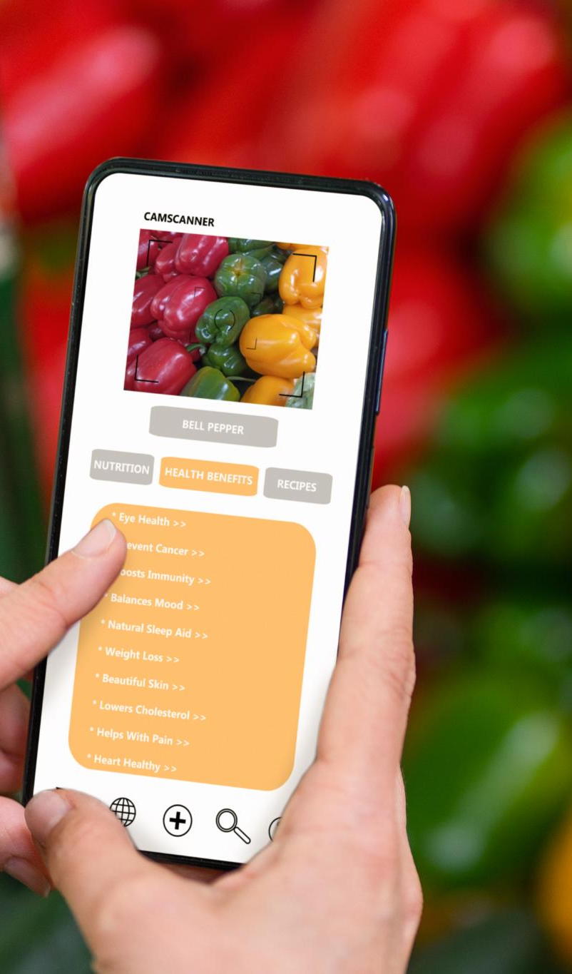
Smart Inventory Dashboard
Visual Expiration Indicators
Color coding clearly shows expiration status, helping users quickly identify items that need attention.
Quick Interaction Features
Users can easily mark items as used or discarded, ensuring inventory stays accurate with minimal effort.
Filtering and Search Options
Filters and search functions allow users to focus on specific categories or expiration time frames.
Supporting Waste Reduction
The dashboard transforms data into actionable insights that help reduce food waste effectively.
Notes:
The smart inventory dashboard serves as the central hub for food management. Its primary purpose is to give users an immediate understanding of what they have and what needs attention. Items are displayed with clear visual indicators based on their estimated expiration status, such as colour coding for expiring soon versus fresh items. This visual hierarchy helps users prioritise decisions without reading detailed information. The dashboard supports quick interactions, such as marking items as used or discarded, which keeps the inventory accurate with minimal effort. Filters and search functions allow users to focus on specific categories or time frames. By making the invisible visible, the inventory dashboard turns passive data into an active decision-making tool that directly supports waste reduction.

Slide 9

Recipe Recommendations
Transforming Awareness to Action
Recipe recommendations help users act on expiring ingredients by offering concrete cooking suggestions.
Personalization Factors
Recipes are prioritized based on expiring items, user preferences, dietary needs, and budget constraints.
Engagement and Refinement
User engagement data refines recommendations to improve personalization over time.
Delightful User Experience
Recipe feature adds discovery and support, reducing friction between intention and behavior.
Notes:
Recipe recommendations complete the behavioural loop by transforming awareness into action. Instead of simply telling users that an item is about to expire, the system offers concrete suggestions on how to use it. Recipes are prioritised based on expiring ingredients, while also factoring in user preferences, dietary restrictions, and budget considerations. This ensures relevance and increases the likelihood that users will act on the recommendation. Over time, engagement data can be used to refine suggestions and improve personalisation. The recipe feature also adds an element of delight and discovery, making the experience feel supportive rather than punitive. By integrating inspiration directly into the management flow, the product reduces friction between intention and behaviour.

Slide 10

Technical Architecture
Event-Driven Cloud Architecture
The architecture is cloud-native and event-driven, enabling scalable and responsive system design.
Streaming Platform Integration
API Gateway routes events to streaming platforms like Kafka or Kinesis for real-time data processing.
AI-Powered Processing
AI services analyze receipt images and apply business rules for expiry prediction and notifications.
Tiered Data Storage
Data is stored in hot storage for active inventory and cold storage for historical analytics to optimize performance and costs.
Notes:
The technical architecture is designed to be cloud-native, event-driven, and scalable. A mobile application communicates with an API gateway, which routes events such as receipt uploads and inventory updates into a streaming platform like Kafka or AWS Kinesis. Stream processing components handle real-time logic, including triggering expiry checks and notifications. AI services process receipt images and apply business rules or models for expiry prediction. Data is stored using a tiered approach, with hot storage for active inventory data and cold storage for historical receipts and analytics. This separation improves performance while controlling costs. The modular design allows individual components to evolve independently, supporting rapid iteration and future expansion.

Slide 11
Privacy and Trust
Data Privacy Measures
Encryption protects data in transit and at rest, with role-based access control ensuring tight security.
User Transparency and Control
Users are informed about data collection and can control their data, including deletion and opting out.
Compliance and Trust Building
Compliance with privacy regulations like GDPR is standard; trust is enhanced via clear AI decision explanations.
Notes:
User trust is foundational to the success of this feature, as grocery data can reveal sensitive behavioural patterns. The privacy strategy focuses on data minimisation, encryption, and transparency. All data is encrypted both in transit and at rest, and access is tightly controlled using role-based permissions. Users are clearly informed about what data is collected and why, and they are given meaningful control, including the ability to delete their data or opt out of analytics. Compliance with regulations such as GDPR is treated as a baseline rather than a differentiator. Beyond technical safeguards, trust is reinforced through UX elements that explain AI-driven decisions, such as how expiry dates are estimated. This openness helps users feel confident and respected.

Slide 12
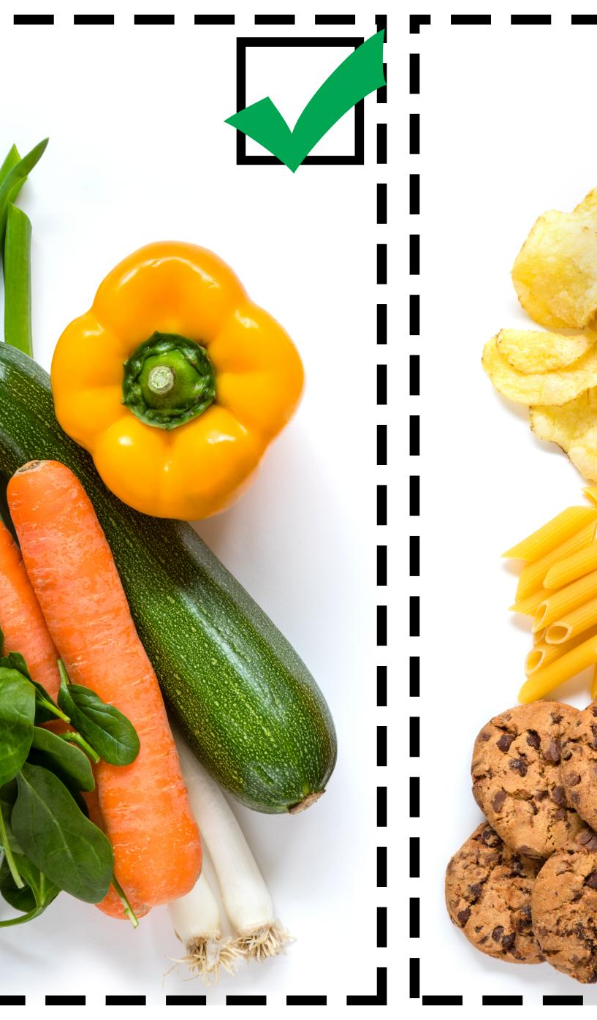
Success Metrics
Food Waste Reduction
Primary success metric is reducing food waste by using items before their expiry dates.
User Engagement Metrics
Weekly active users and feature usage frequency indicate how integrated the feature is in routines.
Recipe Conversion Rates
Measures how effectively insights lead users to prepare recipes, translating data into action.
Retention Metrics
30-day retention metrics assess the long-term value and continued use of the feature.
Notes:
Success for the AI-powered grocery management feature is measured across behavioural, engagement, and business dimensions. A primary metric is the reduction in food waste, tracked through the proportion of items used before their estimated expiry. Engagement metrics such as weekly active users and feature usage frequency indicate whether the solution is becoming part of users’ routines. Recipe conversion rates show how effectively insights are translated into action. Retention metrics, including 30-day retention, help assess long-term value. Together, these metrics provide a balanced view of impact, ensuring that the feature not only attracts users but also delivers on its core promise of reducing waste and enhancing everyday life.

