Slide 1
SGX-2
A Simple SGX with a Clean API

Slide 2
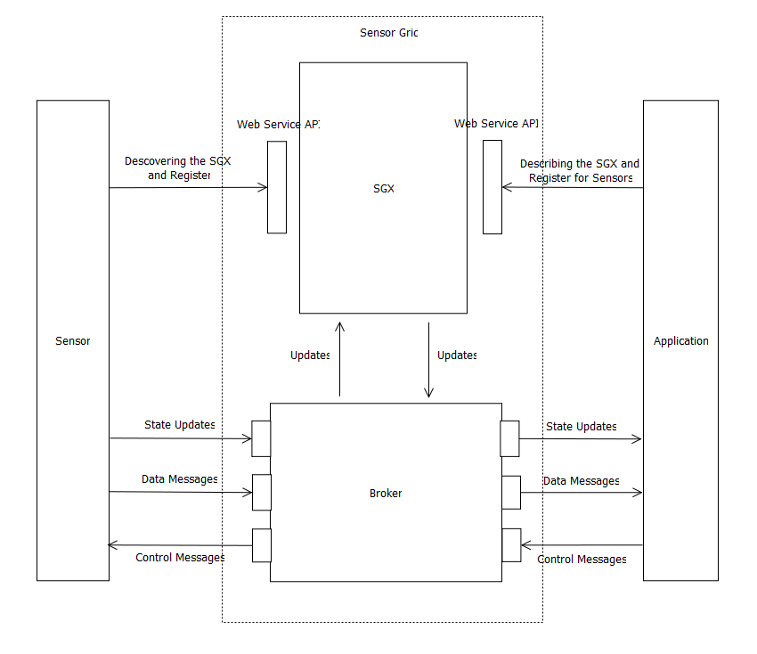
Architecture

Slide 3
DESING
SGX Core
Sensor
Sensor Client

Slide 4
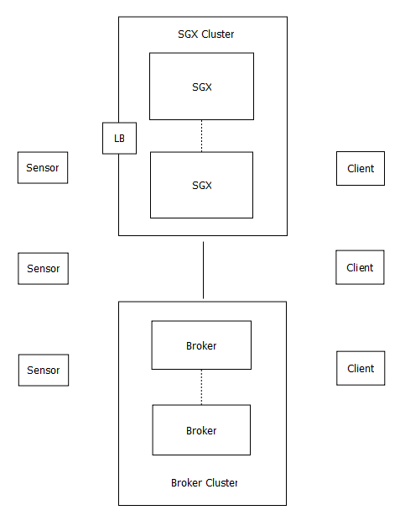
DEPLOYMENT

Slide 5
FUTURE WORK
Supporting Cluster of Brokers
Streaming Messages
Cloud provisioning
Authentication/Authorization

Slide 6
Thank You

