Slide 1

Presented by :
Rasha Yasser
Submitted to :
Coretech / ITIDA
30/7/2024

Slide 2
Project Overview
Objective:
Create a distributed banking system using the client-server model.
Technologies :
QT/C++, TCP Socket for communication, Multithreading.

Slide 3
Functional Requirements
Log in (user, pass)
Get Account number (username)
Get Account number By Admin(admin, username)
View Account balance (account number)
View transaction history (account number, count)
Make Transaction (account number, transaction amount)
Transfer Amount (from_AN, to_AN, transfer amount)
View Bank Database (admin)
Create New User (String userdata)
Delete User (account number)
Update User (AN, newData)

Slide 4
Non-Functional Requirements
System should be distributed on two applications: one for the client and one for the server.
Applications should be developed using the QT/C++ framework.
The client application should be executed as a GUI application.
The server application should be a simple console application that runs in the background.
Client-server communication should happen via the Sockets.
The server should handle multiple requests from multiple clients using threads.

Slide 5
Non-Functional Requirements
Encrypt the whole client request before sending it and decrypt it on the server side.
Add signature to the request message before sending it to the server and verify the signature on the server.
Create a log file to save the requests from clients.
Send the server's response to client requests via email to the associated client.
Apply OOP design to the whole system.

Slide 6
Additional Features
Systemctl Service: Server as a systemd service.
Logging: Save client requests to a log file.
Email Responses: Server responses sent to client's email.

Slide 7
System Architecture
Client-Server Interaction: Overview of communication.
Multithreading: Server handles requests in separate threads.
Encryption: Secure data transmission between client and server.

Slide 8
Implementation Details
Client Application: GUI for user interaction.
Server Application: Runs in the background as a console application. Handles requests and sends responses.
Encryption and Decryption: Details on how data encryption and decryption are handled.

Slide 9
Client Application
Developed using Qt/C++ framework.
Provides a graphical user interface (GUI).
Communicates with the server using socket programming.
MyClient Class: Handles client-side operations.
Includes classes for 'RequestValidator', 'RequestHandler', 'Encryption', 'Signature', and 'MainWindow'.
Requests: Handles different types of requests (Login, Get Account Number, etc.),Includes an abstract class 'Request' from which all requests inherit(OCP).
Encryption: Encrypts requests before sending to the server.
Signature: Adds a signature to each request for verification.

Slide 10
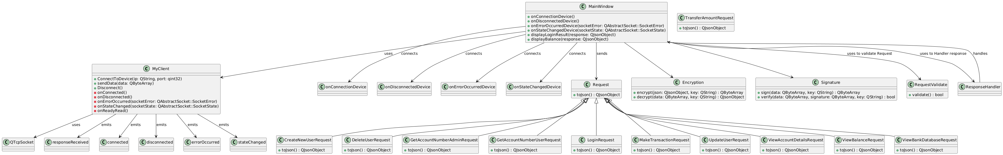
Client Diagram
OverView

Slide 11
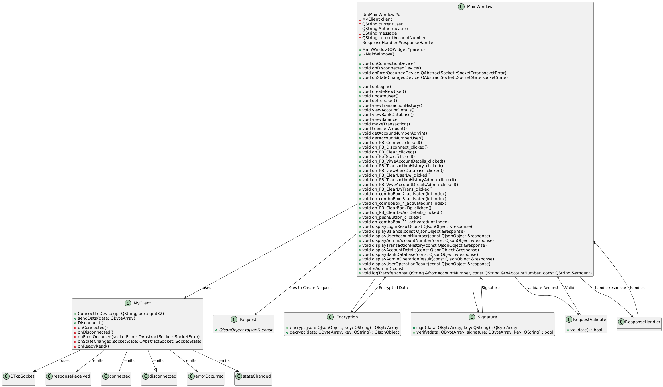
Client Diagram
MainWindow

Slide 12
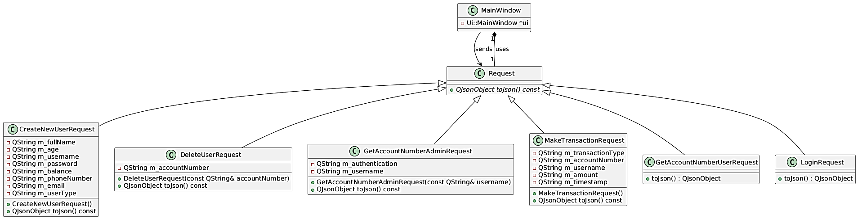
Client Diagram
Request

Slide 13
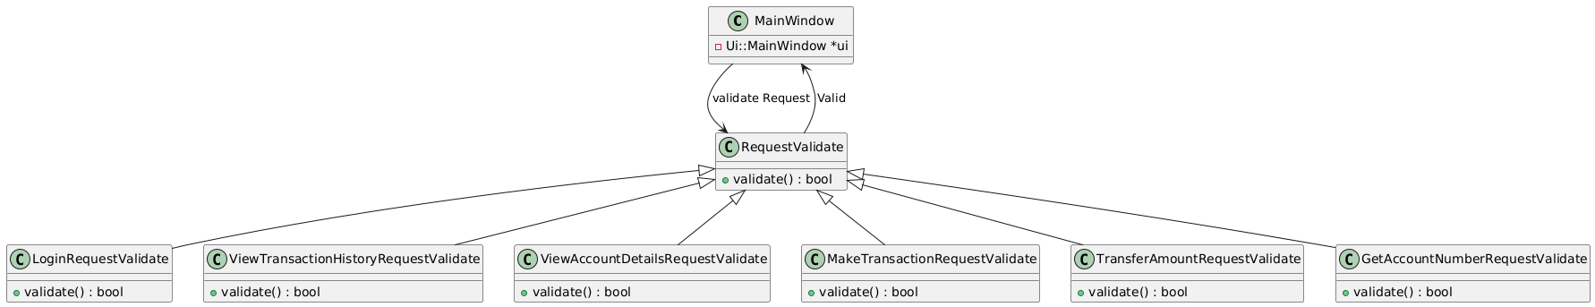
Client Diagram
RequestValidate

Slide 14
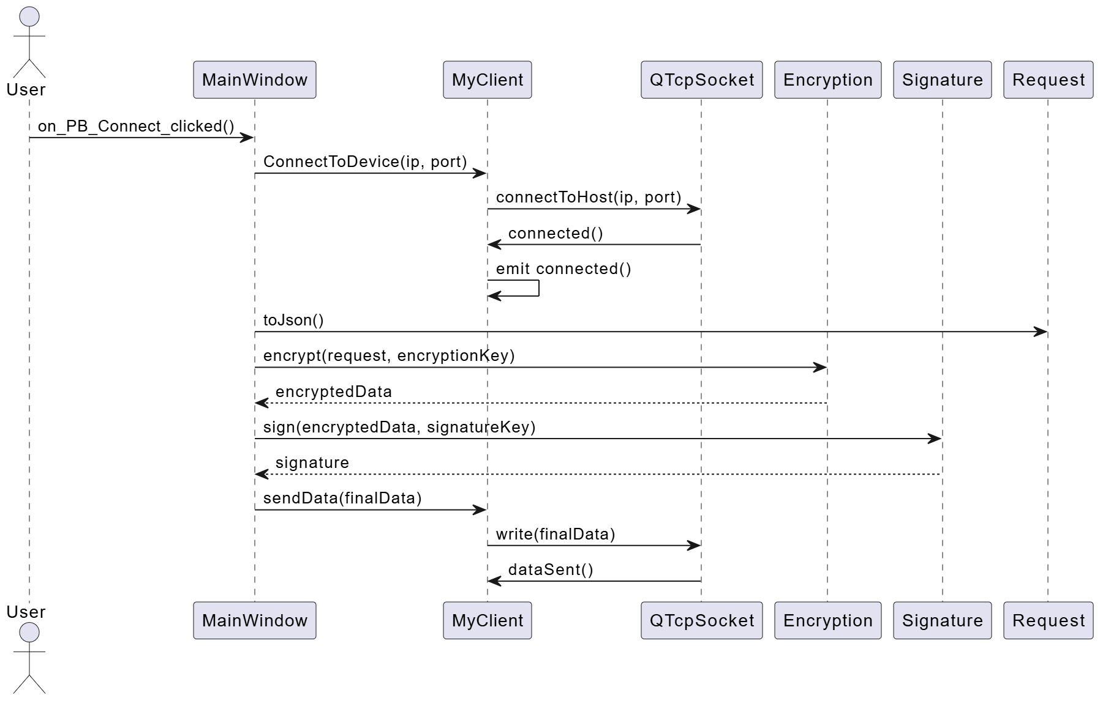
Client Sequence Diagram

Slide 15
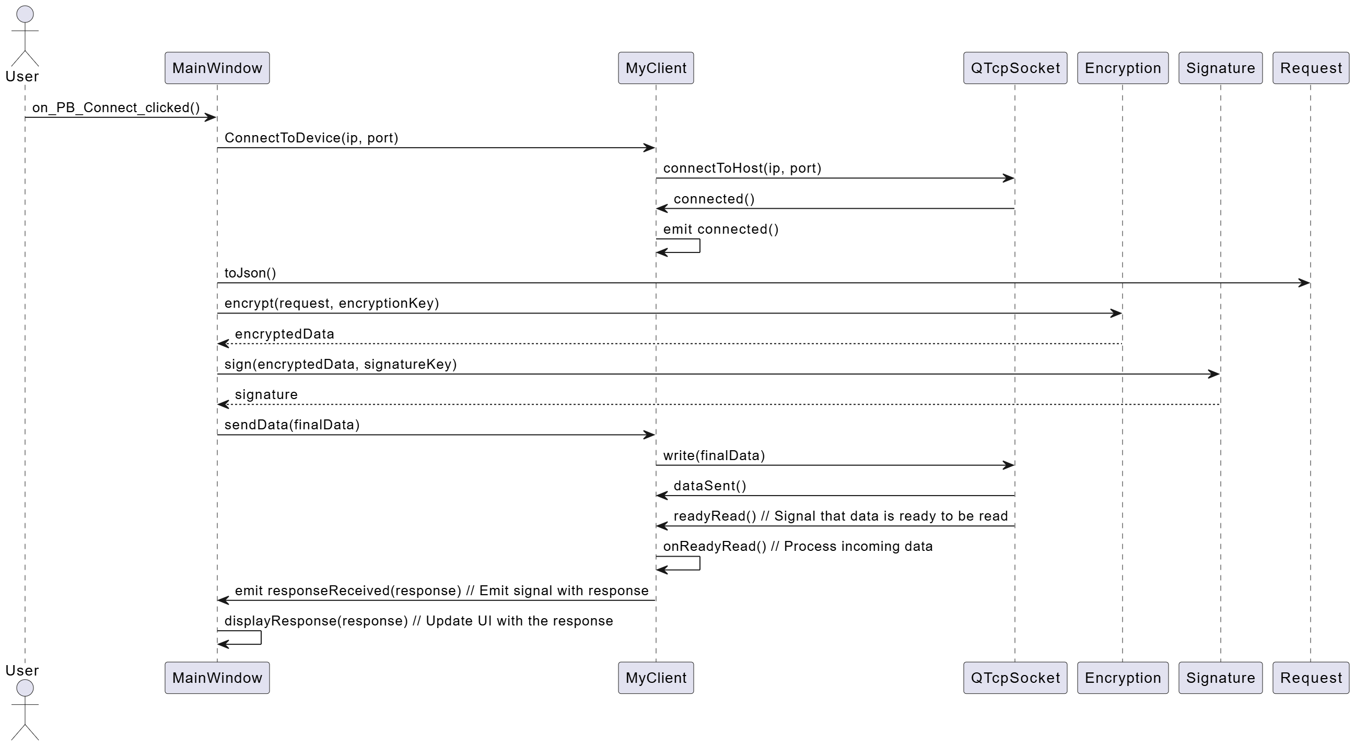
Client Sequence Diagram

Slide 16
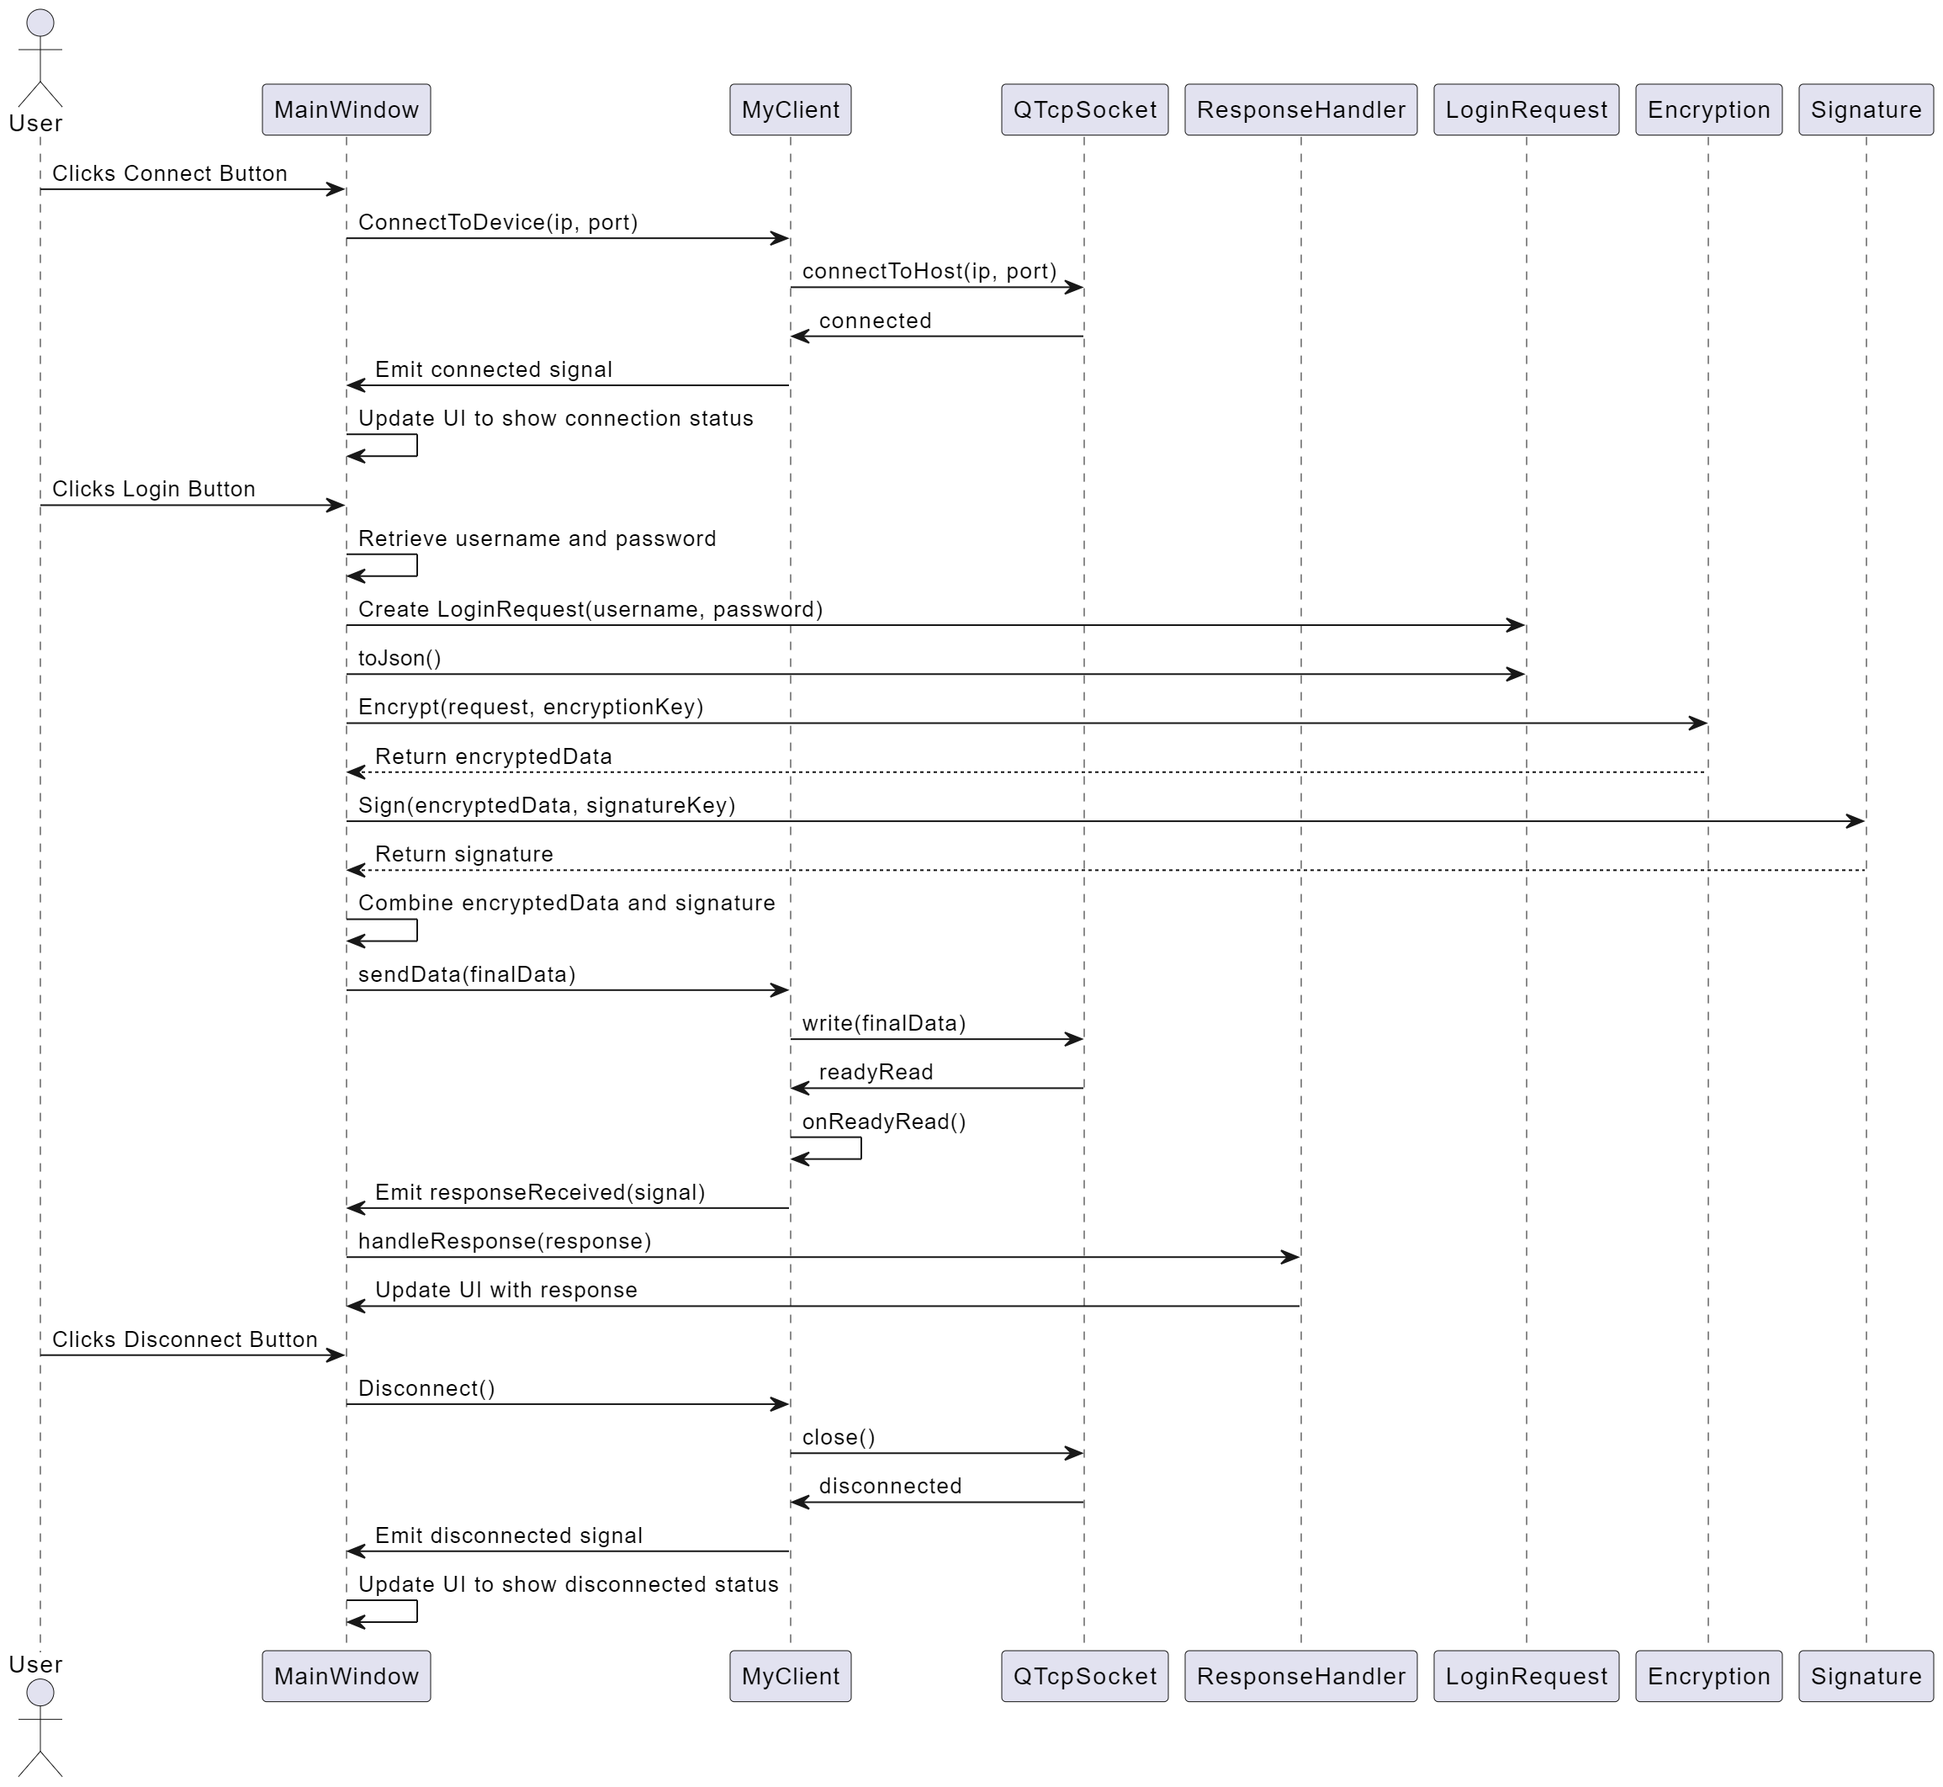
Login

Slide 17
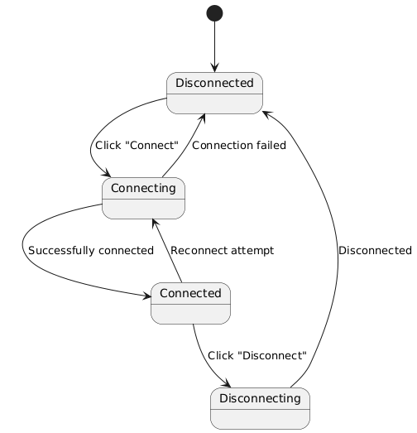
Client State Diagram
Connection

Slide 18
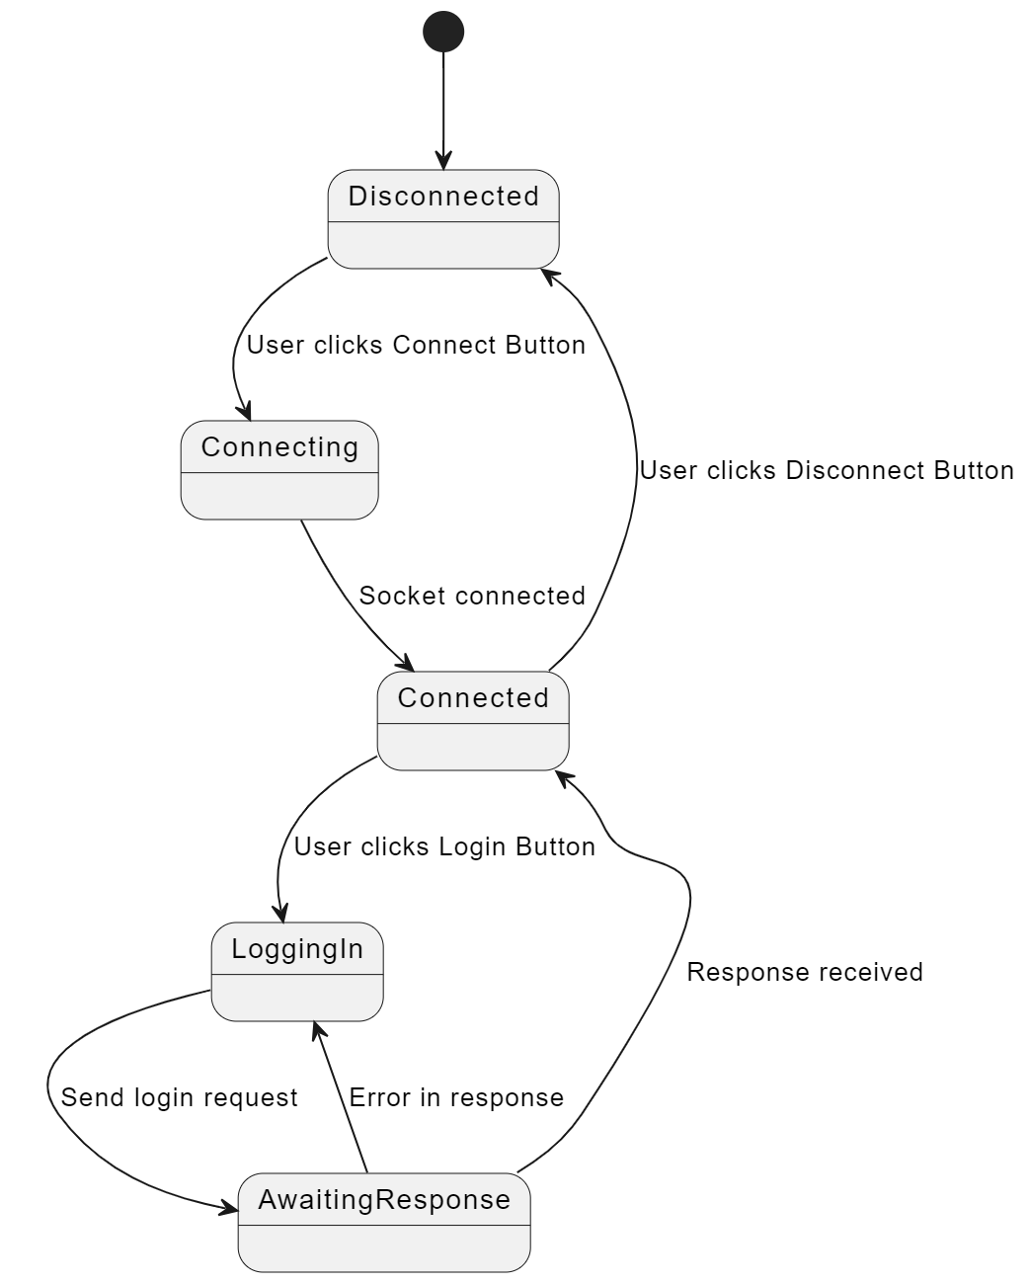
Client State Diagram
Login

Slide 19
Server Application
Developed using Qt/C++ framework.
Runs as a console application in the background.
Uses DatabaseManager: Interacts with the database to retrieve and update information.
'DatabaseManager: implemented with Memento and Singleton design patterns.
Includes classes for 'MyServerHandler', 'MyRequestHandler', 'Encryption', and 'Signature’.
Handles multiple client requests using threading.
Decrypts and processes client requests.
Verifies the signature of each request.
Sends Response Back To Client

Slide 20
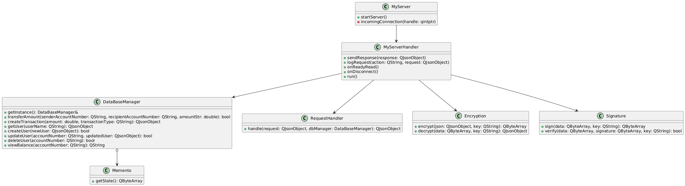
Server Class Diagram

Slide 21
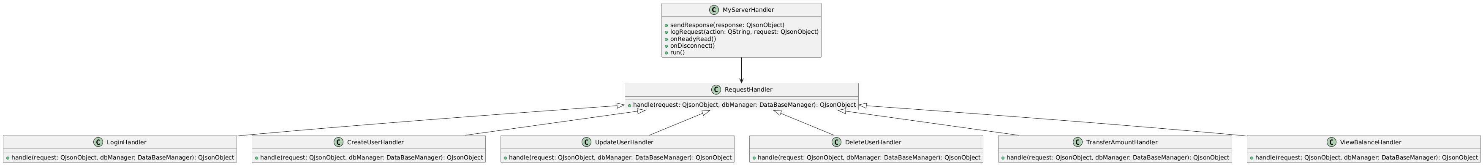
Server Class Diagram
RequestHandler

Slide 22
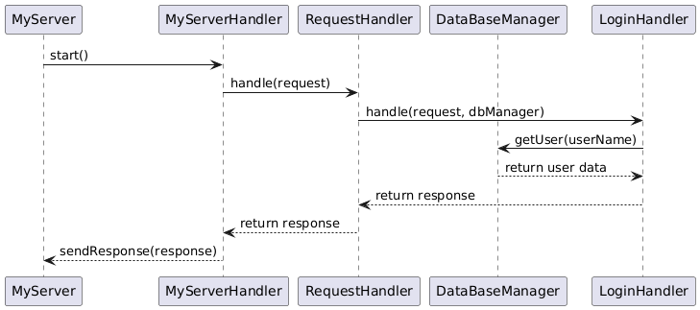
Server Sequance Diagram
Login

Slide 23
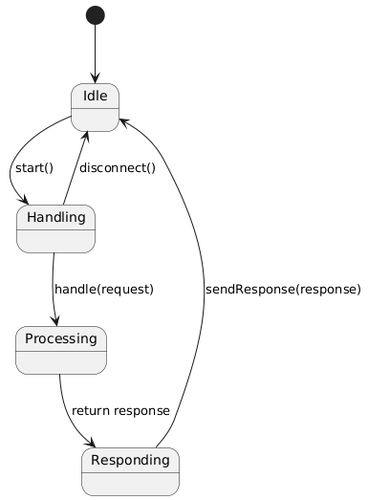
Server State Diagram

Slide 24


Time to See It in Action! 🎉
Are you ready? Let's proceed and see our work in action! 🚀 😎"

Slide 25
Systemd Service
Systemd services allow server applications to run in the background on Linux systems. They enable automatic startup, crash recovery, and ensure continuous availability.

Slide 26

Creating a Service File
1. Open terminalon Linux system and run the command:
`sudo nano /etc/systemd/system/myprogram.service`
This command creates a new service file with administrative privileges.

Slide 27
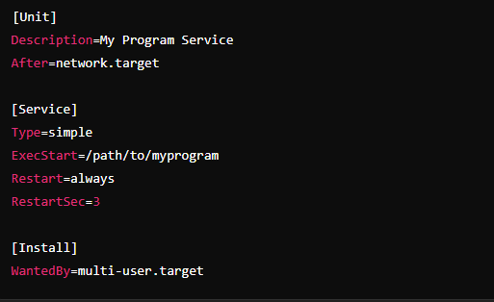
Define the Service

Slide 28
Defining the Service
[Unit]
- `Description`: A brief description of the service.
- `After`: Ensures the service starts after the network is available.
[Service]
- `Type`: Specifies the start type of the service.
- `ExecStart`: Command to start the server application.
- `Restart`: Specifies restart behavior on failure.
- `RestartSec`: Delay before restarting the service.
[Install]
- `WantedBy`: Specifies the target under which the service should start.

Slide 29
Save and Close the Service File
To save the service file and exit the nano editor, follow these steps:
- Press `Ctrl + O` to save the changes.
- Press `Enter` to confirm the file name.
- Press `Ctrl + X` to exit the editor.

Slide 30
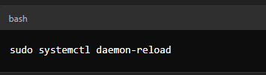
Reloading Systemd Configuration
To apply the new service, reload the systemd configuration by running the command:
`sudo systemctl daemon-reload`

Slide 31


Enable and Start the Service
To enable and start the service, run the following commands:
Enable the Service: This command sets the service to start automatically at boot.
Start The Service:This command starts the service right away

Slide 32
Conclusion and Benefits
By following these steps, we create a systemd service that manages our server application.
This setup ensures that
Application Runs continuously as a background service
Recovers from crashes the application restarts automatically if it crashes
Automatically starts on boot providing reliability and ease of management for server applications.

