Slide 1
Fake News Detection
Using NLP Classifiers
Identifying fake vs. real news using LIAR Dataset,
Linguistic Features, TF-IDF, and DistilBERT
Team : Athulya Mannambath · Amrutha · Rasha KK

Slide 2
Problem Statement & Dataset
Problem Statement
LIAR Dataset
Misinformation spreads rapidly across digital platforms
Manual fact-checking is too slow to scale
Need for automated, accurate fake news detection
Explore whether linguistic patterns alone can distinguish fake vs real news
Compare classical ML against transformer models
Binary Label Mapping
Class | Original Labels
Fake (0) | pants-fire, false, barely-true
Real (1) | half-true, mostly-true, true
Features: statement, speaker, subject, party, context
Source: PolitiFact fact-checked political statements

Slide 3
Methodology & Pipeline
1
2
3
4
5
Data Collection & Preprocessing
Feature Engineering
Classical ML Models
Transformer Models
Analysis & Evaluation
Load LIAR TSV splits.
Binary label mapping.
Lowercasing, URL & punctuation removal
Contraction expansion, stopword removal
8 linguistic features:
readability, punctuation ratio, capital ratio,
exclamation/question count, word/char count
TF-IDF word + char
Logistic Regression + GridSearchCV.
XGBoost + RandomizedSearchCV.
Combined TF-IDF + linguistic matrix.
Feature importance & SHAP analysis
DistilBERT fine-tuning (3 epochs)
BERT embeddings + LR classifier
Attention weight visualisation
AdamW + linear warmup scheduler
Accuracy, F1, ROC-AUC metrics
Confusion matrix analysis
Cross-domain generalisation test
All models compared

Slide 4
Results & Model Comparison
Model | Accuracy | F1 Score | ROC-AUC
Logistic Regression | 0.60 | 0.60 | 0.63
Logistic Regression (Tuned) | 0.62 | 0.61 | 0.65
Gradient Boosting | 0.59 | 0.53 | 0.61
Gradient Boosting (Tuned) | 0.61 | 0.56 | 0.63
BERT Embeddings + LR | 0.67 | 0.66 | 0.71
DistilBERT (Fine-tuned) | 0.72 | 0.72 | 0.76
DistilBERT outperforms all classical models · Gradient Boosting recall skewed toward Real class · BERT embeddings competitive without fine-tuning

Slide 5
Classical ML
Logistic Regression
Gradient Boosting
Accuracy: 0.60 | Macro F1: 0.60 | Weighted F1: 0.61
Accuracy: 0.59 | Macro F1: 0.51 | Recall skewed to Real class

Slide 6
Transformer Models — Results
0.72
0.72
0.76
Accuracy
F1 Score
ROC-AUC
Key Findings
DistilBERT achieves best results across all metrics
BERT embeddings + LR competitive without fine-tuning overhead
Gradient Boosting recall heavily skewed toward Real
Logistic Regression most balanced on Fake class
Transformer models better capture semantic & contextual patterns

Slide 7
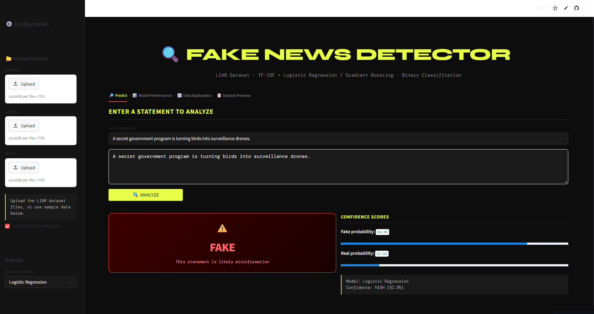
Deployed Application

Slide 8
Conclusion & Future Work
Conclusions
Future Work
DistilBERT achieved best performance (F1: 0.72, AUC: 0.76)
Linguistic features show moderate discriminative power
Fake news uses simpler language, more exclamation marks, higher capital ratio
Transformer models better capture contextual semantics
BERT embeddings + LR is a strong lightweight alternative
Fine-tune RoBERTa or DeBERTa for further improvement
Incorporate metadata (speaker, party) into model features
Multi-class (6-label) classification instead of binary
Real-time browser extension for live news fact-checking
Test on FakeNewsNet for broader cross-domain evaluation

