Slide 1
Welcome!

Slide 2
Student Result and Attendance Management System
-Presented by LoopTroop

Slide 3
Prepared By:
Rashedul Islam Rifat – 2243081072
Sanjida Alam Moonmoon – 2243081071
Fardin Fahad – 2243081172
Amadul Haque Siam – 2243081050
Md. Adnan Arefin Ratul – 2243081062

Slide 4
Overview
Console-based application using C#.
Manages student marks for multiple subjects (OOP, DLD, CA).
Tracks attendance for each student.
Calculates CGPA and attendance percentage.
Generates individual student reports.

Slide 5
Objective
Maintain student academic records efficiently.
Track attendance.
Calculate CGPA for multiple subjects.
Generate detailed student reports.
Practice Object-Oriented Programming concepts.

Slide 6
Abstract Class and Interface
Abstract Class: Person
Contains Name and Id.
Abstract method Show() implemented in Student class.
Interface: Ireport
Defines CreateReport() method.
Benefits: Promotes abstraction and standardization.

Slide 7
Encapsulation
Private method CGPA(double mark) in Result class.
Public methods AverageCGPA() and Display() provide safe access.
Protects internal data and prevents accidental modification.

Slide 8
Copy Constructor
Deep copy of Student and Result objects.
Maintains separate attendance lists.
Example: Student s2 = new Student(s1).
Avoids data conflicts and safe duplication.

Slide 9
List and Calculation
List<bool> attendance stores present/absent status.
MarkAttendance(true/false) updates daily attendance.
AttendancePercentage() calculates: (Present Days / Total Days) * 100.
Benefits: Dynamic storage, easy calculation.

Slide 10
Overloaded Methods
AddMark(double oop, double dld, double ca): Update all marks.
AddMark(string subject, double mark): Update single subject marks.
Benefits: Flexible mark updates, clean code.

Slide 11
Calculation Logic
CGPA calculation from marks using grade scale.
AverageCGPA() calculates mean CGPA.
Attendance calculation as per Slide 9.
Benefits: Automatic grade calculation, evaluates performance numerically.

Slide 12
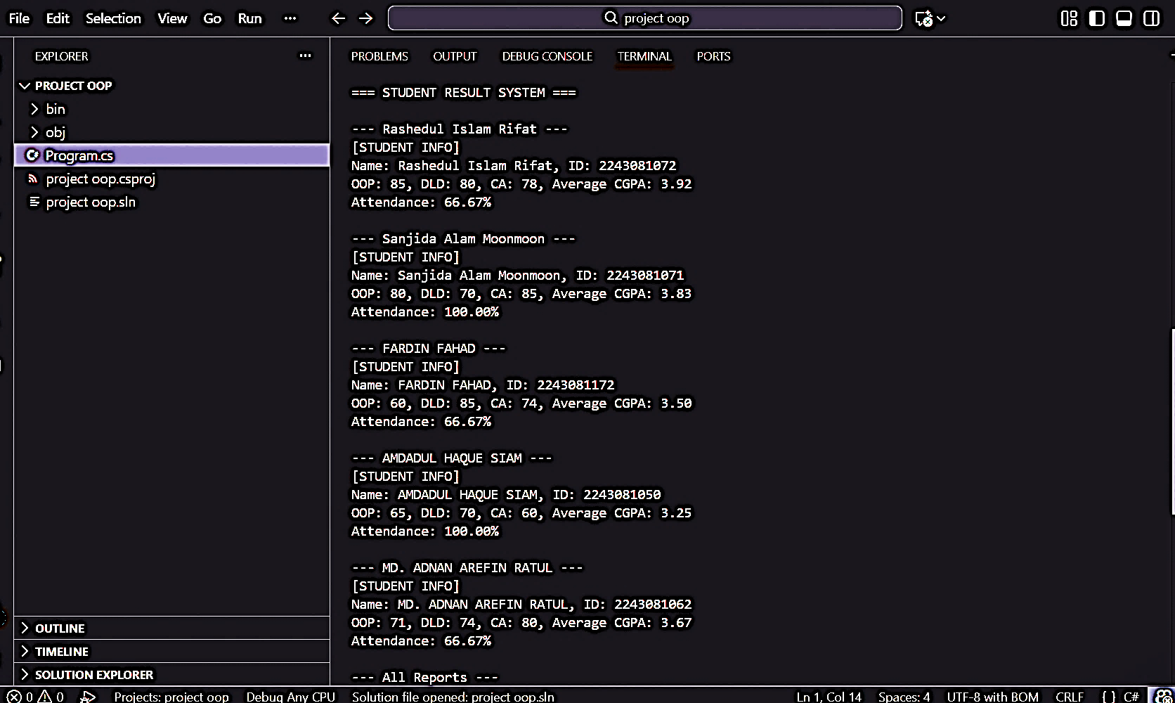
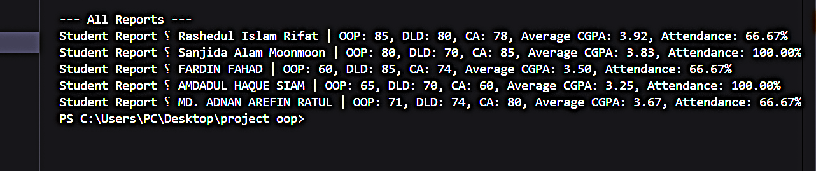
Console Output

Slide 13
Problems and Solutions
Marks copied incorrectly → Fixed with copy constructor.
Attendance errors → Added empty-list check.
Needed simple attendance tracking → Used List<bool>.
CGPA logic messy → Used one CGPA() method

Slide 14
Conclusion
Efficiently manages student marks and attendance
Demonstrates OOP concepts: abstract class, interface, encapsulation, copy constructor, method overloading
Calculates CGPA and attendance automatically
Generates individual student reports for easy analysis
Can be extended to GUI or database for real ERP system

Slide 15
Thank You!

