Slide 1
Introduction
Linux-for-Genomics-Bangla-Tutorial

Slide 2
Why Linux commands in Bioinformatics?
Most of the Bioinformatics tools/software run on Linux
Work on Linux server/clusters
Easy to work with genomic file formats
Faster processing of files

Slide 3
Terminologies
Simply put, the shell is a program that takes commands from the keyboard and gives them to the operating system to perform.
Bash is the shell, or command language interpreter, for the GNU operating system.
GNU is a Linux/Unix like operating system.

Slide 4
Learning objectives?
Basic commands of bash/shell
Working with files
Making bash scripts

Slide 5
Basic commands of bash/shell
Working with files
Making bash scripts

Slide 6
Rashedul Islam (Rony)
Email: Rashedul.gen@gmail.com
Website: rashedul.net
For discussion join our bioinformatics facebook group: Bioinformatics School (বায়োইনফরমেটিক্স স্কুল)

Slide 7
জিনোমিক্সের জন্য
বাংলায় লিনাক্স কমান্ড

Slide 8
su vs sudo commands
Superuser (su): perform important system administration tasks
sudo: some systems (e.g., Ubuntu) employ the sudo command instead. With sudo, one or more users are granted superuser privileges on an as needed basis

Slide 9
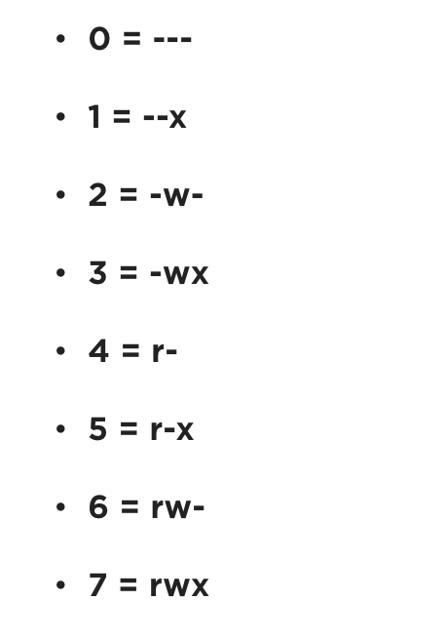
File permissions
`chmod` permission number
Owner – Group - All
`chmod 777 myfile.txt`

Slide 10

Rashedul Islam (Rony)
Email: rashedul.gen@gmail.com
Website: www.rashedul.net

