Slide 1
Introduction
Linux-for-Genomics-Bangla-Tutorial

Slide 2
Why Linux commands in Bioinformatics?
Most of the Bioinformatics tools/software run on Linux
Work on Linux server/clusters
Easy to work with genomic file formats
Faster processing of files

Slide 3
Terminologies
Simply put, the shell is a program that takes commands from the keyboard and gives them to the operating system to perform.
Bash is the shell, or command language interpreter, for the GNU operating system.
GNU is a Linux/Unix like operating system.

Slide 4
Learning objectives?
Basic commands of bash/shell
Working with files
Making bash scripts

Slide 5
Basic commands of bash/shell
Working with files
Making bash scripts

Slide 6
Rashedul Islam (Rony)
Email: Rashedul.gen@gmail.com
Website: rashedul.net
For discussion join our bioinformatics facebook group: Bioinformatics School (বায়োইনফরমেটিক্স স্কুল)

Slide 7
জিনোমিক্সের জন্য
বাংলায় লিনাক্স কমান্ড

Slide 8
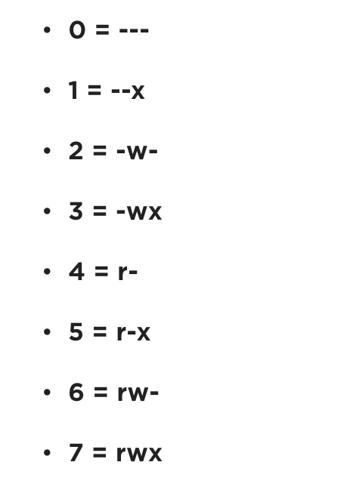
File permissions
`chmod` permission number

Slide 9
In some distributions, most notably Ubuntu, an alternate method is used. Rather than using su, these systems employ the sudo command instead. With sudo, one or more users are granted superuser privileges on an as needed basis. To execute a command as the superuser, the desired command is simply preceeded with the sudo command. After the command is entered, the user is prompted for the user's password rather than the superuser's:

