Slide 1
Group-2
Members:
1. Shamit Nibras 19-40117-1
2. Mehedi Hasan 19-40651-1
3. Md Naymul Islam 19-40125-1
4.Md Rashedul Islam 19-40559-1
Submitted to:
Dr. Razib Hayat Khan
Assistant Professor, CS
American International University - Bangladesh

Slide 2

Project Title:
E-Medicare

Slide 3
Does The Project Have A Clear Target Market Or Audience??
Yes, the project has clear target market or audience.
Our main targeted market or audience is Medical sector of Bangladesh.

Slide 4
E-Medicare
We can divided into three major sector. For the reason user can select any of them.
E-Medicare
Nurse
Pharmacy
Ambulance

Slide 5
Does the team demonstrate a thorough understanding of the need, problem or opportunity, including evidence of research into the need, problem or opportunity?
Need: By using E-Medicare service user can get all Emergency medical service in one click. For example Medicine, Nursing Service & Ambulance.
Problem Solution: Main theme of the project is to serve on a daily basis medical service to the users. Some times now a days it's impossible or very hard to go to a hospital, pharmacy or arrange an ambulance. In such condition user’s need to connect with our system that will connect them with the nearby available Pharmacy, Nurse, Ambulance to take their required help by our system.
Opportunity: A big opportunity will be create in medical sector. User can find their service within a click. This system can save a lot of time and money for user . User can get required help in any emergency situation from home.

Slide 6
Is the project’s purpose and basic functionality easily understood?
Yes, the project’s purpose and basic functionality easily understandable
Functionality:
The functionality of our project is user friendly ,where users can sign up or login by entering very simple information (i.e. Email/phone no, user id , password) and can find their desired option like (nurse , ambulance , pharmacy) by within a click . for authenticity , user can see their review. User can also do payment with this system.
Purpose:
Our main purpose is to create a platform for medical sector, so that patient can get necessary service in any situation. By this project, there will be a little job or work opportunity. It will be less time consuming for the users to get medical service from staying home.

Slide 7
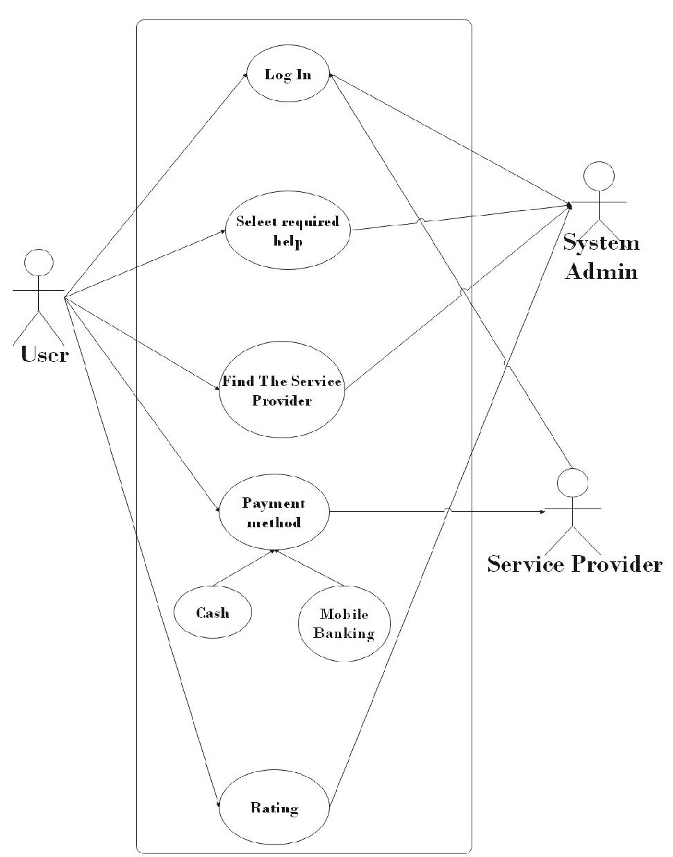
Use Case

Slide 8
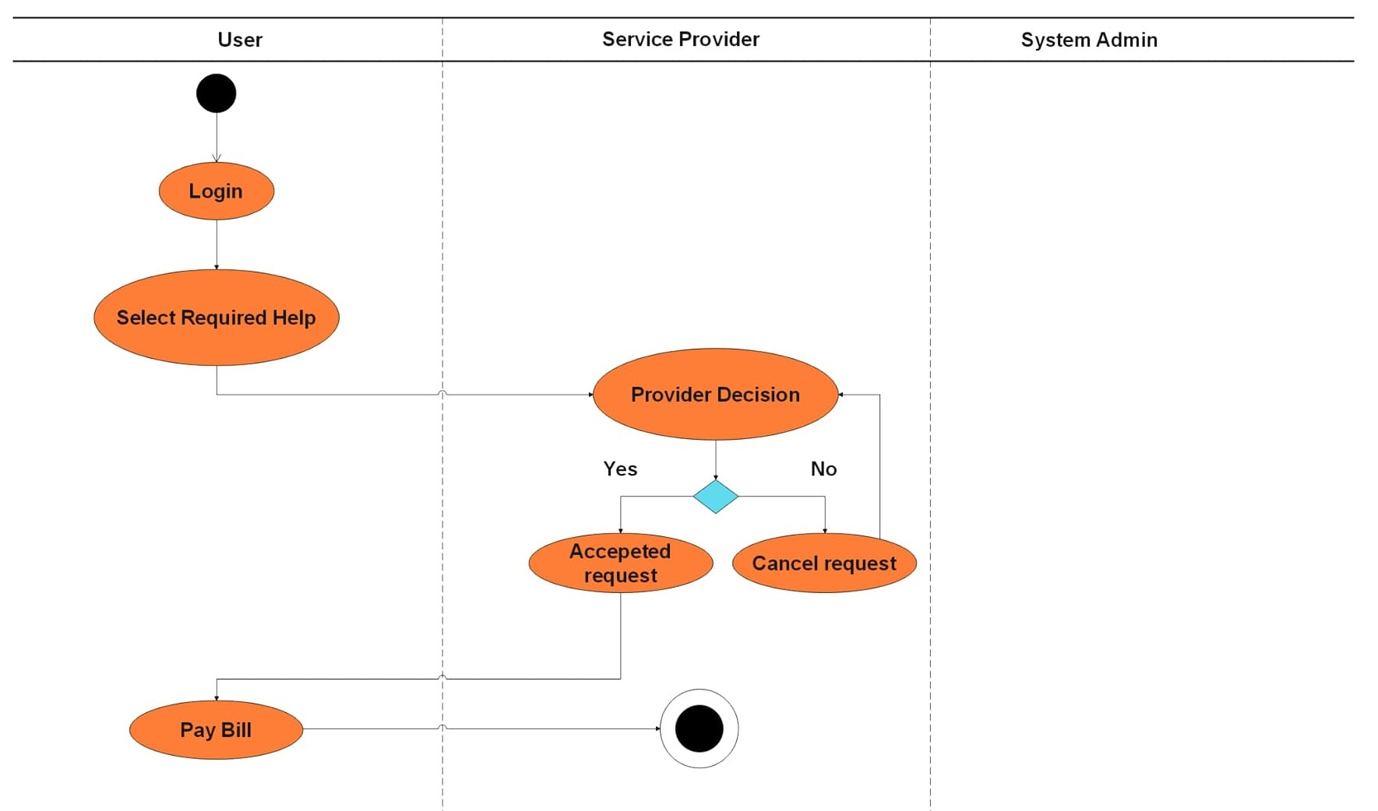
Activity Diagram

Slide 9
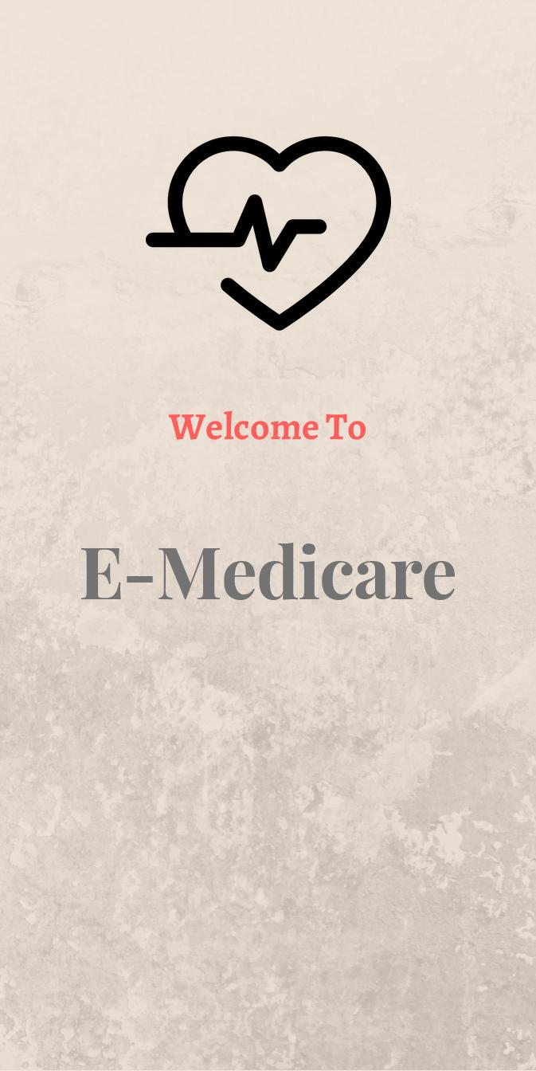
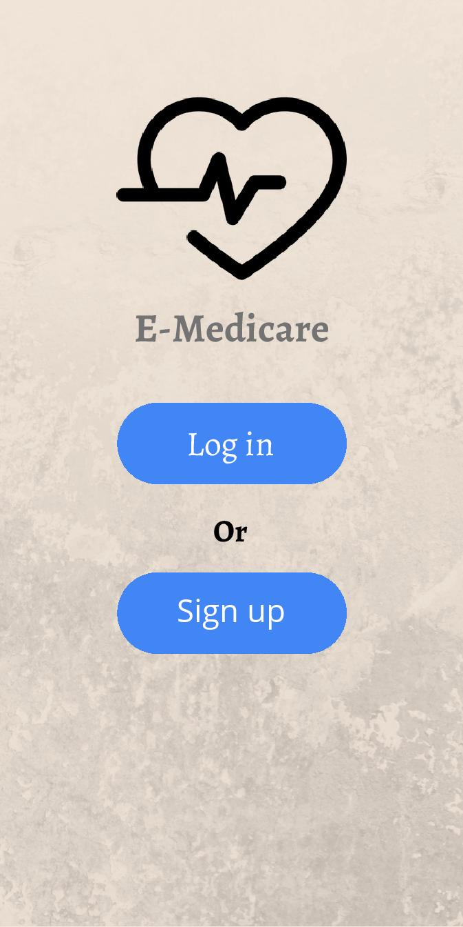
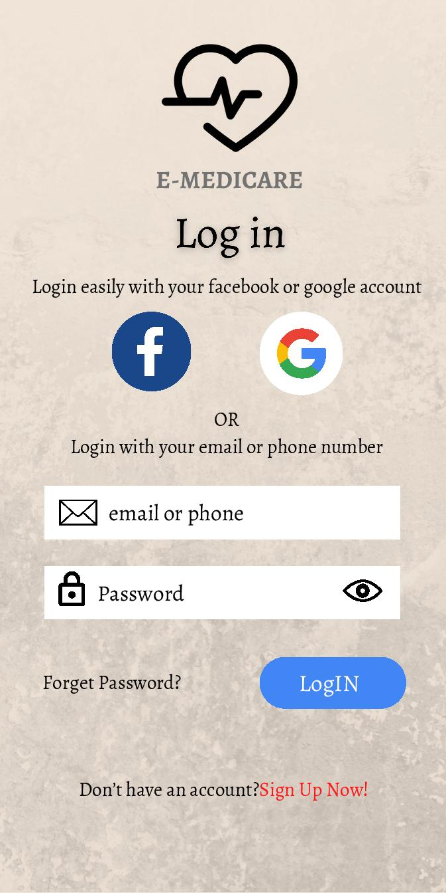
User Interface

Slide 10
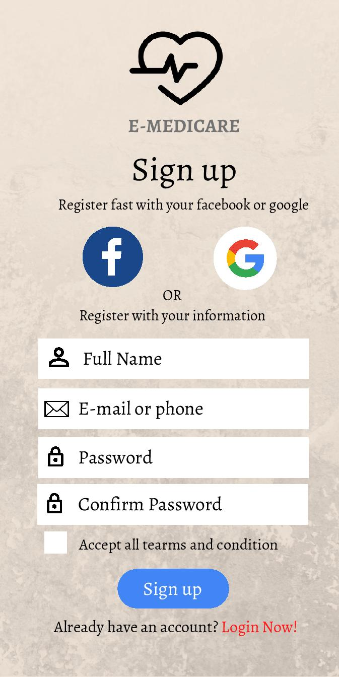
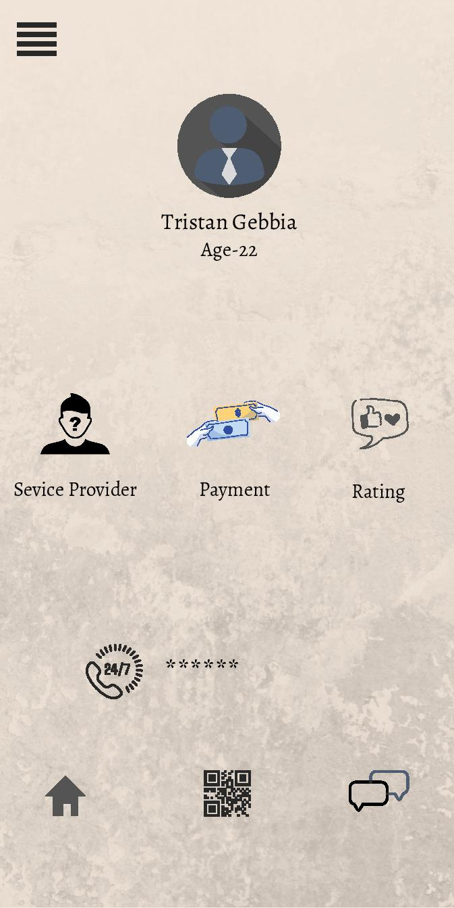

Slide 11
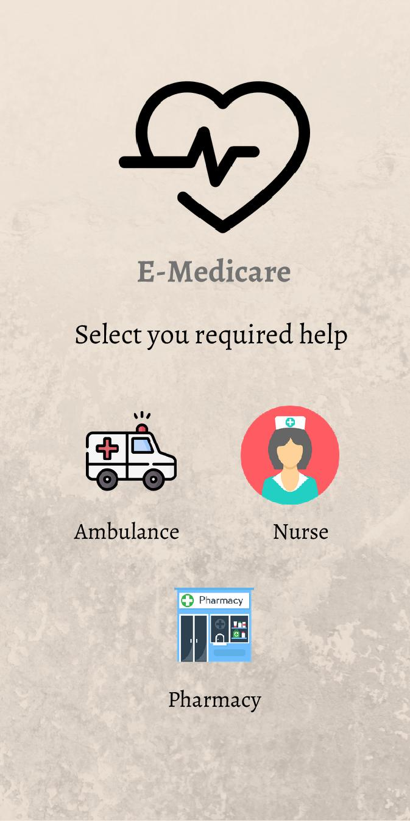
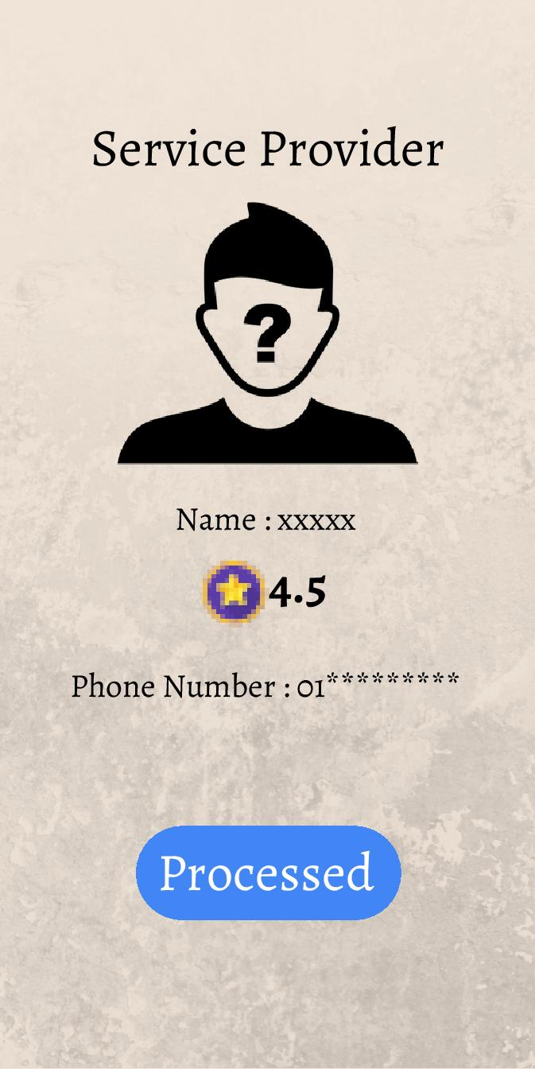

Slide 12
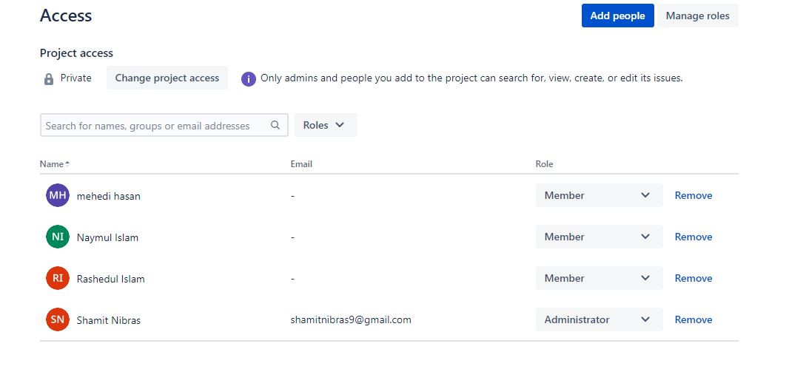
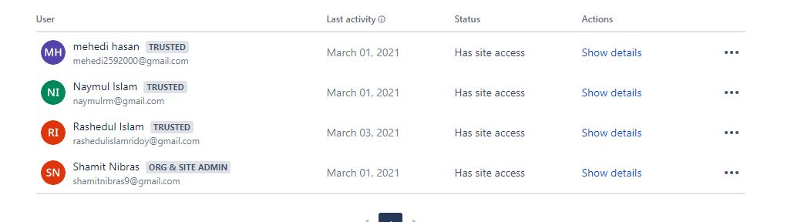
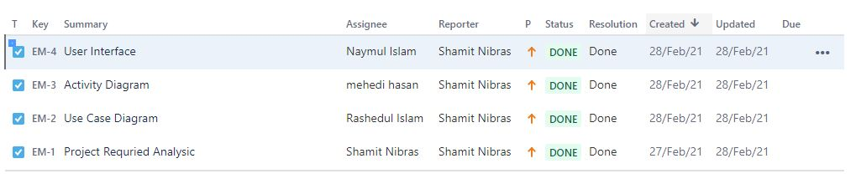
Jira

Slide 13
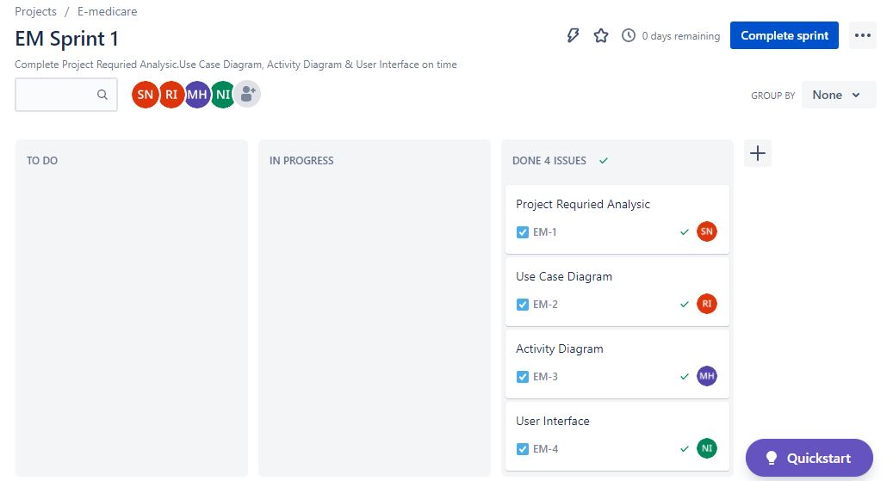
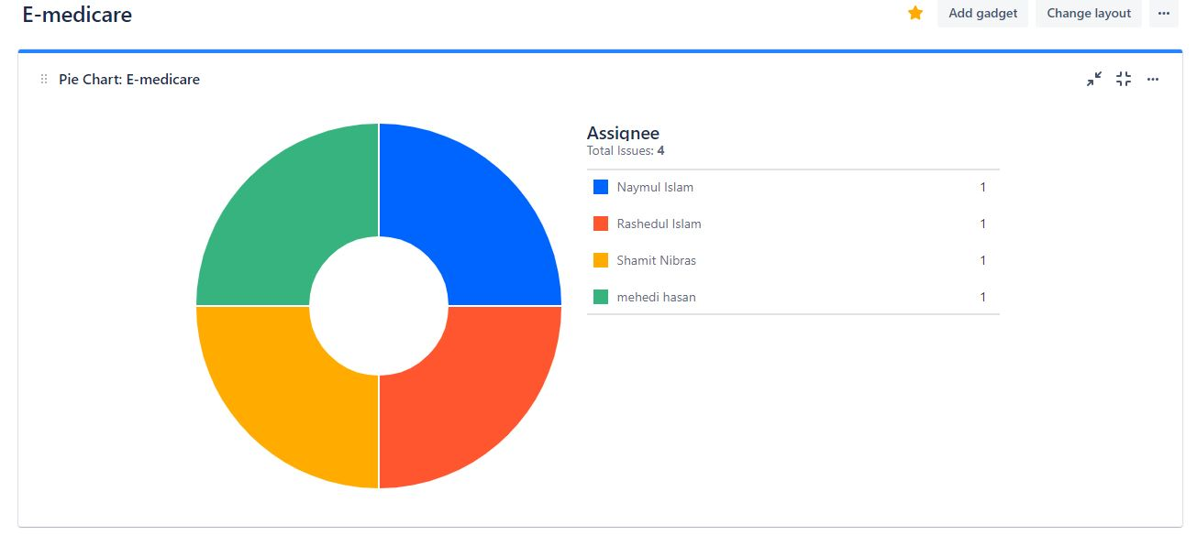
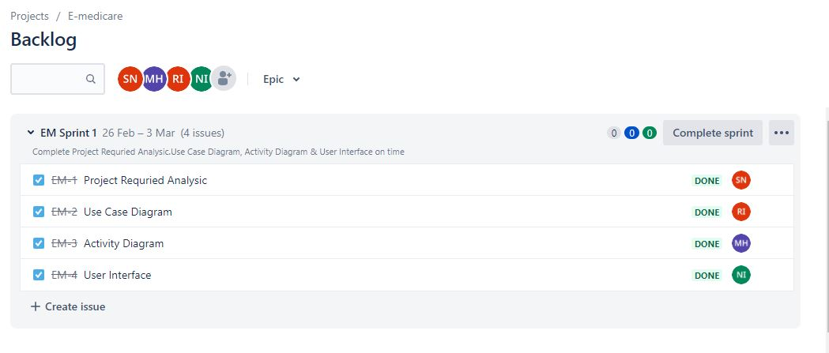

Slide 14


