Slide 1
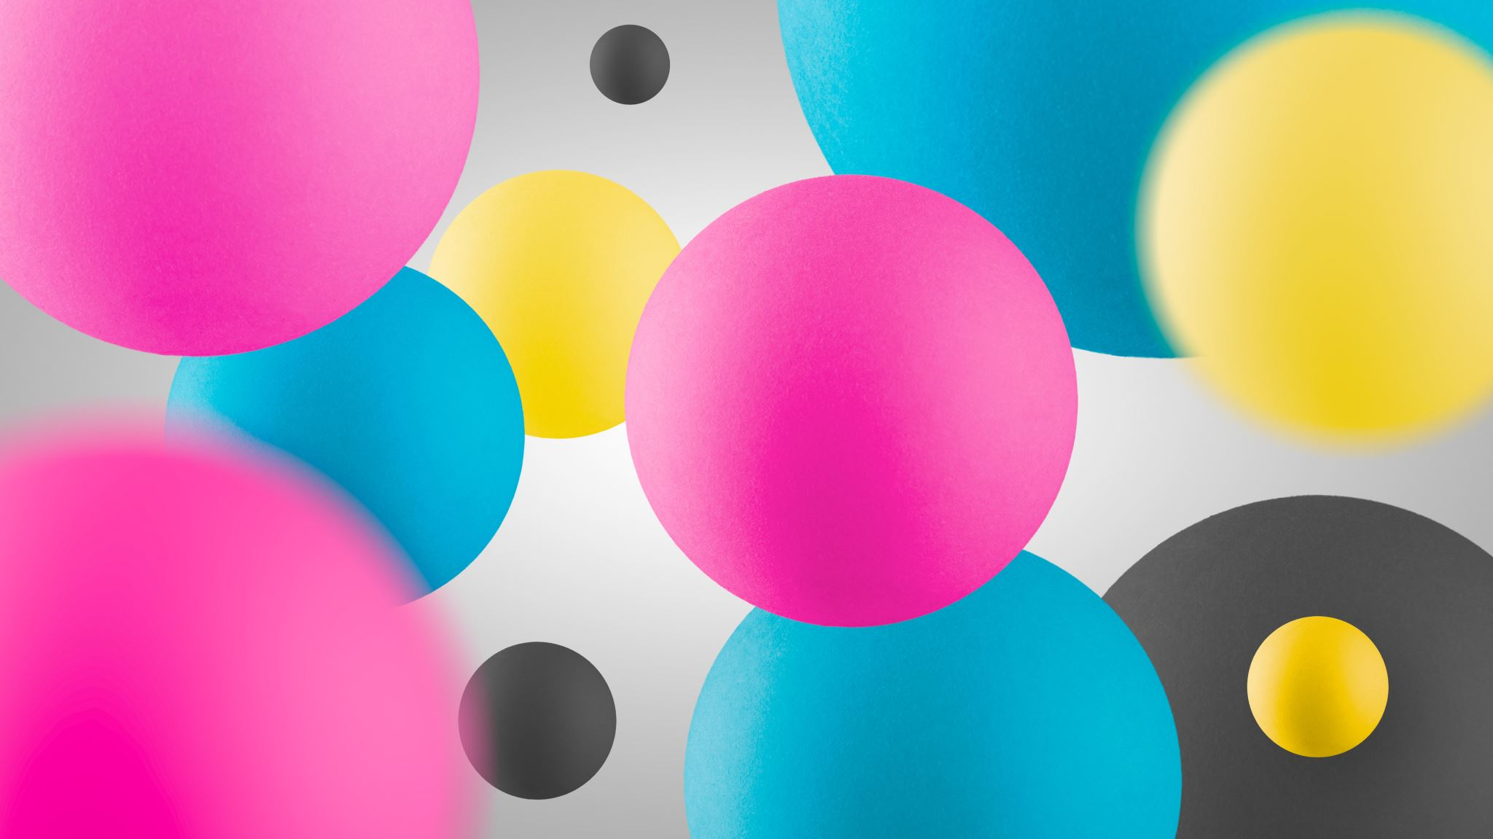
Positions
מיקום של אלמנטים על המסך

Slide 2
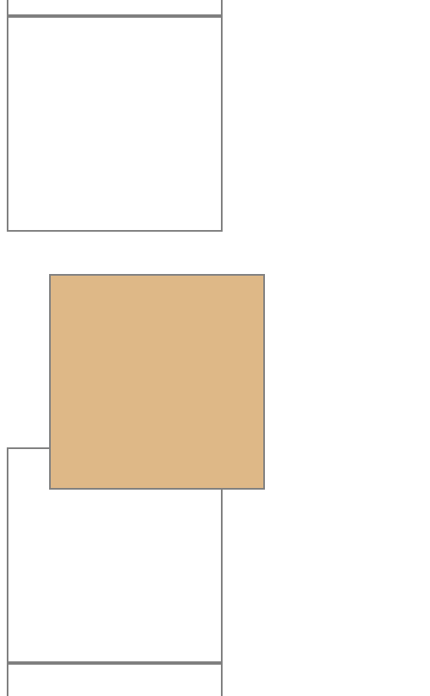
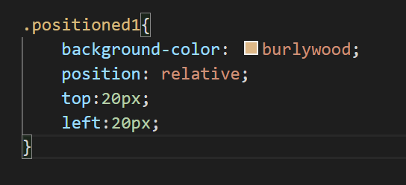

relative
20px
20px

Slide 3
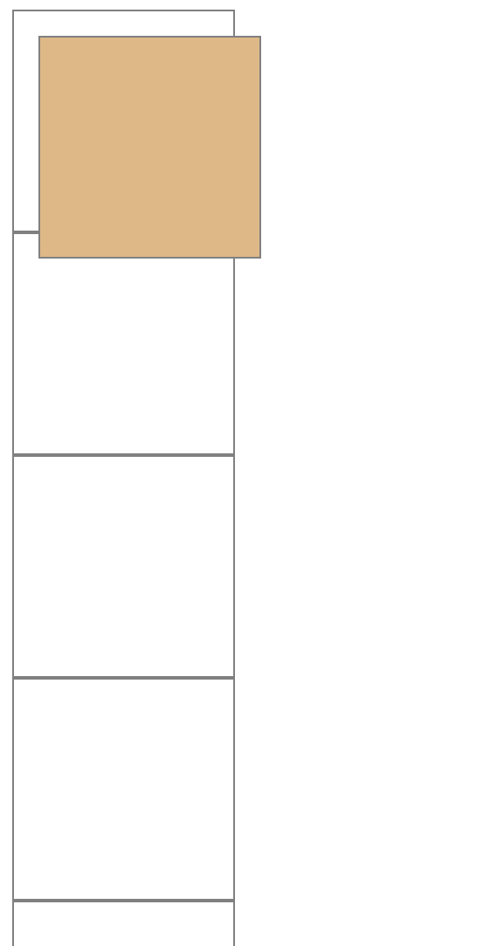
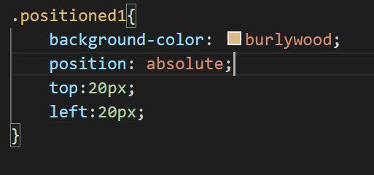
absolute
Relative to the last positioned parent
Losses its position in the board

Slide 5
My site (fixed)
My profile image (sticky)
Text about you
Text about you
Text about you
Text about you

