Slide 1
Quarterly review
Detector group

Slide 2
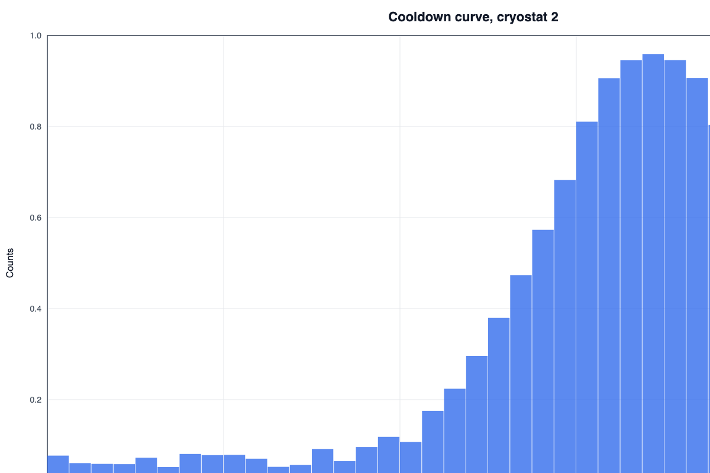
Results
Gain stable
  Channel 12 fixed
Third step
Fourth step
critical accent plain
flagged run log old value
Right column
Big takeaway
Centered note

Slide 3
Data
Run summary
Gain | 1.02 stable
Plan
Build
ignored
Test

Slide 4
Design
Grouped box
Big small again
Plain then code
Step A
Step B
Run | Gain
A | 1.02
B | 0.98
C | 1.01
Notes:
Designed slide notes

