Slide 1
Cooldown overview
Started 2024-03-12
Cryostat reached 4.1 K
Notes:
Mention the pump schedule

Slide 2
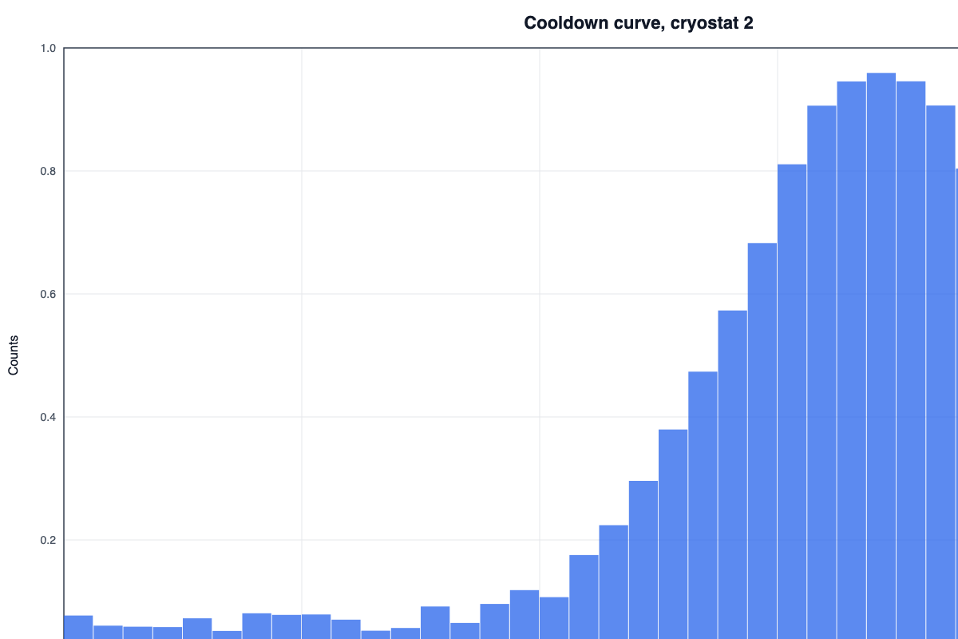
Cooldown curve
Curve from run 4512

Slide 3
Loose notes, 14 Mar 2024

Slide 4
Calibration results
Channel | Gain
12 | 1.02
13 | 0.98
Taken March 20, 2024

Slide 5
Gain plot

Slide 6
Calibration issues
Channel 12 is noisy
Replace the connector

Slide 7
Analysis summary
3/28/2024 summary of the run
Notes:
Thank the beam team

Slide 8
Next steps
Repeat with shielding
Write up for the group meeting

