Slide 1
Election Dataset
Analysis
Presented by: Rasheshwari Walwadkar

Slide 2
Objective
1. Data Integration
2. Data Cleaning and Preparation
3. Data Analysis and Visualization
4. Interactive Dashboard
5. Insights and Recommendations

Slide 3
Data Discription
1. Election Results Data:
- `_id`: Unique identifier for each record.
- `State`: Name of the state.
- `Const. No.`: Constituency number.
- `Constituency`: Name of the constituency.
- `Leading Candidate`: Name of the leading candidate.
- `Leading Party`: Name of the leading party.
- `Trailing Candidate`: Name of the trailing candidate.
- `Trailing Party`: Name of the trailing party.
- `Margin`: Vote margin between the leading and trailing candidates.
- `Status`: Status of the election result (e.g., Won, Lost, Leading, Trailing).
2. Party Alliance Data:
- `Party Name`: Name of the political party.
- `Alliance Name`: Name of the political alliance the party belongs to.

Slide 4
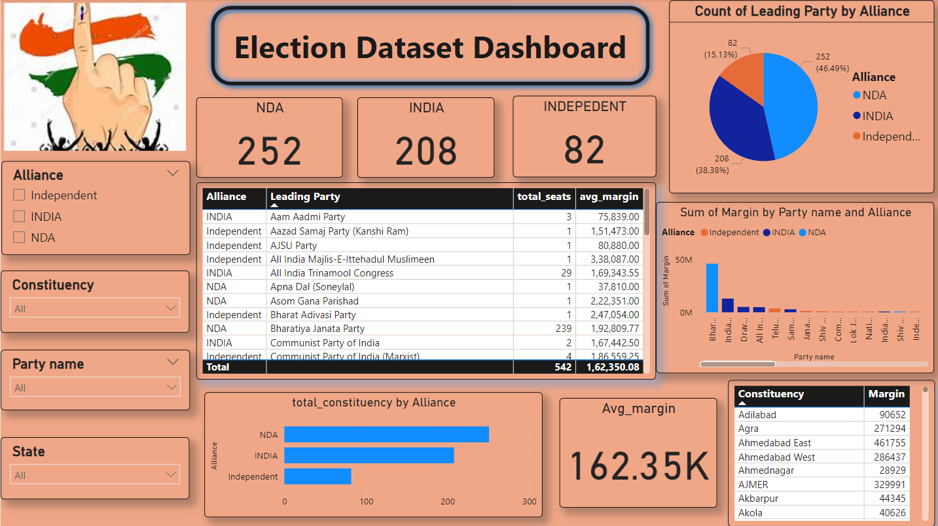

Slide 5
Key insights
Total Seats by Alliance:
NDA: 252 seats (46.49%)
INDIA: 208 seats (38.38%)
Independent: 82 seats (15.13%)
Total Constituencies by Alliance:
NDA: Approximately 250 constituencies
INDIA: Approximately 200 constituencies
Independent: Approximately 80 constituencies

Slide 6
Leading Parties by Alliance:
The dashboard shows a detailed list of leading parties along with the total seats won and the
average margin of votes. For example:
Bhartiya Janata Party (NDA): 239 seats, avg. margin 1,92,809.77
Indian national congress (INDIA): 99 seat, avg. margin 1,31,372.95
Samajwadi Party (INDIA):37 seat, avg. margin 77,555.84
Vote Margin Analysis:
The average vote margin across all parties is 162,350.08. Significant margins are observed for parties like: All India Majlis-E-Ittehadul Muslimeen (INDIA): 3,38,087 Bharat Adivasi Party (Independent): 2,47,054

Slide 7
Conclusion:
The Election Dataset Dashboard effectively summarizes and visualizes the election results,
making it easy to identify trends and significant figures. By leveraging the interactive filters,
users can delve deeper into specific areas of interest, such as party performance, vote margins, and constituency outcomes. This dashboard serves as a valuable tool for political analysts, researchers, and anyone interested in understanding the dynamics of the election results.

Slide 8
Thank You

