Slide 1



Team 5-BIT
presents
Maati - AI Based Crop Recommendation System
Welcome
Welcome
Welcome
Welcome
Welcome
Welcome
Welcome
Objective
Welcome
About Maati
Welcome
Developed by:
Rashi Srivastava
Ankit Jailwal
Shivam Sawarn
Vivek Kumar

Slide 2
In Agricultural Sector, especially for the new-age farmers with basic knowledge of technology.
Selecting appropriate crops for farmers given the choice of multiple crops to grow on single land in one season is a difficult job w.r.t season, soil-type and other conditions. Added to it to select the crop which will help them maximize their revenue sometimes becomes difficult.
Given the current scenario of farmers in India, it’s important for them; to not just be able to select the right crop for cultivation but also to have the know-how to expand their revenues.
Welcome
Objective
Welcome
Welcome
Welcome
Welcome
Welcome
Features
Welcome
About Maati
Where?
What?
Why?

Slide 3

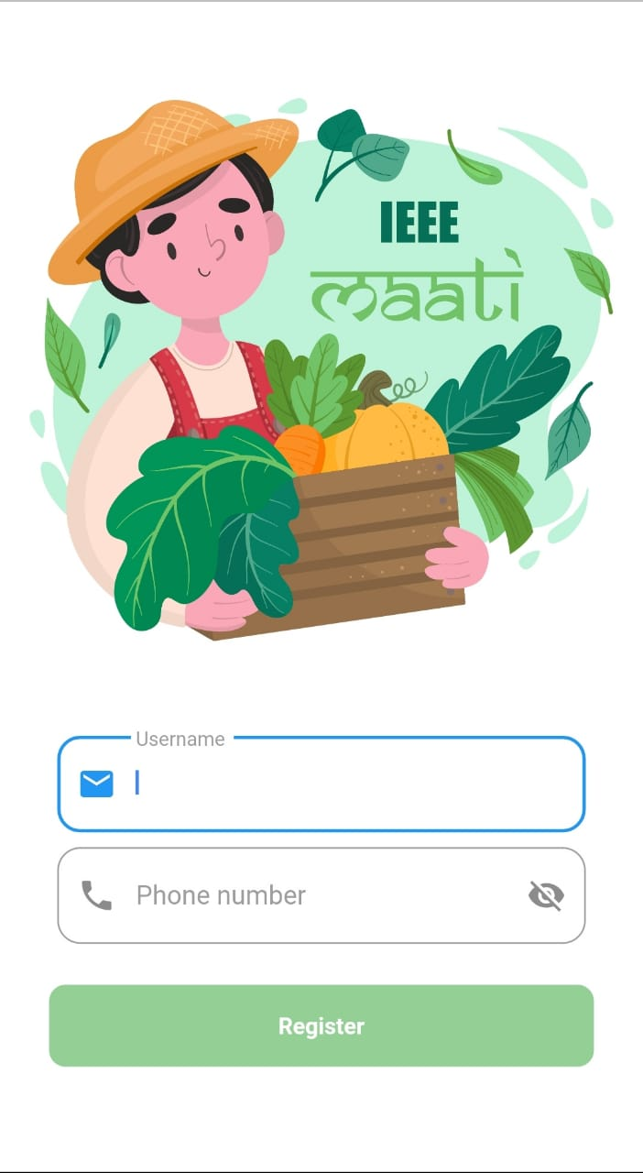
AI-based, user-friendly mobile application:
powered by Machine Learning and Deep Learning.
has Cloud database management system.
having multi-language support.
makes recommendations based on rainfall, cropping-season, ground-water, availability & image of soil type for that particular area.
recommends intelligent farming methods & good agricultural practices.
Predicts crop type and crop diseases.
gives farmers an option to sell their production as well as buy or rent other necessities.
also provides information about various government mandis to sell their production and also information about different government schemes.
Welcome
Welcome
Welcome
Welcome
Welcome
Features
About Maati
Welcome
Frontend
Welcome

Slide 4






Smooth UI/UX: Includes animations, loading screens, error pop ups and appealing colors to give best UI/UX.
Flutter framework: IEEE MAATI will be built using flutter which uses dart as its programming language.
Highly optimized: Builds widgets only once which will allow IEEE MAATI to run on any device with less memory consumption.
Flutter Plugins.
Will use multiple flutter plugins for Maati Shop and its features.
Welcome
Welcome
Welcome
Continued
Backend
Frontend
Welcome
Welcome
Welcome
Welcome
Platform independent: IEEE MAATI will be available for both android and ios

Slide 5





Flask framework will be used to establish a connection between the user and the server in real time.
A customized dataset will be created using multiple sources.
Decision tree classifier will be used to make crop recommendations.
Dataset
Machine Learning
Flask
Welcome
Work Flow
Welcome
Updates
Backend
Welcome
Welcome
Welcome
Welcome
Welcome
A high accuracy deep-learning model will be designed using Python language based on Keras Framework for soil type, crop type and crop disease recognition.
Azure Cloud Services will be used to set up the server.
Deep
Learning
Cloud Backend

Slide 6








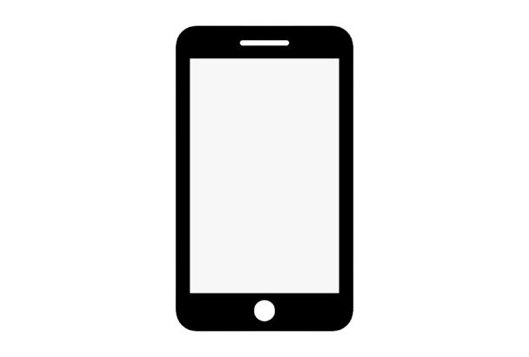
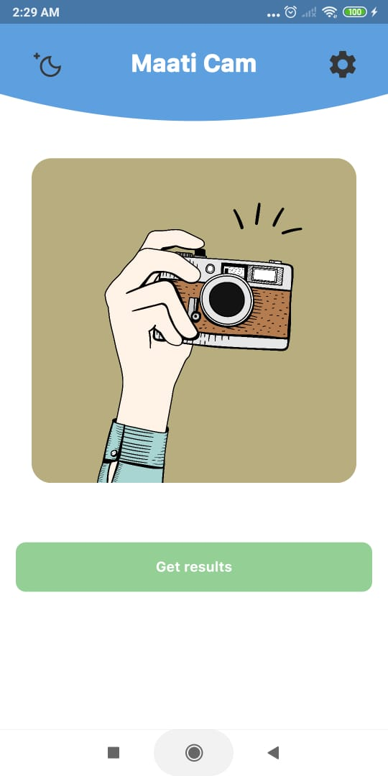
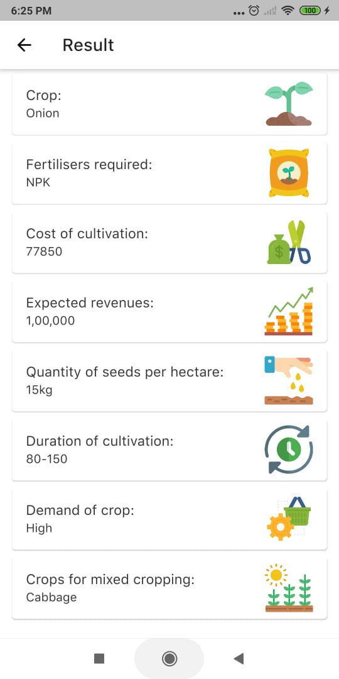

An input array is created based on received data & existing database on cloud.
The predicted soil type and the location with local weather conditions are stored in cloud.
Cloud
Conclusion
Work Flow
Welcome
Welcome
Welcome
Welcome
Welcome
Welcome
Social Impact
Welcome
This data is then given to ML model for final crop prediction.
This image is processed in a deep learning model which predicts the soil type.
Soil image taken by MAATI CAM is uploaded to cloud.
Along with crop name, other relevant information about the crop is also given as output.
User location is tracked through phone GPS

Slide 7
Our proposed idea i.e. AI based crop recommendation system would help farmers to select best fit crop according to their soil type and weather conditions.
It would also help in reducing usage of chemical fertilizers resulting into healthy produce and the suggested mixed-cropping/crop rotation methods would help in replenishing the soil.
Moreover, the output also includes expected revenue estimation for the recommended crop which will help farmer to create greater profits.
It also includes a one stop shop for farmers which would enable them to buy, sell and rent necessities.
Conclusion
Welcome
Welcome
Welcome
Welcome
Welcome
Welcome
Welcome

