Slide 1
UNDERSTANDING THE USE CASE
Title: Automated Resume Ranking System
Content
Purpose: To develop a system that matches resumes with job descriptions using natural language processing and machine learning.
Target Audience: Job seekers and recruiters.
Functionality:
Users can upload resumes in various formats (PDF, DOCX).
Users input a job description.
The system ranks resumes based on their relevance to the job description.
Submitted By: Rashi Jain

Slide 2
SUMMARY OF RESEARCH
Research Objectives:
Investigate effective techniques for matching resumes to job descriptions using NLP and machine learning.
Analyze the performance of different machine learning models in resume ranking.
Research Findings:
Text preprocessing (cleaning, tokenization, lemmatization) is crucial for improving model accuracy.
TF-IDF vectorization significantly enhances the ability to compare textual data.
Models such as Random Forest and Logistic Regression performed well in predicting match scores.
References:
Articles on NLP and its applications in recruitment (e.g., Towards Data Science, Medium).
YouTube videos on text extraction and machine learning models (e.g., NLP with Python).
Research papers on resume screening using AI

Slide 3
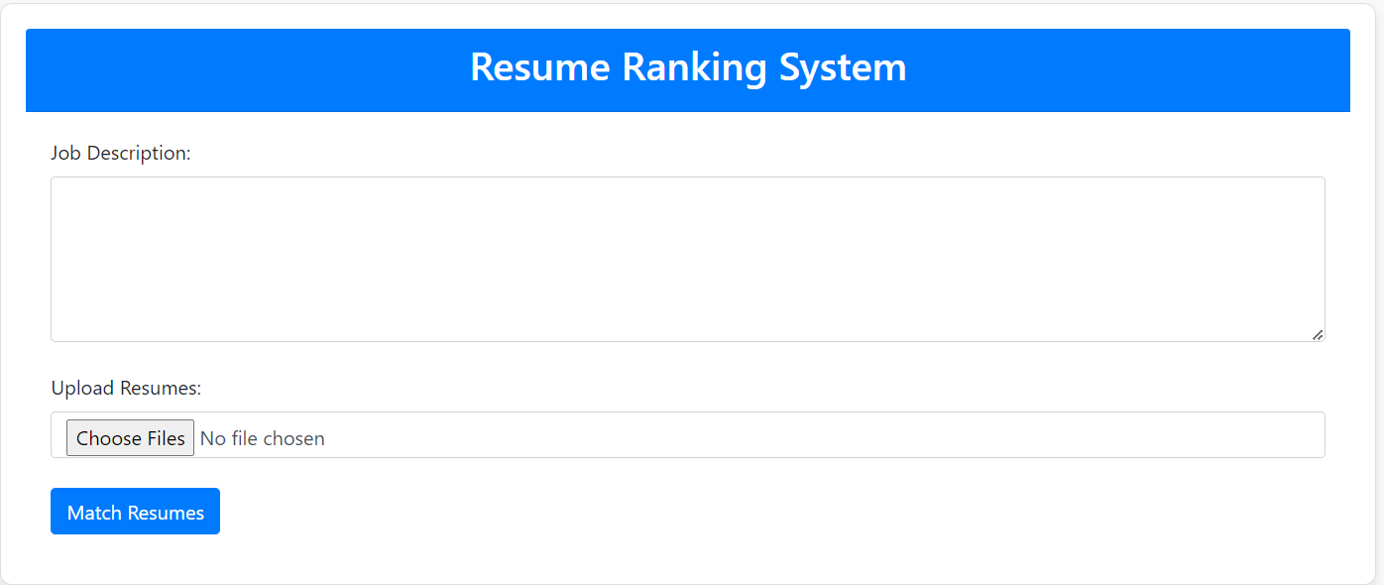
PROTOTYPE / WIREFRAME

Slide 4
OVERALL ARCHITECTURE OF THE SOLUTION
Architecture Overview:
Frontend
HTML/CSS/JavaScript (Flask framework) for user interaction.
Backend:
Flask Application: Handles requests and serves web pages.
Text Extraction Modules: Functions for processing PDF, DOCX, and TXT files.
NLP Preprocessing: Cleaning and preparing text for analysis.
Machine Learning Pipeline:
Model training and evaluation with train-test splits.
Predictive analytics using trained models.

Slide 5
MODEL TESTING
Data Flow Diagram:
Testing Strategy:
Train-Test Split: Data was divided into training and testing sets (80%-20%).
Model Performance Metrics: Evaluated using metrics such as:
Accuracy
Precision
Recall
F1 Score
Uploads Resume And Job Description
Text Extraction Process
Extracted Text Sent To Preprocessing
Resume Matching Process
Matching Results Sent For Report Generation
Matching Results Sent Back To The User

Slide 6
FINAL OUTCOME
Outcome Summary:
The Resume Matching System successfully ranks resumes based on their match to job descriptions.
Provides a user-friendly interface for recruiters to easily upload and analyze resumes.
Streamlines the recruitment process, saving time and resources for HR departments.
User Feedback:
Positive feedback from initial testing phases regarding usability and effectiveness.
Suggestions for further enhancements include additional NLP features and a broader range of supported file types.

Slide 7
POTENTIAL BENEFITS
Efficiency Improvement
Reduces the time spent manually screening resumes.
Enhanced Matching Accuracy
Utilizes machine learning for better candidate-job fit.
User-Friendly Experience
Intuitive design makes it easy for recruiters to navigate and use.
Scalability
Can be expanded to include more advanced features, such as automated candidate ranking and integrated application tracking systems.

Slide 8
LINK TO GITHUB REPO
https://github.com/Rashi1703/Resume-Ranker.git

