Slide 1
ACB – Ansible Automation Platform SETUP
September 25, 2023
Ashu Rana
Rackspace Senior Engineer

Slide 2
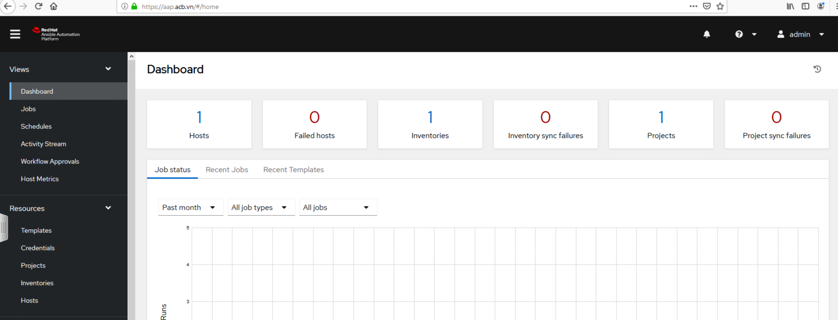
Introduction
Key Objective:
To give a walkthrough of the setup for Ansible Automation Platform.
Demonstrate the Architecture Implementation
Demonstrate the key features of Automation Controller.
Go through Outstanding actions.

Slide 3
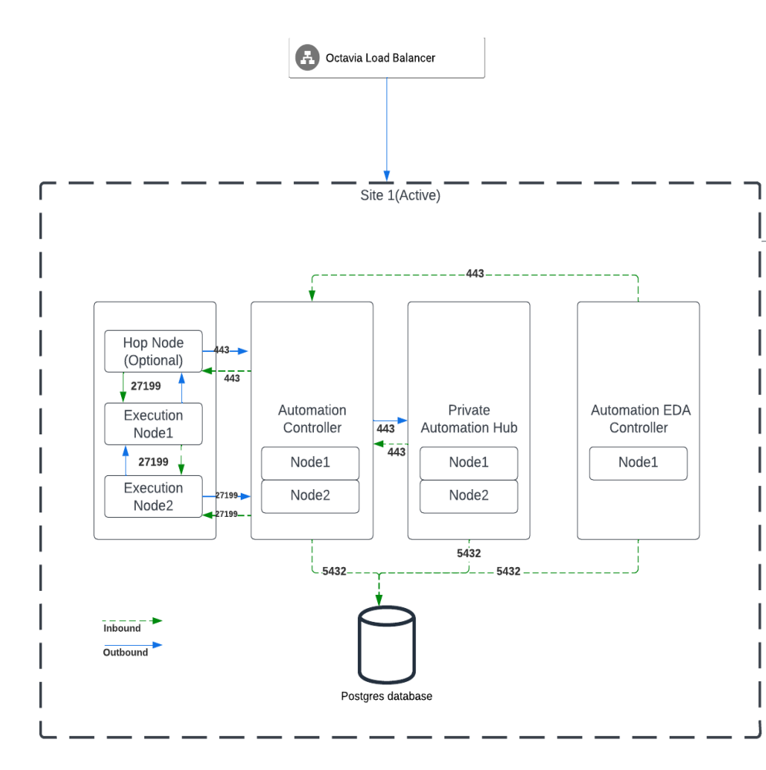
Architecture
Accessing URLs:
Ansible Automation Controller – https://aap.acb.vn
Ansible Automation Hub – https://aap.acb.vn:8443

Slide 4
Automation Controller
Dashboard Overview:
Dashboards
Inventories
Jobs
Credentials
Templates
Credentials etc

Slide 5
Outstanding
S.No | Points | Reason | Action On
1. | Integration of private automation hub with automation controller. | Can’t access Automation Hub, VDI policy adjustment required | ACB to adjust the policy so that Rackspace(Ashu) can continue with the integration
2. | Build Document | Pending on point 1 | ACB to fulfill point 1 for Rackspace(Ashu) to complete the build document – first version will be provided today.
3. | SSO | ACB is working on Microsoft AD | ACB Note: Let Rackspace know if anything is needed from our end. Configuration parameters at ansible side will be shared by Rackspace.

