Slide 1

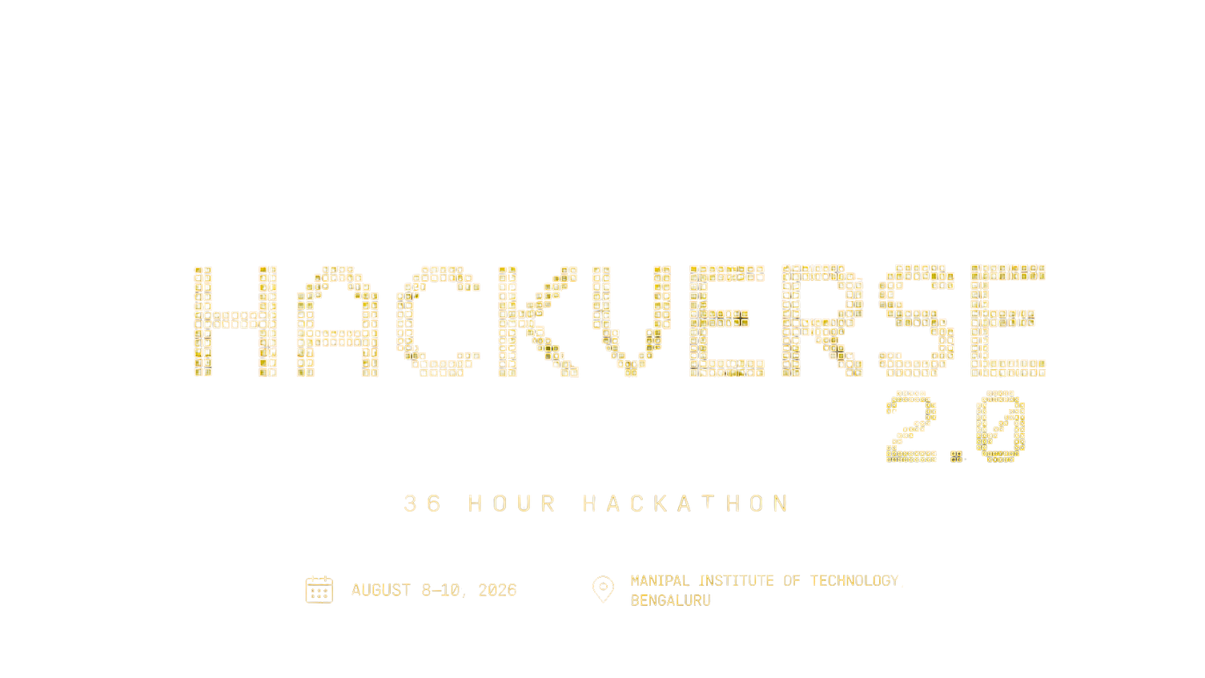
ASTITVA
Rebuilding Lives. Restoring Identity.
AI-Powered Life Orchestration Platform
HACKVERSE 2.0 • EVAL ROUND 1
AI for Sustainable & Social Impact
Problem Understanding | Innovation | Feasibility | Team Coordination
Team: AADITYA • HARSHIT • RASHI • VARSHA
MANIPAL INSTITUTE OF TECHNOLOGY, BENGALURU

Slide 2
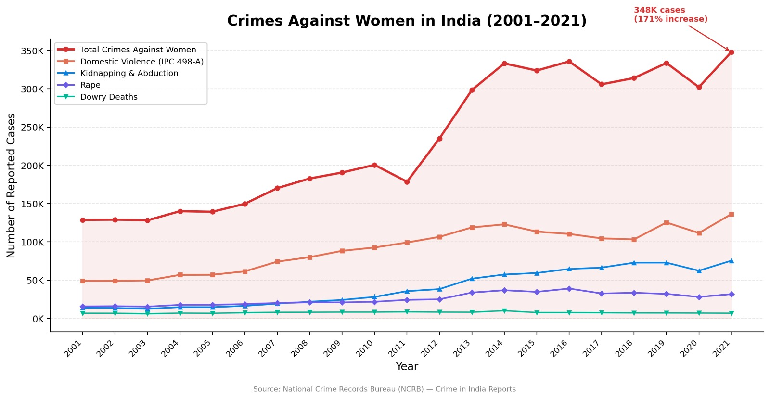
1. The Problem
02
Support exists. Navigation doesn't.
WHY THE CURRENT SYSTEM FAILS
• Services are spread across government, legal, healthcare, NGO, employment and finance systems.
• Users must discover services, check eligibility, collect documents and coordinate agencies themselves.
• In crisis, this creates decision fatigue, delays and low utilization of available support.
• The gap is not the absence of services — it is the absence of intelligent navigation.
Core insight
INFORMATION INEQUALITY → NAVIGATION INEQUALITY
HACKVERSE 2.0 • Eval Round 1
ASTITVA

Slide 3
2. Our Understanding of the User Journey
03
From crisis → clarity → action → independence
01
Crisis / transition
Abuse, widowhood, dependency, career break, abandonment, single parenthood
DESIGN EVOLUTION
Information
→
Personalization
02
Fragmented search
Legal + health + welfare + finance + employment information lives in silos
Personalization
→
Prioritization
03
Decision overload
What is urgent? What am I eligible for? What documents do I need first?
Prioritization
→
Orchestration
Orchestration
→
Adaptation
04
Long-term recovery
Support should evolve as the user's situation and progress change
Astitva is deliberately NOT a generic chatbot.
It converts a complex life situation into an ordered, explainable action pathway.
HACKVERSE 2.0 • Eval Round 1
ASTITVA

Slide 4
3. The Solution
04
Astitva turns fragmented support into a living recovery roadmap.
USER CONTEXT
LIFE PROFILE
VERIFIED RAG
DECISION INTELLIGENCE
LIFE ROADMAP
→
→
→
→
Situation, needs, constraints, goals
Structured, evolving context
Trusted schemes, legal + NGO sources
Urgency + eligibility + dependencies
Prioritized steps, milestones + outcomes
USER COMPLETES MILESTONE
→
PROGRESS IS UPDATED
→
ROADMAP RECALCULATES
Think: “Google Maps for Life Recovery” — the next step changes when the situation changes.
HACKVERSE 2.0 • Eval Round 1
ASTITVA

Slide 5
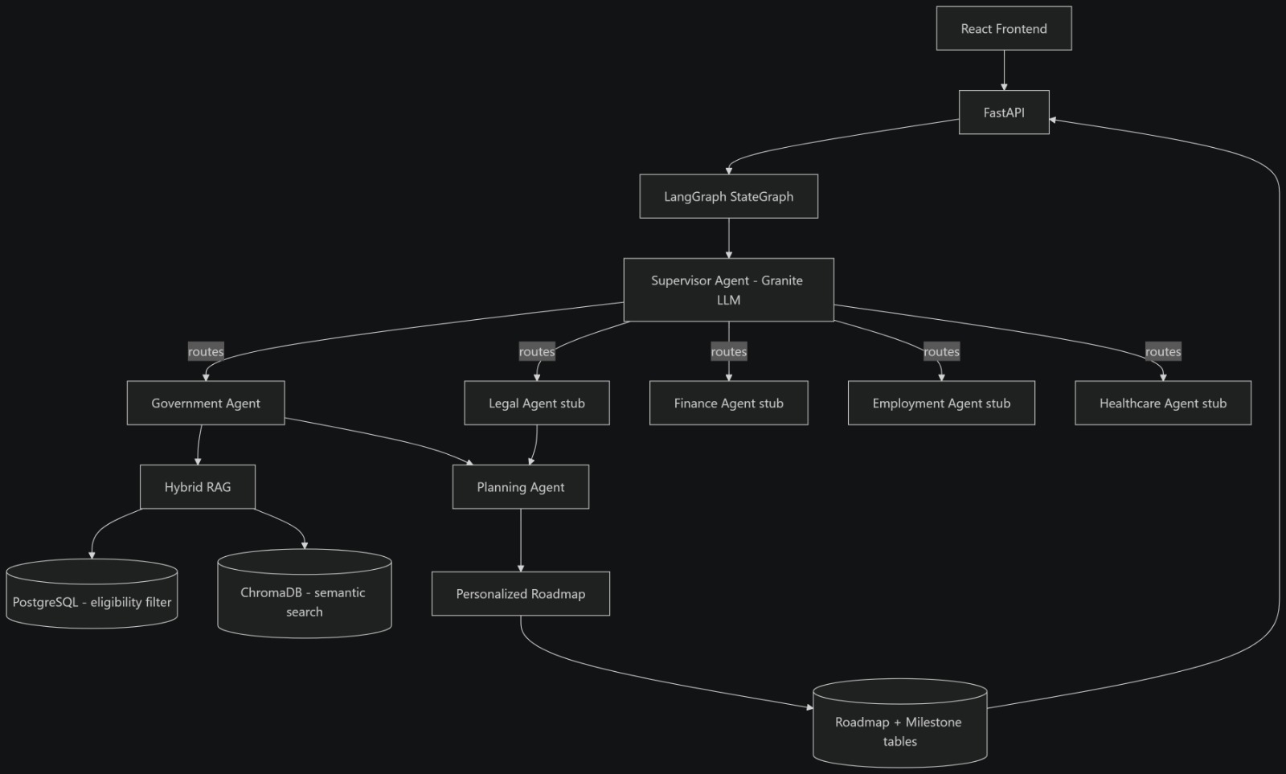
4. Technical Architecture
05
Designed around controlled orchestration, verified retrieval and adaptive state.
STACK
Frontend
React + Tailwind CSS
API
FastAPI (Python)
Orchestration
LangGraph StateGraph
LLM
IBM Granite
Retrieval
Hybrid RAG + ChromaDB
Data
PostgreSQL
Persistence
Roadmap + Milestone tables
Key engineering idea
Stateful orchestration lets the system remember progress and route each request to the right domain agent.
HACKVERSE 2.0 • Eval Round 1
ASTITVA

Slide 6
5. What Makes It Novel
06
Innovation is in the decision layer — not simply in adding a chatbot.
01
Life Orchestration
02
Decision Intelligence
03
Multi-Agent Collaboration
Not a directory. Generates a personalized, step-by-step recovery pathway.
Ranks actions using urgency, eligibility, dependencies and context: Safety → Stability → Growth.
Domain agents handle legal, healthcare, finance, employment and government support.
04
Verified + Explainable
05
Adaptive Roadmap
06
Accessible by Design
RAG grounds answers in trusted sources; each recommendation carries reason, eligibility and source.
Completed milestones change the state; the next-best action is recalculated.
Simple language, multilingual/voice-ready, mobile-first and low-bandwidth compatible.
HACKVERSE 2.0 • Eval Round 1
ASTITVA

Slide 7






6. Feasibility, Roadmap & Scale
07
Start focused; expand after the core loop is stable.
PHASE 1
Core MVP
Onboarding • profile • verified government data • scheme eligibility • basic roadmap
SCALABILITY
• Same orchestration pattern can support other vulnerable populations.
• NGOs can track beneficiary journeys and outcomes.
• Governments can identify scheme-utilization and policy gaps.
• Future deployment can use containers and cloud scaling.
PHASE 2
Agentic MVP
Supervisor + Government/Legal/Finance/Employment/Healthcare routing • milestone persistence
PHASE 3
Adaptive Product
Feedback loop • multilingual/voice • accessibility • NGO/case-worker workflows
SDG ALIGNMENT
PHASE 4
Scale
More domains • more regions • dashboards • low-bandwidth/offline support
HACKVERSE 2.0 • Eval Round 1
ASTITVA

Slide 8
7. Team Coordination & Round 1 Readiness
08
Four people, four workstreams, one integrated system.
AADITYA BHATTACHARJEE
HARSHIT BADERA
RASHI GOYAL
VARSHA ANGADI
AI / Architecture
Backend / Orchestration
Product / Research
UI / Validation
Primary owner + peer review
Primary owner + peer review
Primary owner + peer review
Primary owner + peer review
PROBLEM
INNOVATION
FEASIBILITY
COORDINATION
Clear gap: support exists, navigation doesn't
Life orchestration + decision intelligence
Phased MVP → adaptive system → scale
Shared workstreams + integrated architecture
The promise: make the next right step visible when everything feels overwhelming.
HACKVERSE 2.0 • Eval Round 1 • Thank you
ASTITVA

