Slide 1
Foundation Project - 1
Final Review 1
Group No. 11:
Dhruv M Cairae (11920031)
Rashi Jain (11920010)
Preeti Dass (11920012)
Karthikeyan Alagarswamy (11920021)
Mehul Sadavarte (11920100)

Slide 2
Project Definition
Jeep is concerned about the September 2019 sales of its flagship product, Jeep Compass. The primary stakeholders, namely marketing and product development team, are looking for insights to improve the sales and bounce back. The business analytics team is to provide actionable recommendations to the stakeholders to at least match January 2019 sales numbers.
Situation | Complication | Key Question | Business Outcome
The members of the marketing and the product development team of Jeep are the primary stakeholders. They are responsible for developing strategy to increase sales of Jeep Compass, the flagship product. The team launched the product in July 2017 and initial sales have been good. A total of 13,139 and 18,287 units were sold in 2017 and 2018. However sales in Sep 2019 stood at 603 against 1,267 in Jan 2019. | Even though footfalls in dealerships and online inquiries have not fallen, sales have drastically reduced. At this pace the product is not sustainable. | Why is sales declining? | Based on the insights from the project, Product development team and marketing team to determine changes in product and positioning strategy to boost sales to 1,200 units every month.

Slide 3
ISSUE TREE
Because of Company, Competition, Customer (3 Cs)
Because of Tax changes (GST)
Why is the sales Declining?
Because of compliance (BS VI)
Because of Government
Because of purchasing power of customer
Because of Economy/Industry.
Because of Other Domestic Entities/Institutions
Because of Global Economy
Because of cyclic effect (seasonal effect)
Because of costly Auto Loans

Slide 4
ISSUE TREE (contd…Focusing only 3Cs)
ISSUE TREE
Because of pricing (Price)
APPROACH MAP
(Only For Competition Issue)
Because our product is missing on some new features that competitors are offering (Product)
Analyse how do customers view our product against competition?
Because our product is not positioned appropriately in the minds of our customers (Placement)
Analyse on what attributes are we perceived as Strong? Weak?
Because of
Competitive Pressures
Use Text Analytics (DTM/NLP Techniques) to analyse at least 200 customer reviews of Jeep Compass product
Because of Lack of Proper Advertisement Strategy (Promotion)
Because of Company, Competition, Customer (3 Cs)
Analyse on what attributes is competition perceived as Strong? Weak?
Because of Company
Controversies involving the company
Analyse on what attributes or product features seem to best evoke an 'emotional' response or connect from customers?
Because of Customer
Dealer response to customers not encouraging
Because customer didn’t like a new design feature introduced in 2019

Slide 5
LOGIC TREE
MAIN POINT
KEY MESSAGE
Incorporate Yes/No feature in all product features. Identify deal breakers. Value add here is to obtain the product feature discussed by customers
Analyzing the customer reviews will help understand product features
Sales can be improved by understanding customer sentiments
Analyse and understand the customer reviews using the app
Developing a dashboard/app to dynamically input data and get customer perception
Segment Targeting

Slide 6
Product Backlog
“The product backlog turns out to be the sprint backlog too
because ours was a 1-week sprint.”
S. No. | Story | Owner | Story Points (size)
1 | As a analytics user, I would like 200+ user reviews of Jeep Compass, Kia Seltos and MG Hector products, so that I can use them for my analysis | Preeti & Dhruv | L
2 | As a user I would like to know the actionable insights (based on strength and weakness) of our Jeep Compass product compared to competitors, so that I can take necessary steps | Karthi&Rashi | XL
3 | As a user I need to know the frequency of occurrence of input words, so that I can utilize them for my analysis | Mehul | L

Slide 7
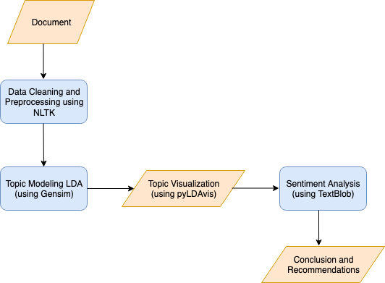
Design

Slide 8
Attributes Comparison Between Products

Slide 9
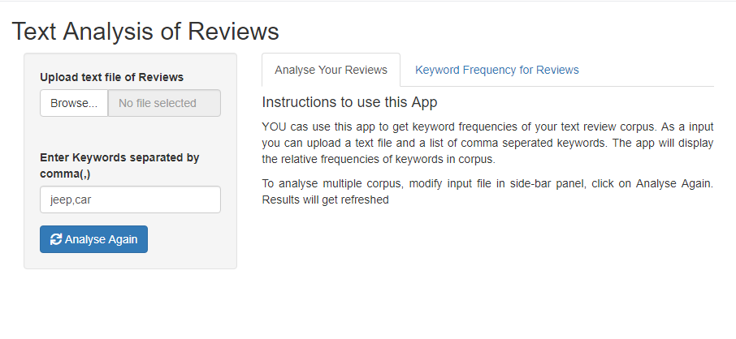
App – For analysing user comments

Slide 10
Conclusion
Our client, Jeep should focus on taking necessary steps in all the aspects such as power, value for money, experience and design. The same need to be integrated to the new models in the coming months. Even though there is positive response from the customers for Jeep Compass, when it comes to weighing along with competitors, other products seem to perform better.

Slide 11
References
FP 1 – Session Materials
TABA – Assignment Problem
TABA – Assignment Report Slides
https://autoportal.com/newcars/jeep/compass/sales-statistics/
https://www.rushlane.com/jeep-compass-sales-decline-2018-12296776.html

