Slide 1
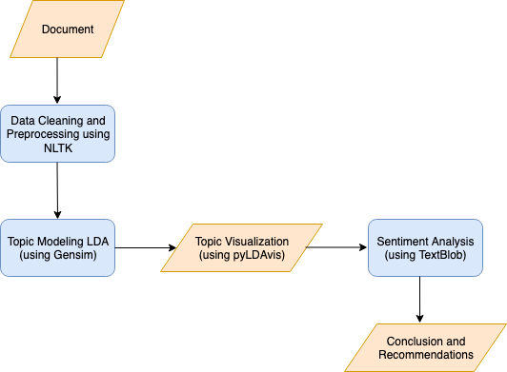
Text Analysis Flowchart

Slide 2
Topics Mined and their relevant keywords
Power - Power, engine, mileage, battery
Experience - performance, driving, experience, safety, service
Value for Money - Money, value, buy
Design - design, look, interior, sunroof

Slide 3
Sentiment Analysis for all Products(Polarity)
 | Jeep | KIA | MG Hector
Power | 0.319304609499922 | 0.497674755327816 | 0.5041183035714286
Experience | 0.329310280505402 | 0.479041641779737 | 0.5085291026023785
Value for Money | 0.242155172413793 | 0.305555555555555 | 0.3374238095238095
Design | 0.373811042388231 | 0.474780923913576 | 0.4730322141482855

Slide 4
How do customers view our product against competition?
Based on the topics and sentiment analysis performed, the average polarity score calculated with 170+ reviews, show that Jeep lags behind Kia and MG Hector in features such as power, experience, value for money and design. Customers are not very happy with these features compared to competitors

Slide 5
On what attributes and product features are we/competitors perceived as Strong or Weak?
Our client Jeep is weak in terms of money value, as per the customers. Further, other features are also comparatively weak based on our comparison.

Slide 6
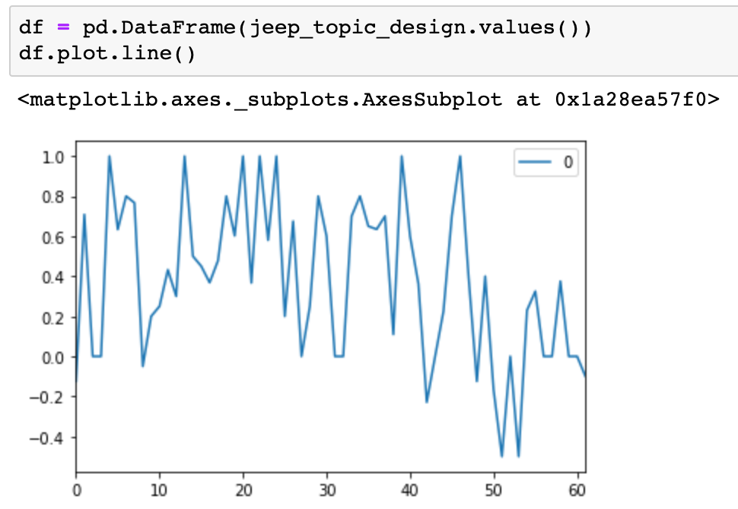
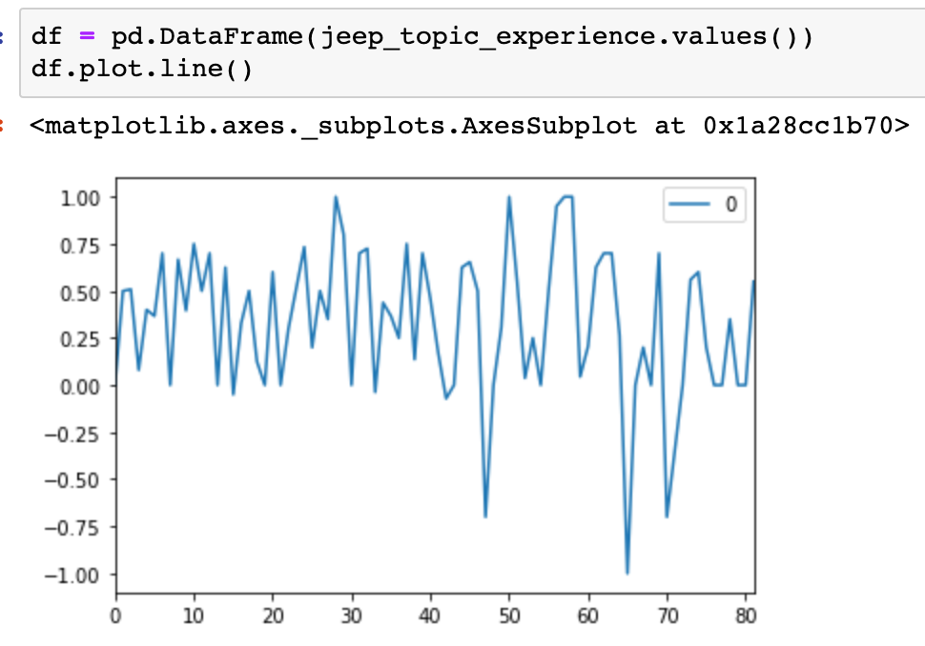
What attributes or product features seem to best evoke an 'emotional' response or connect from customers?
Plotting the polarity of every review shows the emotional variation of the customers. Looks like Design and Experience has got emotional connect with the customers

Slide 7
How should we position ourselves and promote our product against competition?
Our client, Jeep should focus on taking necessary steps in all the aspects discussed above and integrate the same to the new models in the coming months. Even though there is positive response from the customers for Jeep Compass, when it comes to weighing along with competitors, other products seem to perform better.

Slide 8
References
DAPD Materials
DC Materials
TABA Code and Materials
https://www.quora.com/How-can-I-use-Spacy-to-perform-sentiment-analysis
http://blog.echen.me/2011/08/22/introduction-to-latent-dirichlet-allocation/
https://towardsdatascience.com/building-a-topic-modeling-pipeline-with-spacy-and-gensim-c5dc03ffc619
https://medium.com/@colemiller94/topic-modeling-with-spacy-and-gensim-7ecfd3de95f4
https://tech.goibibo.com/key-topics-extraction-and-contextual-sentiment-of-users-reviews-20e63c0fd7ca

