Slide 1
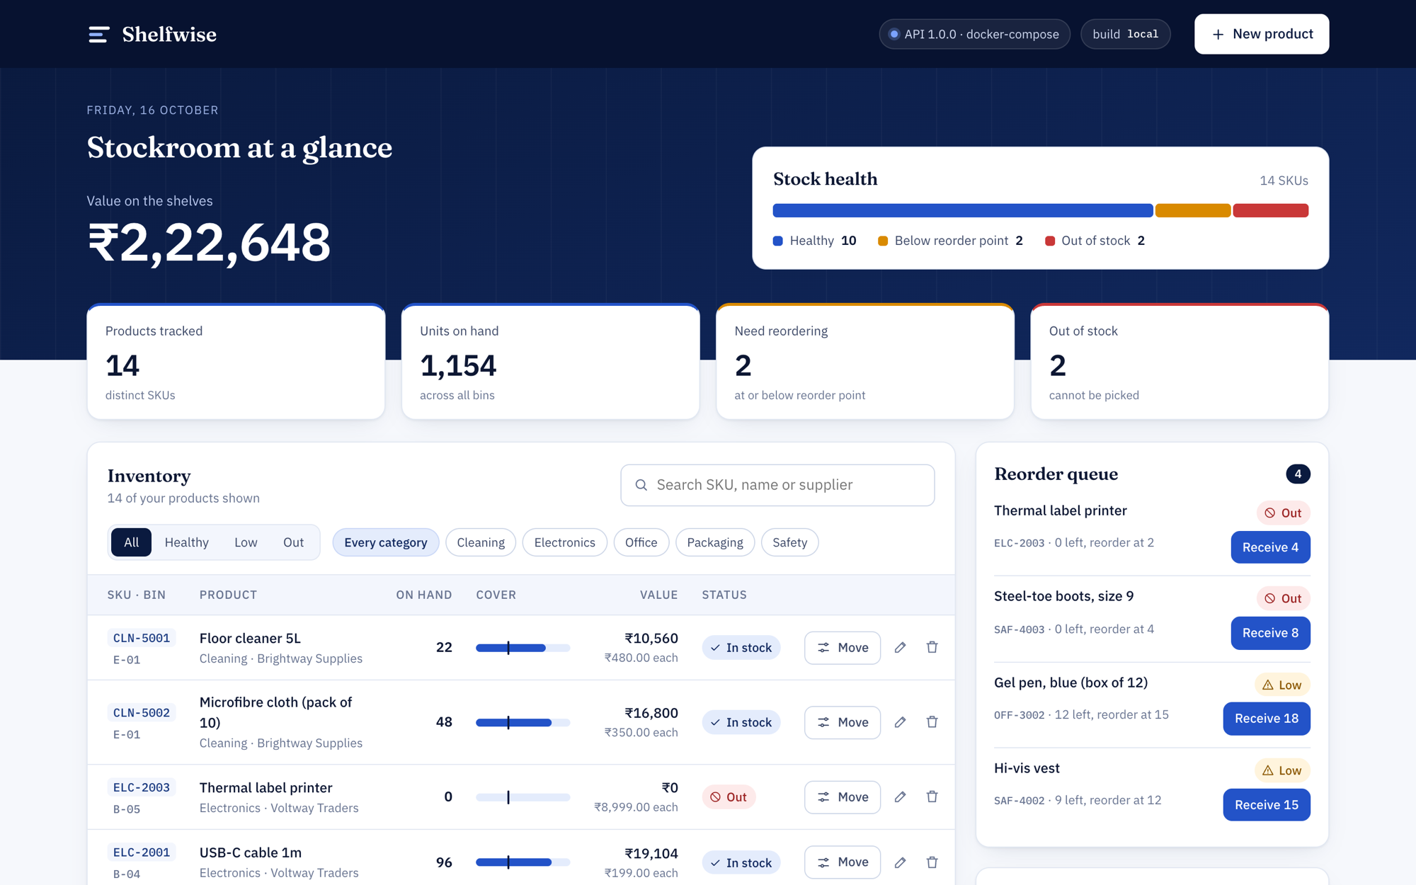
Shelfwise
DEVOPS CAPSTONE · 2026
From a laptop to a monitored Kubernetes cluster
A small inventory app, and the whole delivery path around it: tests, containers, CI/CD with a security gate, Terraform, Helm, GitOps and observability.
Rashi Malik · github.com/RashiMalik02/shelfwise
Notes:
Hi, I’m Rashi. This is Shelfwise, my DevOps capstone. The app itself is deliberately small: an inventory manager for a stockroom. The real subject is the path it takes from my laptop to a monitored Kubernetes cluster: tests, containers, a CI/CD pipeline with a security gate, infrastructure as code on AWS, Helm, autoscaling, GitOps and observability.

Slide 2
An inventory manager for a small stockroom
M1 · THE APPLICATION
Products
SKU, bin location, supplier and unit price, with search and filters.
Reorder queue
Everything below its reorder point, one click to receive stock.
Stock ledger
Every movement logged. Picking more than exists returns 409.
React 19 + Vite · FastAPI · PostgreSQL 17 · 11 REST endpoints
Notes:
Shelfwise tracks products with SKU, bin location, supplier and price. The stock-health bar and reorder queue show what has dropped below its reorder point, and every stock movement — received, sold, returned, written off, counted — lands in a ledger. If you try to pick more units than exist, the API returns 409 and the dialog refuses. Frontend is React 19 with Vite, backend is FastAPI with SQLAlchemy and Postgres, schema managed by Alembic. Swagger docs live at /docs.

Slide 3
One small app, the whole delivery path
WHAT’S IN IT
Frontend
Backend
Database
Tests
React 19 + Vite on unprivileged nginx
FastAPI, SQLAlchemy 2, Pydantic
PostgreSQL 17, Alembic migrations
29 pytest tests, ruff, node:test
Containers
CI/CD
Infrastructure
Deployment
Multi-stage, non-root images + Compose
GitHub Actions → Trivy → GHCR
Terraform: VPC + EKS on AWS
Helm: Ingress, HPA, PDBs, StatefulSet
GitOps
Monitoring
Security
Labs
Argo CD syncs the chart; CI bumps the tag
Prometheus + Grafana, custom dashboard
Restricted Pod Security, read-only root FS
Four break-and-fix troubleshooting labs
Notes:
Here’s the whole stack on one slide. The top row is the application and its tests. The middle row is how it gets packaged and shipped: multi-stage non-root Docker images, a GitHub Actions pipeline with a Trivy security gate pushing to GHCR, Terraform for the AWS VPC and EKS cluster, and a Helm chart. The bottom row is how it runs: Argo CD for GitOps, Prometheus and Grafana for monitoring, a restricted Pod Security namespace, and four troubleshooting labs.

Slide 4

From git push to a running pod
THE PATH
Push
Test
Build
Scan
Publish
to main, or open a pull request
ruff, pytest, node:test, helm lint, terraform test
multi-stage Docker images
Trivy fails on HIGH or CRITICAL
GHCR, tagged with the commit SHA
Deploy · DEPLOY_TARGET=eks
Deploy · GitOps
helm upgrade straight onto the EKS cluster
CI commits the new SHA; Argo CD syncs the cluster
Kubernetes · namespace shelfwise
Observability
Traefik Ingress → nginx ×2 and FastAPI ×2–6 (HPA) → Postgres StatefulSet
Prometheus scrapes every 15s → Grafana
Notes:
This is the whole path. Every push and pull request runs the pipeline: lint and tests for the backend and frontend, helm lint and terraform validate and test. Only if all of that passes do we build the Docker images, and Trivy scans them before anything is pushed. Images go to GHCR tagged with the full commit SHA. Then deploy happens one of two ways: helm upgrade on EKS, or — the GitOps path — CI commits the new SHA into the release values file and Argo CD rolls it out. Prometheus scrapes the backend every 15 seconds and Grafana visualises it.

Slide 5
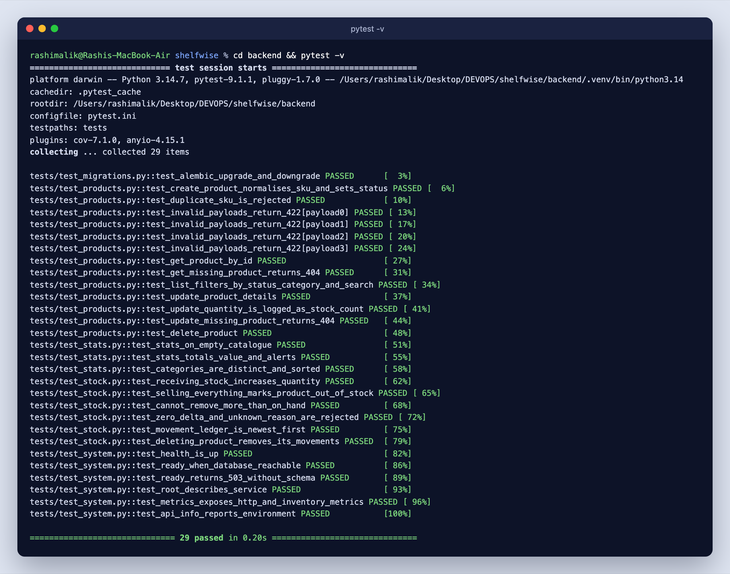
A failing test stops the pipeline
M2 · TESTING
29
tests,
all passing
Cover all 11 endpoints and the Alembic migration chain
In-memory SQLite, never the real database
ruff lint and format checks gate every push
Frontend unit tests with node:test
Notes:
The backend has 29 pytest tests covering all eleven endpoints plus the migration chain. conftest.py points the app at in-memory SQLite before it’s even imported, so tests can never touch a real database. ruff checks lint and formatting, and the frontend has node:test unit tests. In CI, backend-tests is the first job and every later job depends on it — so a failing test stops the pipeline before any image is built.

Slide 6
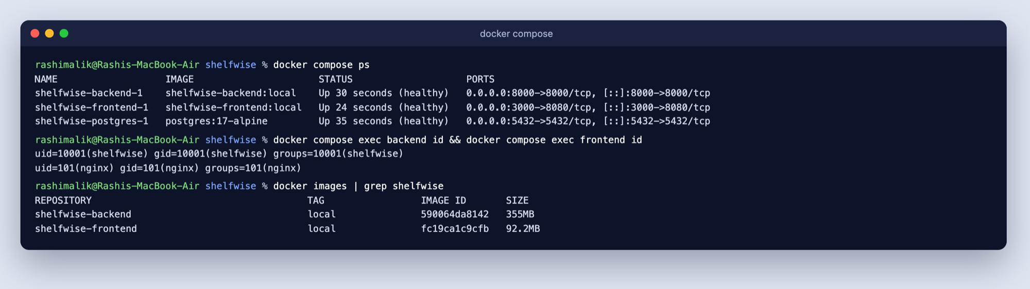
The whole stack in one command, nothing as root
M4 · DOCKER
3
2
10001
101
services from docker compose up
stages: Node build → nginx runtime
backend user id, not root
nginx user id, not root
Notes:
docker compose up --build starts Postgres, the backend and the frontend. The backend runs migrations on start and loads fourteen demo products. The frontend Dockerfile is multi-stage: a Node build stage, then an unprivileged nginx runtime. Both images run as non-root: the backend as uid 10001 and nginx as uid 101 — you can see that in the id output here.

Slide 7
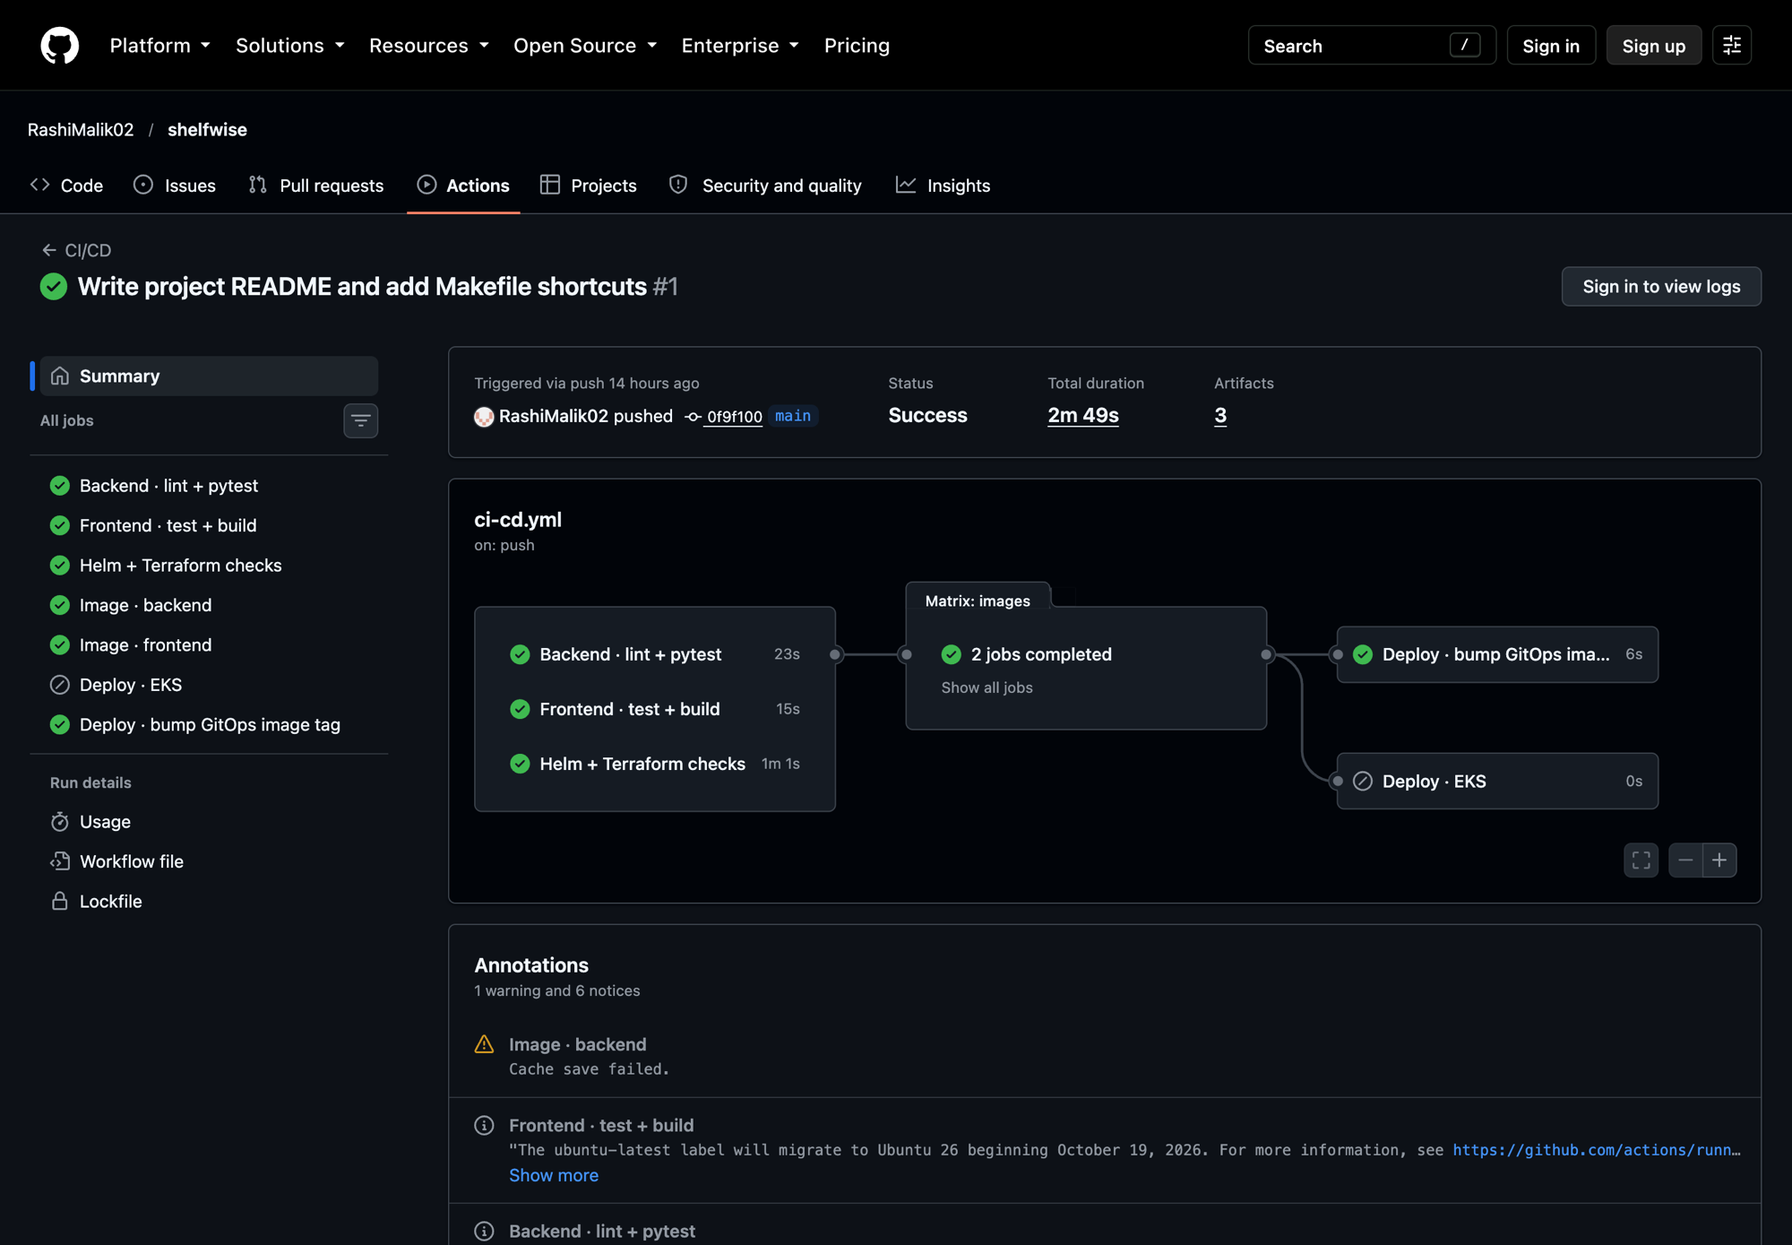
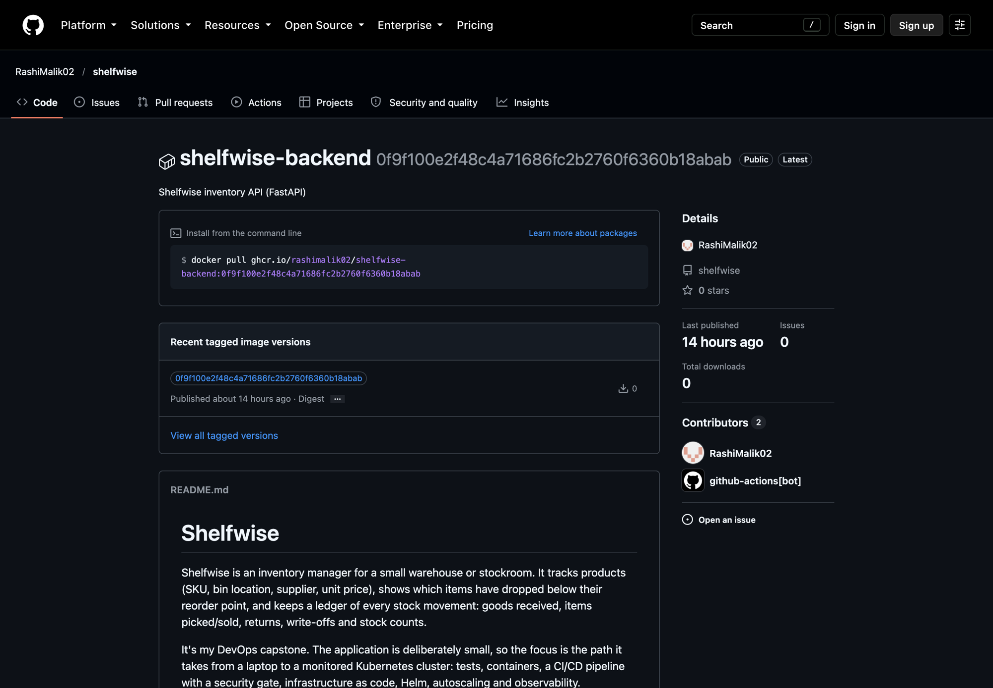
Every image traces back to one commit
M5 · CI/CD
Green run: test → build → scan → push → deploy
GHCR: tagged with the full commit SHA, never latest
Notes:
The pipeline is one GitHub Actions workflow. Here’s a green run: backend tests, frontend build, infra lint, then the image matrix builds backend and frontend in parallel, scans them, and pushes to GitHub Container Registry. Images are tagged with the full commit SHA, never latest — so any running pod traces back to an exact commit, and a rollback is just the previous SHA. Pull requests build and scan, but never push.

Slide 8
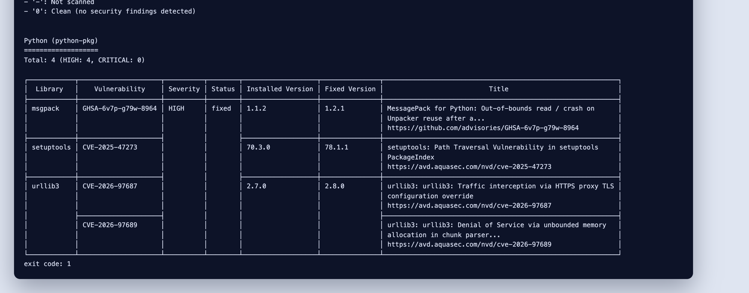
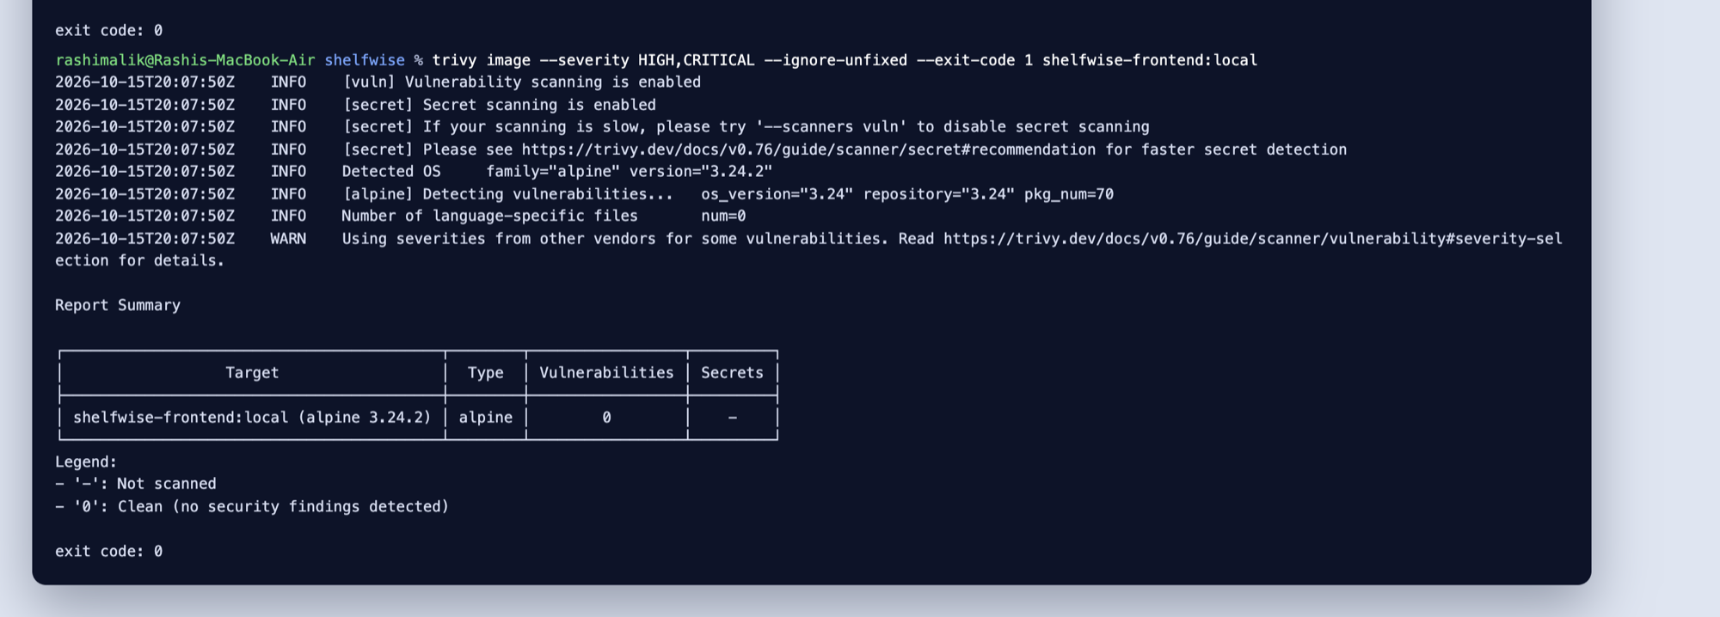
Trivy blocks the push on any fixable HIGH or CRITICAL
M6 · SECURITY GATE
Before · 4 HIGH · exit 1
After · 0 findings · exit 0
The cause
The fix
All four came from copies of urllib3, msgpack and setuptools vendored inside pip, not from the app’s own dependencies.
The running API never needs pip, so it is removed from the runtime image. Both images now scan clean.
Notes:
Trivy scans each built image before it’s pushed — OS packages and every Python and npm package — and fails on any HIGH or CRITICAL finding that already has a fix. The first scan of the backend failed with four HIGH findings. They weren’t in my dependencies: they were copies of urllib3, msgpack and setuptools that pip vendors inside itself. The API never needs pip at runtime, so I removed it from the image, and both images now scan clean.

Slide 9
Tags can move.
Commit SHAs can’t.
SUPPLY CHAIN
Every third-party GitHub Action is pinned to a full commit SHA. In March 2026 attackers force-pushed almost every aquasecurity/trivy-action tag to a commit that stole CI secrets (CVE-2026-33634).
uses: aquasecurity/trivy-action@<40-char SHA> # v0.36.0
Notes:
One detail I’m proud of: every third-party action in the workflow is pinned to a full commit SHA rather than a tag. Tags can be moved — in March 2026 attackers force-pushed almost every trivy-action tag to a commit that stole CI secrets. The version I pinned was released after that incident. The same idea as tagging my own images by SHA: you always know exactly what code is running.

Slide 10
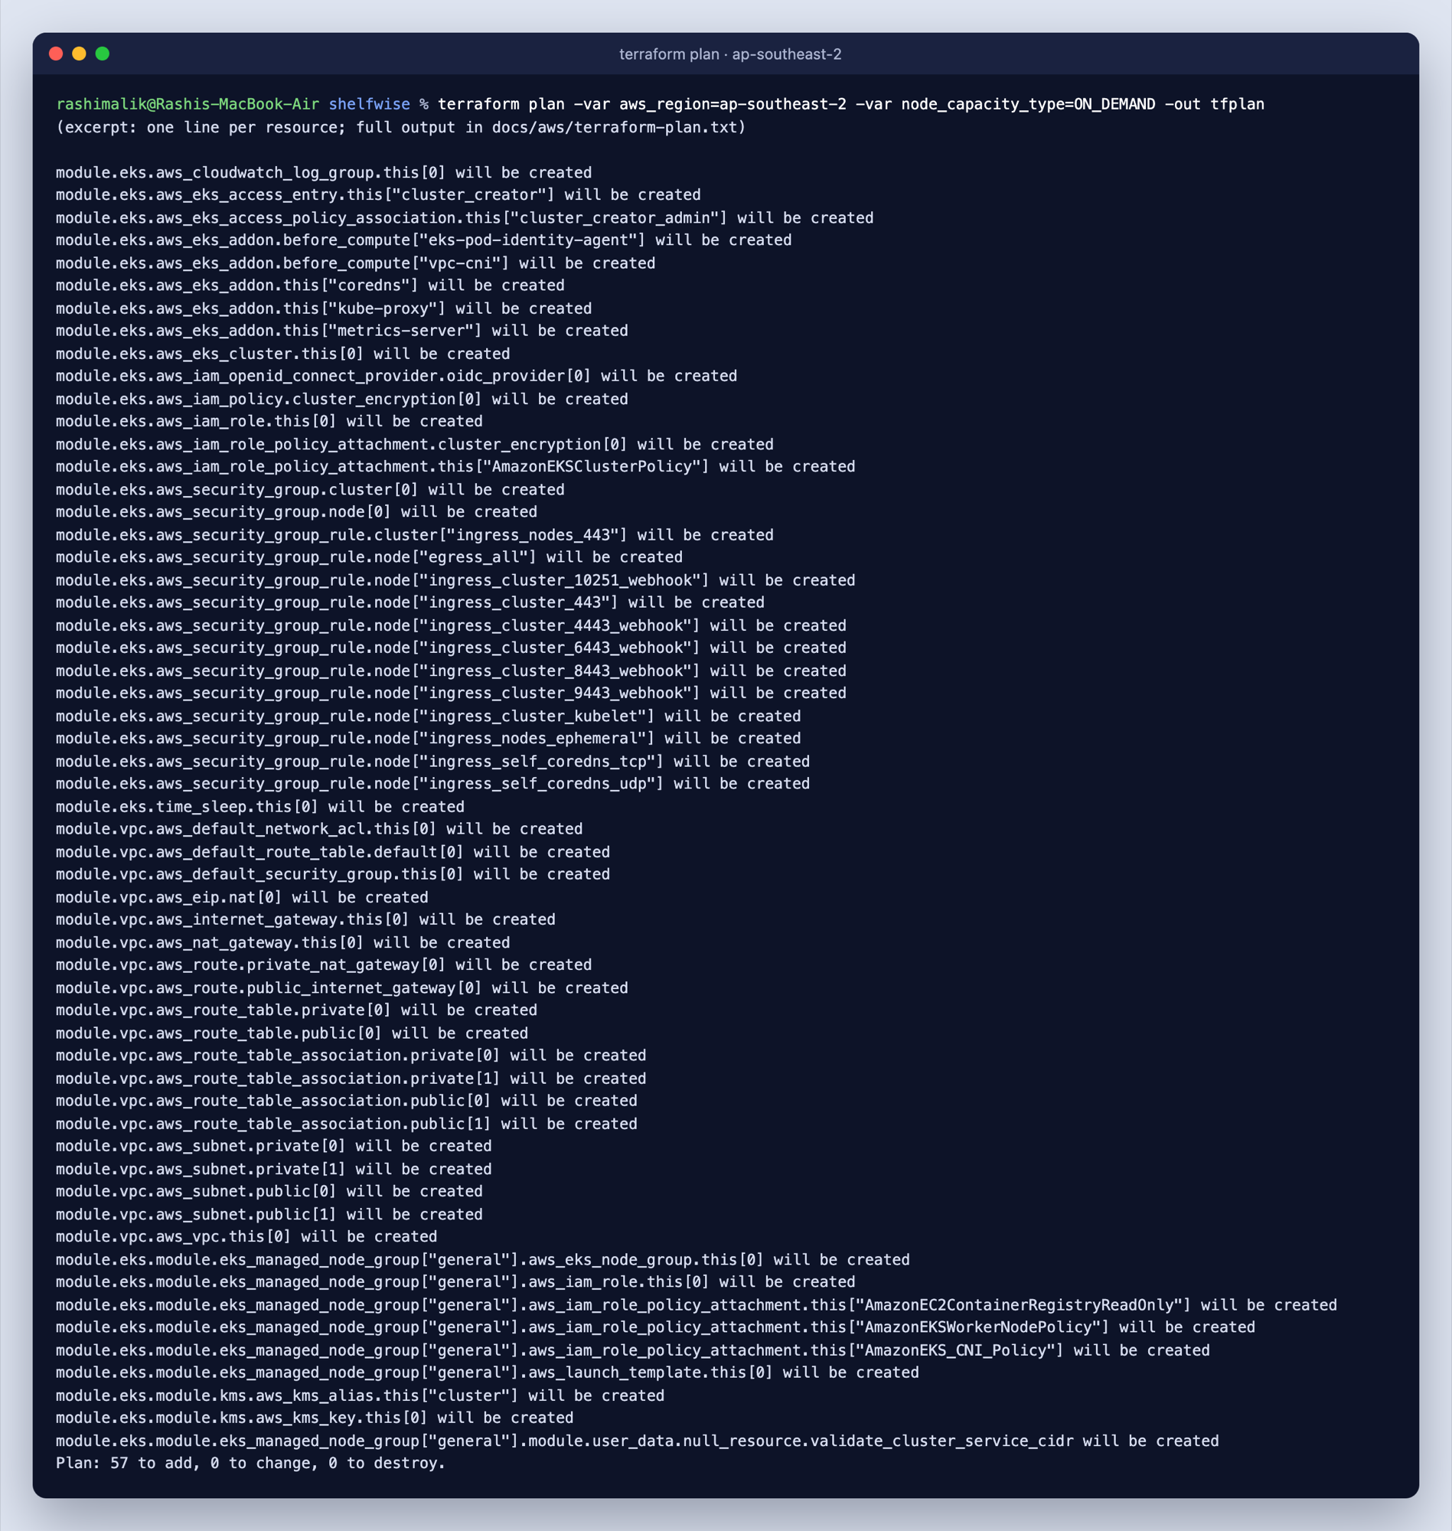
A real VPC and EKS cluster, built and torn down
M7 · TERRAFORM ON AWS
57
2 + 2
resources in the plan
public + private subnets
56
< $1
destroyed, nothing left running
total cost of the run
Free-plan AWS account
One region (ap-southeast-2), Free Tier nodes (c7i-flex.large), and Pod Identity instead of IRSA.
Notes:
Infrastructure is Terraform: a VPC with two public and two private subnets, and an EKS cluster with a managed node group. The plan created 57 resources in ap-southeast-2. It runs offline in CI too: terraform test with a mocked AWS provider, no credentials. I had to adapt to a Free-plan AWS account — locked to one region, Free Tier instance types only, and no permission to create an OIDC provider, so I used EKS Pod Identity instead of IRSA. After capturing the evidence I ran terraform destroy: 56 resources removed, total cost under a dollar.

Slide 11
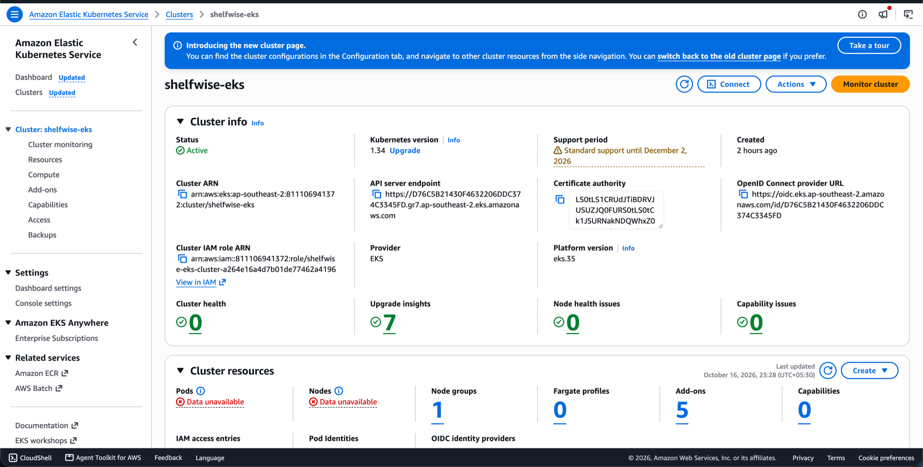
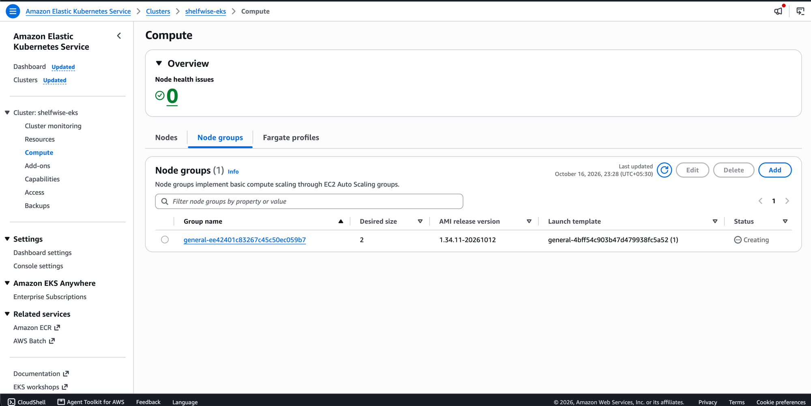
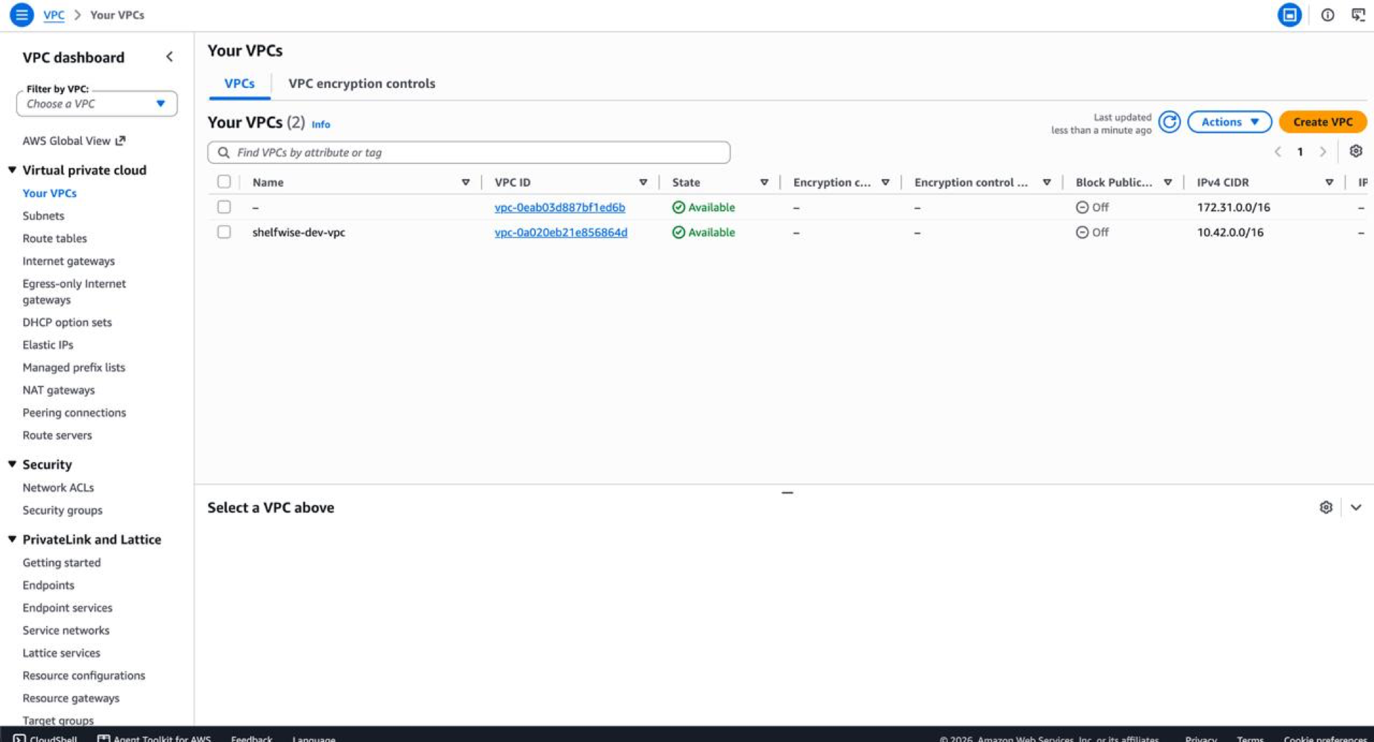
EKS cluster active, nodes ready, VPC in place
M7 · EVIDENCE IN THE AWS CONSOLE
Managed node group
EKS cluster · Active · ap-southeast-2
Notes:
Here’s the evidence from the AWS console while the stack was up: the EKS cluster active in ap-southeast-2, its managed node group under Compute, and the VPC Terraform created. I also captured the CLI view — two public and two private subnets, and kubectl showing the nodes Ready — and the destroy log afterwards.

Slide 12
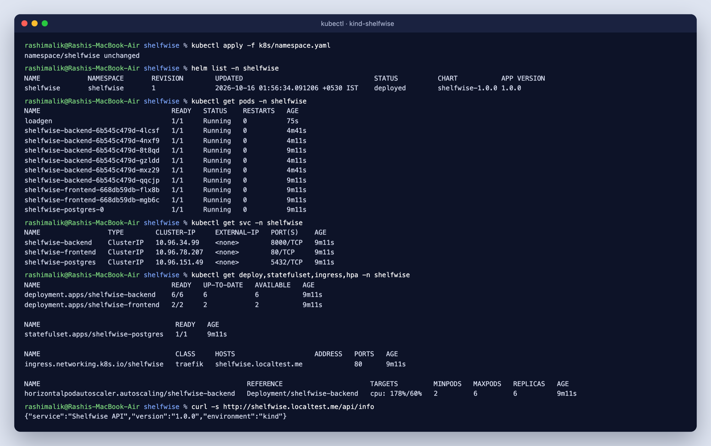
One Helm chart, from kind to EKS
M8 · KUBERNETES + HELM
Ingress (Traefik)
/ → frontend, /api and /docs → backend
Replicas + PDBs
2 of each; backend scales 2–6 with the HPA
Postgres StatefulSet
PVC-backed; password generated on install
/health and /ready
Liveness restarts; readiness only pulls the pod
shelfwise.localtest.me
Notes:
Deployment is a single Helm chart with values files for local kind, EKS and GitOps. A Traefik Ingress sends / to the frontend and /api and /docs to the backend. Two replicas of each, PodDisruptionBudgets, and Postgres as a StatefulSet with a PVC — its password is generated by the chart on first install and reused on upgrade. The backend has separate /health and /ready probes: liveness restarts a stuck process, readiness just takes the pod out of the Service, which is what you want during a database outage.

Slide 13
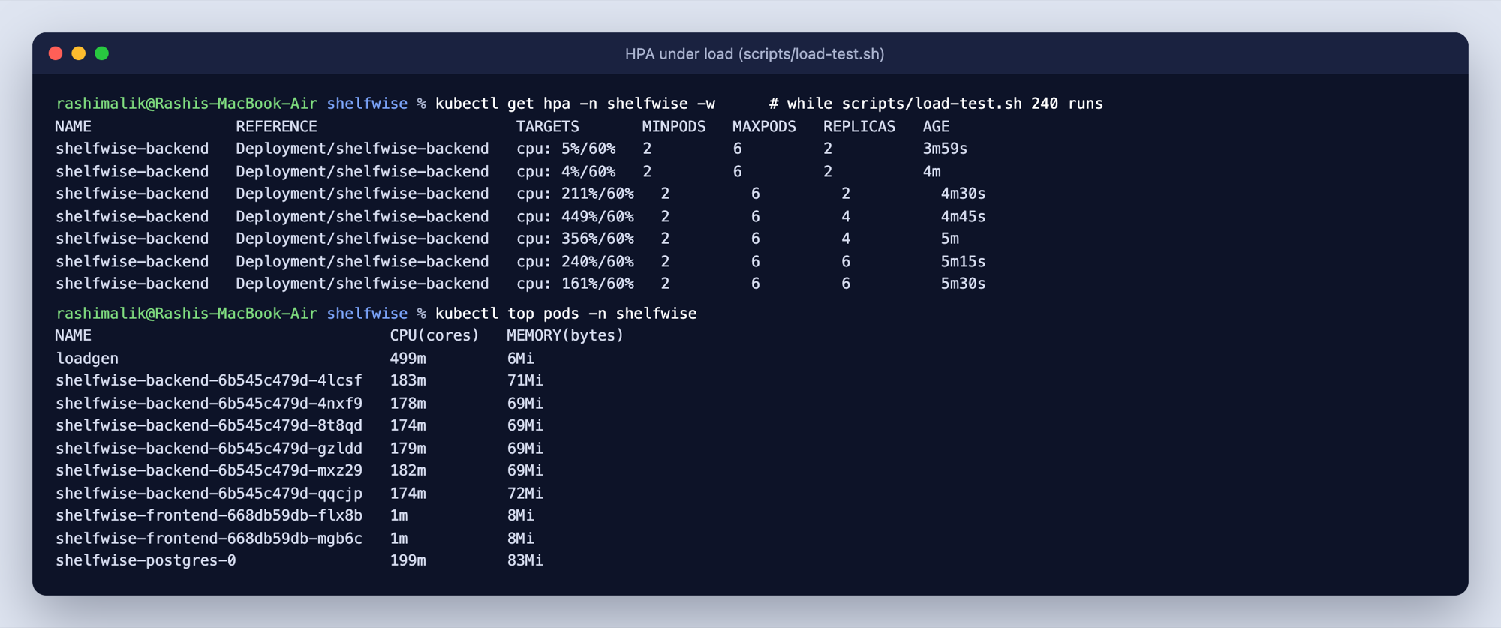
Under load, the backend scales itself
M8 · AUTOSCALING
2 → 6
backend replicas
449%
CPU at peak, up from 4% idle
./scripts/load-test.sh 180
Notes:
To prove autoscaling I ran a three-minute load test against the API while watching the HorizontalPodAutoscaler. CPU went from 4% to 449% of the request, and the HPA stepped the backend from 2 replicas up to its maximum of 6. When the load stopped it scaled back down. metrics-server feeds the HPA; the same climb shows up on the Grafana dashboard.

Slide 14
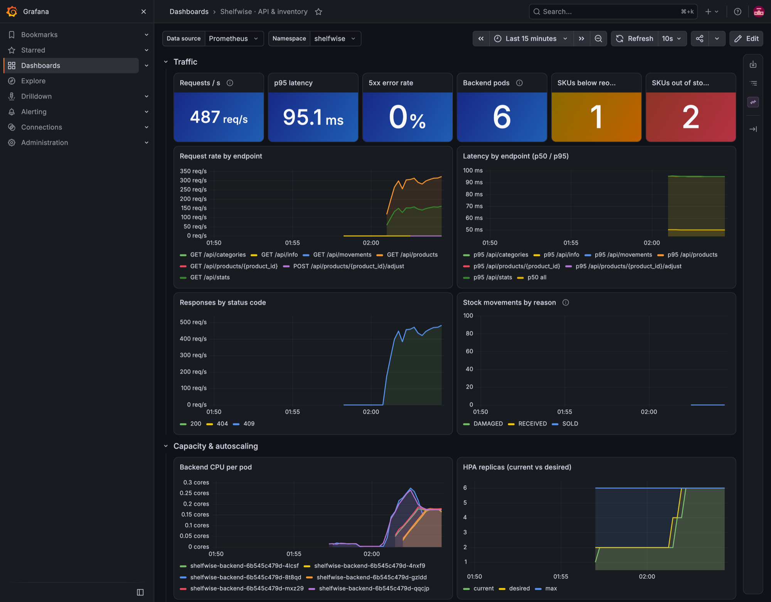
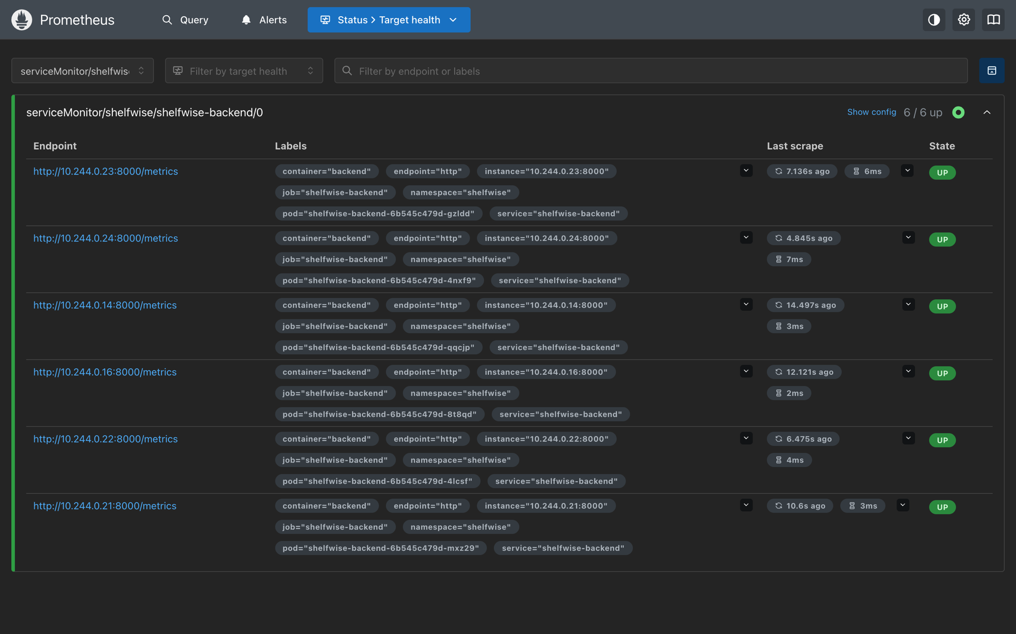
Live app and inventory metrics in Grafana
M9 · OBSERVABILITY
Prometheus: 6/6 backend pods UP, scraped every 15s
shelfwise_stock_movements_total
shelfwise_units_on_hand
http_request_duration_seconds
Notes:
The backend exposes /metrics in Prometheus format: request rate and latency, plus business metrics — stock movements by reason, units on hand, and products by stock status. A ServiceMonitor tells kube-prometheus-stack to scrape every backend pod every 15 seconds; here all six are up during the load test. The custom Grafana dashboard shows requests per second, p95 latency, status codes, stock movements and the HPA replica count side by side.

Slide 15
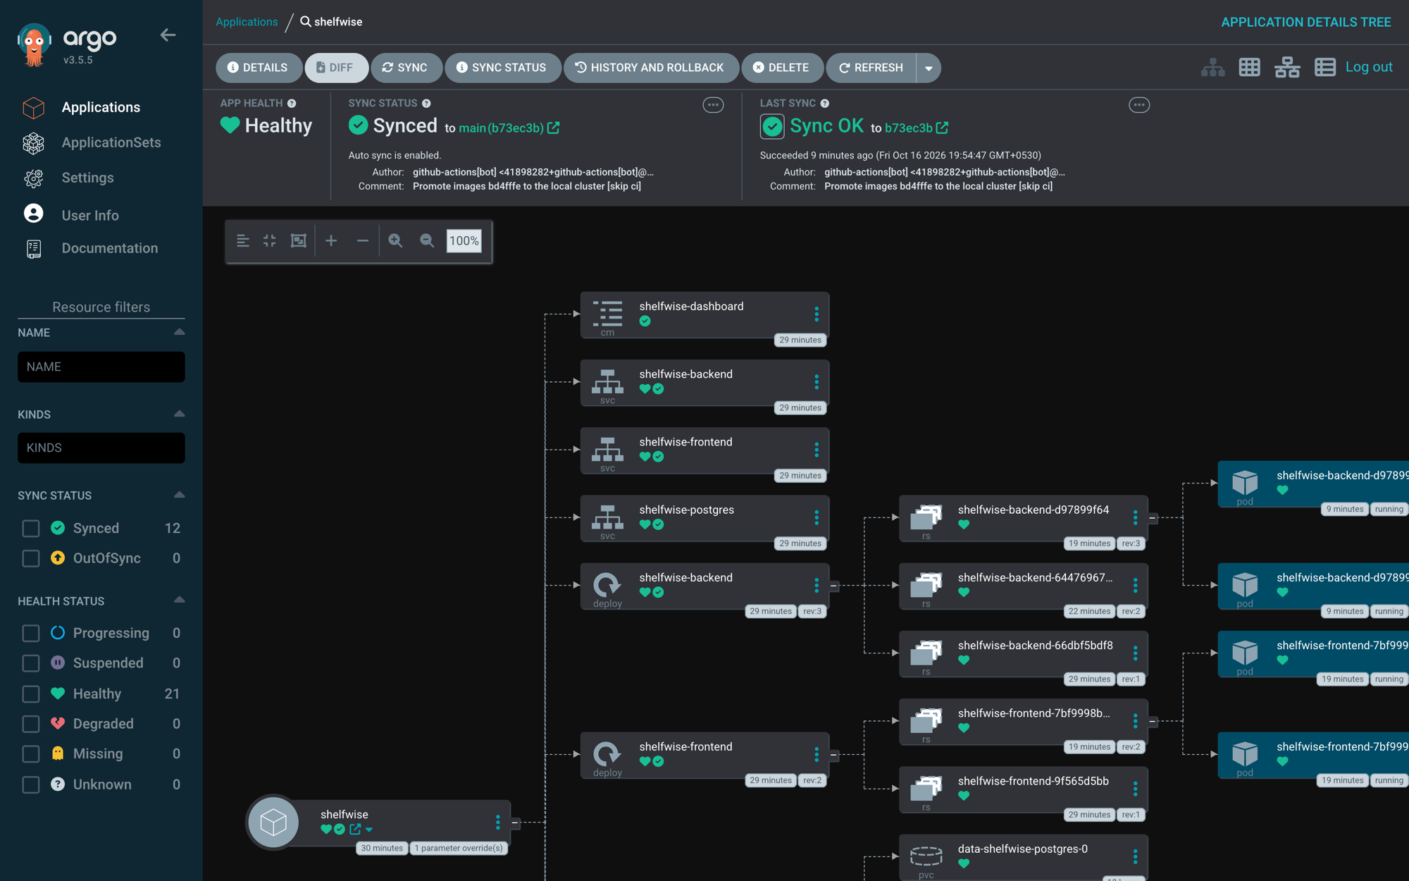
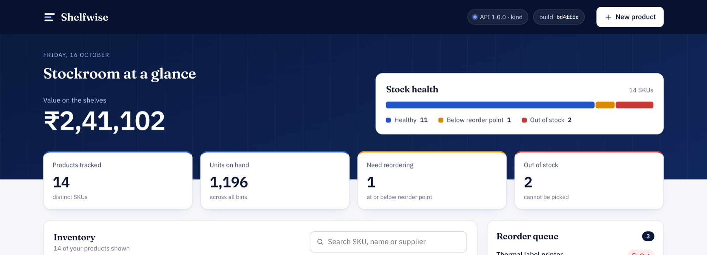
A commit becomes a deployment, untouched
M10 · GITOPS
1 push bd4fffe
2 pipeline run green
3 bot commits b73ec3b
4 Argo CD syncs
5 pods roll to the new SHA
The header’s build pill shows the SHA it was built from.
Argo CD · Synced · Healthy
Notes:
This is the end-to-end demo. I push a change; the pipeline goes green; the promote job commits the new image SHA into values-release.yaml. Argo CD in the local cluster watches the chart, sees the commit and syncs — no kubectl from me. Pods roll over to the new tag, and when I reload the app the build pill in the header shows the same SHA as GHCR and the Actions run. That’s the full loop: commit, pipeline, deployment.

Slide 16




Secure by default, at every layer
HARDENING
Non-root images
Restricted Pod Security
Backend runs as uid 10001, nginx as uid 101.
The namespace enforces the strictest built-in standard.
Locked-down containers
No committed secrets
Read-only root filesystem, no privilege escalation, all capabilities dropped.
Postgres password generated by the chart; tfvars and .env git-ignored.
Notes:
Security runs through every layer. Both images run as non-root. In Kubernetes every container also has a read-only root filesystem, privilege escalation disabled and all Linux capabilities dropped, and the namespace enforces the restricted Pod Security Standard — so a pod that doesn’t meet it is rejected outright. No credentials are committed: the database password is generated on first install and reused on upgrades, and tfvars and .env files are git-ignored. Plus the Trivy gate and SHA-pinned actions we already saw.

Slide 17
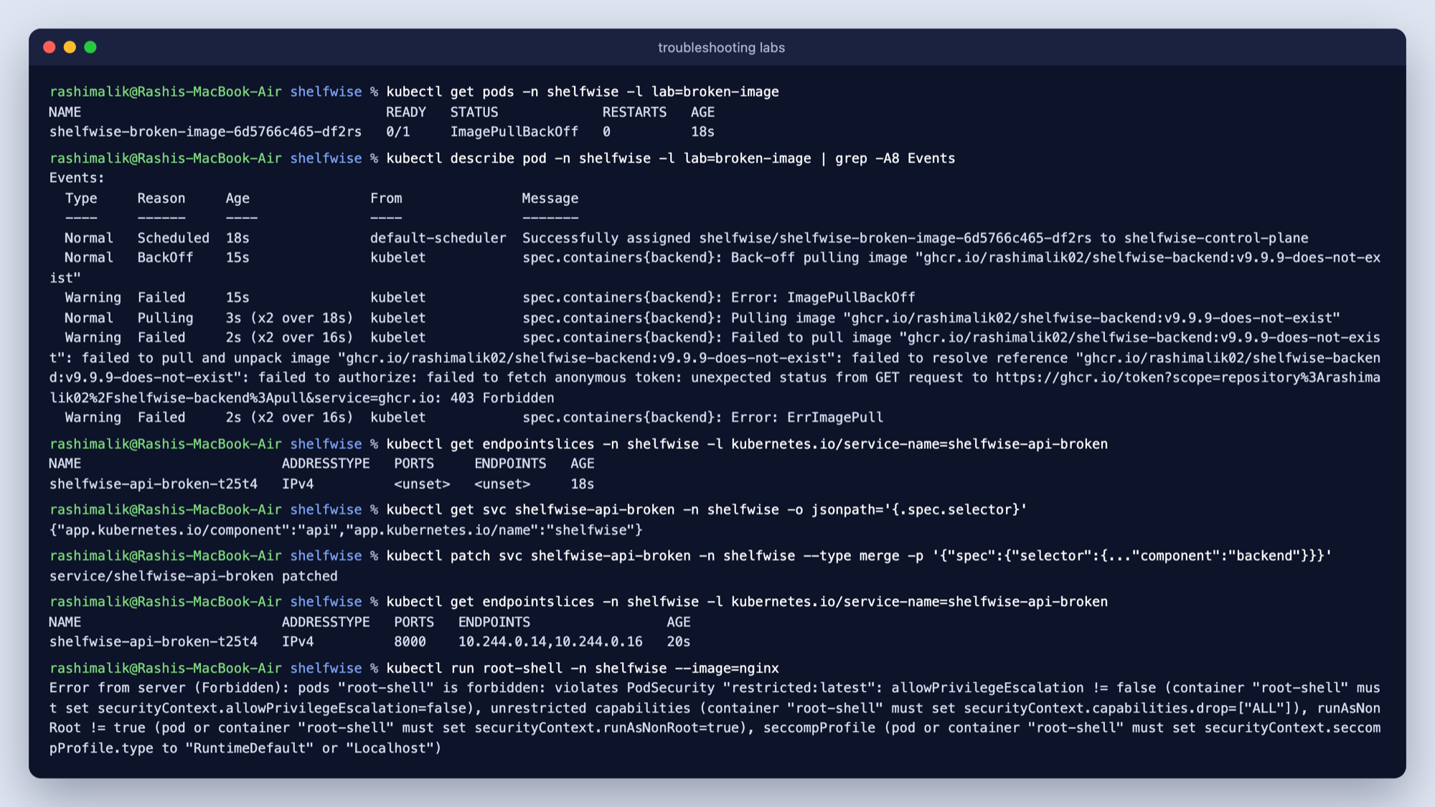
Four labs: break it on purpose, then fix it
M8 · TROUBLESHOOTING
01
ImagePullBackOff
The image tag doesn’t exist
02
No endpoints
Service selector doesn’t match the pod labels
03
Running, not Ready
The database password is wrong
04
Forbidden
Pod Security Admission rejects the pod
Notes:
I also wrote four break-and-fix labs, each a common real-world failure. A bad image tag gives ImagePullBackOff. A Service whose selector doesn’t match the pod labels has no endpoints — that’s the one on screen: the endpoint slice is empty until you patch the selector. A wrong database password leaves the pod Running but never Ready, because the readiness probe checks Postgres. And a pod that asks for privilege escalation is rejected by Pod Security Admission.

Slide 18
The questions people ask
DESIGN DECISIONS
Why SHA tags, not latest?
Why /health and /ready?
Every pod traces back to an exact commit, and a rollback is just the previous SHA.
A database outage should pull the pod from the Service, not restart it.
Why Postgres in the cluster?
Why Traefik, not ingress-nginx?
For the demo. On AWS I’d use RDS; the chart already takes an external database URL.
ingress-nginx was archived in March 2026. Only ingressClassName changes.
Notes:
A few decisions worth explaining. Images are tagged by commit SHA so every pod traces back to a commit and a rollback is just the previous SHA. Separate health and readiness endpoints mean a database outage takes pods out of rotation instead of restart-looping them. Postgres runs in the cluster for the demo; in production on AWS I’d use RDS, and the chart already supports an external database URL. And I chose Traefik because ingress-nginx was archived in March 2026 — the Ingress object is the same, only the class name changes.

Slide 19
Thank you
SHELFWISE · DEVOPS CAPSTONE
29 tests passing
0 HIGH/CRITICAL CVEs
57 AWS resources
2 → 6 pods
< $1 cloud bill
Questions? · github.com/RashiMalik02/shelfwise
Notes:
To wrap up: a small app with a complete delivery path — 29 tests, a security gate that’s clean, real infrastructure on AWS built with Terraform and destroyed for under a dollar, Kubernetes with autoscaling from 2 to 6 pods, GitOps with Argo CD, and Prometheus and Grafana watching it all. The code and every screenshot are in the repo. Thank you — happy to take questions.

