Slide 1
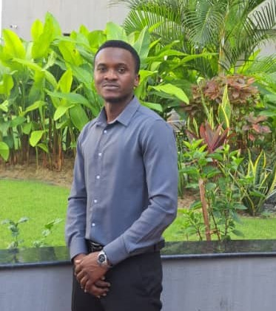
RASHID HASSAN ALLY
GRAPHICS DESIGNER
PORTFOLIO 2026
Bold visuals. Clear ideas. Meaningful design.

Slide 2
ABOUT ME
Hi, I'm Rashid — a graphic designer with a passion for bold, clean, and meaningful visuals. I help brands tell their story through design that stands out.
I combine creativity, design principles, and practical problem-solving to create visuals that are not only eye-catching but also communicate clearly and serve a purpose. Every design is crafted with attention to detail and tailored to the client’s goals, audience, and brand identity.
SKILLS
Adobe Photoshop
Illustrator
Figma
After Effects
Branding

Slide 3
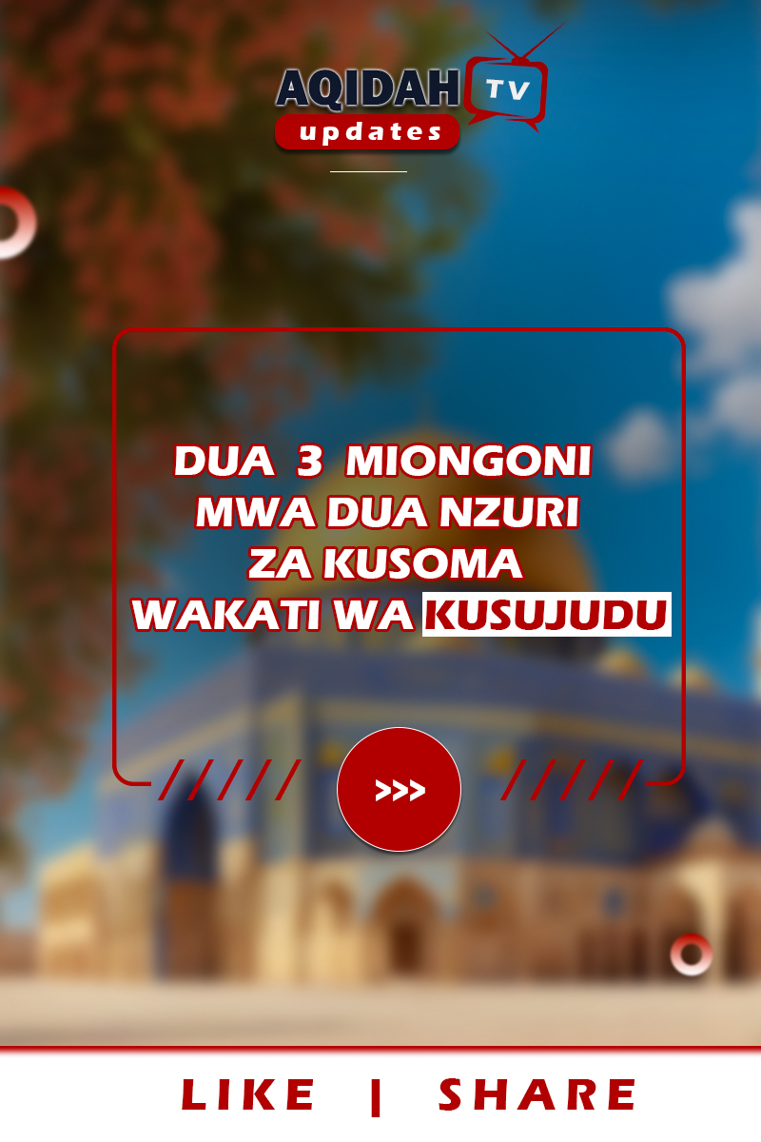
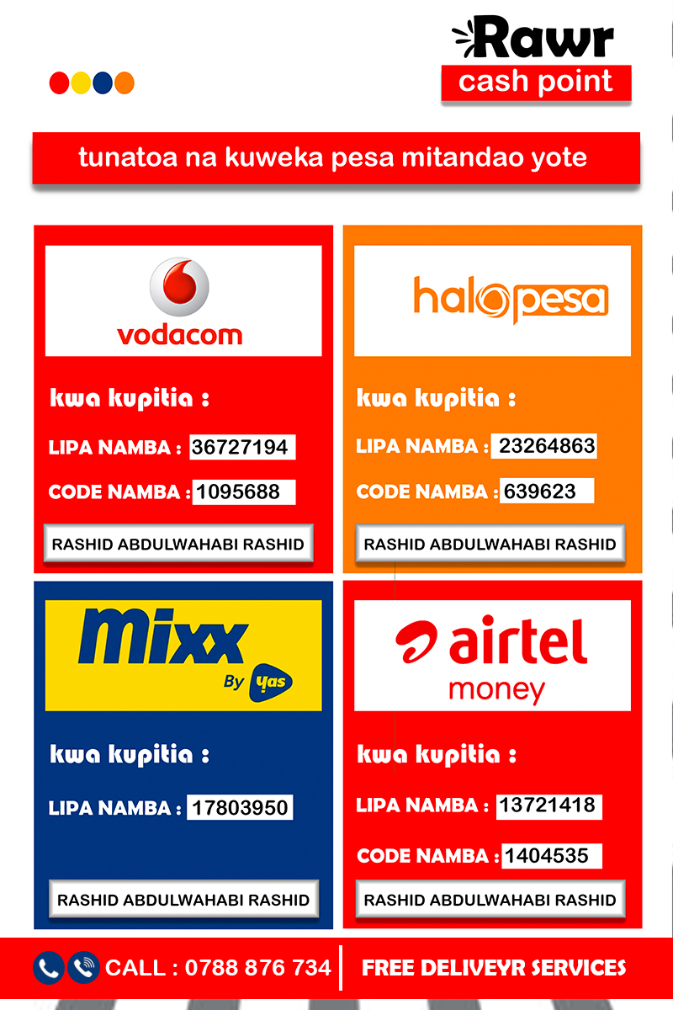
SELECTED WORK
01 — 02
channel
wakala
SOCIAL MEDIA CHANNEL
POSTER
#
#

Slide 4
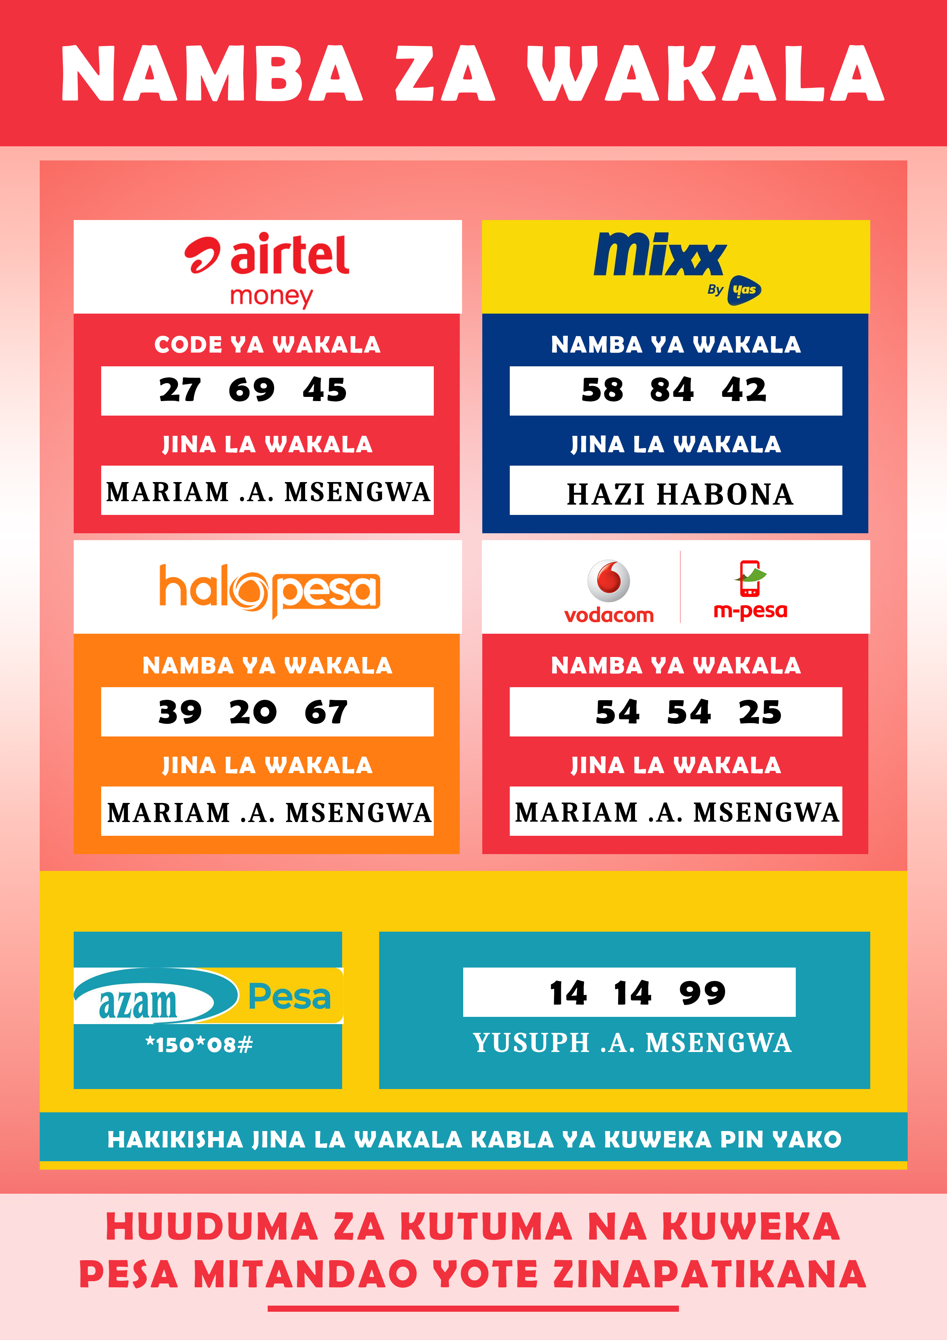

SELECTED WORK
03 — 04
wakala
rise
POSTER
POSTER
#
#

Slide 5


SELECTED WORK
05 — 06
sticker soup2
sticker soup
STICKER
STICKER
#
#

Slide 6
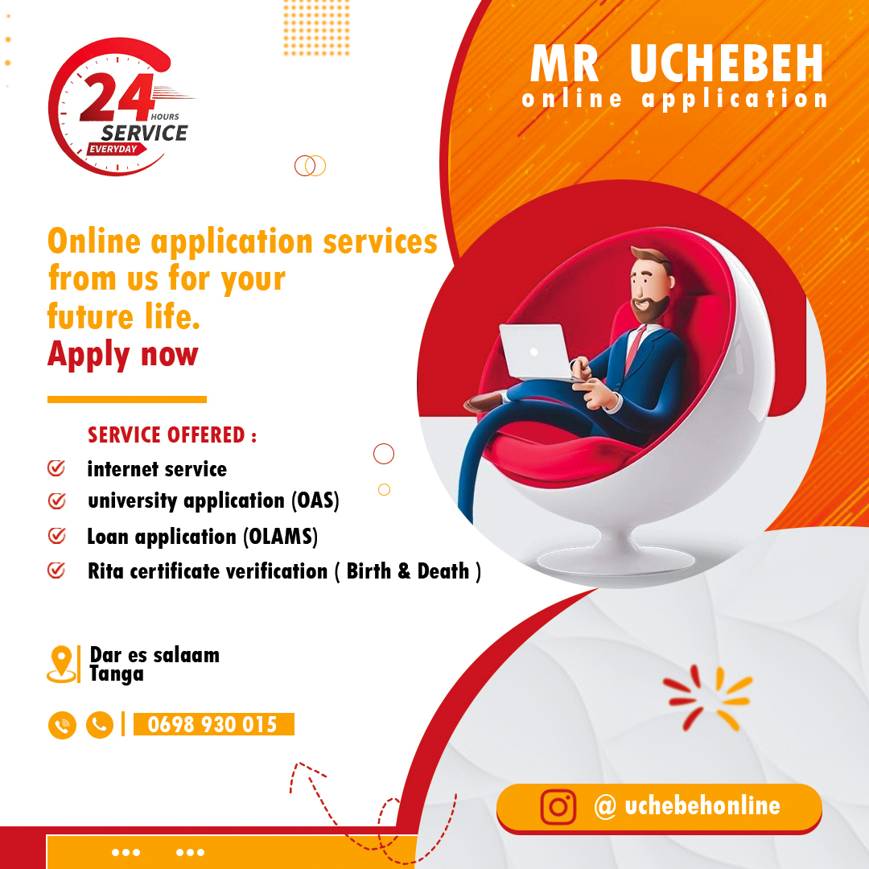
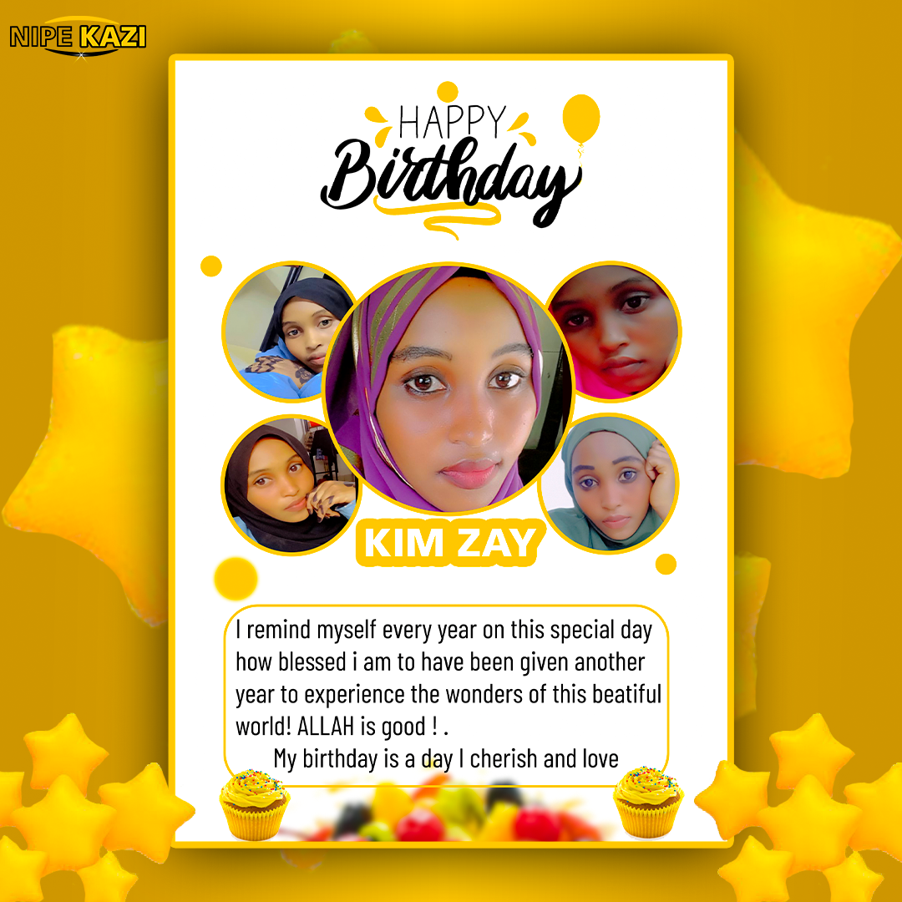
SELECTED WORK
07 — 08
bussiness 3
birthday
POSTER
POSTER
#
#

Slide 7


SELECTED WORK
09 — 10
bussiness 2
dawra poster
POSTER
ANNOUCEMENT
#
#

Slide 8


SELECTED WORK
11 — 12
brand
flayer2
LOGO
FLAYER
#
#

Slide 9

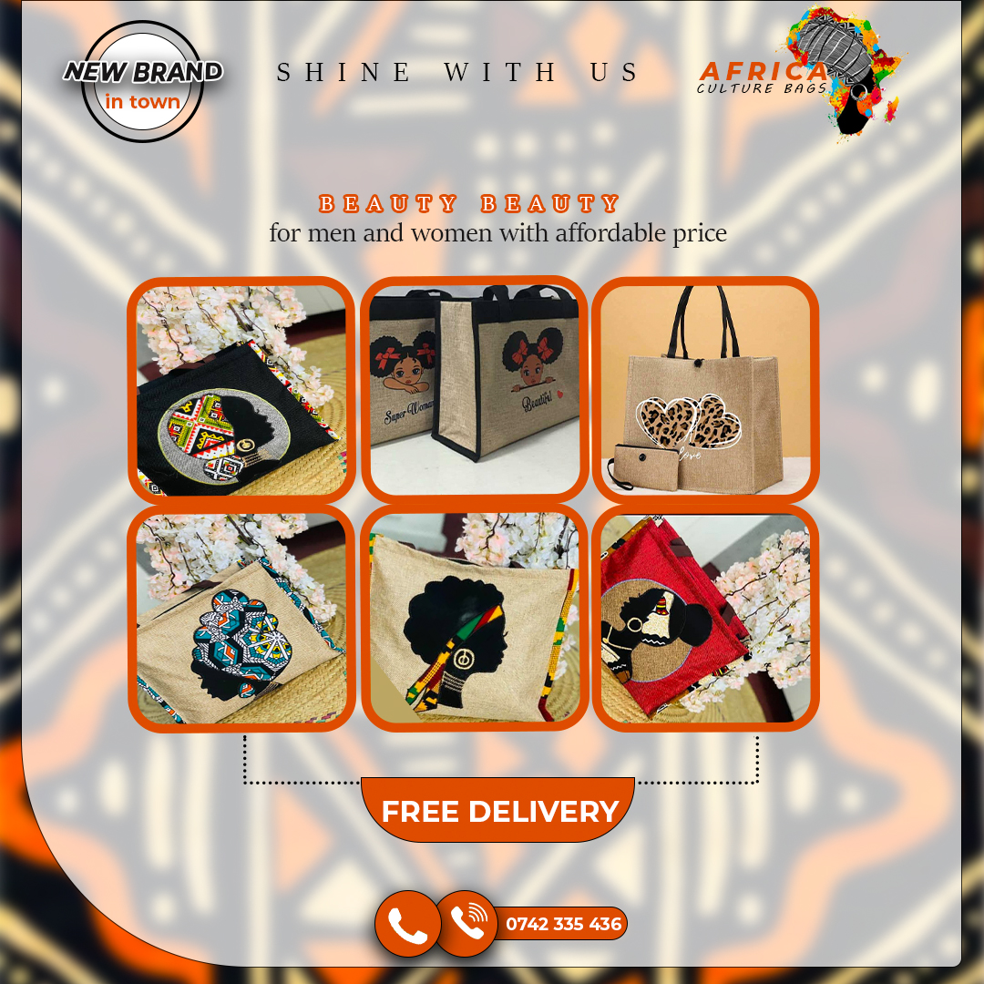
SELECTED WORK
13 — 14
flayer
bussiness
FLAYER DESIGN
POSTER
#
#

Slide 10

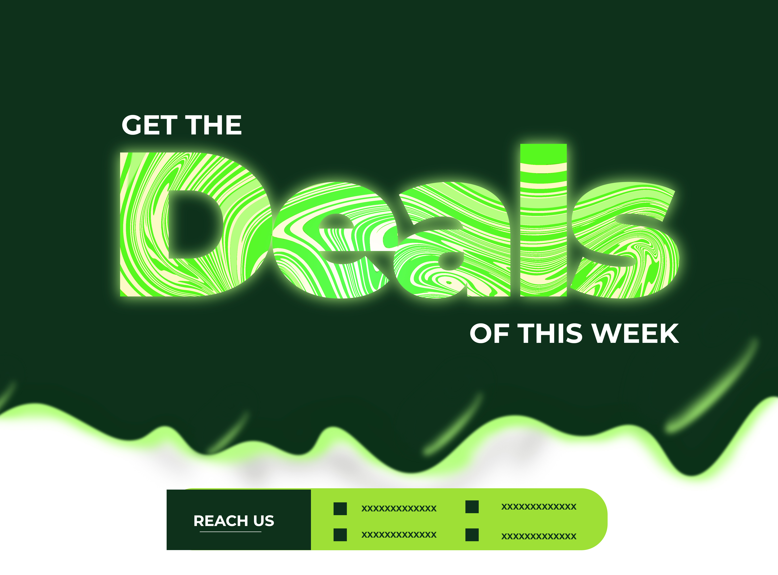
SELECTED WORK
15 — 16
branding 2
branding
POSTER
POSTER
#
#

Slide 11
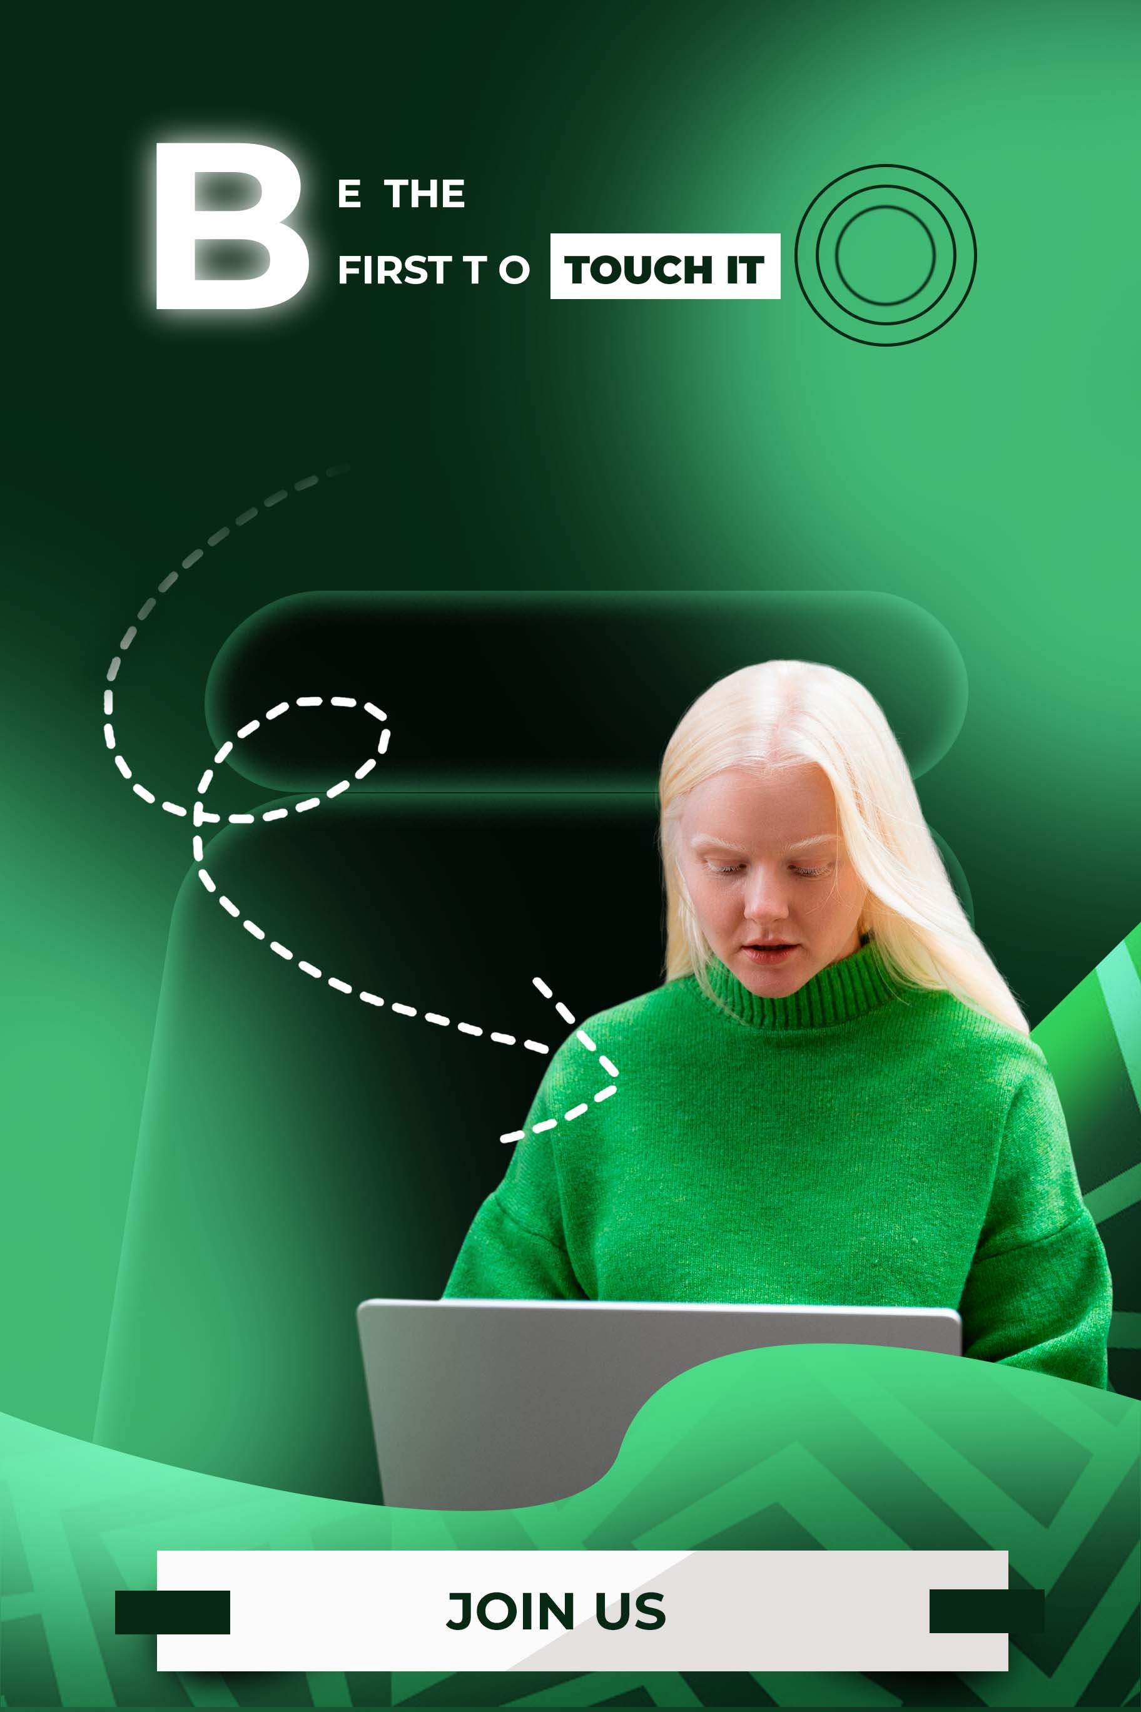
SELECTED WORK
17 — 17
brand 3
POSTER
#

Slide 12
LET'S WORK TOGETHER
For design enquiries and creative collaborations.
EMAIL
rashidhassanally0203@gmail.com
PHONE
+255 788 315 183
WHATSAPP
+255 616 741 032
THANK YOU

