Slide 1
পারমানবিক বিদ্যুৎ কেন্দ্রের চুল্লিতে ব্যবহৃত রক্ষন আবরণের কাঠামোগত বৈশিষ্ট সংক্রান্ত গণনামূলক গবেষণার জন্য কম্পিউটার ক্রয়
W. মোহাম্মাদ আবদুর রশিদ
সহকারী অধ্যাপক
পদার্থবিজ্ঞান বিভাগ
যশোর বিজ্ঞান ও প্রযুক্তি বিশ্ববিদ্যালয়

Slide 2
Uses of Computers
Education & Research
Communication
Business
Healthcare
Retail and Trade
Government
Marketing
Science
Publishing
Arts and Entertainment
Banking and Finance
Transport
Navigation
Working From Home
Military
Social
Booking Vacations
Security and Surveillance
Weather Forecasting
Robotics

Slide 3
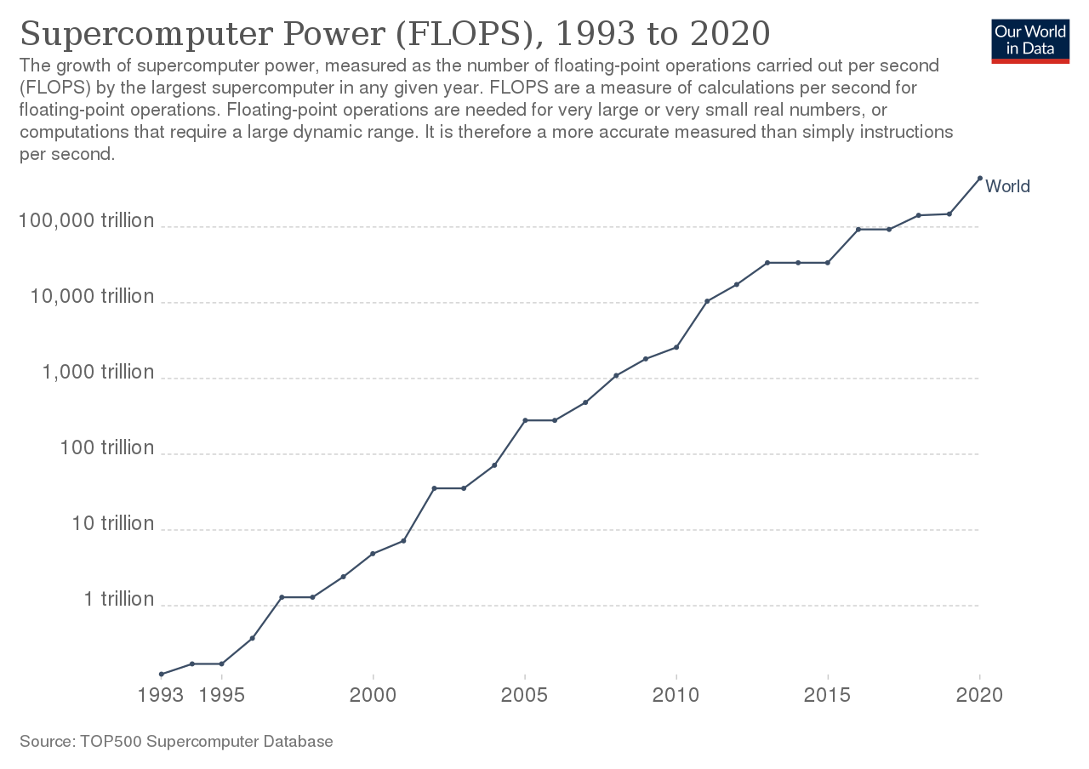

Slide 4
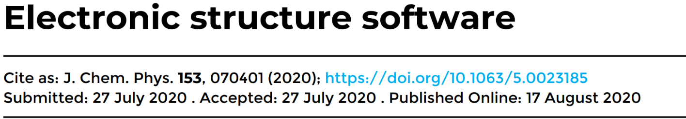
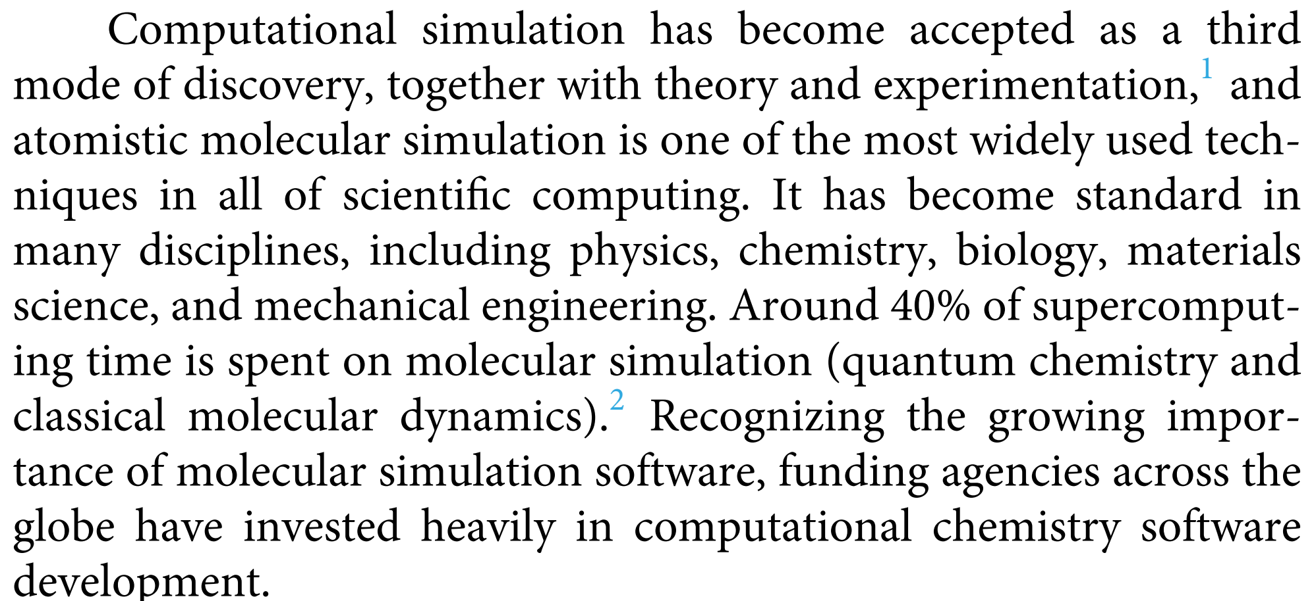

Slide 5
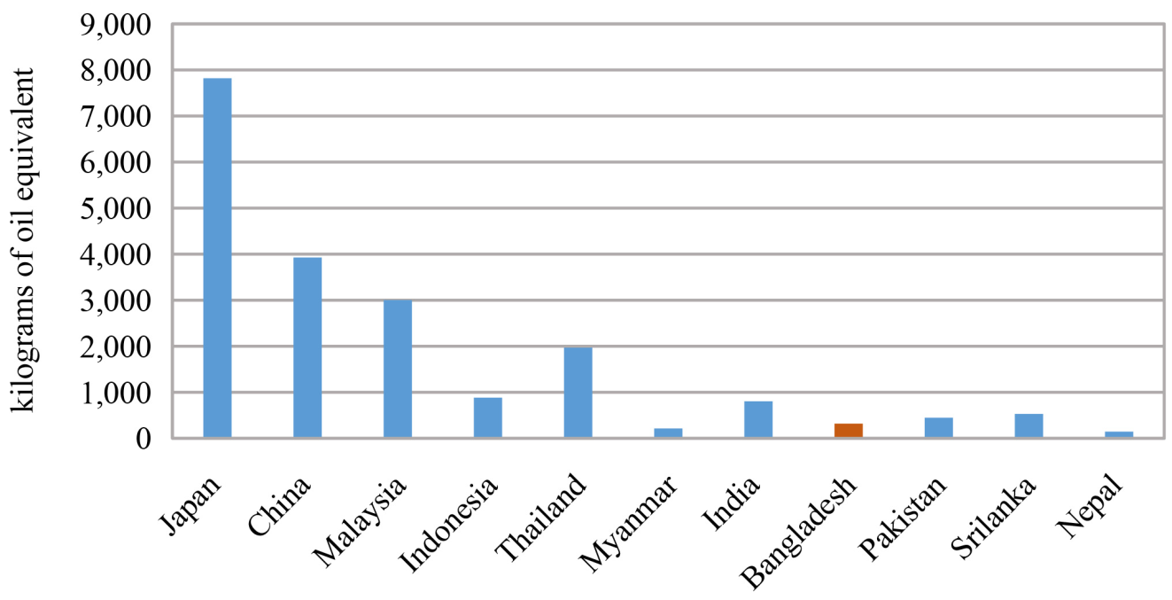
Energy consumption per capita
Energy consumption per capita in different countries of Asia.
The World Bank Energy Use Report 2014

Slide 6
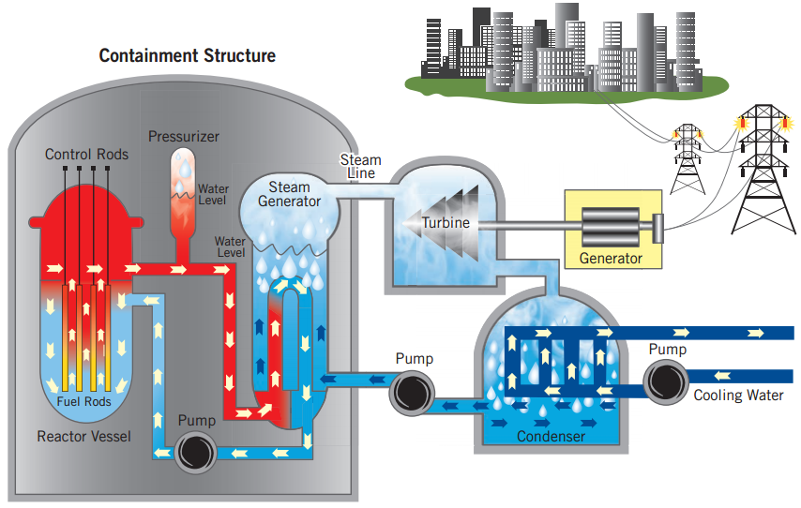
Nuclear technology & Bangladesh
American Nuclear Society

Slide 7
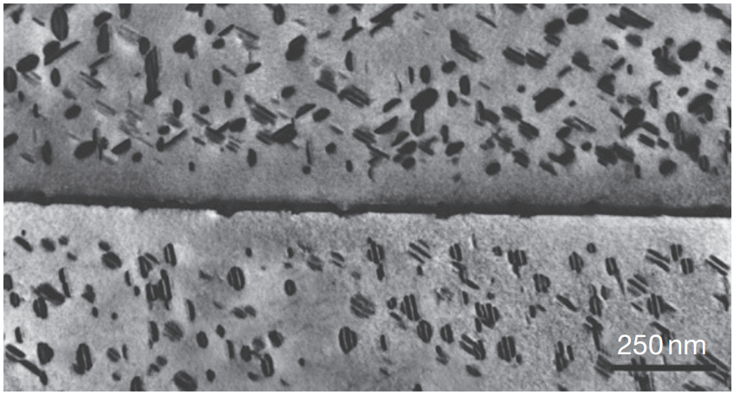
Radiation-induced precipitates
Rice et at., Nucl. Mater. 258–263, 1414–1419 (1998).

Slide 8
Goal of the project
Learn and teach the use of modern technology
Use ICT in research and education
Develop new ICT based methodology for research
Improve overall research quality of the department

Slide 9
Strategic Analysis
DFT is the most accurate theoretical tool to estimate any physical, chemical and mechanical properties.
Accuracy of DFT depends on the choice of exchange correlation function.
Theoretical results need to be verified by experiments.

Slide 10
Publication in 2023
A. Allen, Mohammad Abdur Rashid, P. Rahe, S. P. Jarvis, J. N. O'Shea, J. L. Dunn & P. Moriarty, “Self-assembly and tiling of a prochiral hydrogen-bonded network: bi-isonicotinic acid on coinage metal surfaces”, Molecular Physics, e2192824 (2023)
M. Naseri, D. R. Salahub, S. Amirian, H. Shahmohamadi, Mohammad Abdur Rashid, M. Faraji, N. Fatahi, “Multi-functional lead-free Ba₂XSbO₆ (X = Al, Ga) double perovskites with direct bandgaps for photocatalytic and thermoelectric applications: A first principles study”, Materials Today Communications 35, 105617 (2023)
S. Jaman, M. B. Asfia, Mohammad Abdur Rashid, “Band gap engineering and enhanced optoelectronic performance by varying dopant concentration in RbSr_{1-x}Sn_{x}Cl₃: Ab-inito study”, Physica B: Condensed Matter [under review] (2023)

Slide 11
Publication in 2022
M. B. Asfia and Mohammad Abdur Rashid, “First principles calculations of structural, electronic and optical properties of Sn-doped ZnS”, Physica B: Condensed Matter 646, 414335 (2022)
M. B. Asfia, S. Jaman and Mohammad Abdur Rashid, “Pressure induced band gap shifting from ultra-violet to visible region of RbSrCl₃ perovskite”, Materials Research Express 9, 095902 (2022)
M. Naseri, D. R. Salahub, S. Amirian and Mohammad Abdur Rashid, “Computational investigation of Ba₂ZrTiO₆ double perovskite for optoelectronic and thermoelectric applications”, Journal of Solid State Chemistry 314, 123385 (2022)
Mohammad Abdur Rashid, M. Saiduzzaman, A. Biswas and K. M. Hossain, “First-principles calculations to explore the metallic behavior of semiconducting lead-free halide perovskites RbSnX₃ (X = Cl, Br) under pressure”, European Physical Journal Plus 137, 649 (2022)
M. B. Asfia and Mohammad Abdur Rashid, “First-Principles Study of Half Metallic Ferromagnetic and Optical Properties of Nb Doped Cubic ZnS using TB-mBJ Approximation”, Dhaka University Journal of Science 69(3), 194-201 (2022)

Slide 12
Estimated Budget (BDT): 2,500,000.00
No. | Item description | Quantity | Estimated unit price (BDT) | Total estimated cost (BDT)
1 | High Performance Computer (HPC) with 64 threads and 128 GB RAM for DFT simulation | 1 | 800,000.00 | 800,000.00
2 | High Performance Computer (HPC) with 20 threads and 16 GB RAM for DFT simulation | 5 | 250,000.00 | 1,250,000.00
3 | Industrial grade online UPS (4 kVA) with 2 hours backup | 1 | 300,000.00 | 300,000.00
4 | DFT simulation software (WIEN2k) | 1 | 70,000.00 | 70,000.00
5 | Workshop | 3 | 20,000.00 | 60,000.00
6 | Stationary, Transport, etc |  |  | 20,000.00
Total | Total |  |  | 2,500,000.00

Slide 13


