Slide 1
Project title: Theoretical study of radiation induced damage in the microstructure of shielding materials
Dr. Mohammad Abdur Rashid
Assistant Professor
Department of Physics

Slide 2
Outline
Nuclear technology
Research scope
Our Proposal
Advantage & disadvantage
Estimated cost

Slide 3
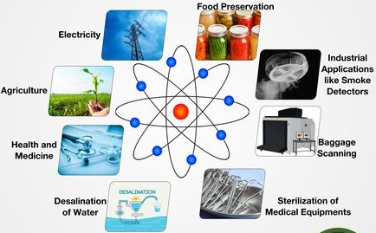
Application of Nuclear
technology
#NuclearFacts

Slide 4
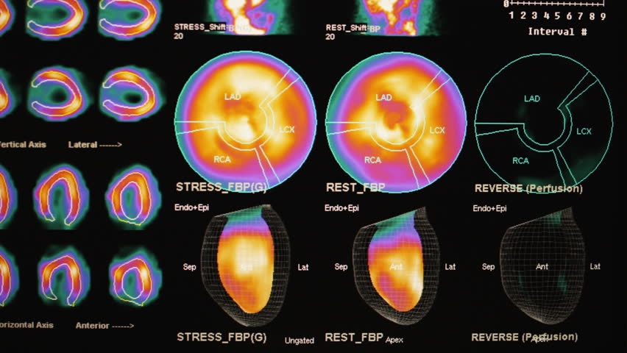
Nuclear technology & Bangladesh

Slide 5
Nuclear technology & Bangladesh
New varieties of rice through mutation breeding
Increased crops production three-fold in the last few decades
Enabled us to achieve food security and improved nutrition

Slide 6
Nuclear technology & Bangladesh
New varieties of rice produced through mutation breeding have increased crops three-fold in the last few decades. During a period of rapid population growth, the use of nuclear techniques has enabled Bangladesh and large parts of Asia in general, to achieve food security and improved nutrition.

Slide 7
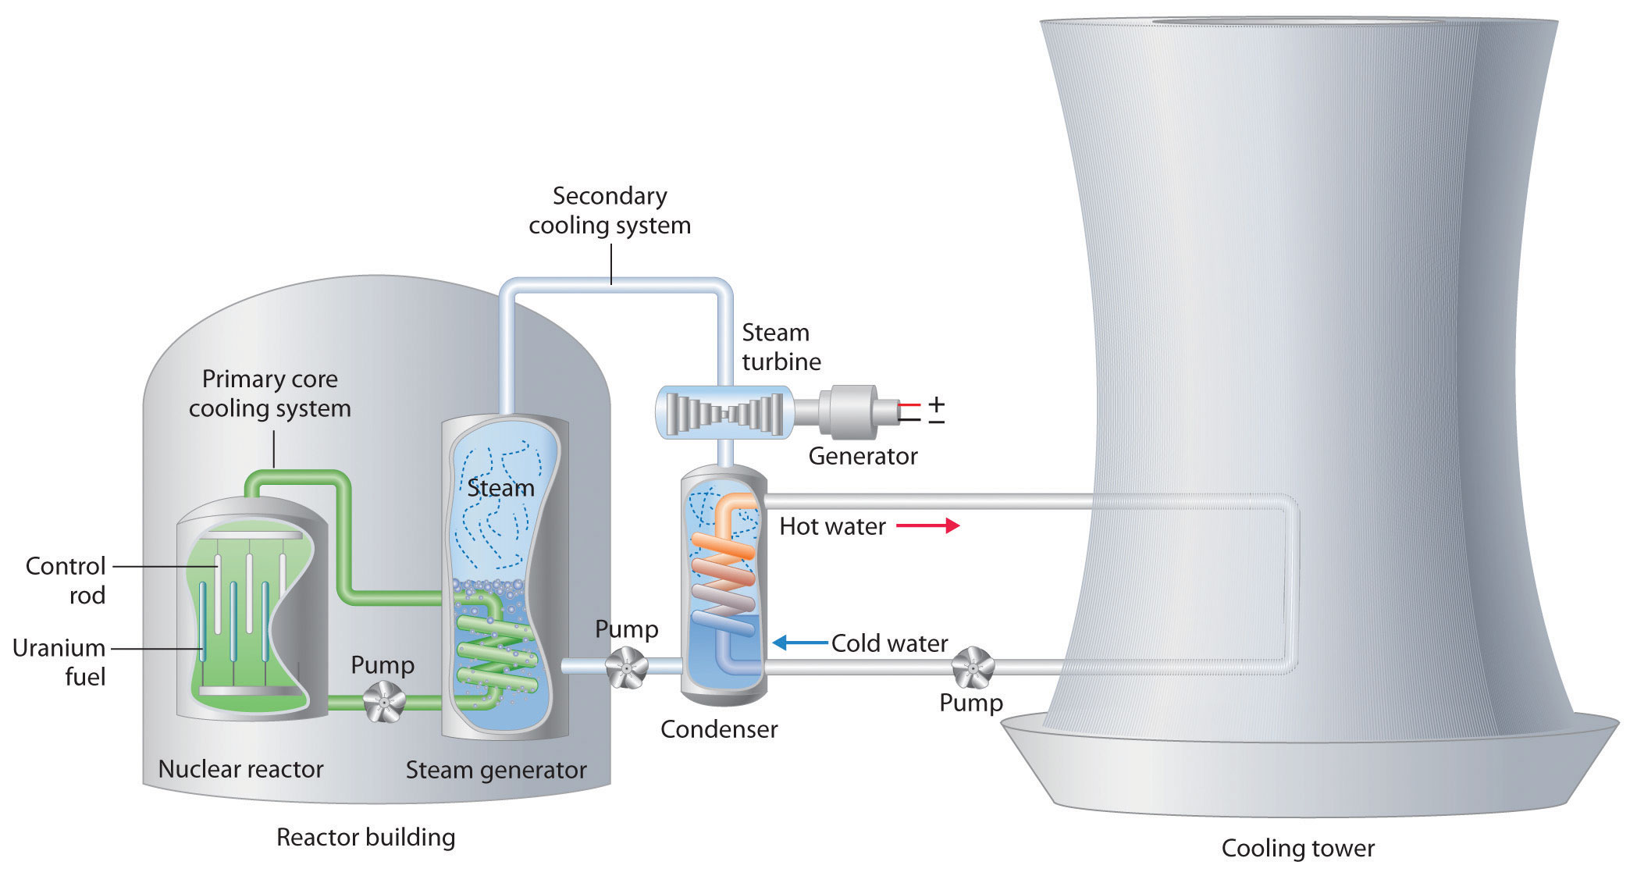
Nuclear technology & Bangladesh
saylordotorg.github.io

Slide 8
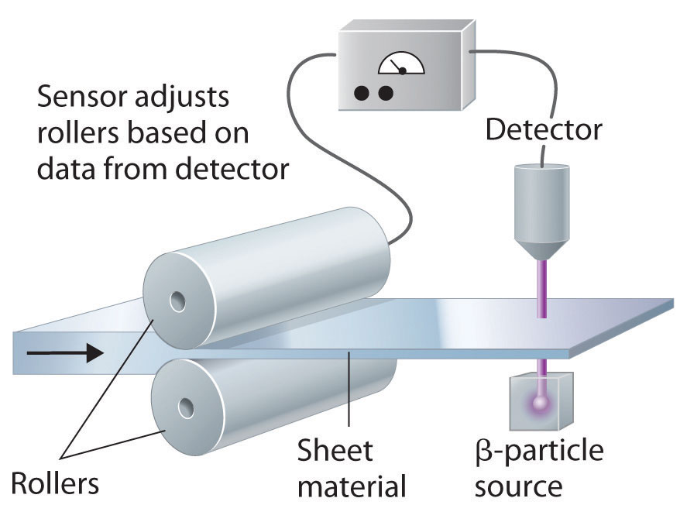
Nuclear
technology
in industry
saylordotorg.github.io

Slide 9
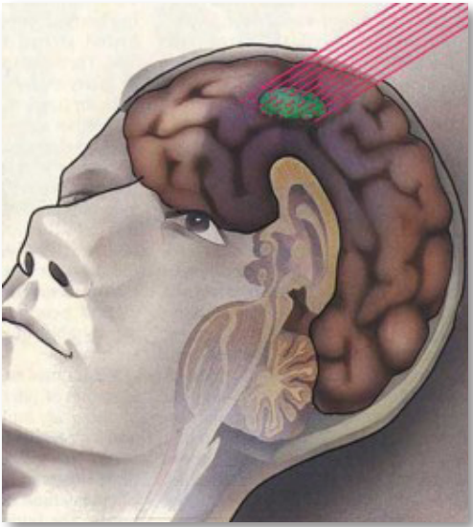
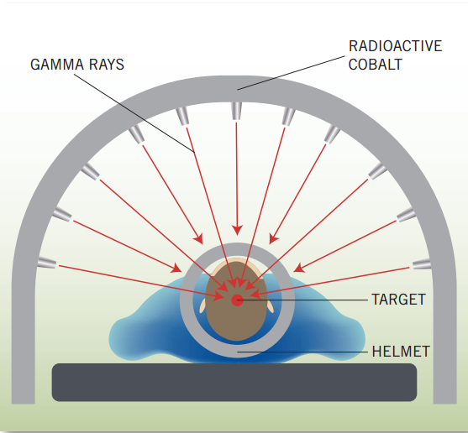
Nuclear technology in medicine
American Nuclear Society

Slide 10
Today, about one-third of all procedures used in modern hospitals involve radiation or radioactivity.
American Nuclear Society

Slide 11
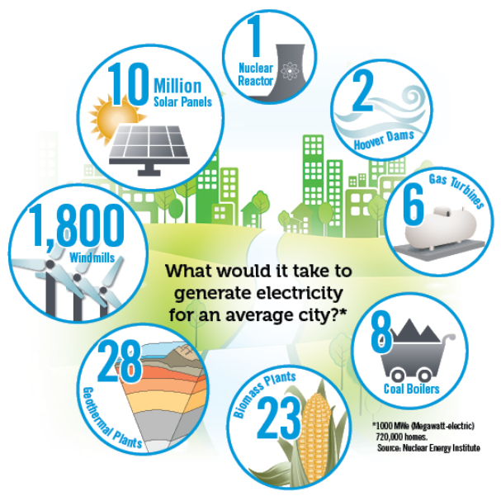
Comparison of nuclear reactor
American Nuclear Society

Slide 12
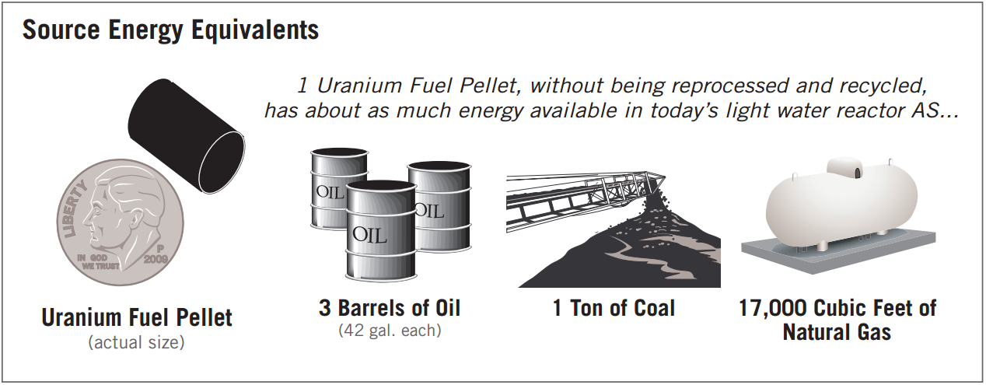
American Nuclear Society

Slide 13
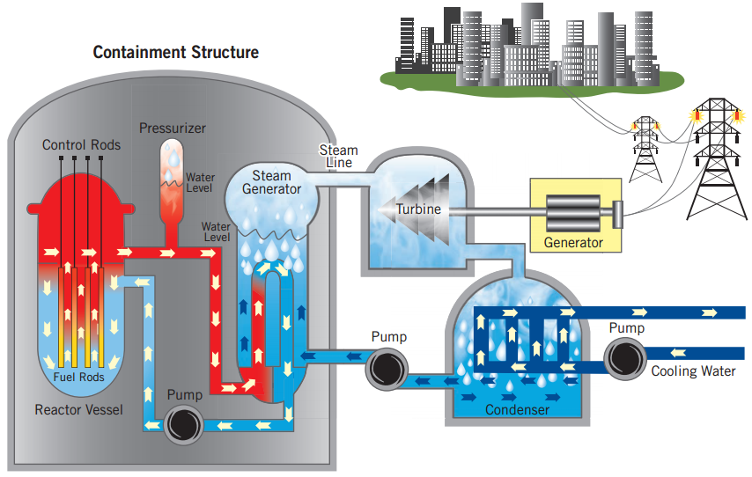
Research
scope
American Nuclear Society

Slide 14
Research scope
designing new reactors
adding new safety features
radiation induced damage in materials
designing fuel elements
radioactive waste management

Slide 15
Research scope
designing new reactors
adding new safety features
radiation induced damage in materials
designing fuel elements
radioactive waste management

Slide 16
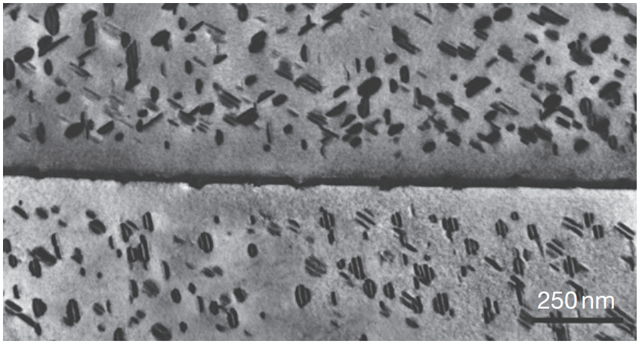
Radiation-induced precipitates on {001} habit planes observed next to a grain boundary in V–4Cr–4Ti following neutron irradiation
Rice et at., Nucl. Mater. 258–263, 1414–1419 (1998).

Slide 17
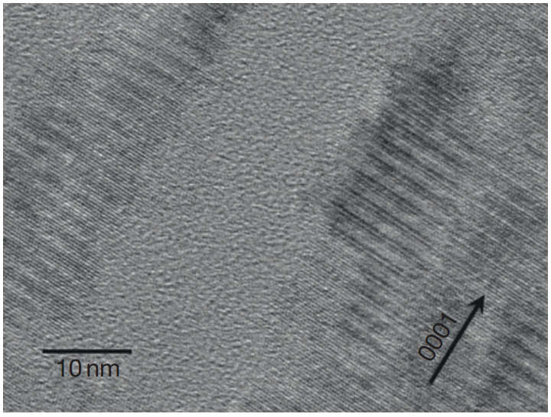
High-resolution TEM image of single crystal 6H–SiC following 0.56MeV Si ion irradiation
Snead et al., J. Nucl. Instrum. Methods B, 141, 123–132 (1998).

Slide 18
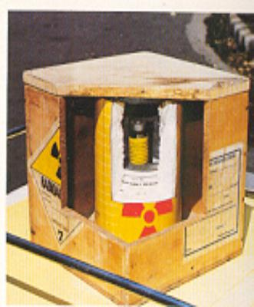
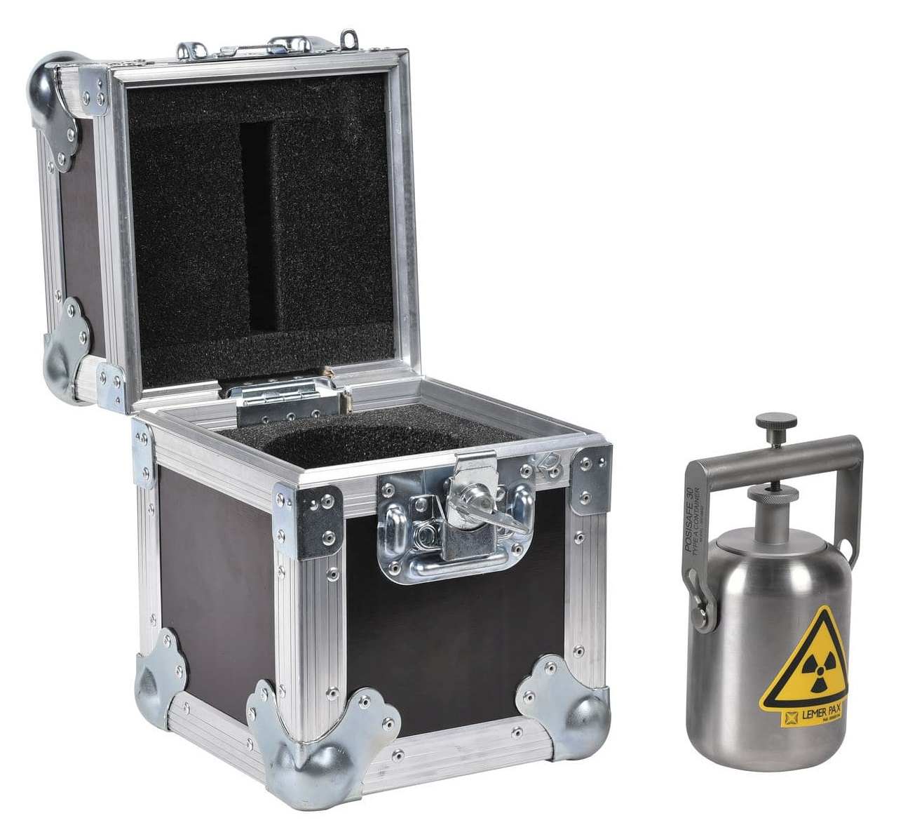
Shielding radioactive materials

Slide 19
Nuclear shielding material
Lead (Pb) is widely used as an effective shielding material because of its high density, abundance and low cost.
However, none chemical stability, toxicity, weak mechanical strength and heavy weight of Pb make it less reliable.

Slide 20
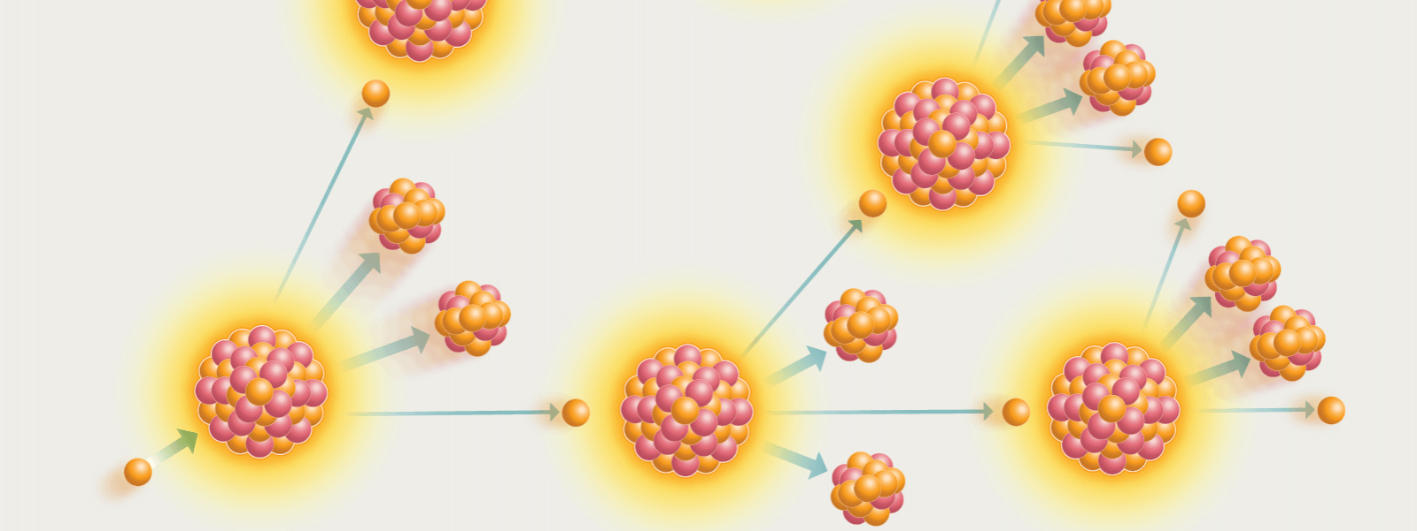
Nuclear reaction in reactor

Slide 21
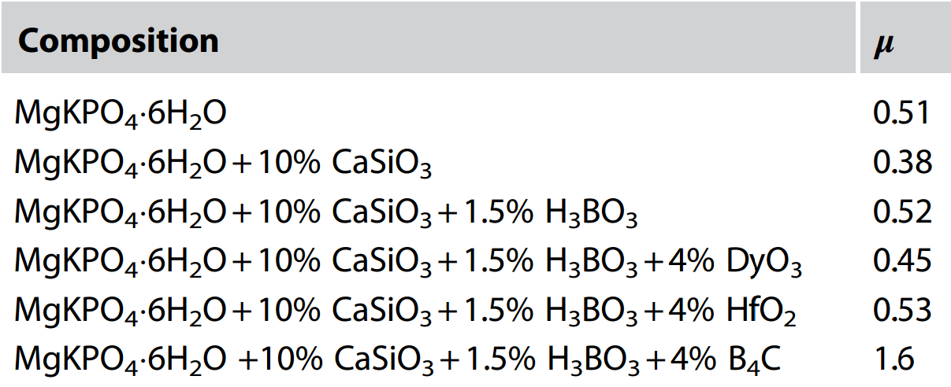
Neutron absorption coefficients (μ) of ceramicrete samples

Slide 22
Proposed samples
CaSi₂+B₄C
CaB₆ +B₄C
Material | Density (g/cm³)
CaSi₂ | 2.50
CaB₆ | 2.45

Slide 23
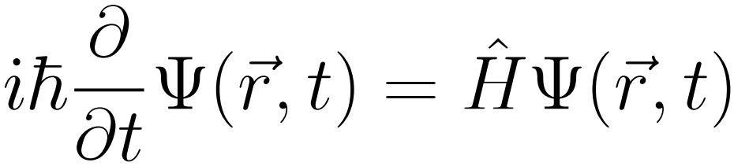
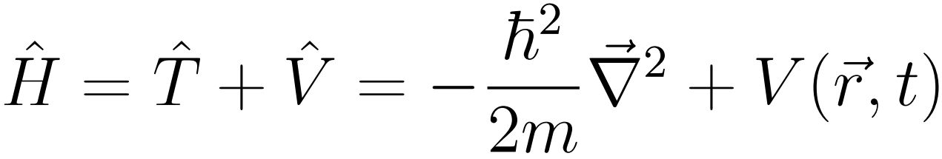
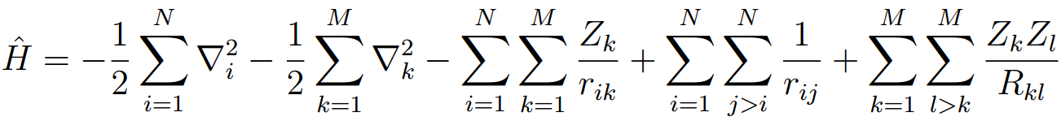
Quantum mechanics
For a single particle:
For a system of molecules:

Slide 24
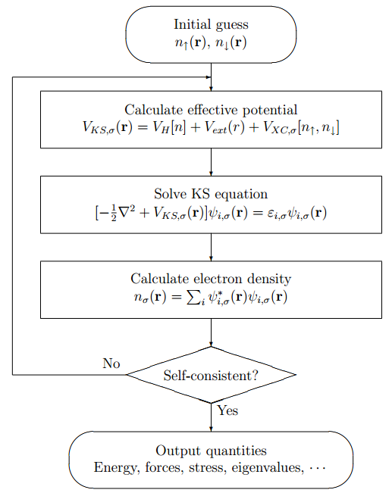
Density functional theory (DFT)

Slide 25
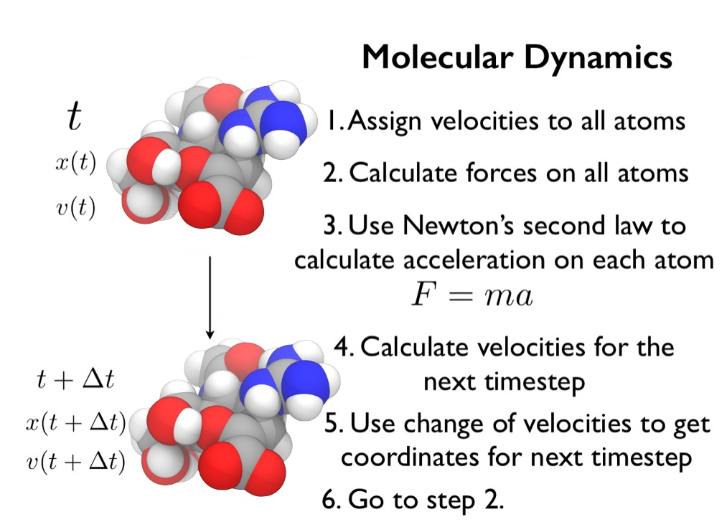
chryswoods.com

Slide 26
Work Plane
Study theoretically the radiation induced defect of the proposed material by MD and DFT simulation.
By changing the concentration of boron find an optimal concentration of boron in the material which will best serve the shielding.

Slide 27
Work Plane
We aim to study systematically the shielding ability and physical stability of the proposed boron enhanced materials. For this at first, we shall study theoretically the radiation induced defect of the proposed material by MD and DFT simulation. Then, by changing the concentration of boron in the material we shall investigate to find an optimal concentration of boron in the material which will best serve the shielding.

Slide 28
Strategic Analysis
DFT is the most accurate theoretical tool to estimate any physical, chemical and mechanical properties.
Accuracy of DFT depends on the choice of exchange correlation function.
Theoretical results need to be verified by experiments.

Slide 29
Strategic Analysis
DFT is supposed to be the most accurate theoretical tool to estimate any physical, chemical and mechanical property for a material. However, because of not knowing the exact formalism of exchange correlation function approximations are made which may reduce the accuracy of the calculations in some extend. To overcome this limitation, theoretical results need to be verified by experiments.

Slide 30
Category wise break down of the cost
Item type | Cost (BDT)
DFT simulation software (WIEN2k) | 60,000.00
Stationery, necessary books, furniture, etc | 40,000.00
PC to prepare and test files for DFT simulation | 150,000.00
HPC (high performance computers) for DFT simulation | 600,000.00
IPS 3000 VA (control unit, battery, service, total setup) | 100,000.00
Publication cost | 50,000.00
Total | 1,000,000.00

Slide 31
Thank You

