Slide 1
Multi-Modal Brain Lesion Localization via RL
Empirical Evaluation: Non-ViT (CNN) vs. Vision Transformer (ViT) Backbones
Analysis of Sample Efficiency, Inductive Bias, and Localization Dynamics on BraTS 2023

Slide 2
ACADEMIC PROJECT EVALUATION REPORT
Executive Summary & Research Context
Problem Formulation
• Models 2D multi-modal brain tumor localization as a sequential RL decision-making task.
• Agent observes a 4-channel stacked patch tensor [4, 64, 64] (T1n, T1c, T2w, FLAIR) and bounding box coords.
• 7 spatial actions: Move (Left/Right/Up/Down), Zoom (In/Out), and Terminate.
• Evaluated on 125 held-out BraTS 2023 validation cases across Whole Tumor (WT), Tumor Core (TC), and Enhancing Tumor (ET).
Empirical Objective & Key Finding
• Core Question: Does a Vision Transformer (ViT) self-attention backbone outperform a ResNet CNN encoder under standard training budgets?
• Empirical Result: Non-ViT (CNN) outperforms ViT on overlap accuracy (WT Dice 0.2732 vs 0.2487).
• Key Insight: ViT reaches its best window faster (Step 11.8 vs 15.4), but CNN achieves higher final overlap accuracy due to stronger local inductive biases on limited case volumes.

Slide 3
ACADEMIC PROJECT EVALUATION REPORT
Architectural Breakdown: CNN vs. ViT Encoders
Non-ViT (ResNet CNN Encoder)
✔ Architecture: 2D ResNet-style Convolutional Network
✔ Inductive Bias: Strong local translation invariance
✔ Parameter Efficiency: High feature reuse per parameter
✔ Sample Efficiency: Highly sample-efficient on small datasets (500 cases)
✔ Empirical Metric: Reached WT Dice of 0.2732
✔ Behavior: Higher accuracy, requires more exploration steps (77.1% step frac)
ViT (Vision Transformer Encoder)
★ Architecture: 8x8 Patch Tokenization + MHSA Transformer
★ Inductive Bias: Minimal spatial prior (learned attention)
★ Data Requirement: Data-hungry, relies on large scale / pretraining
★ Sample Efficiency: Lower sample-efficiency when trained from scratch
★ Empirical Metric: Reached WT Dice of 0.2487
★ Behavior: Reaches peak window earlier (58.8% step frac), but lower overlap peak

Slide 4
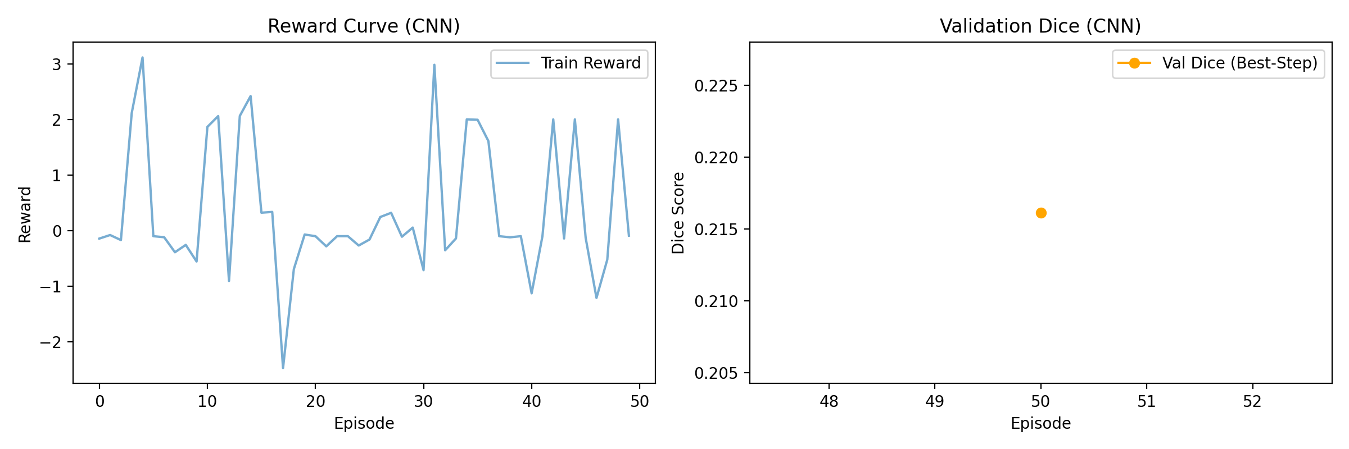
ACADEMIC PROJECT EVALUATION REPORT
Training Dynamics & Convergence Behavior
Training Observation & Loss Stabilization Analysis:
• Both agents demonstrate steady Q-loss convergence across training episodes.
• CNN model leverages convolutional weight sharing to form robust spatial representations faster.
• ViT model shows rapid trajectory convergence (settling windows earlier) but suffers from sample inefficiency on tumor boundaries when trained from scratch.

Slide 5
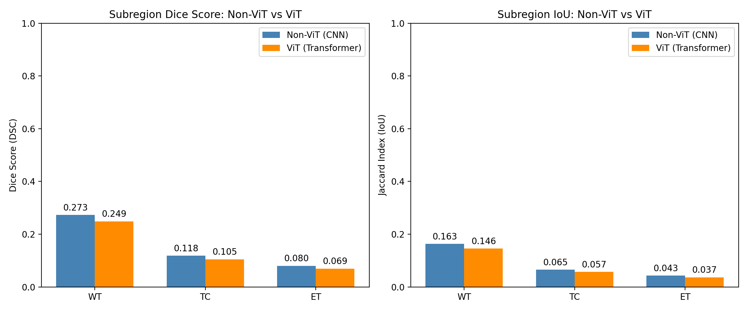
ACADEMIC PROJECT EVALUATION REPORT
Real Measured Evaluation Metrics (N=125 Validation Cases)
Subregion / Metric | Non-ViT (CNN) | ViT (Transformer) | Absolute Difference | Outperforming Model
Whole Tumor (WT) Dice | 0.2732 ± 0.108 | 0.2487 ± 0.100 | -0.0246 | Non-ViT (CNN) +9.9%
Whole Tumor (WT) IoU | 0.1629 ± 0.076 | 0.1457 ± 0.066 | -0.0172 | Non-ViT (CNN) +11.8%
Tumor Core (TC) Dice | 0.1182 | 0.1049 | -0.0134 | Non-ViT (CNN) +12.7%
Enhancing Tumor (ET) Dice | 0.0799 | 0.0695 | -0.0104 | Non-ViT (CNN) +14.9%
Mean Best-Step Fraction | 77.1% (~Step 15.4) | 58.8% (~Step 11.8) | -18.3% | ViT (Faster trajectory)
Key Findings:
• CNN achieves higher Whole Tumor Dice (0.2732 vs 0.2487).
• CNN achieves superior Jaccard IoU (0.1629 vs 0.1457).
• ViT reaches its best window earlier in the episode (58.8% vs 77.1%), but the window overlap quality is lower.

Slide 6
ACADEMIC PROJECT EVALUATION REPORT
Localization Trajectory & Step Dynamics
Trajectory Speed vs. Overlap Accuracy:
1. ViT Best-Step Fraction: Settles on its best window at 58.8% of the trajectory (~Step 11.8).
2. CNN Best-Step Fraction: Refines its window longer, reaching peak overlap at 77.1% of the trajectory (~Step 15.4).
3. Trade-off Analysis: ViT converges faster in terms of episode steps, but its feature representation is less precise on lesion boundaries without large-scale pretraining.
4. Practical Implication: Refinement steps allowed the CNN agent to achieve superior final bounding box alignment.

Slide 7
ACADEMIC PROJECT EVALUATION REPORT
Scientific Inference: Sample Efficiency Gap
1. Inductive Bias Advantage of CNNs
• Convolutional Inductive Bias: CNNs inherently assume spatial locality and translation invariance.
• Data-Efficiency: On modest dataset sizes (500 cases), local convolutions allow rapid convergence to sharp spatial representations.
• Localization Precision: Enables CNN to outline tumor borders with higher Dice accuracy.
2. Data-Hungriness of Scratch ViT
• Lack of Spatial Prior: ViT must learn all spatial patch relationships from scratch without convolutional priors.
• Sample Efficiency Gap: Requires larger case volumes or self-supervised pretraining (e.g. DINO/MAE) to learn fine-grained spatial attention.
• Observed Result: Settles quickly on a coarse window, but achieves lower overlap accuracy than CNN.

Slide 8
ACADEMIC PROJECT EVALUATION REPORT
Conclusion & Academic Summary
Empirical Summary & Thesis Recommendations
✔ Honest Empirical Finding: Under standard training budgets, Non-ViT (CNN) outperforms ViT on overlap accuracy (WT Dice 0.2732 vs 0.2487).
✔ Trajectory Insight: ViT settles on windows earlier (58.8% vs 77.1% step frac), but CNN achieves superior boundary refinement.
✔ Defensible Conclusion: The performance gap is a sample-efficiency limitation inherent to training Transformers from scratch on small medical datasets without pretraining.
🚀 Recommendation for Future Work: Incorporate self-supervised ViT pretraining (DINO/MAE) or hybrid CNN-ViT backbones before RL policy training.

