Slide 1
Form Validation in JavaScript
Form Validation in JavaScript

Slide 2
What is Form Validation?
Form validation ensures that:
Inputs are not empty
Data is correct
Format is valid
📌 Example:
Email must contain @
Password must be at least 6 characters

Slide 3
Types of Validation
Client-side (JavaScript / jQuery)
Server-side (backend)

Slide 4
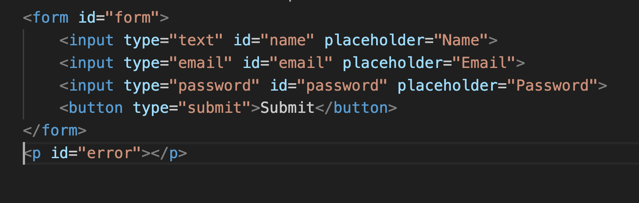
Basic HTML form

Slide 5
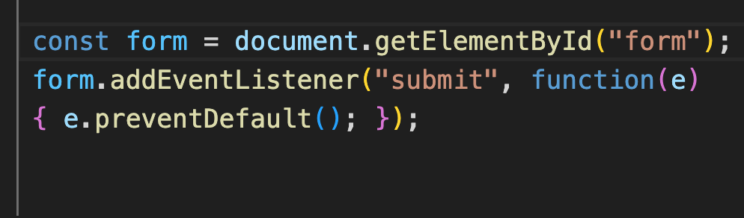
Validation WITHOUT jQuery
Step 1: Prevent Default

Slide 6
Get Input Values
const name = document.getElementById("name").value.trim();
const email = document.getElementById("email").value.trim();
const password =document.getElementById("password").value.trim();

Slide 7
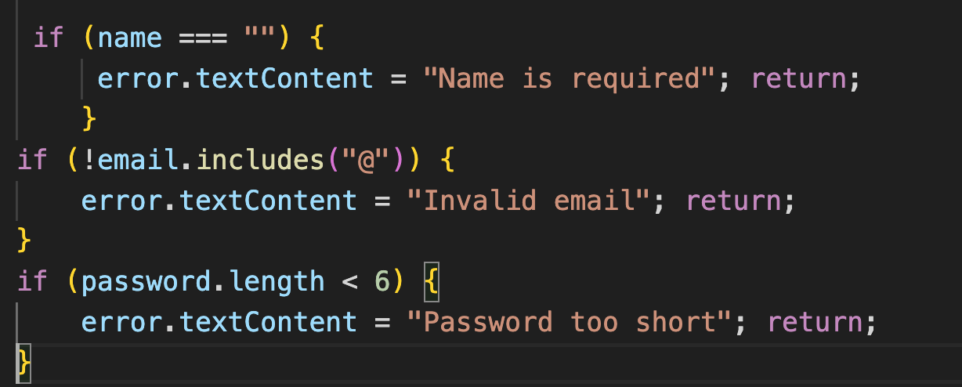
Validation Logic

Slide 8
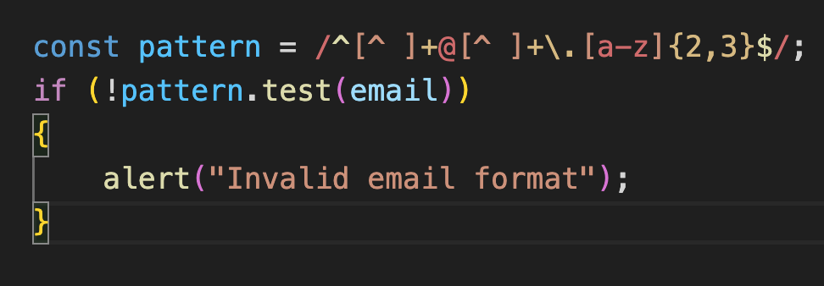
Better Email (Regex)

Slide 9
Validation WITH jQuery
Why jQuery?
Less code
Easier to read
Faster development

Slide 10
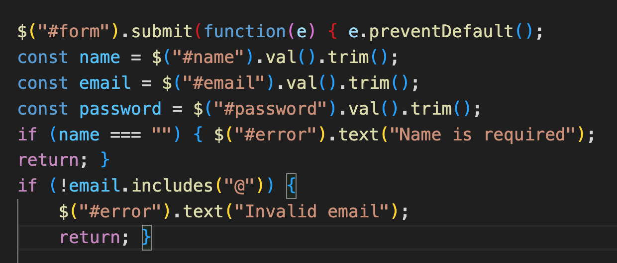
jQuery Validation Code

Slide 11
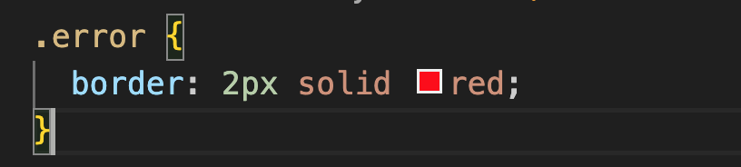
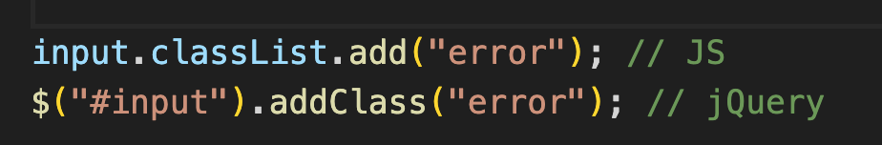
UI Feedback (Both)

Slide 12
Best Practices
Use .trim()
Show clear error messages
Validate step by step
Avoid only using alerts

