Slide 1
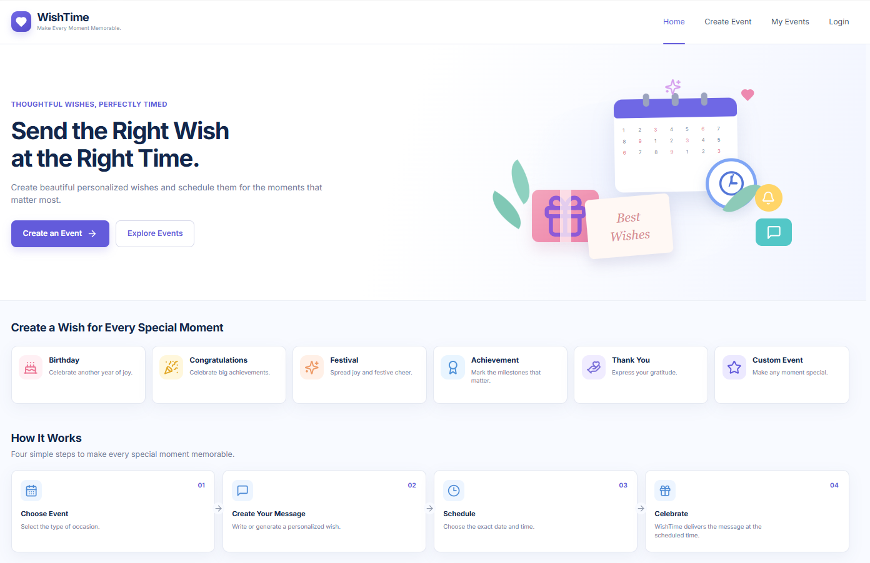
WishTime
Send the Right Wish at the Right Time.
A web app to create, personalize and schedule email wishes for birthdays, festivals, achievements and more.
Project Presentation

Slide 2
What WishTime Does
Everything needed to plan a wish once and let it deliver itself
6 event types
Rich-text messages
Smart scheduling
Birthday, Congratulations, Festival, Achievement, Thank You, Custom
Format your wish and see a live card preview as you type
Pick date, time and time zone (default: India Standard Time)
Automatic delivery
Secure accounts
Event dashboard
Wishes are emailed to the recipient at the scheduled moment
Email sign-up / login with Google sign-in option
Track Upcoming, Scheduled, Sent and Draft; search, edit, delete
How it works
1 Choose event
2 Write message
3 Schedule
4 Celebrate

Slide 3
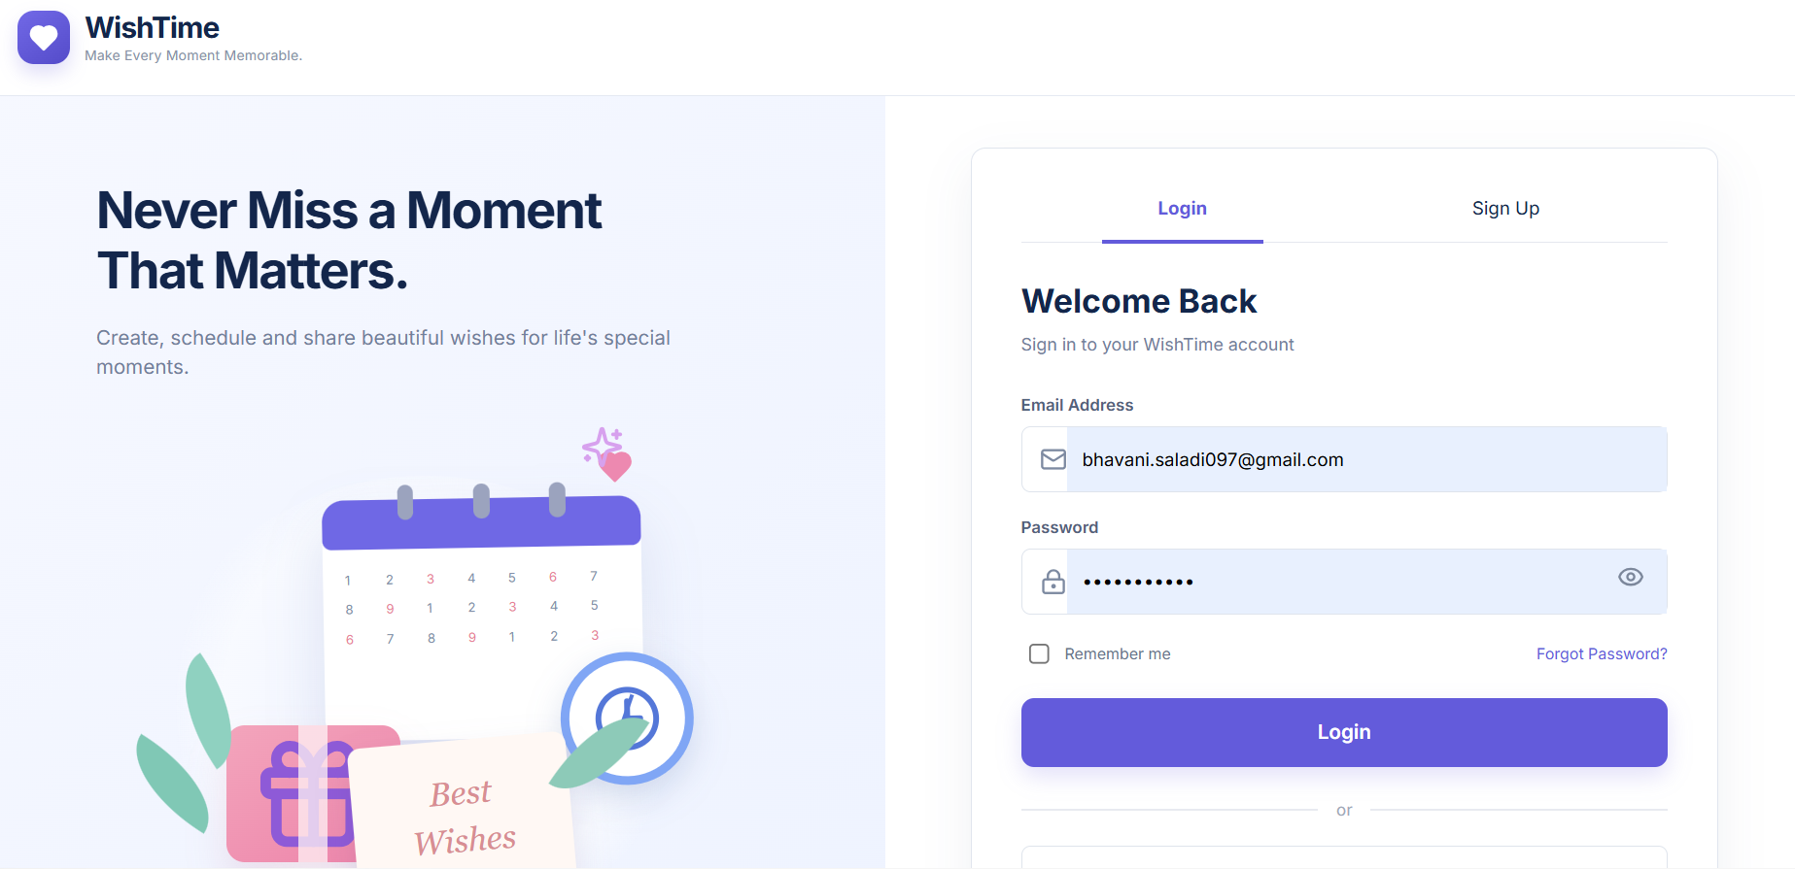
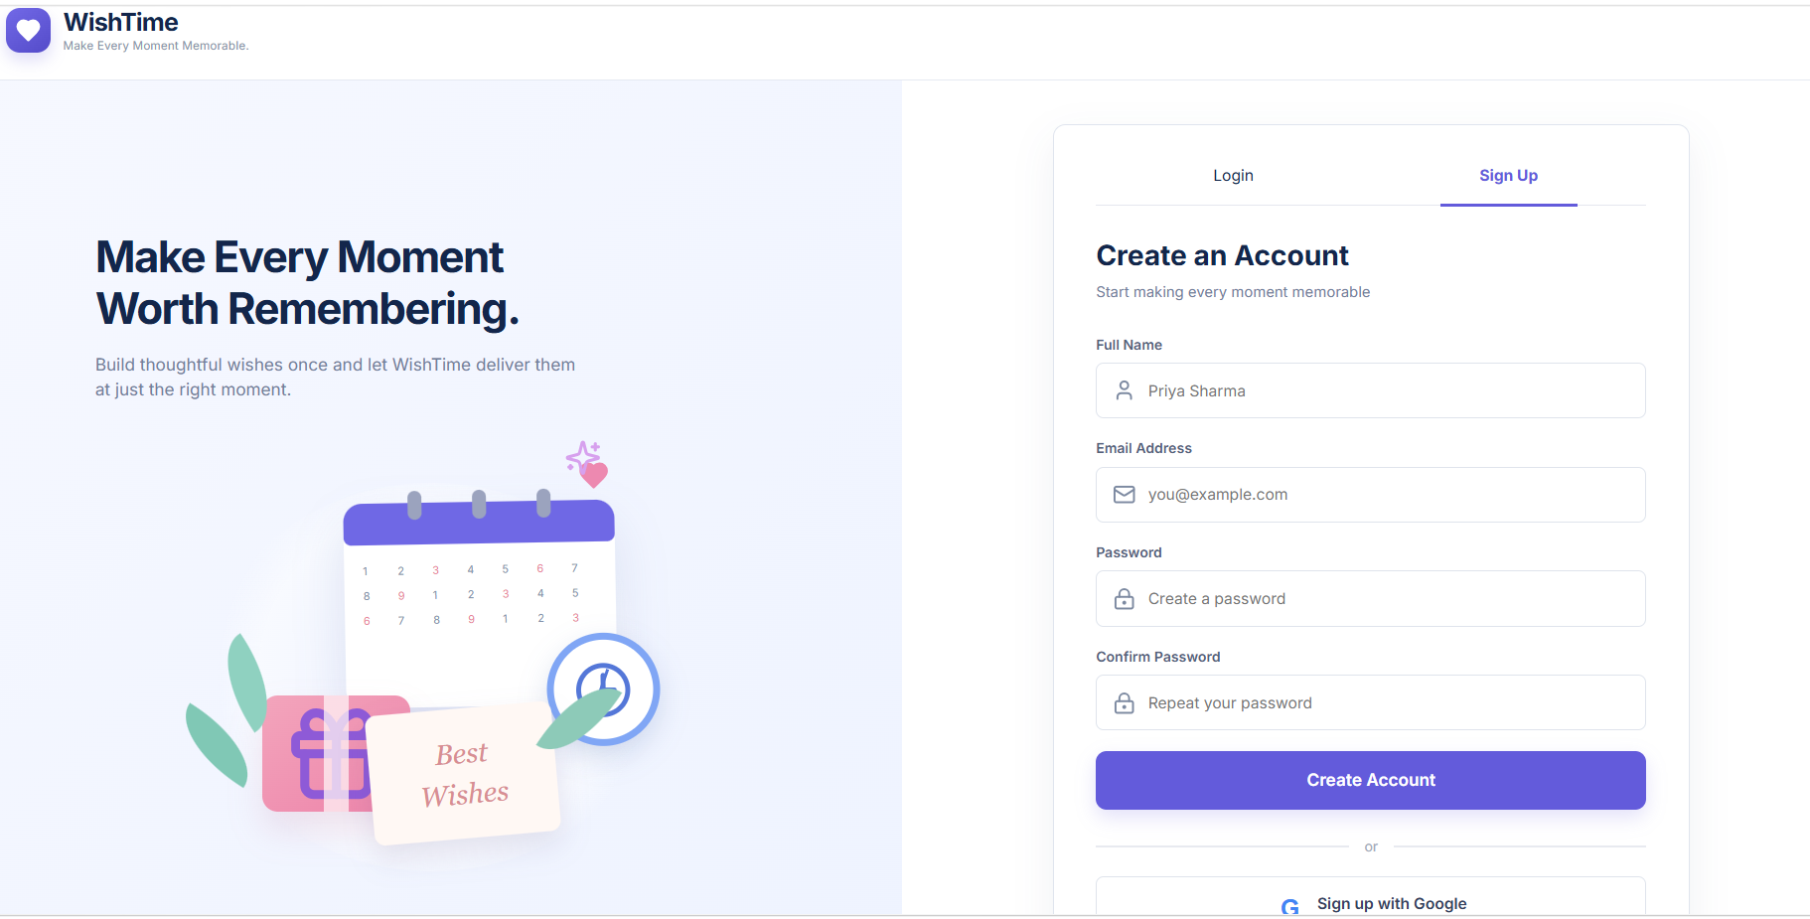
Secure Login & Sign Up
Clean two-tab authentication screen
Login
Sign Up
Email and password with show/hide toggle, remember me, forgot password
Sign up with full name, email and confirm password
Google sign-in available on both tabs

Slide 4
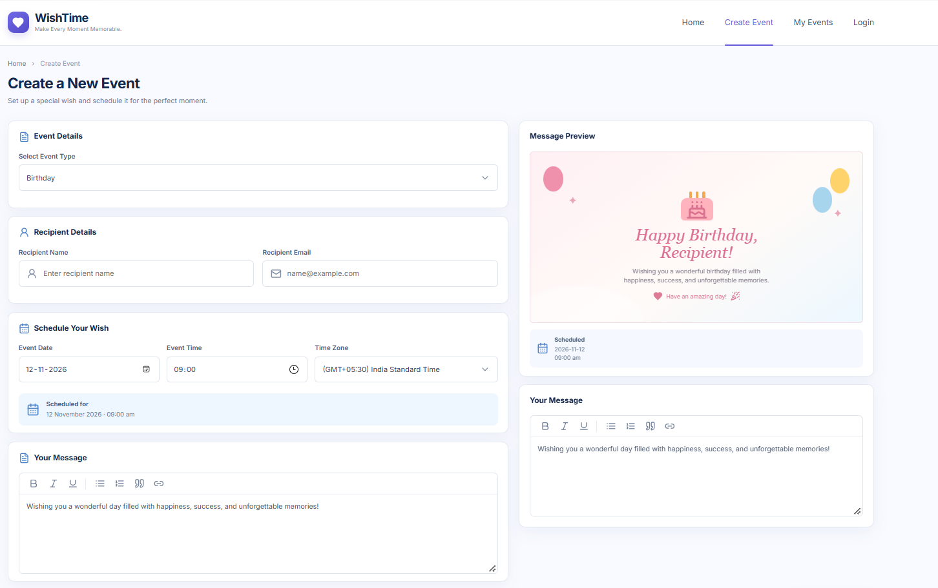
Create an Event
Set up a wish and schedule it in one screen
Select event type from a dropdown
Enter recipient name and email
Choose date, time and time zone; a summary confirms the schedule
Write the message in a rich-text editor
Live preview card updates with the event type and message

Slide 5
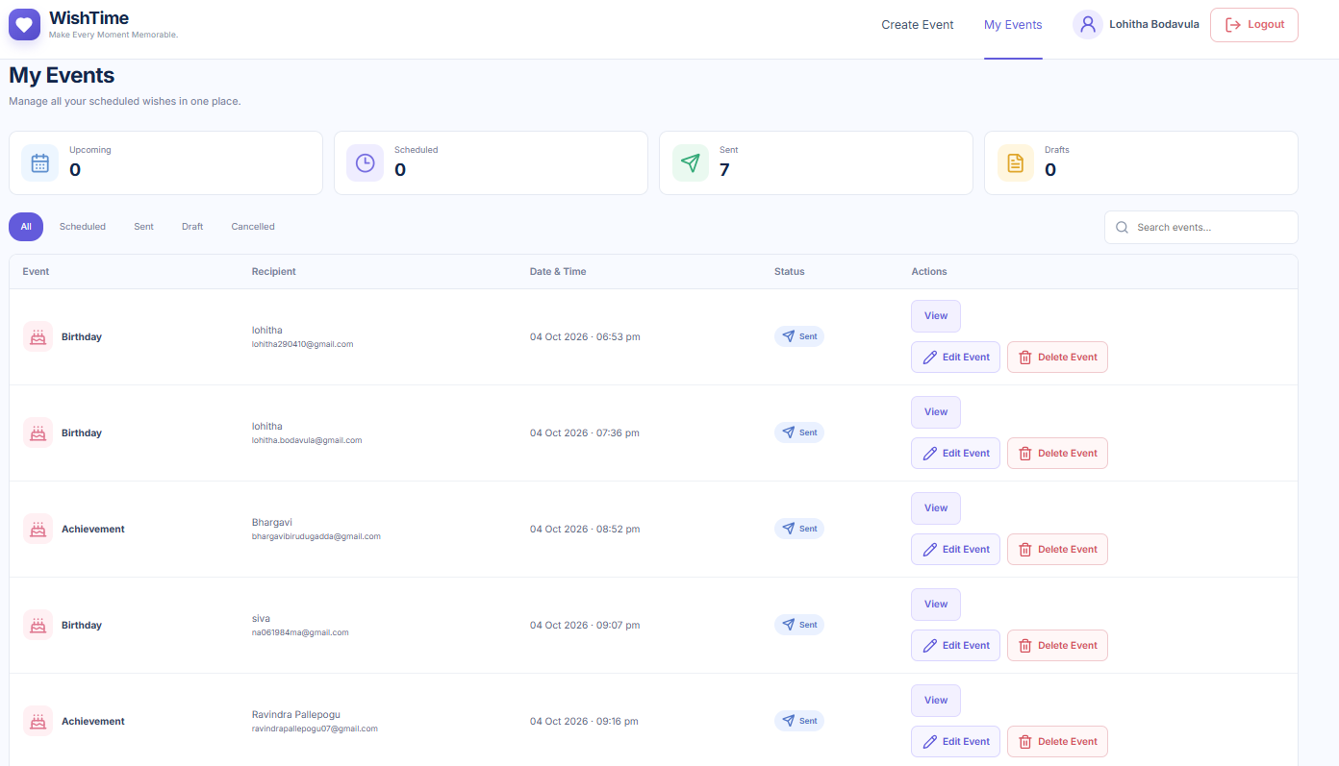
My Events Dashboard
Manage every scheduled wish in one place
Summary cards: Upcoming, Scheduled, Sent, Drafts
Filter by All, Scheduled, Sent, Draft, Cancelled
Search events by recipient
View, edit or delete each event
Status badges show delivery state (7 wishes sent in demo)

Slide 6
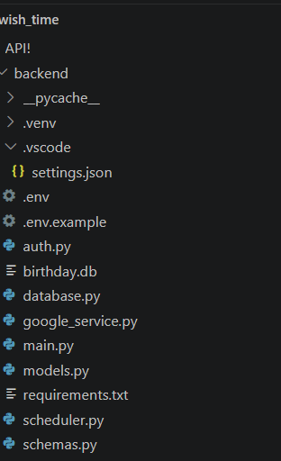
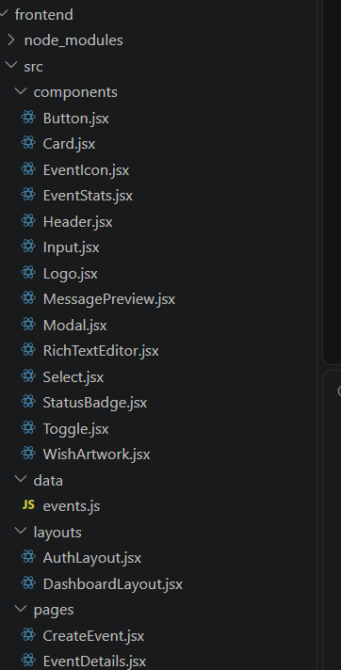
Architecture & Project Structure
Python backend with a React frontend
Backend | Python API
Frontend | React (JSX)
main.py: API routes
auth.py: login and sign-up
models.py, schemas.py: data layer
database.py: SQLite (birthday.db)
scheduler.py: timed delivery
google_service.py: Google integration
.env: secrets and config
components: Button, Card, Input, Select, Modal, RichTextEditor, MessagePreview, StatusBadge
layouts: Auth and Dashboard
pages: CreateEvent, EventDetails, ...
data: events.js

Slide 7
Summary & Future Scope
What we built
Next steps
Full-stack wish scheduler with authentication
Rich-text editor with live preview
Automated email delivery via a background scheduler
Dashboard to track and manage every event
AI-assisted message generation
Recurring yearly events (birthdays)
SMS and WhatsApp delivery
Custom card templates and themes
Mobile app and push notifications
Thank you

