Slide 1


The Leaky Pipeline:
Where do Women Disappear in Tech?
A structural investigation of gender attrition in software engineering.

Slide 2

Why We Chose this Topic?
Team : Hard Boiled
Members:
  Rashik Raihan (BSSE 1619)
  Nafis Ahmed (BSSE 1621)
  Naim Islam (BSSE 1635)
  Oasi Mahmud (BSSE 1652)
Motivation:
Despite women graduating in STEM at comparable rates to men, far fewer enter and remain in software engineering.
This begged the question: Is this a choice issue or a deeply rooted structural problem?
Through our cumulative research regarding the leakage in this pipeline, we map where talent is lost and why.

Slide 3
How We Researched
Step | Description | Source
1 | Workforce Reports – Analyzed global tech employment stats, gender ratios, and attrition data | 🎓 University Data
2 | University Data – Examined STEM enrollment, graduation, and participation trends | 📊 Workforce Reports
3 | Surveys & Studies – Reviewed studies on hiring bias, workplace culture, pay gaps | 🔍 Surveys & Studies
3

Slide 4
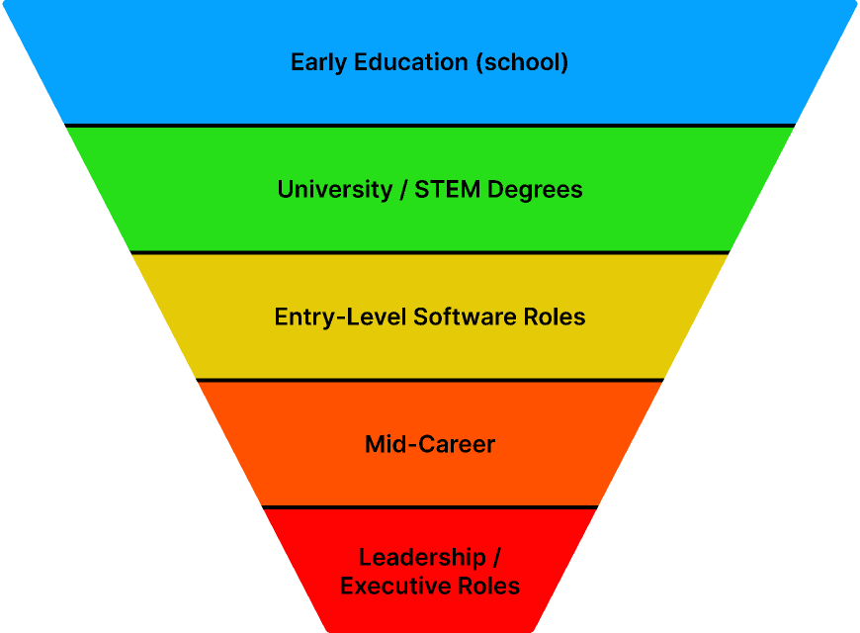





The Leaky Pipeline Explained
The ‘leaky pipeline’ stands a metaphor for the gradual loss of women in STEM and software engineering careers.
At each stage, from school to senior leadership, women exit at higher rates than men, creating structural gaps in representation and leadership.

Slide 5
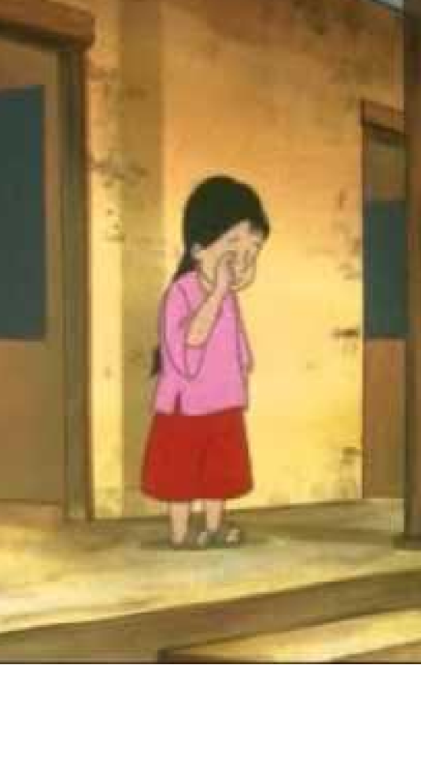
Stage 1: Early Education & Social Conditioning
5
Cultural Stereotypes: Girls often receive subtle messaging that STEM is “for boys”
Teacher & Peer Influence: Early bias in encouragement, participation, and recognition
Interest Gap Formation: By middle school, fewer girls pursue STEM extracurricular or electives
Early Decision Impact: These early leaks reduce the number of girls entering STEM degrees, starting the long-term attrition process

Slide 6


Stage 2: Higher Ed & Prejudice
6
Implicit Bias: Professors and peers may favor male students in participation and recognition
Stereotype Threat: Women perform worse when reminded of negative stereotypes about STEM competence
Networking & Mentorship Gaps: Fewer role models and mentors for women in advanced courses
Program Attrition: Many women switch majors or avoid STEM-intensive tracks due to bias or lack of support

Slide 7


Stage 3: First Jobs & Early Barriers
7
Bias in Assignments: Women often receive less challenging or less “prestige” projects
Early Performance vs. Potential Gap: Men are promoted on perceived potential; women on proven performance
Social Exclusion: Networking, after-work socialization, and mentorship often favor men
First Promotions Matter: Missing early advancement opportunities creates long-term attrition risk

Slide 8




Stage 4: Mid-Career Exit – The Big Leak
8
BROKEN RUNG
GLUE WORK & INVISIBLE LABOR
MOTHERHOOD PENALTY
Early promotions disproportionately favor men, creating long-term gaps
Non-promotable tasks slow career advancement for women
Caregiving responsibilities intersect with career growth, leading to exits

Slide 9

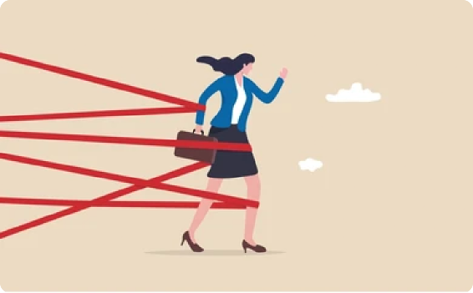


Stage 5: Senior Leadership – The Glass Ceiling
9
Cumulative Impact:
Attrition and systemic bias drastically reduce female representation in top leadership
GLASS CEILING
SPONSORSHIP & NETWORKING
Invisible barriers block women from executive roles
Few senior leaders advocate for women, limiting opportunities

Slide 10

Fixing the Pipeline: What Can Be Done?
10
03
01
Early Career (Entry-Level Jobs)
Transparent promotion criteria
Equal access to mentorship & sponsorship
Address pay gaps and biased evaluations
Early Education (School Level)
Encourage girls in STEM
Challenge stereotypes early
Provide visible female role models
02
04
Mid–Senior Career
Fix the Broken Rung
Recognize and reward “glue work”
Equitable parental leave & flexible policies
University Level
Inclusive classroom culture
Anti-bias training for faculty
Mentorship programs for female students

Slide 11


Conclusion: Talent Is Not the Problem
The gender gap in software engineering is structural, not biological.
Barriers accumulate across education, career entry, and leadership.
Fixing systems, not “fixing women” is the real solution.

Slide 12

“Maybe, just maybe, if we stopped only looking in the mirror and began looking beyond it, we could create opportunities for them to soar.”

