Slide 1
SOFTWARE PROJECT LAB-1
Submitted By: Asshifa Sultana
Roll: BSSE 1632
1 / 11

Slide 2
STEGOFUSION
A HYBRID ALGORITHM BASED IMAGE STEGANOGRAPHY SYSTEM
Supervised By: Dr. Emon Kumar Dey
Associate Professor · IIT, University of Dhaka
2 / 11

Slide 3
Objectives
01
02
Securely hides text data inside BMP images using multiple algorithms.
Integrates compression, error detection and LSB embedding
03
04
Uses randomized pixel selection to avoid detectable patterns.
Preserves image quality with minimum visual distortion.
05
06
To transmit the stego image securely to a receiver over a network using simple TCP socket communication.
Displays details after embedding, including modified pixel count, exports the data to CSV file.
3/ 11

Slide 4
Algorithms at a Glance
1. Huffman Compression Compresses the secret message before embedding using a frequency-based binary tree, reducing the number of bits that need to be stored in the image.
2. Hamming Error Correction Encodes every 4 data bits into 7 bits by adding parity bits, allowing the system to automatically detect and correct single-bit errors during extraction.
3. Logistic Chaotic Map Scatters the embedded bits across randomly permuted pixel positions using a nonlinear chaotic function, making the data placement unpredictable and resistant to detection.
4. LSB Embedding Hides secret text by modifying the least significant bit of selected image pixels, keeping visual changes imperceptible to the human eye.
5. TCP Socket Transmission Allows the sender to transmit the stego image directly to a receiver over a network by entering their IP address and port, using a simple TCP socket connection.
4 / 11

Slide 5
Workflow
EMBEDDING
Text
Huffman
Compress
Hamming
Encode
Chaotic
Map
LSB
Embed
Stego
BMP
▶
▶
▶
▶
▶
EXTRACTING
Stego
BMP
Chaotic
Map
LSB
Extract
Hamming
Decode
Huffman
Decompress
Text
▶
▶
▶
▶
▶
TRANSMISSION
Stego
BMP
TCP Socket
Send
Network
Transmit
Receiver
Accepts
Stego
Received
▶
▶
▶
▶
5 / 11

Slide 6
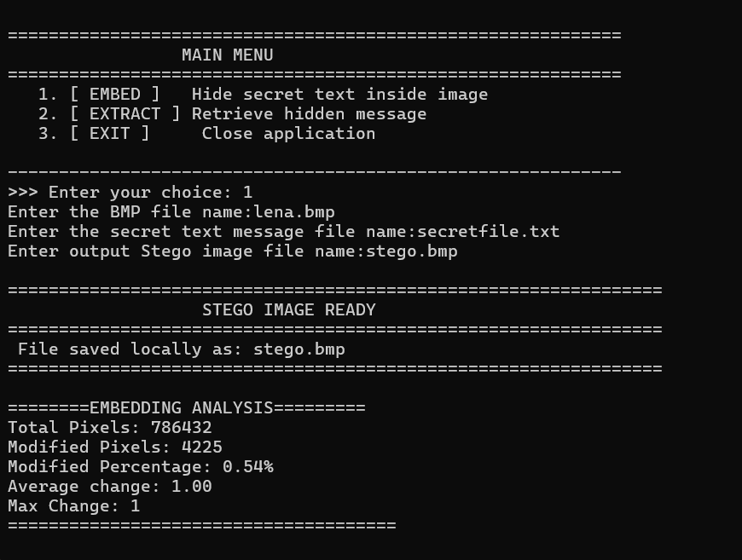
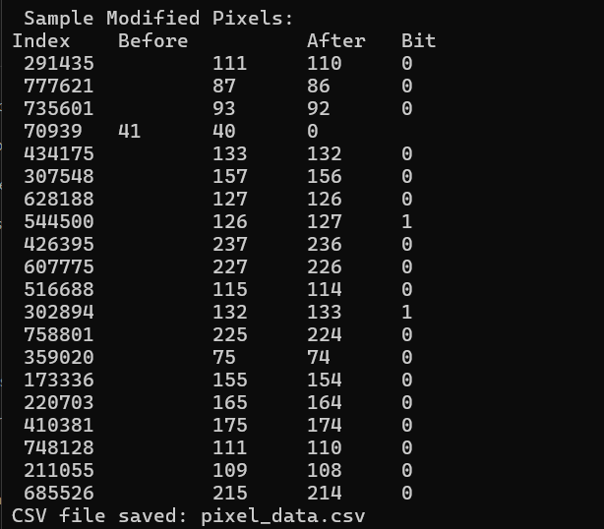
Program Output
6 / 11

Slide 7
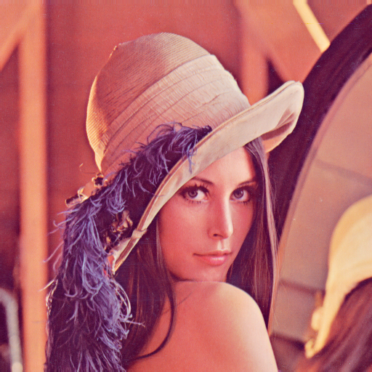

Program Output
Before
After
lena.bmp
Stego.bmp
7 / 11

Slide 8
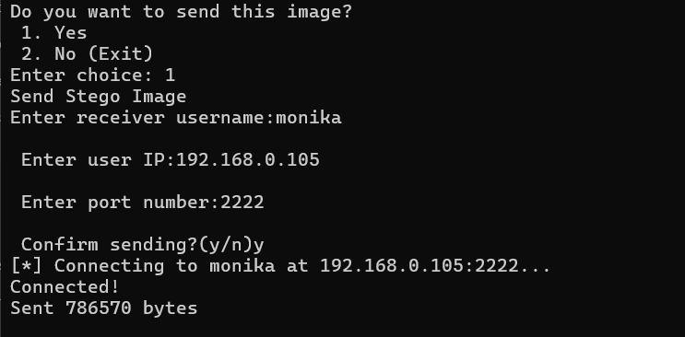
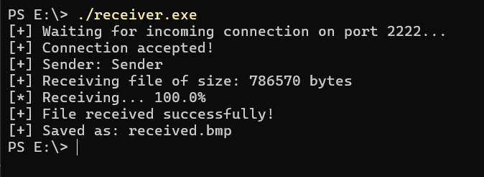
Program Output
8 / 11

Slide 9
Limitations
1. Supports only 24-bit BMP images, excluding common formats like JPEG and PNG.
2. Hamming(7,4) can only correct single-bit errors; multiple errors in one block cause incorrect decoding.
3. Hamming overhead increases embedded bit count by 75%, reducing the effective capacity of the cover image.
4. Message size is strictly limited by image dimensions, restricting the amount of data that can be hidden.
9/ 11

Slide 10
Future Enhancement
1.Replace terminal UI with a graphical interface using a C GUI library or a web front-end.
2.Support popular image formats like JPEG and PNG.
3.Embed across 2 or 3 LSB per pixel instead of 1, increasing overall message capacity.
4. Use Discrete Wavelet Transform to make hidden data robust against compression, resizing, and noise.
10/ 11

Slide 11
Thank You!
Email: bsse1632@iit.du.ac.bd
GitHub: https://github.com/asshifasultana/SPL-1.git
11/ 11

