Slide 1
SOFTWARE PROJECT LAB - 01
NAME: RASHIK RAIHAN
BSSE ROLL: 1619

Slide 2
Project Title – Pixel++
Supervised By Mohd. Zulfiquar Hafiz
Professor IIT, University of Dhaka

Slide 3
Project Overview
Problem
Digital images often suffer from:
Noise (unwanted distortions)
Blur (loss of detail)
Low resolution (pixelation when scaled)
Basic processing methods may be fast but reduce image quality
Objective
Enhance image quality using advanced algorithms
Compare basic vs advanced techniques
Improve performance using multithreading
Analyze results using CSV-based benchmarking

Slide 4
Project Evolution
Feature |  | During Midterm | Final
Upscaling | Bilinear Interpolation | ✔️ | ✔️
 | Lanczos | ❌ | ✔️
Denoising | Median Filter | ✔️ | ✔️
 | Non-Local Means | ❌ | ✔️
Sharpening | Laplacian Filter | ❌ | ✔️
 | Unsharp Masking | ✔️ | ✔️
Edge Detection | Sobel Operator | ✔️ | ✔️
Performance | Multithreading | ❌ | ✔️
Analysis | CSV | ❌ | ✔️

Slide 5
Algorithm Overview
Feature | Basic | Advanced
Upscaling | Bilinear Interpolation | Lanczos
Denoising | Median Filter | Non-Local Means
Sharpening | Unsharp Mask | Laplacian
Edge Detection | Sobel Operator | (Enhanced quality)

Slide 6

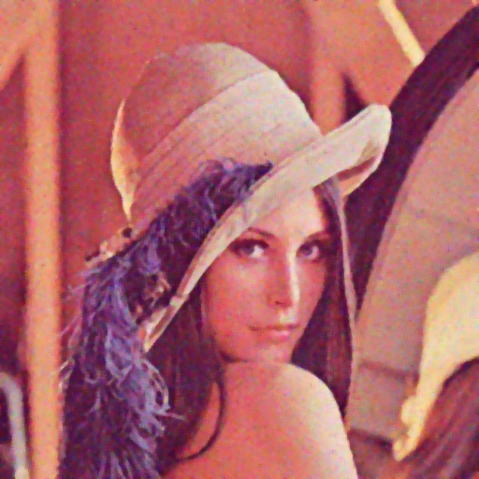

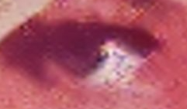
Results (Denoising)
Median Filter (Preserves less detail)
Non-Local Means
(Preserves more detail)

Slide 7
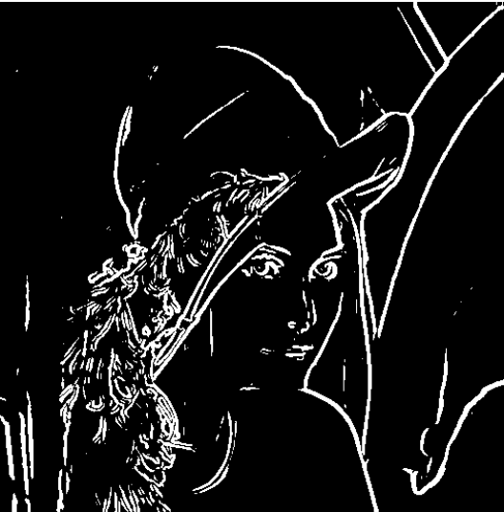
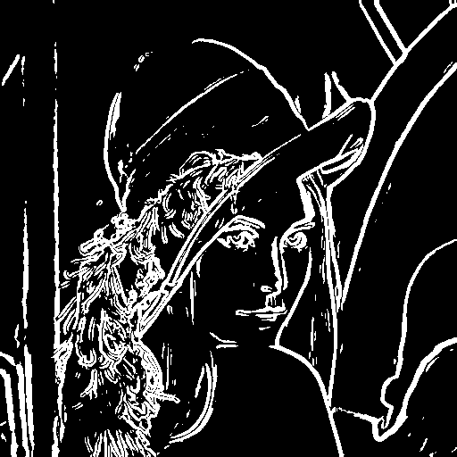
Results (Edge Detection)
Sobel Operator (Static Threshold)
Sobel Operator (Dynamic Threshold)

Slide 8
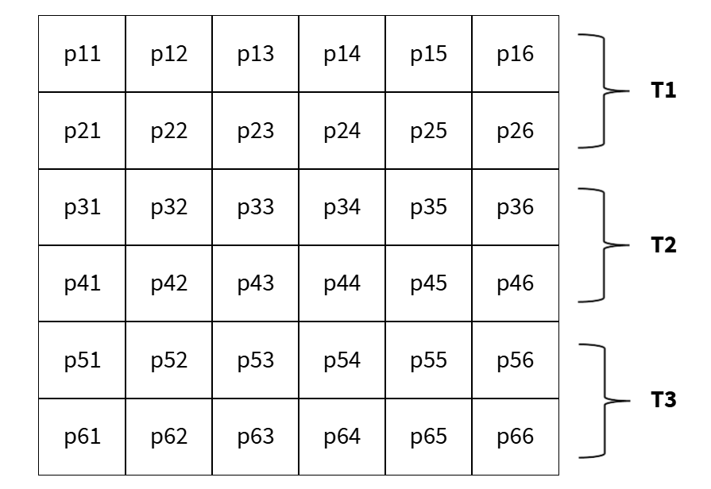
Optimization
Multithreading (MT)
Divides image processing work across multiple CPU threads
Processes different parts of the image simultaneously
Reduces overall execution time
Achieves significant speed improvement (up to 10x speedup)
Contiguous memory layout improves cache locality. This reduces cache misses and enhances performance during parallel processing
6 rows of pixels divided into 3 threads

Slide 9
Performance & Benchmarking
Algorithms | Basic (s) | MT (8 threads) (s) | MT (16 threads) (s)
Bilinear Interpolation | 0.796872 | 0.132289 | 0.079367
Lanczos | 9.550705 | 1.648525 | 1.204690
Median Filter | 94.594565 | 13.440227 | 9.346646
Non-Local Means | 2861.486949 | 658.994235 | 464.183417
Unsharp Masking | 3.525117 | 0.652248 | 0.574929
Laplacian | 2.341146 | 0.532913 | 0.424064
Sobel Operator | 4.389104 | 0.839225 | 0.608131
All algorithms are tested with 10,000 x 10,000 resolution images ~ 100 million pixels

Slide 10
Conclusion & Challenges
Conclusion
Successfully implemented multiple image processing features in C
Improved image quality using advanced algorithms
With the help of data parallelism achieved significant performance improvement
Built a system capable of both quality enhancement and performance benchmarking
Challenges
Efficient memory management in C during image processing
Synchronization and coordination in multithreaded processing
Knowing when to lock a variable and when to share it
Balancing performance improvement with code maintainability

Slide 11
THANK YOU

