Slide 1
Courses No: EEE 2217
Course Title: Electrical Drives and Instrumentation
Presentation on DC Machines
Mr. Tawabur Rahman
Lecturer
Department of Electrical and Electronic Engineering

Slide 2
Electric Machines
Device in which occurs electromagnetic phenomena is called machine.
Converts electrical energy into mechanical energy or mechanical energy into electrical energy
Generator
Motor
Transformer

Slide 3
Faraday’s Law of Electromagnetic Induction
In 1831 Michael Faraday made an important discovery. He learned that ”a voltage is induced in a conductor if the conductor cuts lines of magnetic flux.”
Moreover, The magnitude of the emf induced in a conductor is equal to the rate of change of magnetic flux i.e. The rate at which the magnetic flux changes with time.

Slide 4
DC Generator
An electrical Generator is a machine which converts mechanical energy (or power) into electrical energy (or power).
Working Principle :
If a conductor is placed in magnetic field and the conductor is rotated by any external means for which the conductor cuts rate of change of flux then there induced a voltage across the conductor according to Faraday's Laws of Electromagnetic Induction. This e.m.f. causes a current to flow if the conductor circuit is closed.
Essential parts of an electric generator:
Magnetic field and
Armature in which conductors are housing.

Slide 5
Working Principle (Cont.)
The amount of voltage generated depends on:
the flux density of magnetic field, B
the speed at which the conductor is moved, v
the length of the conductor within the magnetic field
E=Blv volts

Slide 6
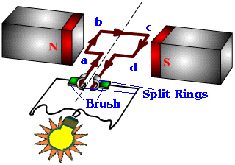
Working Principle (cont.)
(Commutator)

Slide 7
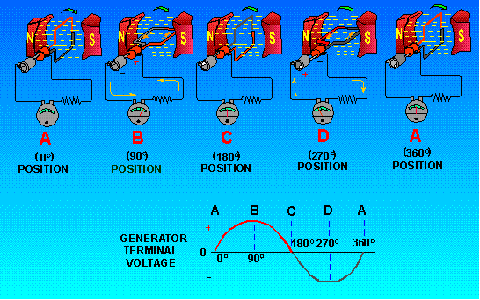
Working Principle (cont.)

Slide 8


Slide 9
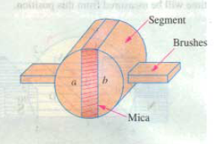
Commutator
Typical view of Commutator

Slide 10
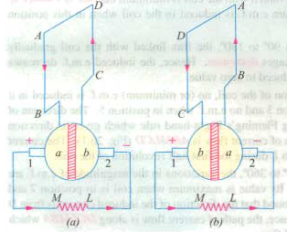
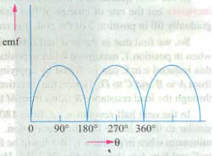
Unidirectional Current From Alternating Current
Commutator: Converts alternating currents into unidirectional currents.
Fig(a). Currents flows along ABMLCD i.e. Brush no.1 in contact with segment a acts as the positive end of supply and ‘b’ as negative end .
In fig(b), direction of induced current is reversed and position of segments ‘a’ and ‘b’ have also reversed.
Current through load resistance again flows from M to L

Slide 11
PARTS OF DC MACHINE
Major parts of the machine are:
Magnetic frame or Yoke
Pole coils or poles
pole core and pole shoes
Armature
Commutator
Brushes, Bearings and shaft.

Slide 12
Yoke
It serves two major purposes
i. It provides mechanical support for the poles and acts as a protecting cover for the whole machine
ii. It carries the magnetic flux produced by the poles.
Materials used
For small machine – cast iron
For large machine – cast steel

Slide 13
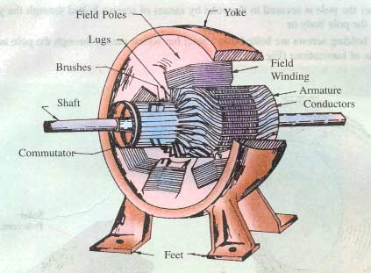
Sectional View of an D.C. Generator

Slide 14
Pole Coils
Consists of copper wire or strip
When current passes through these coils, they electromagnetize the poles which produce the necessary flux that is cut by revolving armature conductors.

Slide 15
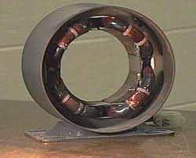
Field Winding/Pole Coil

Slide 16
Pole core and Pole shoes
The field magnets consists of pole cores and pole shoes.
Purposes:
Spread out the flux in the air gap and reduce the reluctance due to being of larger cross section.
2. Supports the field coils or exciting coils.

Slide 17
Armature
Armature core:
cylindrical shaped
Houses the armature conductor or coils- causes them to rotate and cut flux
Armature winding:
Insulated from each other
Conductor are placed in the armature slots .

Slide 18
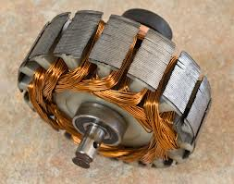
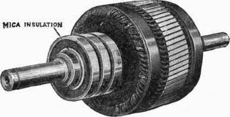
Typical View of Armature
(a) (b)

Slide 19
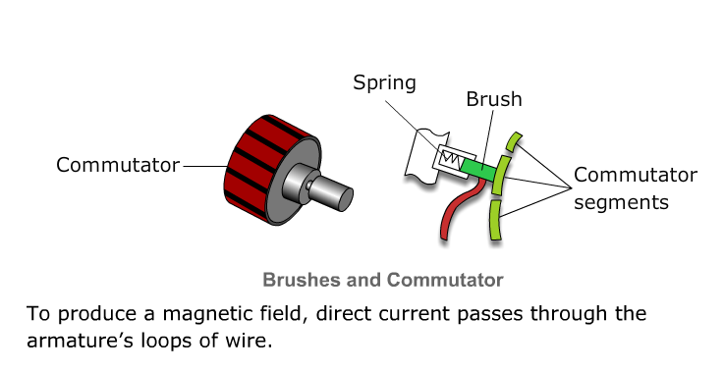
Commutator
The commutator converts the alternating emf into unidirectional or direct emf.
Cylindrical structure

Slide 20
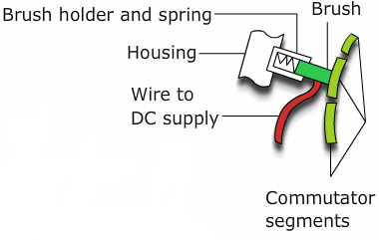
Brushes
Made up of carbon or graphite, collects the current from the commutator and convey it to the external load resistance.

Slide 21
Terminology
Coil: Two conductors connected in series is called coil of one turn.
Coil side: any side of coil that cuts lines of flux.
Coil span or coil pitch: distance between two coil sides of a coil.
Pole pitch: distance between identical points on adjacent poles.
Pole pitch=No. of conductor/pole
If there are 48 conductors and 4 pole then
Pole pitch=48/4=12.
If coil pitch=pole pitch, called full pitch.

Slide 22
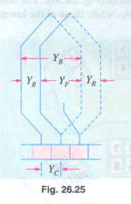
Front pitch(Y_{F}): distance between the second coilside of one coil and the first coilside of the next coil which are connected at the front i.e. commutator end of the armature.
Back pitch (Y_{B} ):the Distance , measured in terms of the armature conductors, which a coil advances on the back of the armature is called back pitch.
Commutator pitch: distance between the segments to which the two ends of a coil are connected.

Slide 23
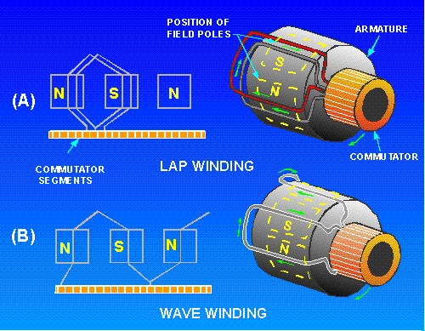
Lap Winding
One coil side must be under the north pole and the other coil side under the south pole.
The coil is placed on the armature and spans the distance from the north pole to the same point on the south pole , or one pole pitch.
In Lap winding, the finishing end of one coil is connected to a commutator segment and to the starting end of adjacent coil situated under same pole and so on .
Used in machines designed for low voltage and high current.

Slide 24
Wave Winding
Two coil side does not lie under the same pole pair.
Coil A has one side under the north pole and the other side under the south pole.
Coil B is not located under the same poles as coil A.
Used in machines designed for high voltage and low current

Slide 25
Difference between Lap and Wave winding
In lap winding, has many parallel paths in the armature.
No.of parallel paths in armature=mP;
P=No. of pole
m=multiplicity of Lap winding
So it is more suited for high current low voltage application.
In wave winding the no of parallel path is only two. So it is suitable for high voltage low current application.

