Slide 1
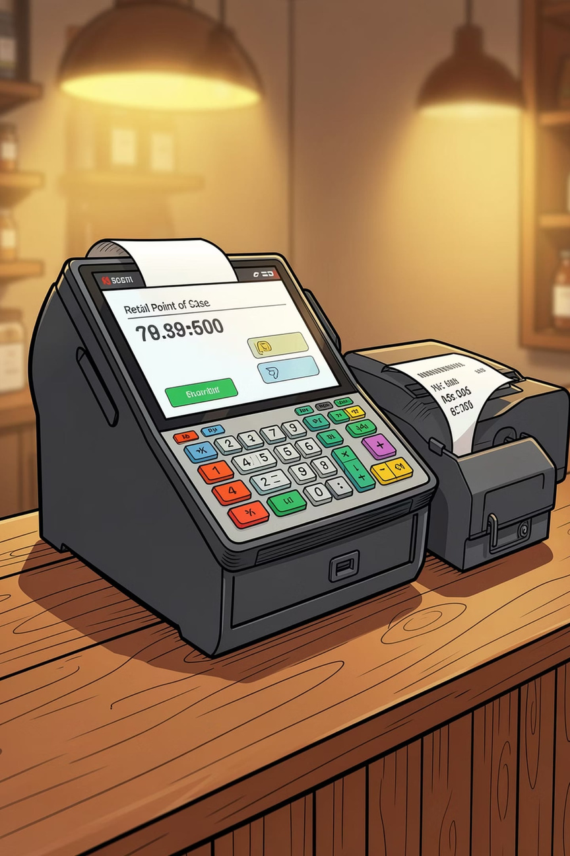
POS Billing System using C Programming
A college mini-project demonstrating real-world application of C programming for retail billing and inventory management.
Department of Computer Science And Engineering
JJ College Of Engineering & Technology
Prakash N -811325104154
Mohamed Sameer M-811325104127
Mohamed Rashik Jabar Sheik-81132510126
Notes:
1

Slide 2
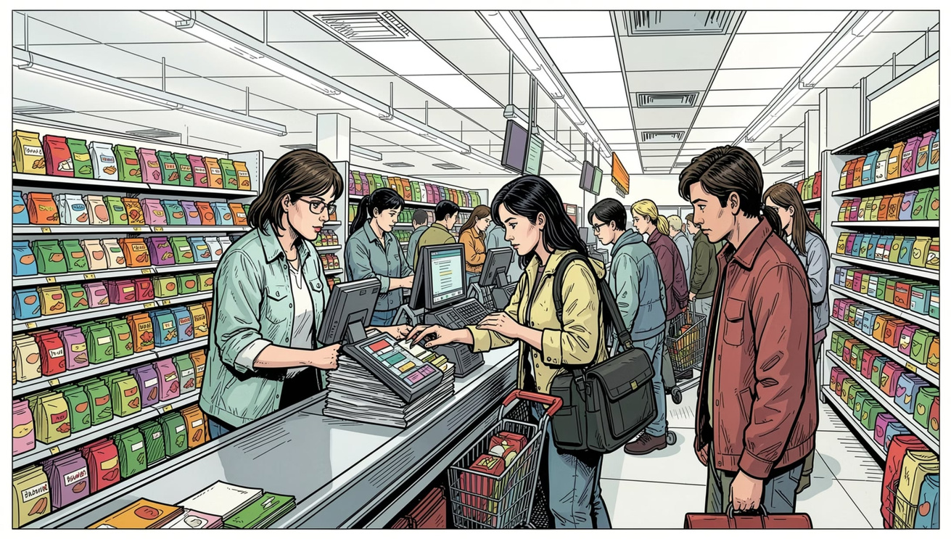
Introduction
What is a POS Billing System?
A Point of Sale (POS) system is the hub of retail operations — managing product catalogs, processing transactions, and generating customer receipts in real time.
Why It Matters
Reduces manual billing errors significantly
Speeds up the checkout process
Keeps inventory synchronized automatically
Project Purpose
This project applies core C programming concepts to build a functional, menu-driven billing application for small retail environments.
Notes:
2

Slide 3






Project Objectives
Six clear goals guided the development of this system.
C Application
Inventory Management
Build a billing app using C.
Track product stock levels.
Bill Generation
Auto Stock Update
Generate itemized customer bills.
Reduce quantities after each sale.
Error Reduction
Billing Efficiency
Minimize manual billing mistakes.
Faster checkout experience.
Notes:
3

Slide 4

Technologies Used
Each C language feature serves a specific role in the system.
Technology
Purpose
C Programming
Core application development
Structures
Store product info (ID, name, price, quantity)
Arrays
Maintain the product list in memory
Functions
Modular, reusable code blocks
String Library
Username and password validation
Boolean Library
Logical flags and state control
Notes:
4

Slide 5
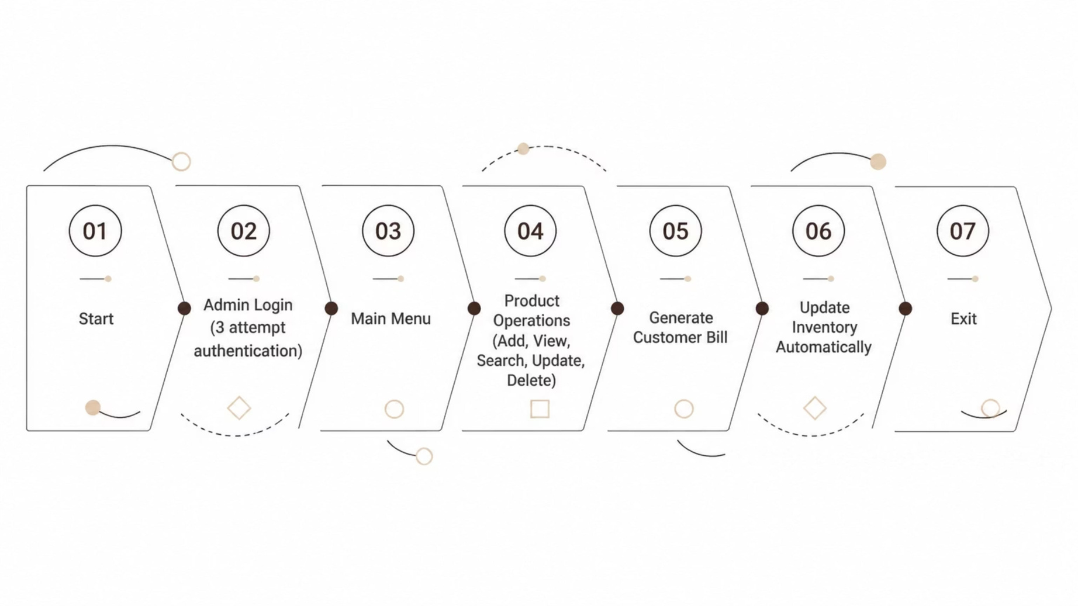
System Architecture & Flow
Use this slide to explain the overall program flow. Mention that the admin login is the entry gate for all operations.
Notes:
5

Slide 6
Key Modules
Seven modules form the complete system.
Admin Login
Add Product
View Products
Secure auth with 3 attempts.
Add new product details.
Display all products.
Search Product
Update Product
Delete Product
Find by Product ID.
Modify details.
Remove a product.
Print Bill
Generate bill, reduce stock.
Notes:
6

Slide 7

Code Highlights
Product Structure
Core Concepts Applied
struct Product {
int id;
char name[100];
float price;
int quantity;
};
Structures & Arrays
Functions & Loops
Modular design with iterative menus.
Store and manage product records.
This struct groups all product attributes into a single record, stored in an array for the full catalog.
String Handling
Conditionals & Boolean
strcmp() for login validation.
Control flow and state flags.
Notes:
7

Slide 8
Sample Output
The console interface is clean and menu-driven, with a formatted bill generated at checkout.
Main Menu
Generated Bill
================================
POS BILLING SYSTEM
================================
1. Add Product
2. View Products
3. Search Product
4. Update Product
5. Delete Product
6. Print Bill
7. Exit
================================
========== BILL ==========
Rice x2 = 120.00
Sugar x1 = 55.00
--------------------------
Total Amount = 175.00
==========================
Notes:
8

Slide 9
Advantages & Limitations
✅ Advantages
⚠️ Limitations
Simple, user-friendly interface
Faster billing process
Automatic inventory update
Easy product management
Modular and maintainable code
Console-based — no GUI
No database connectivity
Data not stored permanently
Single-user application
No barcode or GST support
Notes:
9

Slide 10

Future Scope & Conclusion
Future Enhancements
Conclusion
Database Integration
This system demonstrates how C programming — structures, arrays, functions, loops, and string handling — can build a real-world billing and inventory application.
It provides an efficient foundation for managing products, generating bills, and maintaining stock.
MySQL/SQLite for persistent storage.
File Handling
Save data across sessions.
GST & Barcode
Thank You
Tax calculation and scanner support.
Questions are welcome.
GUI & Reports
Graphical interface and sales reports.
Notes:
10

