Slide 1
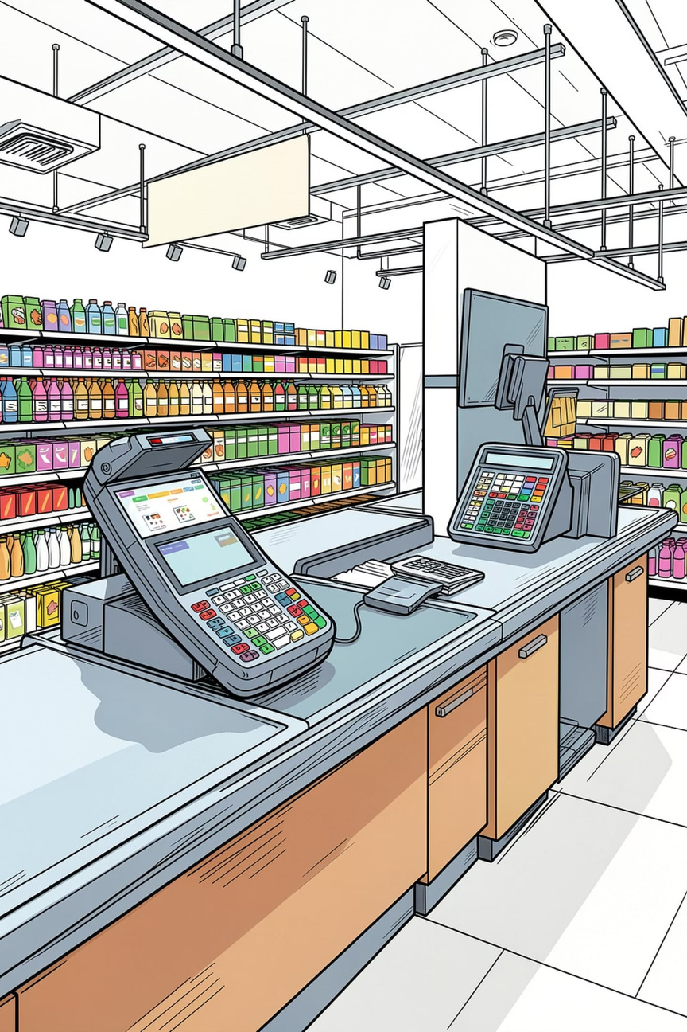

POS Billing System
Point of Sale & Inventory Management System using C Programming
JJ College of Engineering and Technology
Computer Science & Engineering
Prakash N -811325104154
Mohamed Sameer M-811325104127
Mohamed Rashik Jabar Sheik-811325104126
Notes:
1

Slide 2
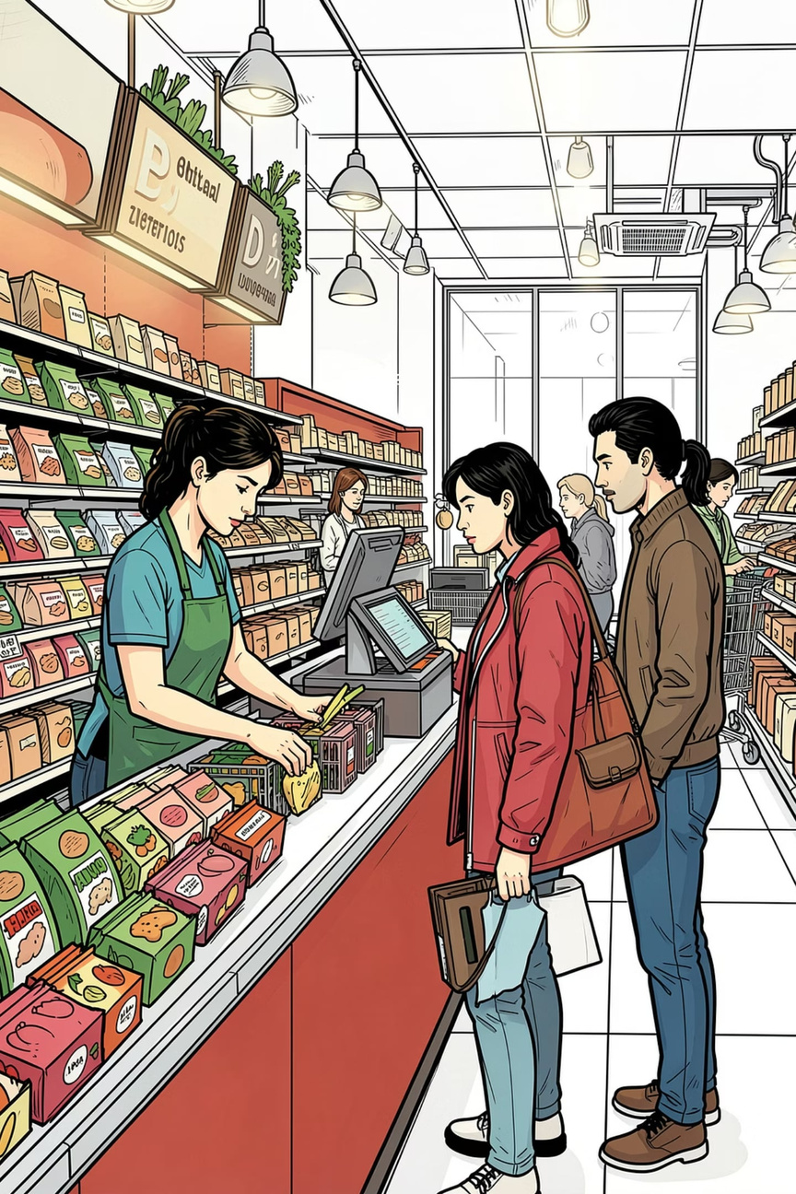
What Is the POS Billing System?
A console-based application developed in C that automates product management and customer billing for supermarkets, grocery stores, and retail shops. It replaces slow, error-prone manual processes with a fast, accurate, computerized solution.
Automated
Accurate
Handles billing and inventory without manual effort
Eliminates calculation errors at checkout
Retail-Ready
Designed for supermarkets and grocery stores
Notes:
2

Slide 3





Project Objectives
Product Management
Customer Billing
Inventory Control
Add, update, delete, and search products by ID with duplicate validation
Generate bills and calculate totals automatically at checkout
Track stock levels and update quantities in real time
Persistent Storage
Speed & Accuracy
Store all product data using file handling for reliability
Reduce billing errors and improve checkout speed significantly
Notes:
4

Slide 4
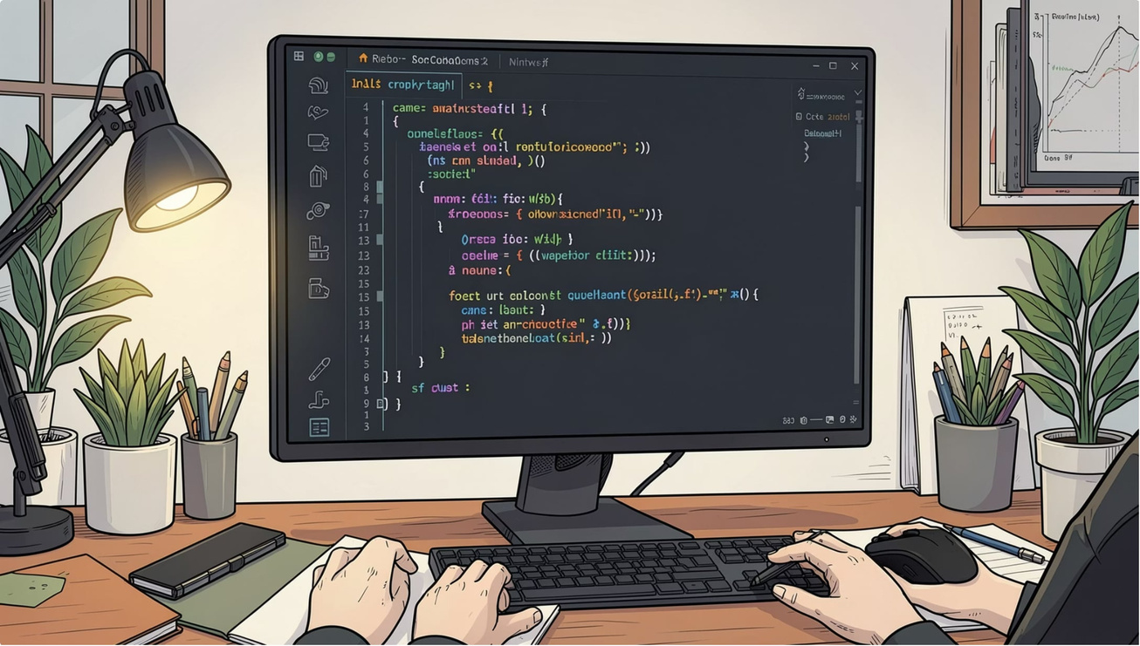
Technologies Used
Programming Language
C — chosen for its efficiency, low-level control, and strong foundation in systems programming.
Core Concepts
Structures & Arrays
Functions & Modular Design
File & String Handling
Loops & Conditionals
Development Tools
VS Code / Code::Blocks · GCC Compiler
Notes:
5

Slide 5
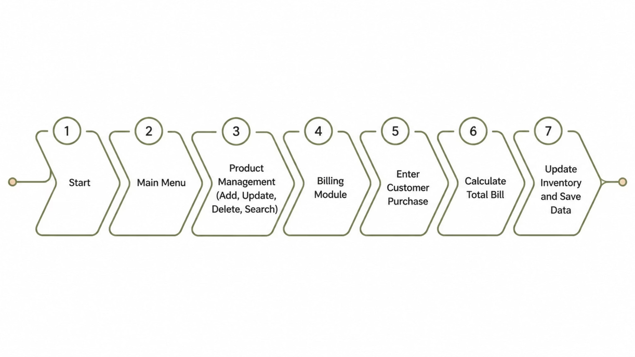
System Workflow
A clear, menu-driven flow guides users from login to final data storage — ensuring every step is logical and traceable.
Notes:
6

Slide 6






Key Features
Product Management
Inventory Tracking
Full CRUD operations with ID validation
Real-time stock level monitoring
Auto Billing
Product Search
Totals calculated instantly, error-free
Locate any item quickly by ID
Data Persistence
Menu-Driven UI
Product data saved to files reliably
Simple, intuitive navigation for all users
Notes:
7

Slide 7
Code Highlights
Core C programming concepts brought to life in a practical retail application.
Product Structure
Billing Logic
struct Product {
int id;
char name[50];
float price;
int qty;
};
total += price * qty;
printf("Total: %.2f", total);
File Handling
FILE *f = fopen("data.dat","wb");
fwrite(&p, sizeof(p), 1, f);
fclose(f);
Duplicate ID Check
if (id == products[i].id) {
printf("ID exists!");
return 0;
}
Notes:
8

Slide 8
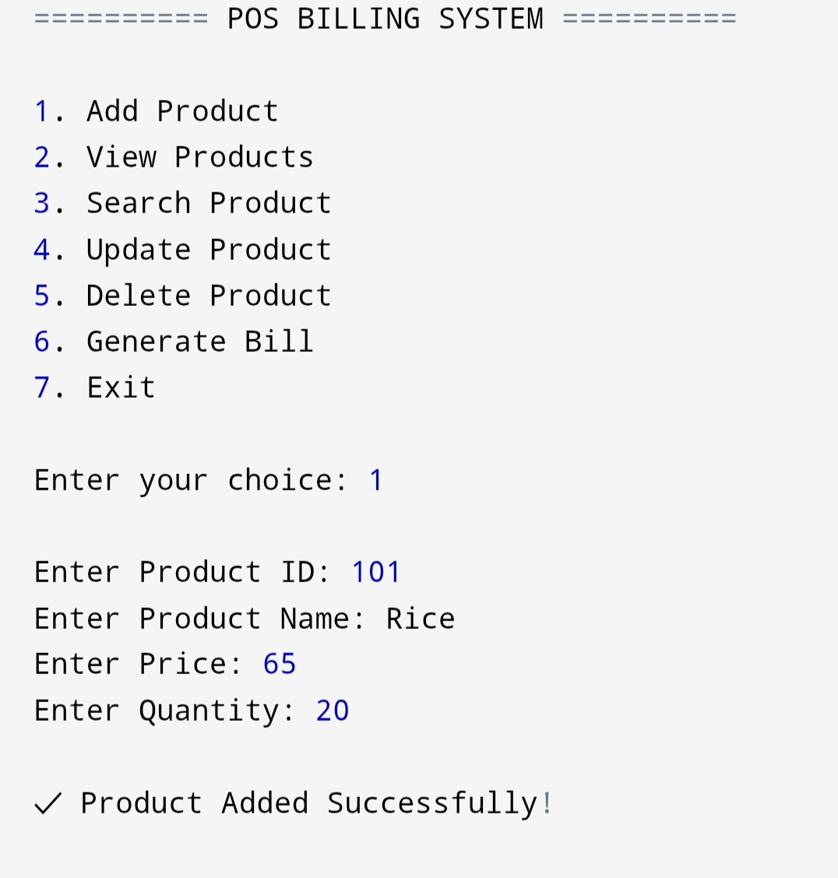
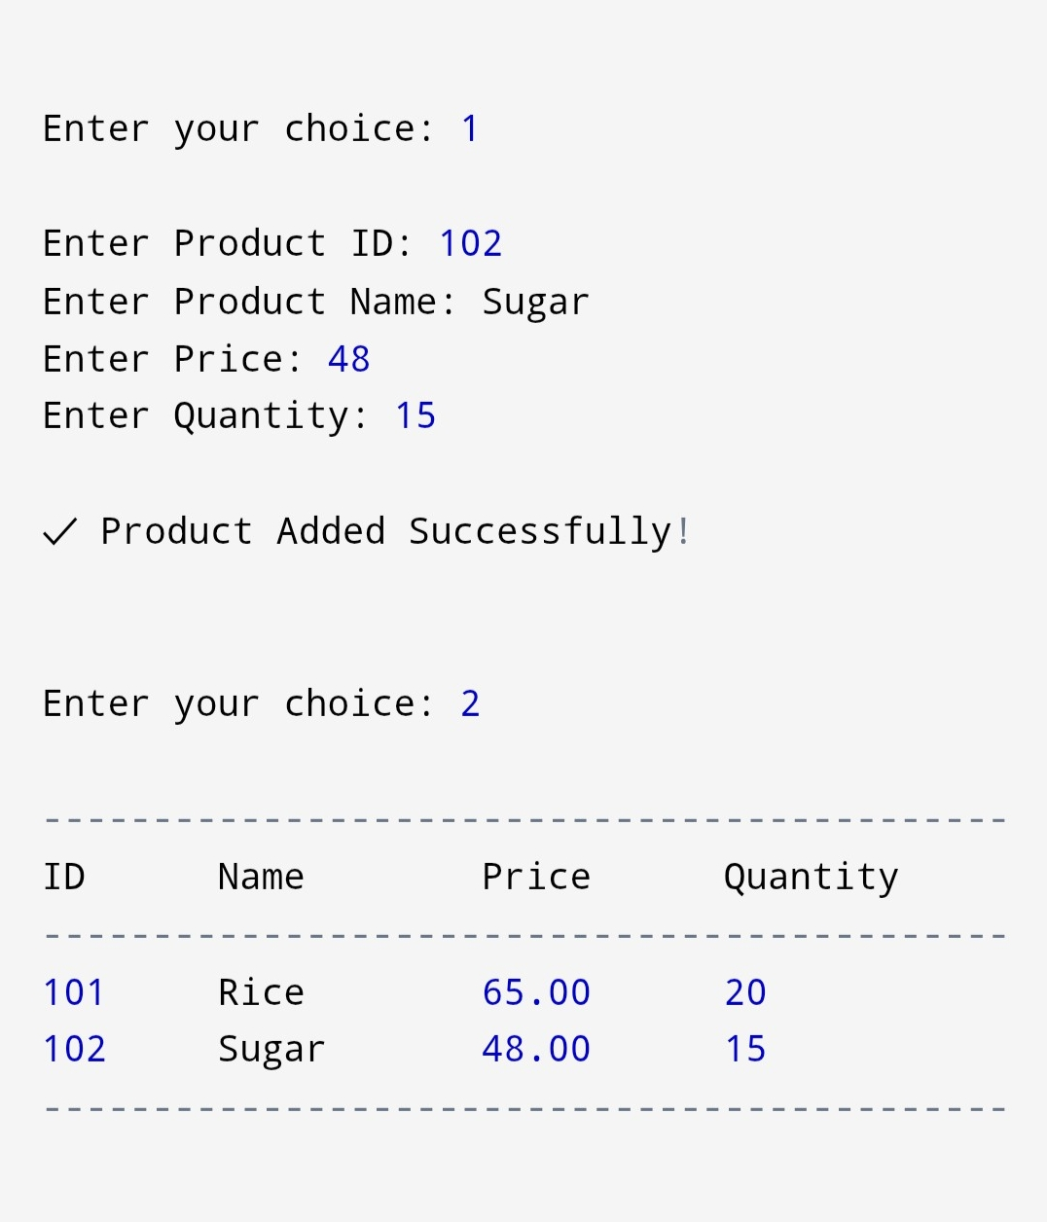
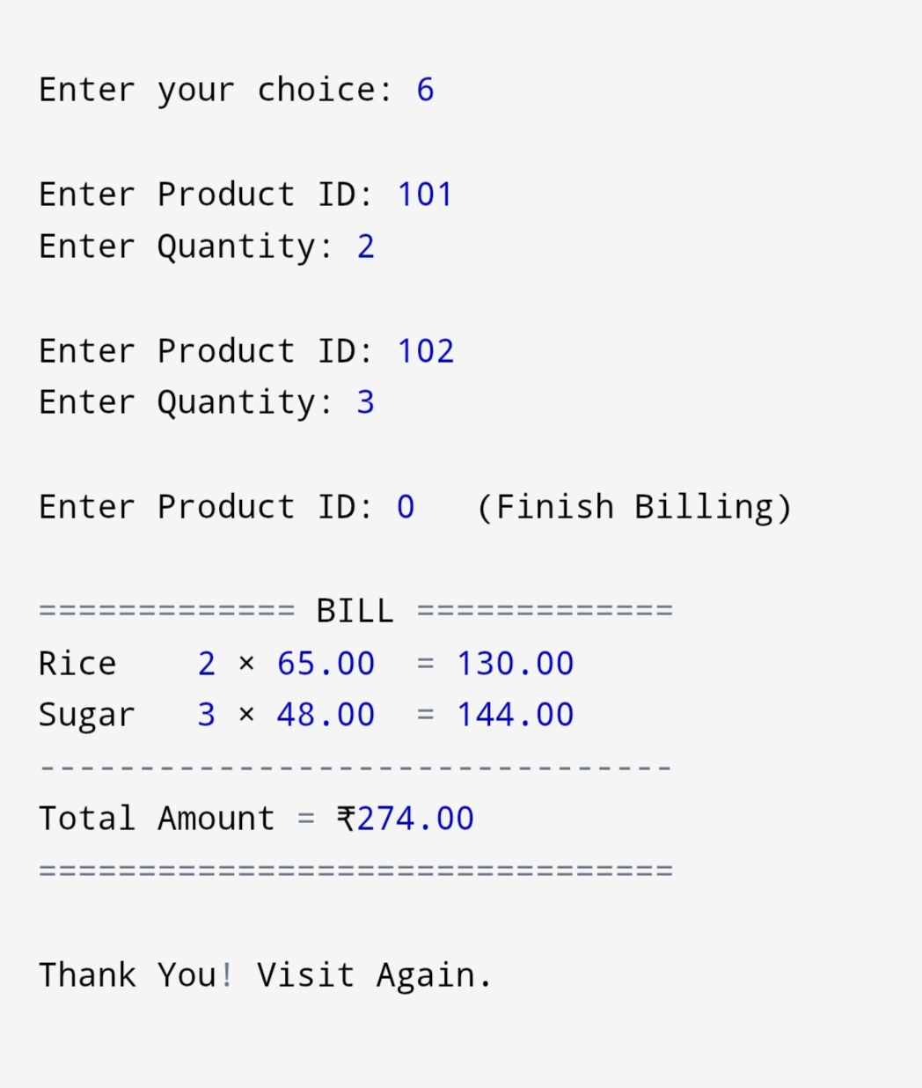
Sample Outputs

Slide 9


Results & Future Scope
✅ Achieved Results
🔭 Future Enhancements
Faster, error-free billing at checkout
Accurate, real-time inventory updates
Barcode Scanner Integration
Reliable file-based data storage
Improved overall operational efficiency
Login Authentication & User Roles
GST Calculation & Discounts
Sales Reports & Invoice Printing
GUI, MySQL/SQLite & Cloud Backup
Notes:
9

Slide 10
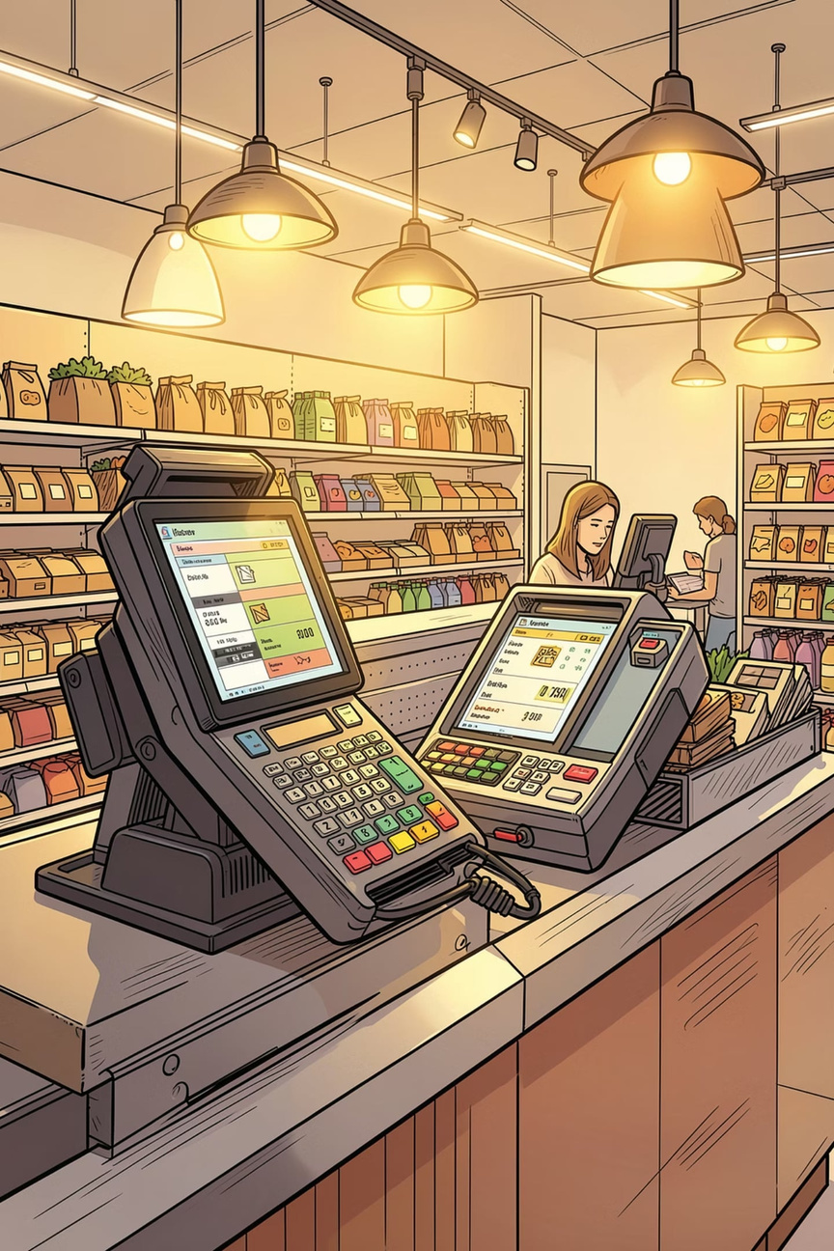
Conclusion
The POS Billing System demonstrates how C programming can deliver a practical, efficient retail management solution. It improves billing speed, maintains accurate inventory, reduces human error, and lays a strong foundation for building advanced Point of Sale software.
Thank You!
Notes:
10

