Slide 1
8
Ready Notes
Managing Strategy and Strategic Planning
Slides Prepared by M A Kashem, MIIS, DU

Slide 2
Learning Objectives
The Nature of Strategic Management
Using SWOT analysis to Formulate Strategy
Identify and Describe various alternative approaches to business level strategy
Describe how business level strategies are implemented
Identify and describe various alternative approaches to corporate-level strategy formulation
Describe how corporate level strategies are implemented
Discus international and global strategies

Slide 3
The Nature of Strategic Management
Strategy: a comprehensive plan for accomplishing an organization’s goals.
Strategy involves five Ps: plan, ploy, pattern, position, and perspective.
Strategies answer a set of Hows:
Strategic management: a comprehensive and ongoing management process aimed at formulating and implementing effective strategies; it is a way of approaching business opportunities and challenges.

Slide 4
Effective Strategy
A strategy that promotes a superior alignment between the organization and its environment and between the organization and the achievement of its strategic goals.
The effectiveness of a strategy is judged by three tests:
Test of fitness
Test of competitive advantage
Test of better performance

Slide 5
The Components of Strategy
Distinctive components: an organizational strength possessed by only a small number of competing firms.
Scope: when applied to strategy, it specifies the range of markets in which an organization will compete.
Resource deployment: how an organization will distribute its resources across the areas in which it competes.
Uniqueness: strategies should be unique and not an easy-paste approach.
Answering a set of Hows:
how to attract and please customers,
how to respond to changing situations,
how outcompete the rivals,
How to perform internal processes smartly
How to earn an above average return on investment

Slide 6
Types of Strategic Alternatives
Business-level strategy is the set of strategic alternatives that an organization chooses from as it conducts business in a particular industry or market.
Corporate-level strategy is the set of strategic alternatives that an organization chooses from as it manages its organization and operations simultaneously across several industries and markets.

Slide 7
Types of Strategic Alternatives
Functional Strategy: setting strategic plan at each functional areas. Operations, marketing, finance, human resource, and other functional areas should formulate respective functional strategies.
Operational Strategy: Strategies at each operating units.

Slide 8
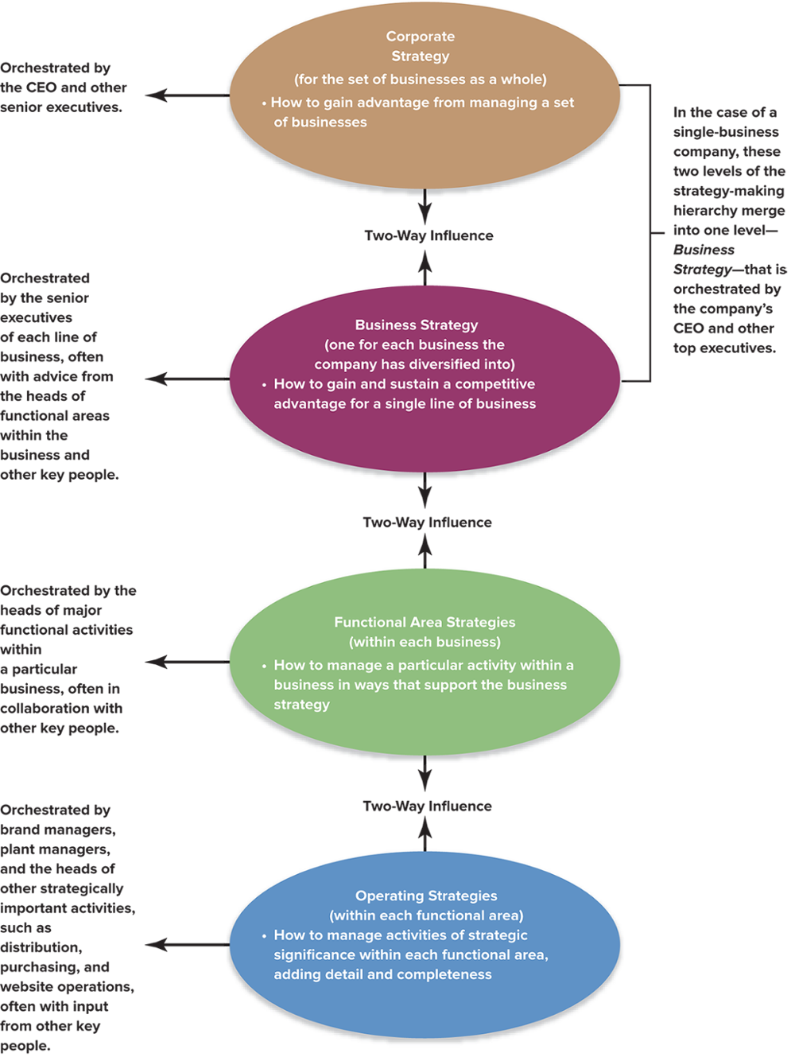
A Company’s Strategy-Making Hierarchy
Jump to Appendix 3 long image description

Slide 9
Strategy Formulation and Implementation
Strategy formulation: the set of processes involved in creating or determining the strategies of the organization; it focuses on the content of strategies.
Strategy implementation: the methods by which strategies are operational or executed within the organization; it focuses on the processes through which strategies are achieved.

Slide 10
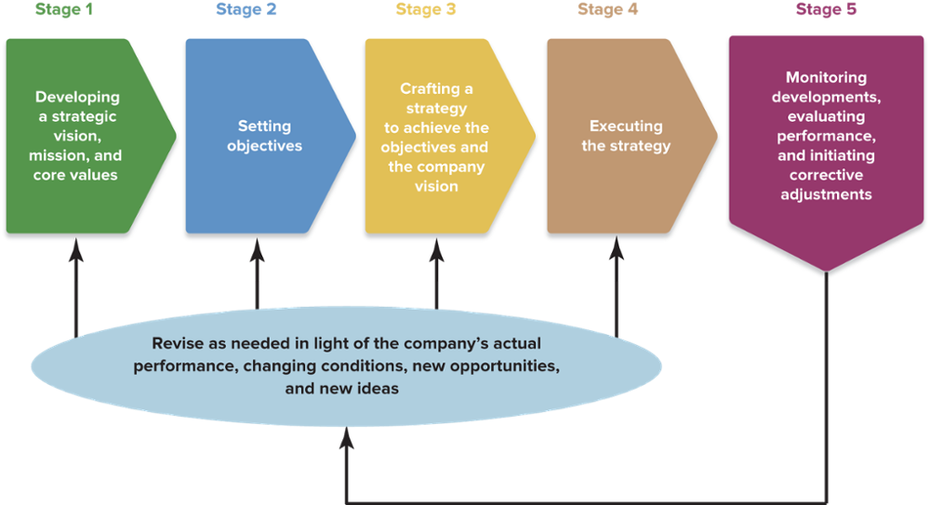
FIGURE : The Strategy-Making, Strategy-Executing Process
Jump to Appendix 1 long image description

Slide 11
Actions Needed for Strategy Execution
Creating a strategy-supporting structure
Staffing the firm with the needed skills and expertise
Developing and strengthening strategy-supporting resources and capabilities
Allocating ample resources to the activities critical to strategic success
Ensuring that policies and procedures facilitate effective strategy execution
Organizing work effort to achieve best practices
Installing information and operating systems that enable company personnel to perform essential activities
Motivating people and tying rewards and incentives directly to the achievement of performance objectives
Creating a company culture conducive to successful strategy execution
Exerting the internal leadership needed to propel implementation forward

Slide 12

Formulation and Implementation (cont’d)
Deliberate strategy: a plan chosen and implemented to support specific goals.
Emergent strategy: a pattern of action that develops over time in an organization in the absence of missions and goals or despite missions and goals.

Slide 13
Using SWOT Analysis to Formulate Strategy
SWOT: An acronym that stands for strengths, weaknesses, opportunities, and threats.
Organizational strength: a skill or capability that enables an organization to conceive of and implement its strategies.
Common strength: an organizational capability possessed by numerous competing firms.

Slide 14
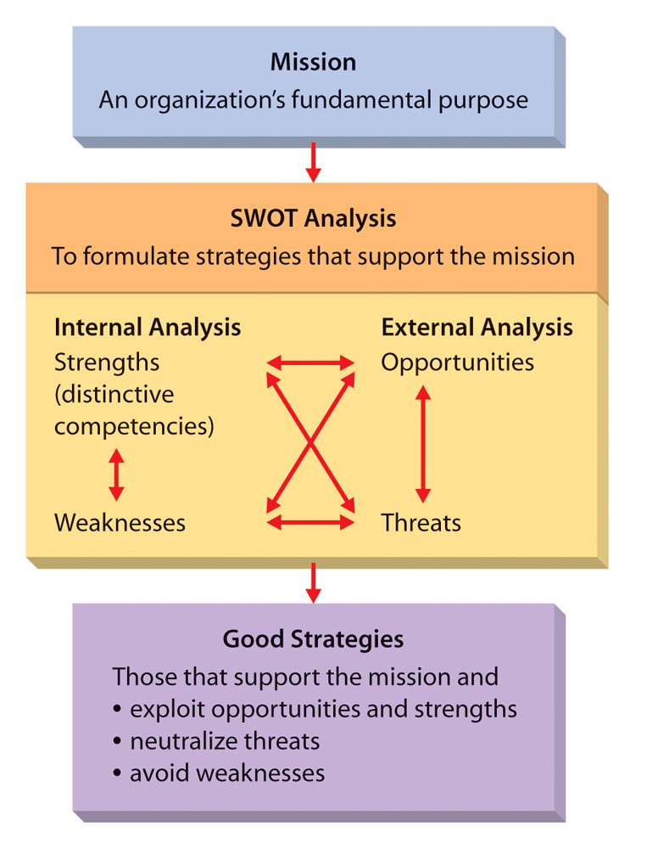
Figure 8.1: SWOT Analysis

Slide 15
SWOT: Evaluating Strengths
Strategic imitation: the practice of duplicating another organization’s distinctive competency and thereby implementing a valuable strategy.
Sustained competitive advantage: a competitive advantage that exists after all attempts at strategic imitation have ceased.

Slide 16
Evaluating an Organization’s Weaknesses
Organizational weakness: a skill or capability that does not enable an organization to choose and implement strategies that support its mission.
Competitive disadvantage: a situation in which an organization is not implementing valuable strategies that are being implemented by competing organizations.

Slide 17
Evaluating an Organization’s Opportunities and Threats
Organizational opportunity: an area in the environment that, if exploited, may generate higher performance.
Organizational threats: an area in the environment that increases the difficulty of an organization performing at a high level.

Slide 18
Porter’s Generic Strategies
Differentiation strategy: a strategy in which an organization seeks to distinguish itself from competitors through the quality of its products or services.
Overall cost leadership strategy: a strategy in which an organization attempts to gain a competitive advantage by reducing its costs below the costs of competing firms.
Focus strategy: a strategy in which an organization concentrates on a specific regional market, product line, or group of buyers.

Slide 19
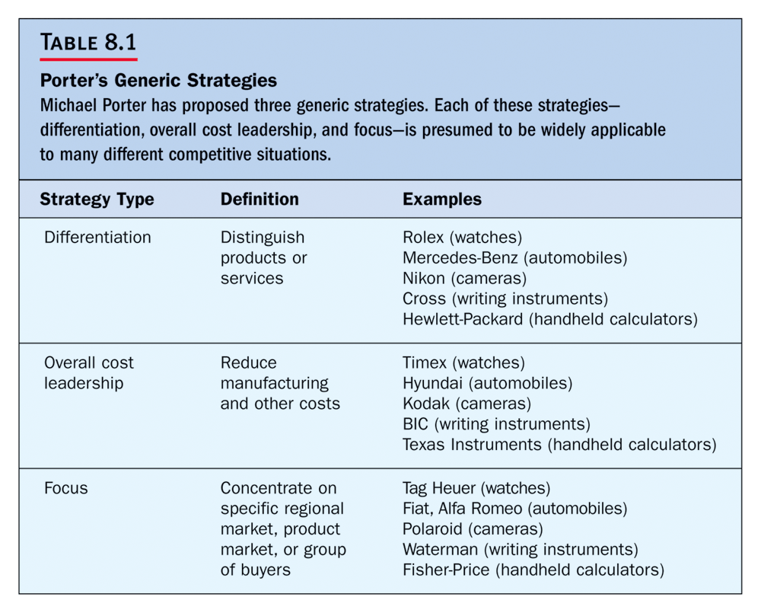

Slide 20
The Miles and Snow Typology
Prospector strategy: a strategy in which the firm is constantly seeking new markets and new opportunities and is oriented toward growth and risk taking.
Defender strategy: a strategy in which the firm concentrates on protecting its current markets, maintaining stable growth, and serving current customers.

Slide 21
Miles and Snow Typology (cont’d)
Analyzer strategy: a strategy in which the firm attempts to maintain its current businesses and to create new market opportunities.
Reactor strategy: a strategy in which a firm has no consistent approach to strategy.

Slide 22
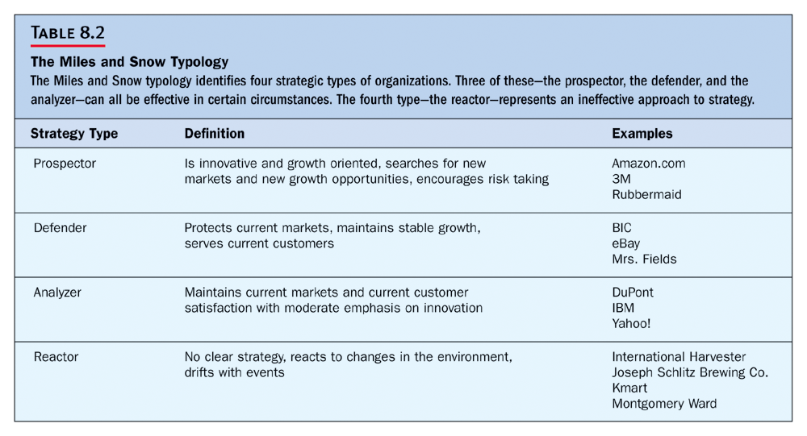

Slide 23
Strategies Based on the Product Life Cycle
Product life cycle: a model that shows sales volume changes over the life of products.
Introduction stage: demand may be very high and sometimes outpaces the firm’s ability to supply the product.
Growth stage: more firms begin producing the product, and sales continue to grow.
Mature stage: overall demand growth begins to slow down.
Decline stage: demand for product decreases.

Slide 24
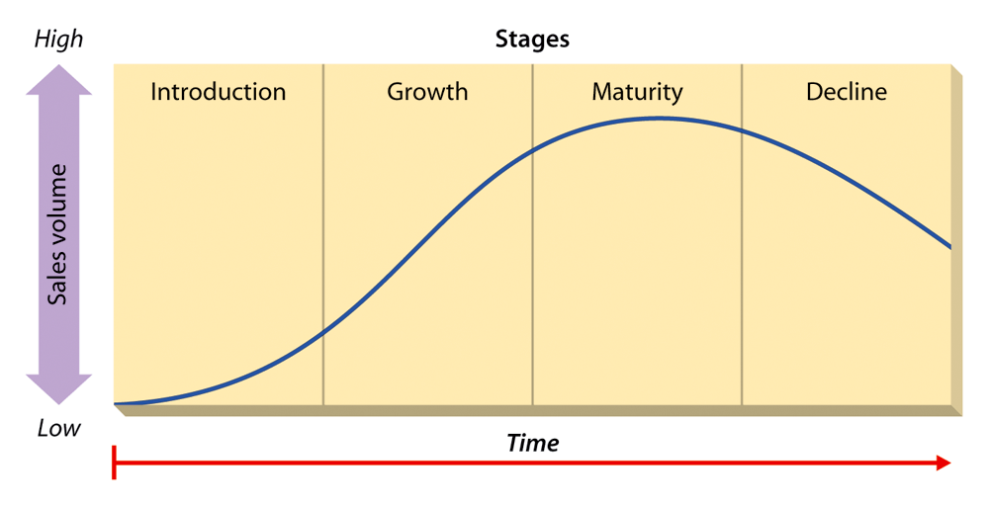
Figure 8.2: The Product Life Cycle
Insert Figure 8.2

Slide 25
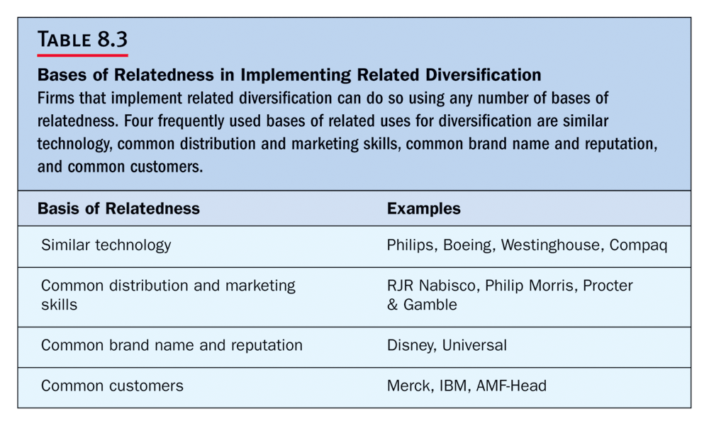

Slide 26
Formulating Corporate Level Strategies
Diversification: the number of different businesses that an organization in engaged in and the extent to which these businesses are related to one another.
Single-product strategy: a strategy in which an organization manufactures just one product or service and sells it in a single geographic market.
Related diversification: a strategy in which an organization operates in several different businesses, industries, or markets that are somehow linked.
Unrelated diversification: when a firm operates multiple businesses that are not logically associated with one another.

Slide 27
Implementing Corporate Level Strategies
Backward vertical integration: an organization begins the business activities formerly conducted by its suppliers.
Forward vertical integration: an organization stops selling to one customer and sells instead to that customer’s customers.
Merger: the purchase of one firm by another of the same size.
Acquisition: the purchase of a firm by another that is considerably larger.

Slide 28
International and Global Strategies
International firms can improve their efficiency through several means not accessible to a domestic firm.
Location efficiencies, by locating their facilities anywhere in the world that yields the lowest costs.
They may also lower costs by capturing economies of scale.
By broadening their product lines they can enjoy economies of scope.

Slide 29
Multinational Flexibility
Unlike domestic firms which operate in and respond to changes in the context of a single domestic environment, international businesses may also respond to a change in one country by implementing a change in another country.

Slide 30
Worldwide Learning
The diverse operating environments of multinational corporations may also contribute to organizational learning.
Differences in these operating environments may cause the firm to operate differently in one country than another.

Slide 31
Strategic Alternatives for International Business
Home replication: a firm utilizes the core competency or firm specific advantage it developed at home as its main competitive weapon in the foreign markets that it enters.
Multi-domestic strategy: a corporation manages itself as a collection of relatively independent operating subsidiaries and is free to customize its products, its marketing campaigns, and operating techniques to meet local customer needs.

Slide 32
Global Strategy
A global corporation views the world as a single marketplace and has as its primary goal the creation of standardized goods and services that will address the needs of customers worldwide.
Transnational strategy: the transnational attempts to combine the benefits of global scale efficiencies, such as those pursued by a global corporation, with the benefits and advantages of local responsiveness, which is the goal of a multi-domestic corporation.

Slide 33
Replacement of Suppliers and Customers
Backward
Vertical
Integration
An organization’s beginning the
business activities formerly conducted
by its suppliers
Forward
Vertical
Integration
An organization stops selling to one
customer and sells instead to that
customer’s customers

Slide 34
Managing Diversification
Portfolio
management
technique
A method that diversified organizations
use to make decisions about what
businesses to engage in and how to
manage these multiple businesses
to maximize corporate performance
BCG
matrix
A method of evaluating businesses
relative to the growth rate of
their market and the organization’s
share of the market

Slide 35
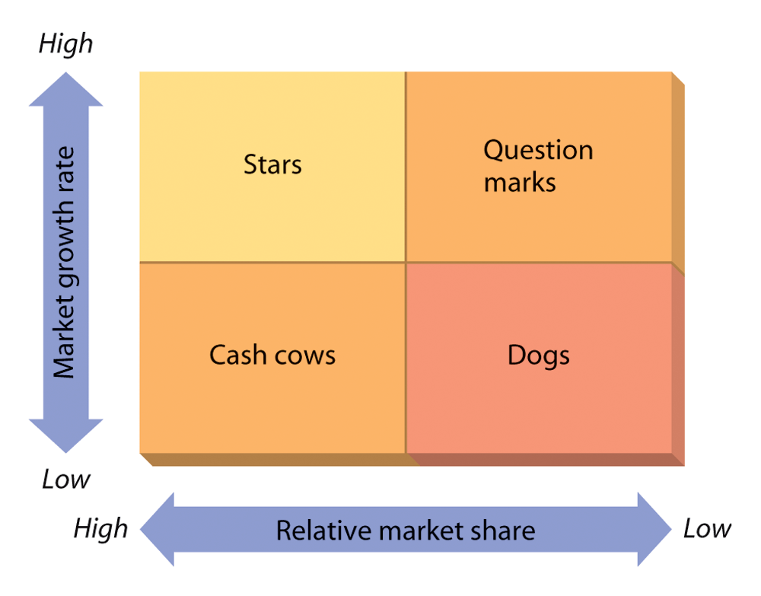
Figure 8.3: The BCG Matrix

Slide 36
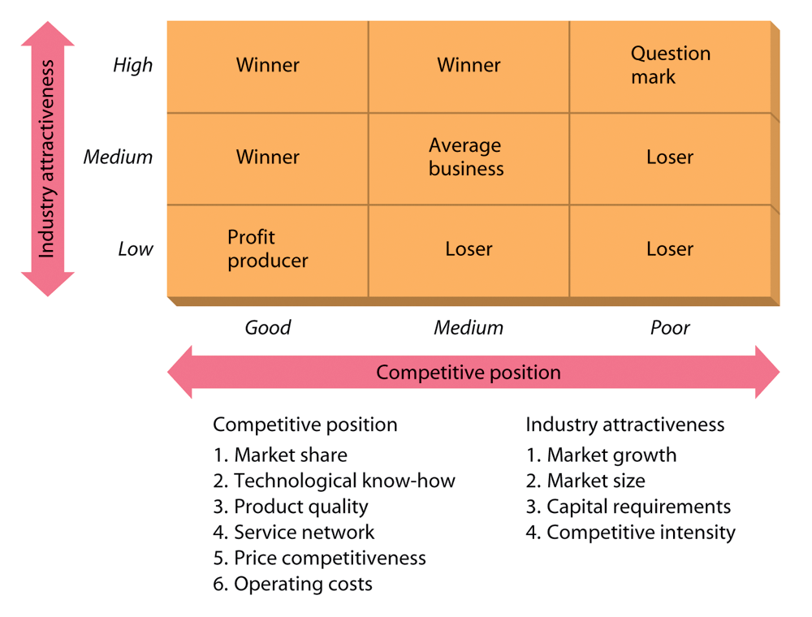
Figure 8.4: The GE Business Screen

