Slide 1
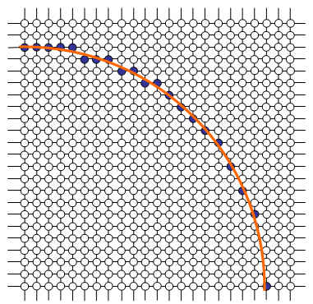
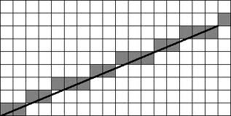
Computer Graphics
Scan Conversion

Slide 2
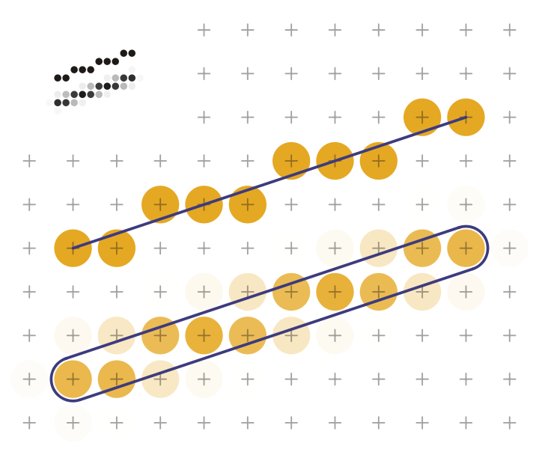
Scan Conversion Introduction
Basic Problem
Line Representations
Naïve Algorithm

Slide 3
Computer Screens: Raster Displays
pixel rasters
(usually) square pixels in rectangular raster
evenly cover the image
problems
no such things such as “lines”, “circles”, etc.
need scan conversion

Slide 4
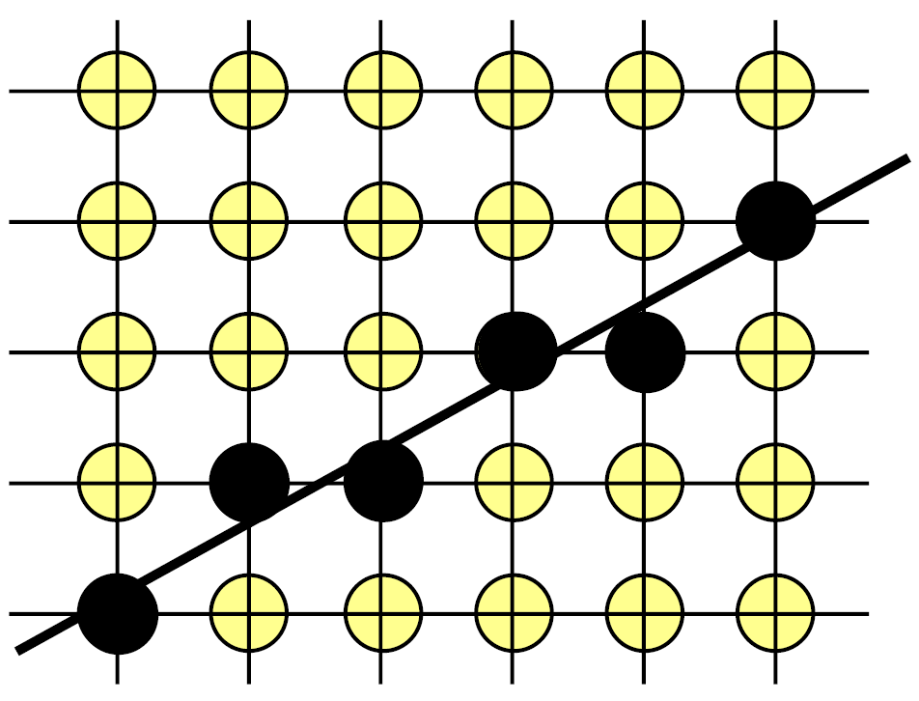
Goal: Draw Graphic Primitives in Raster Displays
graphic primitives: lines, circles, ellipsoids
how to show such shapes on a raster?
task: determine the pixels to draw
requirements:
efficiency
Quality
simplest case: straight lines

Slide 5
Lines: Mathematical Descriptions
input:
P₁(x₁, y₁) and P₂(x₂, y₂) Δx = x₂ – x_{1;} Δy = y₂ – y_{1;} m = Δy/Δx (The slope (m) of a line is the ratio of the amount that y increases as x increases some amount. Slope tells you how steep a line is, or how much y increases as x increases.)
explicit equation:
f(x) = mx + n m = Δy/Δx; n: intersection with y-axis
parametric description:
x = x₁ + t(x₂-x₁) = x₁ + tΔx y = y₁ + t(y₂-y₁) = y₁ + tΔy
implicit equation: F(x, y) = ax + by + c = 0
advantageous for scan conversion

Slide 6
Naïve Algorithm
use explicit equation f(x) = mx + n, iterate over x
problems:
accuracy (floating point computations)
efficiency (multiplications)
rounding
sometimes missing pixels or not defined at all
?

Slide 7
Implicit Line Equation: Advantage
not only defines the line but tells us if a pixel is on the line or not
F(x, y) = ax + by + c
F(x, y) > 0 → below the line
F(x, y) = 0 → on the line
F(x, y) < 0 → above the line
tells us on which side of the (mathematical) line a (discrete) pixel lies

Slide 8
Implicit Line Equation: Getting there
F(x, y) = ax + by + c = 0
finding a, b, (and c)
f(x) = mx + n; m = Δy/Δx
y = mx + n
0 = mx – y + n
0 = Δy x – Δx y + n’
F(x, y) = Δy x – Δx y + n’ = 0
→ a = Δy; b = -Δx
(c = n’can be determined using one point but we won’t really need it)

Slide 9
Bresenham’s Midpoint Algorithm
for Lines

Slide 10
Bresenham Midpoint Algorithm
Jack Bresenham (1965)
goals:
integer arithmetic
no division, as little multiplication as possible
constraints:
slope (m) between 0 and 1 (one octant)
all pixels on integer raster
later: generalize to other octants

Slide 11
Bresenham Midpoint Algorithm
general idea: iterative positioning of pixels
previous pixel: P
next pixels: NE or E
consider line-raster intersection x
choose NE or E to minimize distance to x
iterate!
NE
x
P
E

Slide 12
Bresenham: How to Decide?
easier/cheaper to test whether midpoint (M) is above or below the line
current pixel: P(x, y)
midpoint M(x+1, y+½)
F(M) = F(x+1,y+½)
NE
M
P
E

Slide 13
Bresenham: How to Decide?
if F(M) < 0 → midpoint above line → E next pixel
if F(M) ≥ 0 → midpoint below line → NE next pixel
decision variable: d = F(M) = F(x+1,y+½)
optimization:
do not compute d, but how it changes!
NE
NE
M
M
P
P
E
E

Slide 14
Bresenham: Iteration, Case 1
NE is next pixel and M₁ next midpoint
F(M) = F((x+1), (y+½)) = a(x+1) + b(y+½) + c
F(M₁) = F((x+2), (y+³/₂)) = a(x+2) + b(y+³/₂) + c
F(M₁) - F(M) = a + b thus, F(M₁) = F(M) + a + b
we know: a = Δy; b = -Δx F(M₁) = F(M) + Δy – Δx thus, d’ = d + Δd_{NE} where Δd_{NE} = Δy – Δx
y+2
M₁
NE
y+1
M
M₂
P
E
y
x
x+1
x+2

Slide 15
Bresenham: Iteration, Case 2
E is next pixel and M₂ next midpoint
F(M) = F((x+1), (y+½)) = a(x+1) + b(y+½) + c
F(M₂) = F((x+2), (y+½)) = a(x+2) + b(y+½) + c
F(M₂) - F(M) = a thus, F(M₂) = F(M) + a
we know: a = Δy; F(M₂) = F(M) + Δy thus, d’ = d + Δd_{E} where Δd_{E} = Δy
y+2
M₁
NE
y+1
M
M₂
P
E
y
x
x+1
x+2

Slide 16
Bresenham: Algorithm
Putting it all together
Pixel p = line starting point (rounded)
compute d = F(M)
While p != line endpoint
select E or NE accordingly
draw pixel
update d according to choice (E or NE)
increment x
how to initialize d?

Slide 17
Bresenham: Computing d₀
line starts at P₁(x₁, y₁)
→ d₀ = F(M₁)
= F((x₁+1), (y₁+½))
= a(x₁+1) + b(y₁+½) + c
= ax₁ + a + by₁ + ½b + c
= F(x₁,y₁) + a + ½b
P₁ lies on the line → F(x₁,y₁) = 0
→ d₀ = a + ½b
problem: we want to work with integer values!

Slide 18
Bresenham: Computing d₀
we are only interested in sign of d! → multiply everything by 2!
multiplication does not change sign → d₀ = 2a + b = 2Δy – Δx (a = Δy; b = -Δx) → Δd_{E} = 2Δy → Δd_{NE} = 2Δy – 2Δx

Slide 19
Bresenham: Extension to All Slopes
(-y,x)
(y,x)
use of symmetry:
changing signs of x and/or y before drawing pixel
switching x and y
combinations of these
possible optimizations:
special cases for lines along axes
(-x,y)
(x,y)
(-x,-y)
(x,-y)
(-y,-x)
(y,-x)

Slide 20
Bresenham-Lines: Summary
incremental algorithm
using only integer arithmetic
using only additions during iterations
multiplications only for initialization
use symmetry to extend to all octants
fast and simple
easily implementable in graphics hardware

Slide 21
Bresenham’s Midpoint Algorithm
for Circles

Slide 22
Let’s Have More Fun: Circles!
input: center point C(x_{c}, y_{c}) and radius r
circle equation: F(x,y) = x² + y² = r² if C = (0, 0)
general: F(x,y) = (x-x_{c})² + (y-y_{c})² = r²
naïve approach to draw circle: solve for y and iterate over x

Slide 23
Problems with Naïve Algorithm
expensive computations
square roots
powers of 2
inaccurate!
slooooow!
incomplete pixels where |x| ≈ r
we need something better!

Slide 24
Parametric Approach for Circles
use parametric equations: x = r cos ϕ , y = r sin ϕ
iterate over ϕ
no problems with holes at |x| ≈ r anymore
but: trigonometric functions expensive to compute
still not efficient enough!

Slide 25
Bresenham Midpoint for Circles
use same idea as with lines: implicit function and decision point
F(x,y) = x² + y² – r² = 0 for points on the circle < 0 for points inside the circle > 0 for points outside of the circle (assuming a circle centered at 0,0)

Slide 26
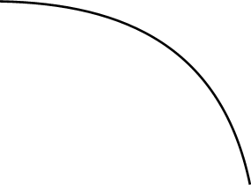
Bresenham Midpoint for Circles
use only one octant again
from pixel P, decide between E and SE
based on M’s position
with respect to circle
goals (again):
incremental algorithm
avoid divisions, multiplications
P
E
M
M₁
SE
M₂

Slide 27
Bresenham Midpoint for Circles
midpoint M(x+1,y-½)
decision variable d = F(M) = (x+1)² + (y-½)² – r²
if d < 0 (circle above M),
draw E
if d ≥ 0 (circle on/below M)
draw SE
need to compute the
increments of d again
P
E
M
M₁
SE
M₂

Slide 28
Bresenham Midpoint for Circles
Case 1: d < 0; select E
d = F(M) = F((x+1), (y-½)) = (x+1)² + (y-½)² – r²
d’ = F(M₁) = F((x+2), (y-½)) = (x+2)² + (y-½)² – r² = (x+1)² + (y-½)² – r² + 2x + 3 = F(M) + 2x + 3 → Δd_{E} = 2x + 3
P
E
M
M₁
SE
M₂

Slide 29
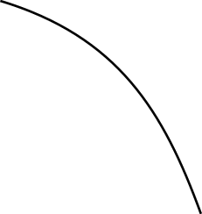
Bresenham Midpoint for Circles
Case 2: d ≥ 0; select SE
d = F(M) = F((x+1), (y-½)) = (x+1)² + (y-½)² – r²
d’ = F(M₂) = F((x+2), (y-³/₂)) = (x+2)² + (y-³/₂)² – r² = (x+1)² + (y-½)² – r² + 2x + 3 - 2y + 2 = F(M) + 2x – 2y + 5 → Δd_{SE} = 2(x-y) + 5
P
E
M
M₁
SE
M₂

Slide 30
Bresenham Midpoint for Circles
Initialization of d
first pixel P(0, r) → first midpoint M(1, r-½) d₀ = F(1, r-½) = 1² + (r-½)² – r² = ⁵/₄ – r
d₀ is not an integer!
approximation d₀ = 1- r

Slide 31
Bresenham Circle Symmetry
(-x,y)
(x,y)
similar to line octants:
changing signs of x and/or y before drawing pixel
switching x and y
combinations of these
other details
set all eight pixels at the same time (faster)
for circles not centered at (0,0): offset drawn pixels by center coordinates
(-y,x)
(y,x)
(-y,-x)
(y,-x)
(-x,-y)
(x,-y)

Slide 32
Bresenham Circle Summary
efficient algorithm
incremental and integer arithmetic
multiplications still needed for increments
Δd_{E} = 2x + 3 and Δd_{SE} = 2(x-y) + 5
line algorithm had constant increments
can we do this here, too?
refinement: second order differences
idea: compute increments of increments
how: consider two steps in advance
(see next chapter in the slides)

Slide 33
Bresenham Midpoint Algorithms
Summary
fast and simple because of
incremental technique using integer arithmetic
multiplication/division avoidance
extensions
many other curves (implicit equations needed)
not axis-aligned curves
practical importance
OpenGL / DirectX drivers
printer drivers (PostScript, PDF, …)

