Slide 1
Camera Transformations

Slide 2
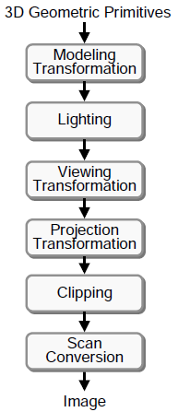
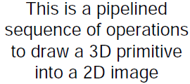
3D Rendering Pipeline (for direct illumination)

Slide 3
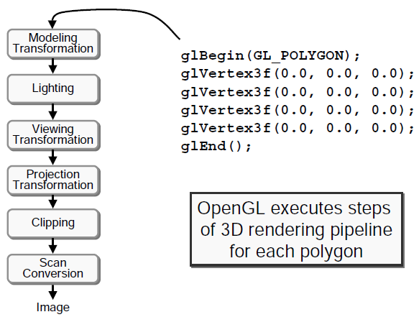
Example: OpenGL

Slide 4
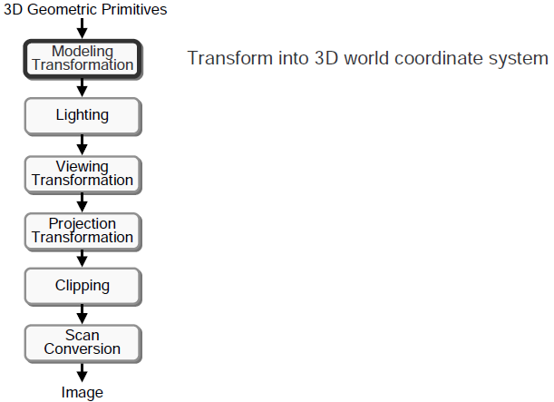
3D Rendering Pipeline (for direct illumination)

Slide 5
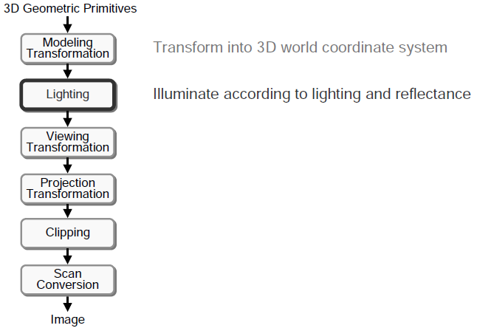
3D Rendering Pipeline (for direct illumination)

Slide 6
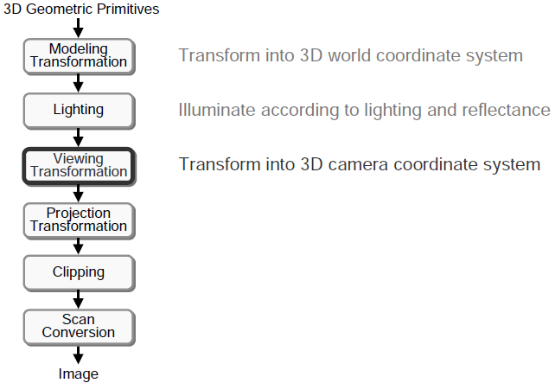
3D Rendering Pipeline (for direct illumination)

Slide 7
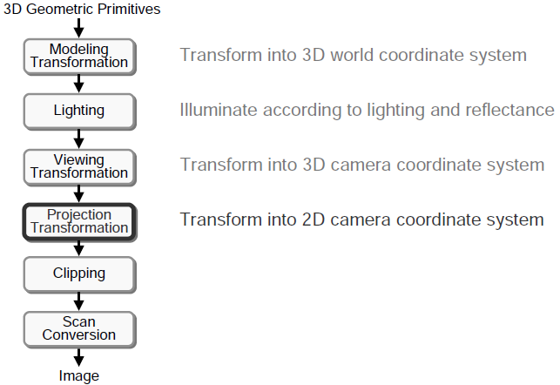
3D Rendering Pipeline (for direct illumination)

Slide 8
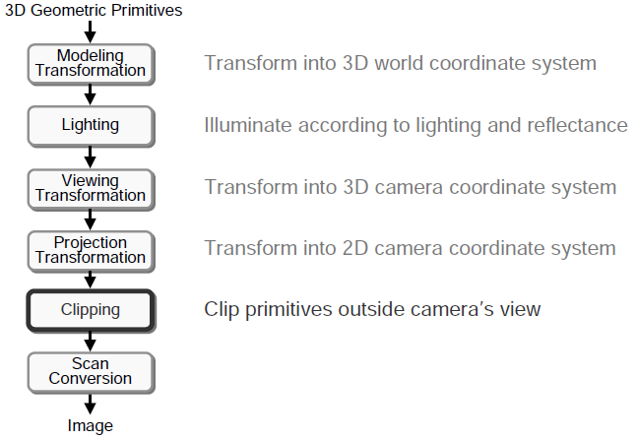
3D Rendering Pipeline (for direct illumination)

Slide 9
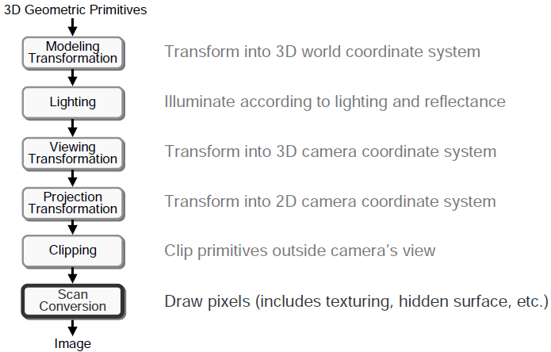
3D Rendering Pipeline (for direct illumination)

Slide 10
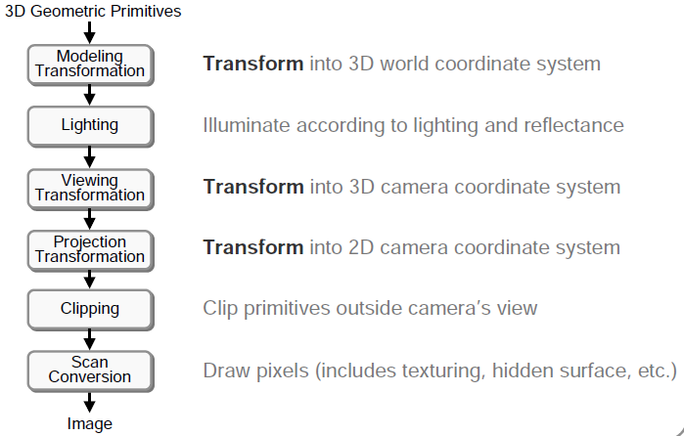
Transformations

Slide 11
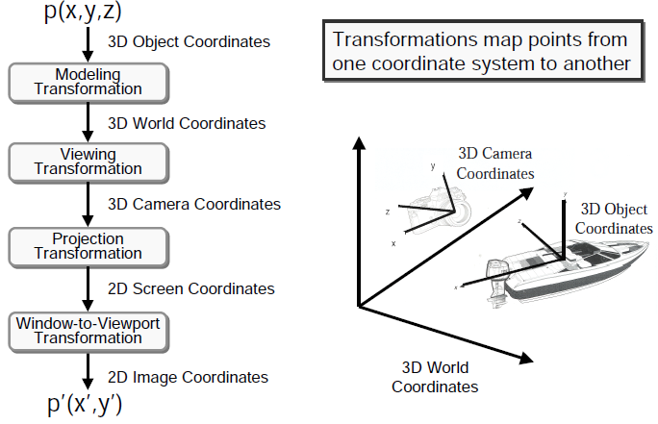
Transformations

Slide 12
Trick to Accommodate Camera Projection i.e., Perspective Projection

Slide 13
If we look at the coordinates (x; y; z; 1) in four dimensions, we notice that they all lie on the space w = 1.

Slide 14
We will utilize a projective approach in which we will identify points out of the w = 1 space with points in the space as follows:
Given a coordinate (x, y, z, w), we identify the point (x0; y0; z0; 1) in the w = 1 space with (x; y; z; w) if the point (x0; y0; z0; 1) is the unique point on the line connecting (x; y; z;w) with the origin.

Slide 18
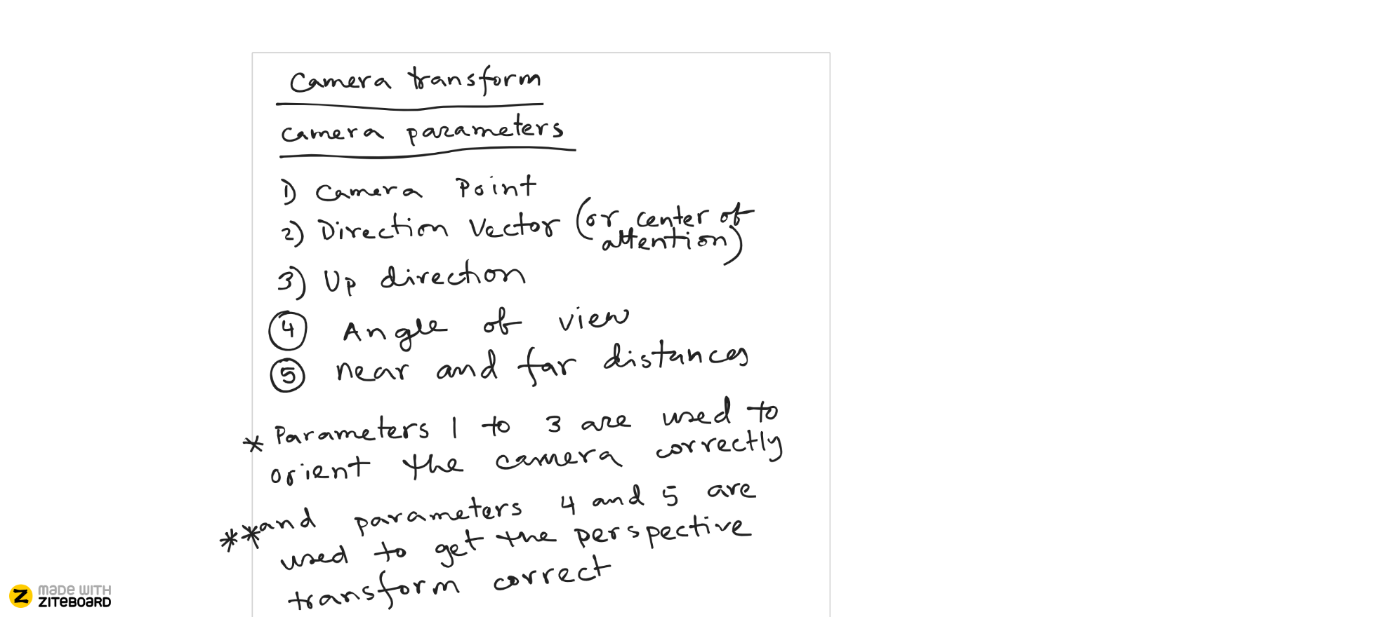

Slide 19
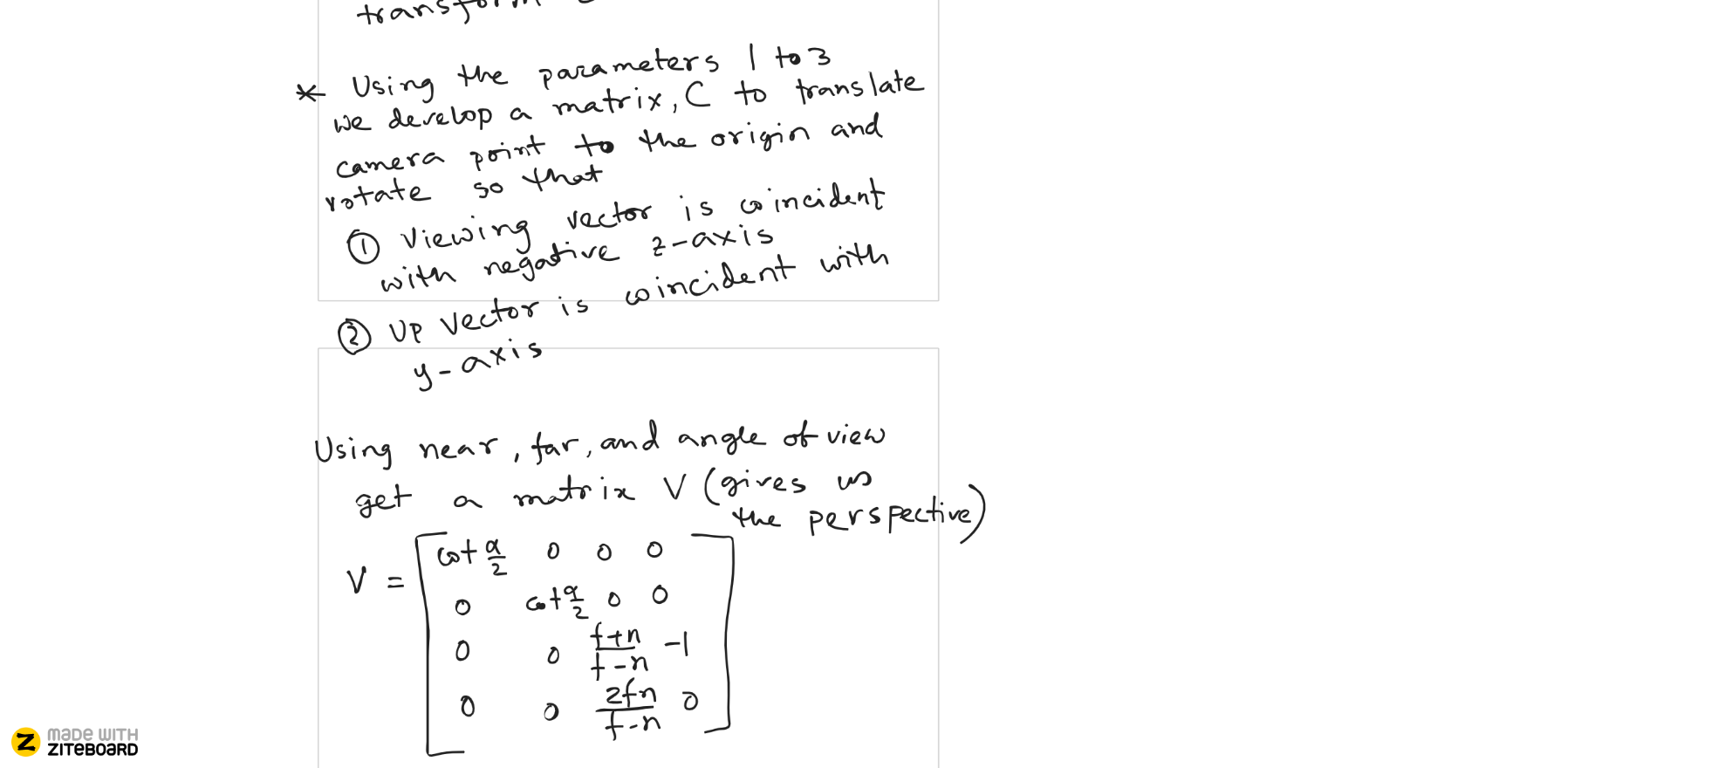

Slide 20
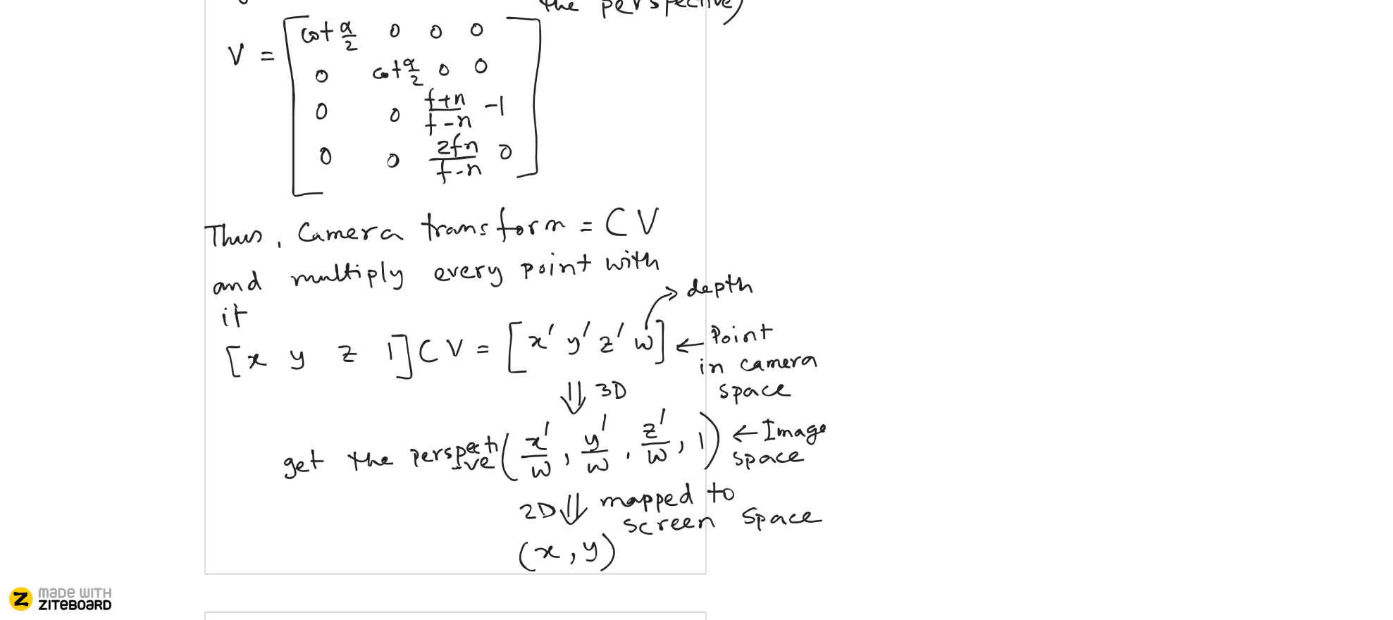

Slide 21
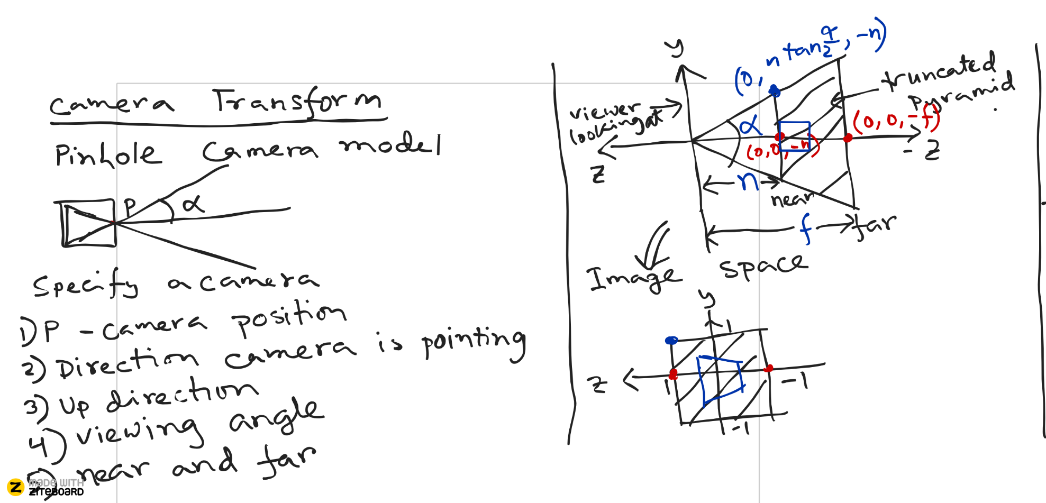

Slide 22
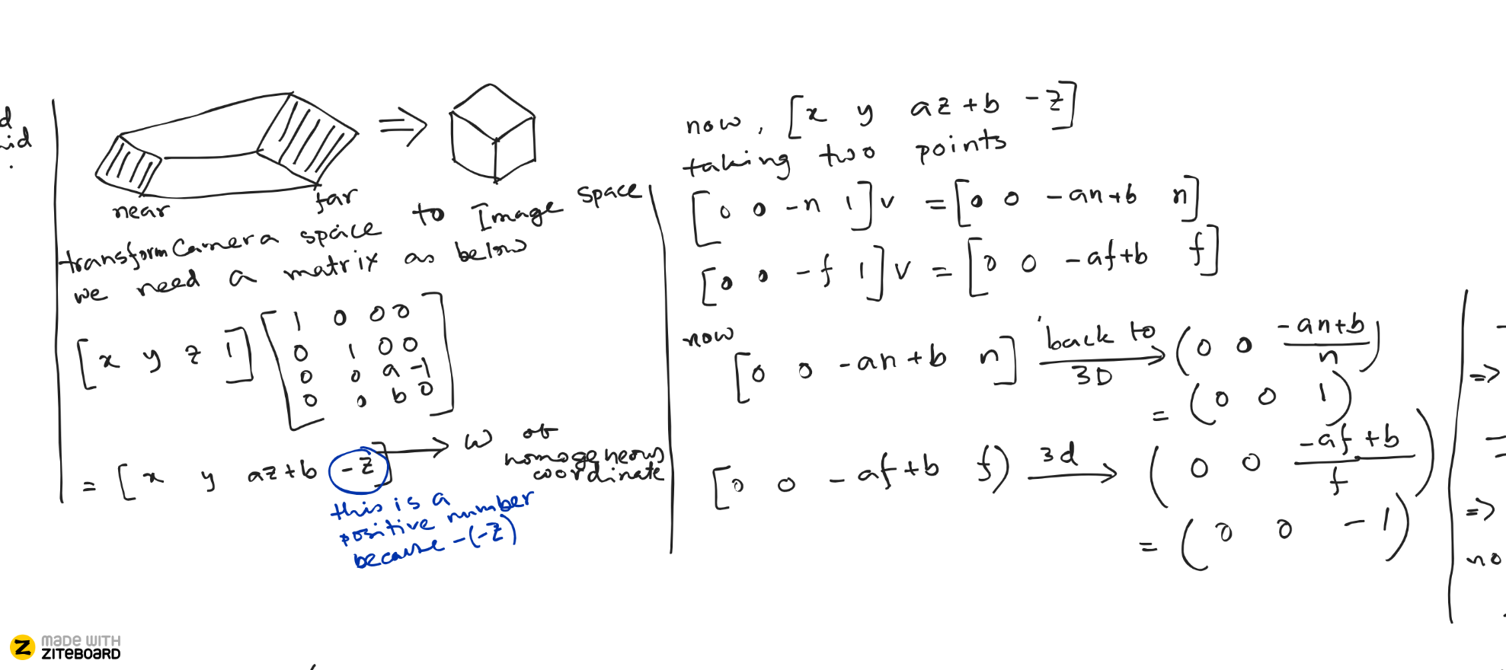

Slide 23
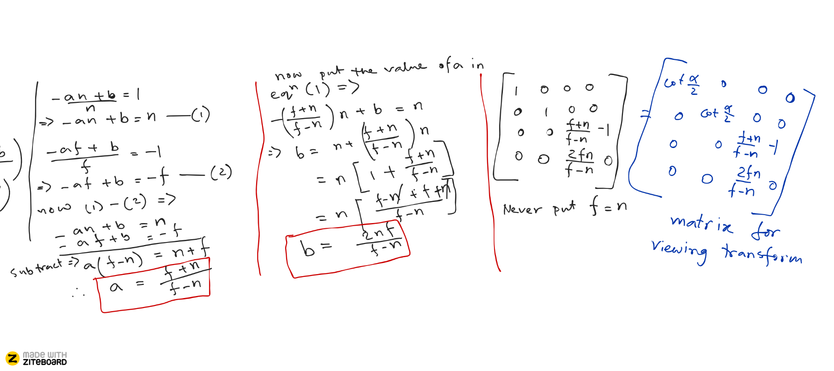

Slide 24
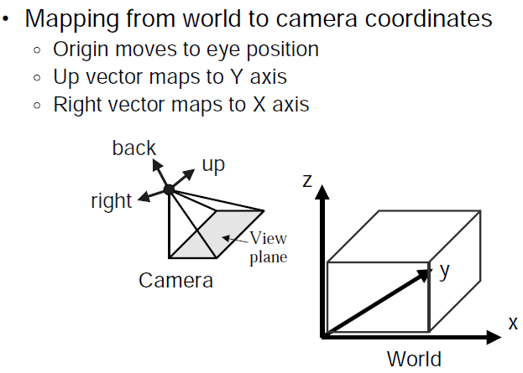
Viewing Transformations

Slide 25
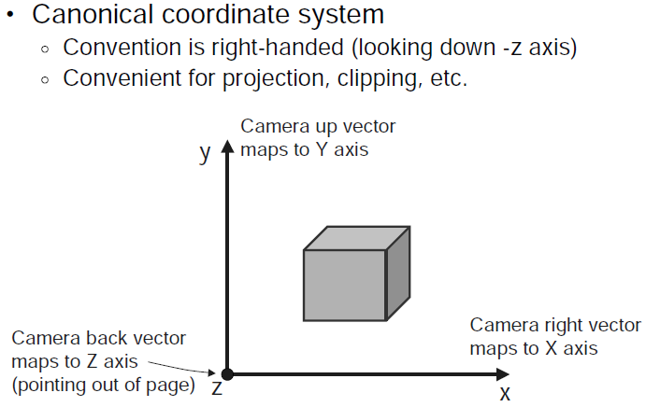
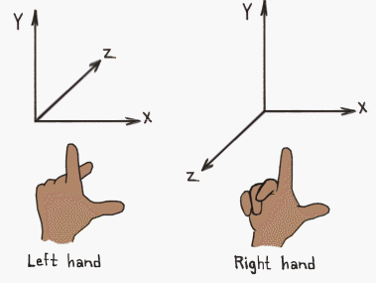
Camera Coordinates

Slide 26
Viewing Transformation
Fortunately, there’s a handy function for this in OpenGL:
gluLookAt( GLdouble e_x, GLdouble e_y, GLdouble e_z, GLdouble c_x, Gldouble c_y, GLdouble c_z, GLdouble u_x, GLdouble u_y, GLdouble u_z )
e_x, e_y, and e_z specify the desired viewpoint
c_x, c_y, c_z specify some point along the desired line of sight
u_x, u_y, and u_z define the up vector of our camera
Since we want to transform to our viewpoint before transforming our objects, we want this to be the last transformation applied (which means we should call it first, right after we load the identity).

Slide 27
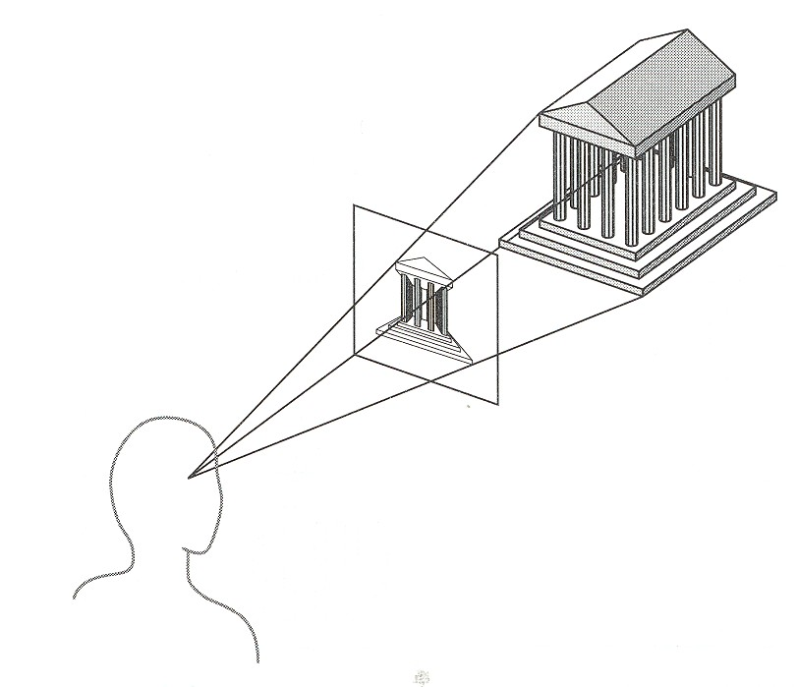
Projection
General definition:
Transform points in n-space to m-space (m<n)
In computer graphics:
Map 3D camera coordinates to 2D screen coordinates

Slide 28
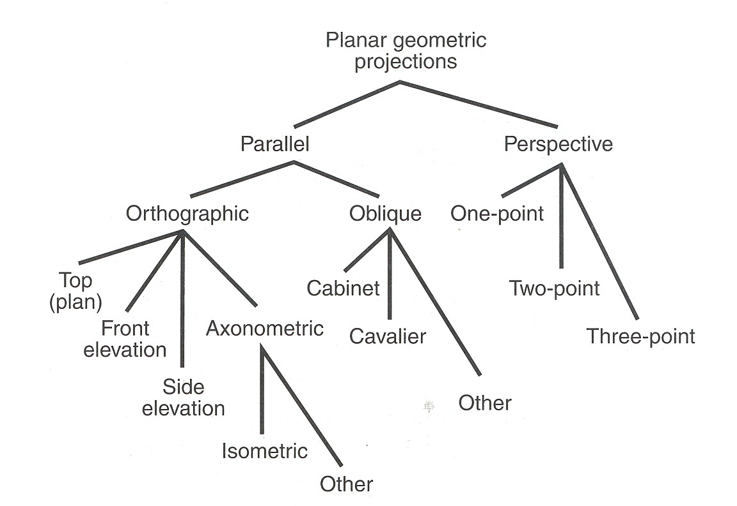
Taxonomy of Projections

Slide 29
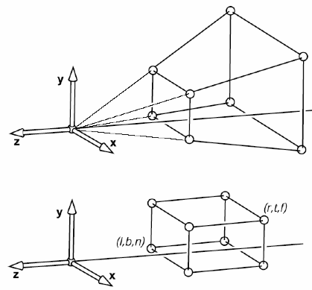
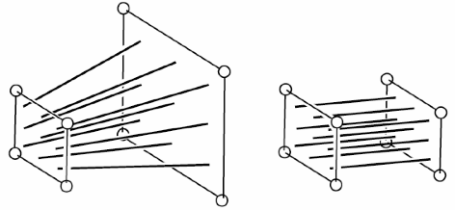
Perspective and Parallel Projection

Slide 30
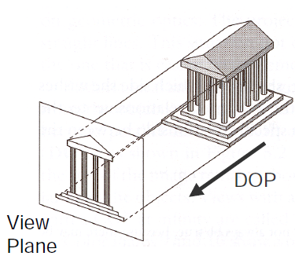
Parallel Projection
Center of projection is at infinity
Direction of projection (DOP) same for all points

Slide 31
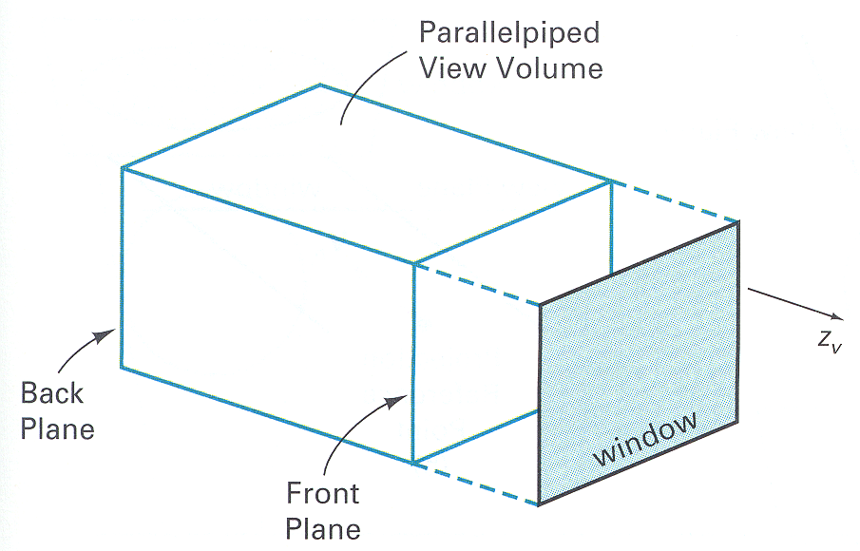
Parallel Projection View Volume

Slide 32
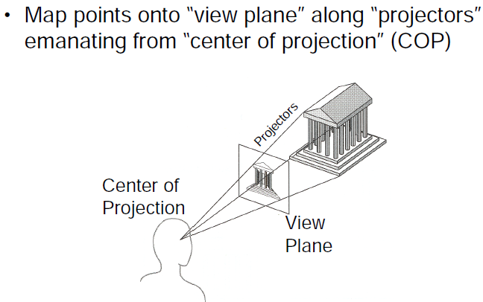
Perspective Projection

Slide 33
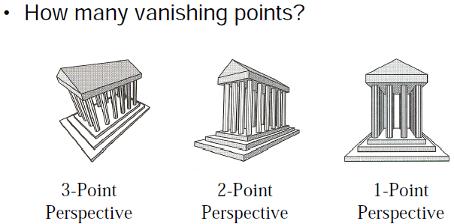
Perspective Projection

Slide 34
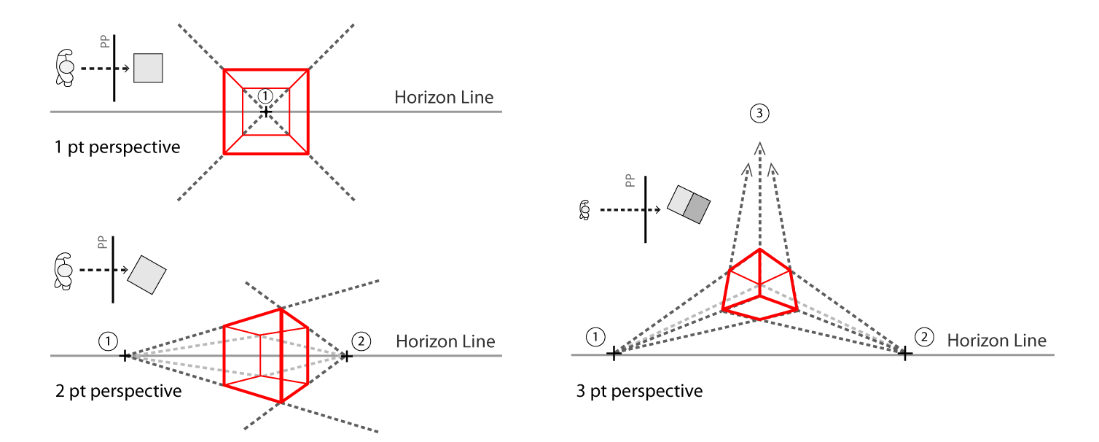
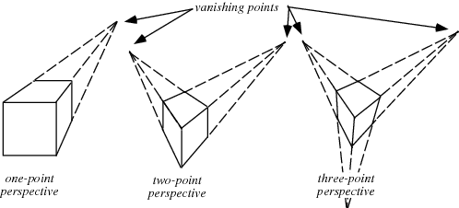
Perspective Projection

Slide 35
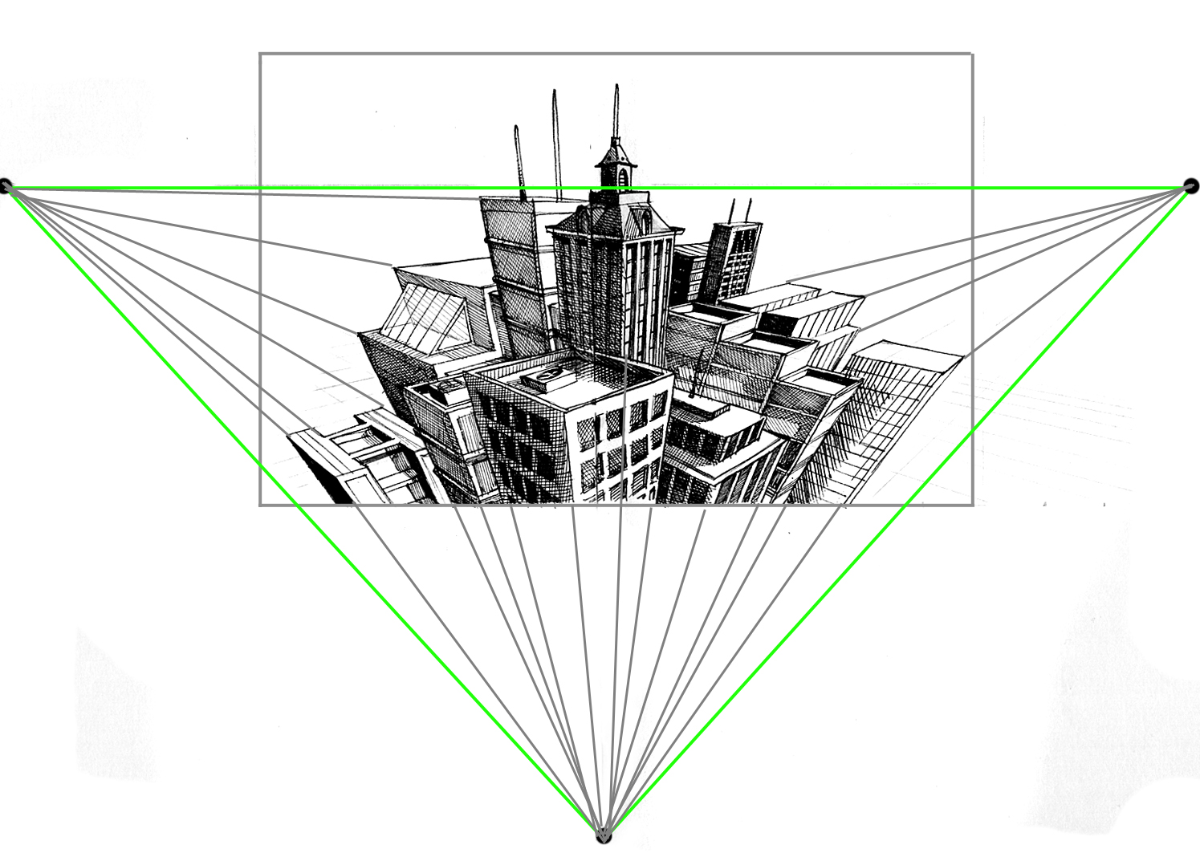
Perspective Projection

Slide 36
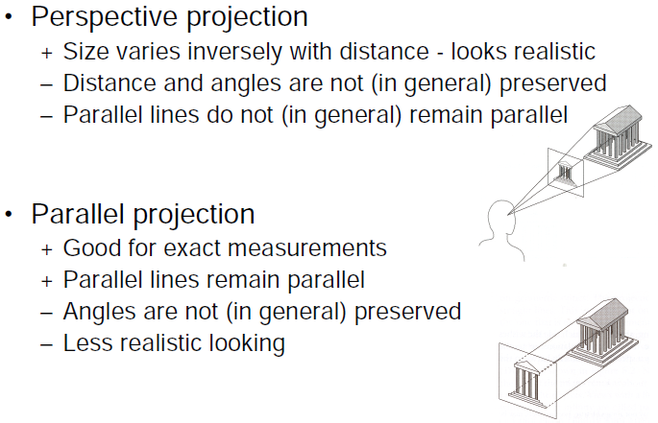
Perspective vs. Parallel

Slide 37
Projections in OpenGL
Matrix mode use is similar:
glMatrixMode(GL_PROJECTION)
We are really concerned with only two types of projection transformations:
§ Orthographic (Parallel) projection
▪ Our viewing volume is rectangular and all objects appear the same size no matter the distance
§ Perspective projection
▪ Uses perspective to give a sense of depth. Our viewing
volume is conical or pyramidal in shape.

Slide 38
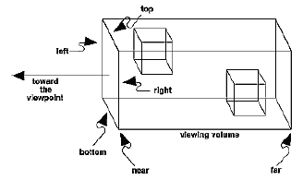
Orthographic Projections
glOrtho( GLdouble left, GLdouble right, GLdouble bottom, GLdouble top, Gldouble near, GLdouble far)
§ left, right, top, and bottom define the boundaries of the near/far clipping planes
§ near and far specify how far from the viewpoint the near and far clipping planes are

Slide 39
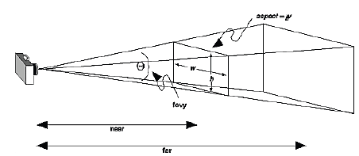
Perspective Projections
gluPerspective( GLdouble fovy, Gldouble aspect, GLdouble near, GLdouble far )
§ fovy is the angle in the field of view (in range from [0.0, 180]
§ aspect is the aspect ratio of the frustrum (width of window over height of window)
§ near and far are the values between viewpoint and the near/far clipping planes

