Slide 1

14
Ready Notes
Managing Human Resources in Organizations
For in-class note taking, choose Handouts or Notes Pages from the print options, with three slides per page.

Slide 2

The Environmental Context of Human Resource Management
What is Human Resource Management?
  (HRM), the set of organizational activities directed at attracting, developing, and maintaining an effective workforce.
Why Human Resource Management?
  Human resources are critical for effective organizational functioning.

Slide 3
The Strategic Importance of HRM
What is the status of HRMs in organizations?
  Once regarded as second class, the HRMs now play an important role because of:
    Increased legal complexities.
    Improving productivity.
    Awareness of the costs associated with poor HRM.

Slide 4

The Legal Environment of HRM
Title VII of the Civil Rights Act of 1964:
  Forbids discrimination on the basis of gender, race, color, religion, or national origin in all areas of the employment relationship.
Adverse impact:
  When minority group members pass a selection standard at a rate less than 80 percent of the rate of majority group members.

Slide 5
Equal Employment Opportunity Commission
What is it?
  Charged with enforcing Title VII of the Civil Rights Act of 1964, as well as several other employment-related laws.
Can you define the Age Discrimination in Employment Act?
  Outlaws discrimination against people older than forty years; passed in 1967, amended in 1978 and 1986.

Slide 6

Affirmative Action
What was the intention of this legislation?
  Intentionally seeking and hiring employees from groups that are underrepresented in the organization.

Slide 7

Americans with Disabilities Act
Who is protected by this legislation?
  Forbids discrimination on the basis of disabilities and requires employers to provide reasonable accommodations for disabled employees.

Slide 8
Civil Rights Act of 1991
How has this legislation affected discrimination lawsuits?
  Amends the original Civil Rights Act, making it easier to bring discrimination lawsuits while also limiting punitive damages that can be awarded in those lawsuits.

Slide 9

Fair Labor Standards Act
How does this act protect wages?
  Sets a minimum wage and requires overtime pay for work in excess of forty hours per week; passed in 1938 and amended frequently since then.

Slide 10
Equal Pay Act of 1963
What does this legislation require?
  Requires that men and women be paid the same amount for doing the same job.
What standards does the Employee Retirement Income Security Act of 1974 (ERISA), set?
  Sets standards for pension plan management and provides federal insurance if pension funds go bankrupt.

Slide 11
Family and Medical Leave Act of 1993
What does this act require?
  Requires employers to provide up to twelve weeks of unpaid leave for family and medical emergencies.
What procedures does the National Labor Relations Act call for?
  Passed in 1935 to set up procedures for employees to vote whether to have a union; also known as the Wagner Act.

Slide 12

National Labor Relations Board
What is its function?
  Established by the Wagner Act to enforce its provisions.
What does the Labor Management Relations Act limit?
  Passed in 1947 to limit union power; also known as the Taft Hartley Act.

Slide 13

OSHA
What does OSHA stand for?
  Occupational Safety and Health Act of 1970: Directly mandates the provisions of safe working conditions.

Slide 14

Change and HRM
What does “Employment at Will” limit?
  A traditional view of the workplace in which organizations can fire their employees for any reason; recent court judgments are limiting employment-at-will.

Slide 15
Attracting Human Resources
What is a Job Analysis?
  A systematic analysis of jobs within an organization.
How do HRMs forecast human resource demand and supply?
  Assessing trends.
  Sales forecast analysis.
  Forecasting the labor supply.
  Plan for dealing with predicted shortfalls or overstaffing.

Slide 16
Human Resource Planning
Assess trends in:
External labor market
Current employees
Future organizational plans
General economic trends
Predict demand
Forecast internal supply
Forecast external supply
Compare future demand and
internal supply
Plan for dealing with predicted
shortfalls or overstaffing

Slide 17
Recruiting Human Resources
What does recruiting consist of?
  Attracting qualified persons to apply for the jobs that are open.
What are the forms of recruiting?
  Internal recruiting: considering present employees as candidates for openings.
  External recruiting: attracting persons outside the organization to apply for jobs.

Slide 18
Developing Human Resources
What does training mean?
  Teaching operational or technical employees how to do the job for which they were hired.
What is employee development?
  Teaching managers and professionals the skills needed for both present and future jobs. (see next slide Figure 14.2 for illustration on training)

Slide 19
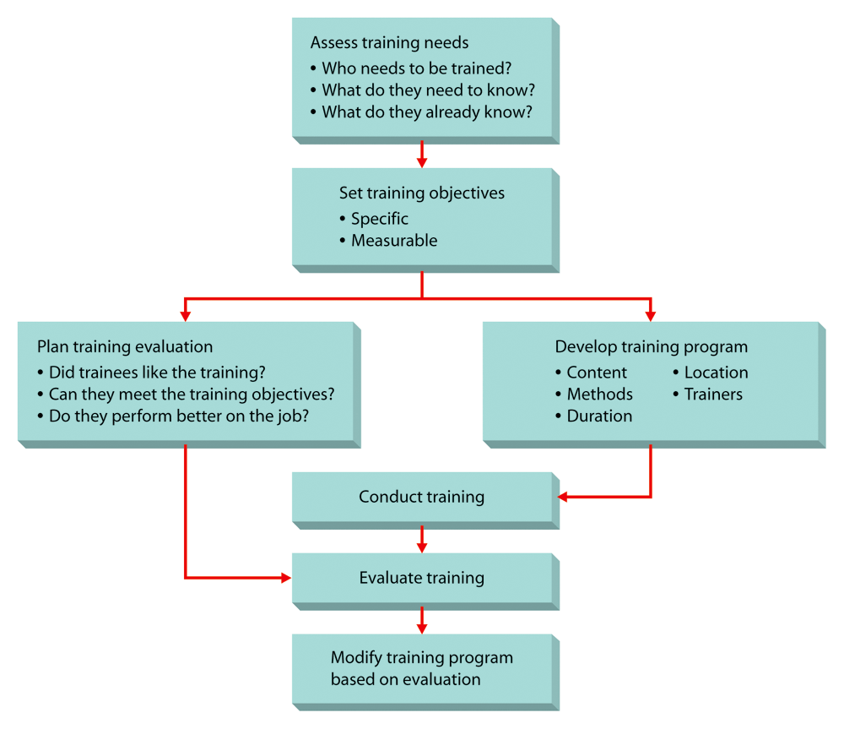
Figure 14.2: The Training Process

Slide 20
Selecting Human Resources
Validation, determining the extent to which a selection device is predictive of future job performance
Application
Blanks
Tests
Interviews
Assessment
Centers

Slide 21
Assess training needs
Who needs training?
What do they need to know?
What do they already know?
Set training objectives
Specific Measurable
Plan training evaluation
Did trainees like the training?
Can they meet training objectives?
Do they perform better on the job?
Develop training program
Content Location
Methods Trainers
Duration
Conduct training
Evaluate training
Modify training program
based on evaluation

Slide 22
What Is a Performance Appraisal?
A formal assessment of how well an employee is doing his or her job.
There are various form of appraisals such as:
  Behaviorally anchored rating scale (BARS), a sophisticated rating method in which supervisors construct a rating scale associated with behavioral anchors. (see next two slides for Figures 14.3 and 14.4)

Slide 23
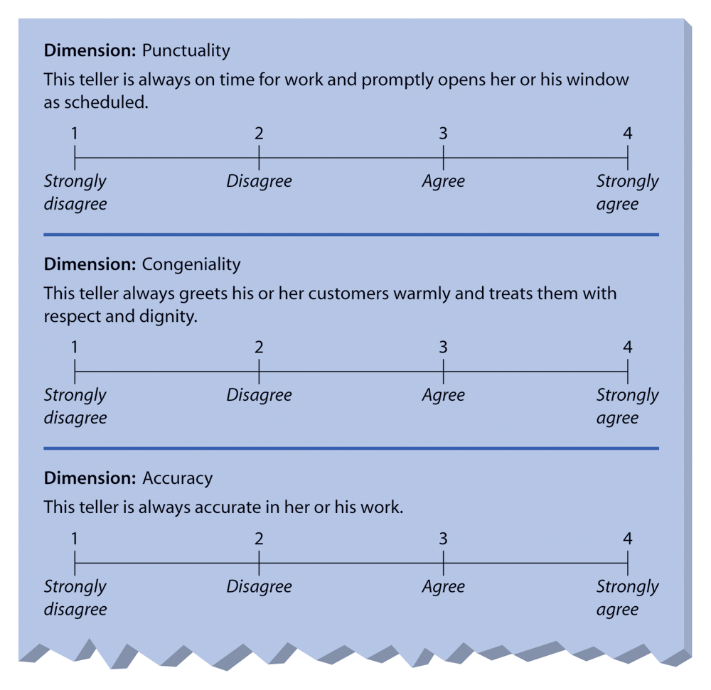
Figure 14.3: Graphic Rating
Scales for a Bank Teller

Slide 24
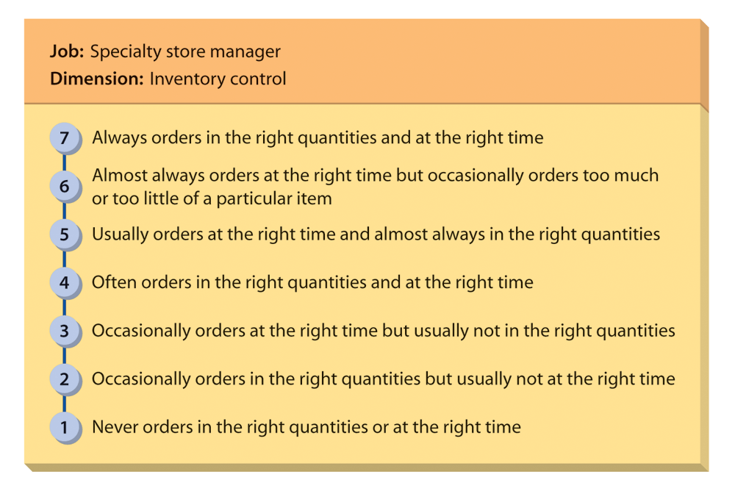
Figure 14.4: Behaviorally
Anchored Rating Scale

Slide 25
Determining Compensation
Compensation is the financial remuneration given to employees by the organization for their work, based on:
Wage-Level
Decision
Wage-Structure
Decision
Individual Wage
Decisions

Slide 26
Can You Define Labor Relations?
The process of dealing with employees when they are represented by a labor union. (see next slide Figure 14.5)
Define the following:
  Collective bargaining
    The process of agreeing on a satisfactory labor contract.
  Grievance procedure
    The means by which a labor contract is enforced.

Slide 27
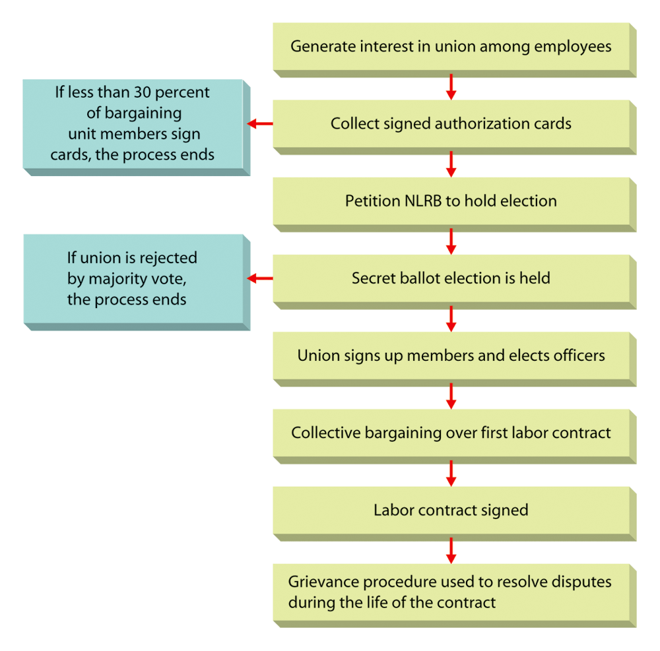
Figure 14.5: The Union-Organizing Process

