Slide 1
14
Ready Notes
Managing Human Resources in Organizations
For in-class note taking, choose Handouts or Notes Pages from the print options, with three slides per page.

Slide 2
6.1 Definition of Human Resource Management
What is Human Resource Management?
  (HRM), the set of organizational activities directed at attracting, developing, and maintaining an effective workforce.
Human resource management (HRM) is the process of acquiring, training, appraising, and compensating employees, and of attending to their labor relations, health and safety, and fairness concerns. (Garry Dessler)
Copyright © Houghton Mifflin Company. All rights reserved.
14 - <number>

Slide 3
In other words, HRM is (i) getting people, (ii) preparing people, (iii) stimulating them, and (iv) keeping them
Why Human Resource Management?
Human resources are critical for effective organizational functioning.
Copyright © Houghton Mifflin Company. All rights reserved.
14 - <number>

Slide 4
6.2 SCOPE OF HRM
The HRM process includes the followings:
Conducting Job Analyses—determining the nature of each employee’s job.
Planning Labor Needs and Recruiting Job Candidates
Selecting Job Candidates
Orienting and Training New Employees
Managing Wages and Salaries—compensating employees
Providing Incentives and Benefits

Slide 5
Appraising Performance
Communicating—Interviewing, Counseling, Disciplining
Training and Developing Managers
Building Employee Commitment
And what a manager should know about:
Equal employment and affirmative action
Employee health and safety
Handling grievance and labor relations

Slide 6
6.3 Why is HR Management Important to All Managers?
HR Management is important to all types of managers because of being careful about the following mistakes regarding the managing of people.
Hire wrong person for the job.
Experience high turnover
Find your people not dong their best
Waste time with useless interviews

Slide 7
Have your company taken to court because of discriminatory actions
Have your company cited under occupational safety laws for unsafe practices
Have some employees think that their salaries are unfair and inequitable relative to others in the organization.
Allow a lack of training to undermine your department’s effectiveness
Commit any unfair labor practices.

Slide 8
6.4 Human Resource Manager’s Duties
In providing the specialized assistance, the human resource manager carries out three distinct functions:
A line function
A coordinative function
Staff function

Slide 9
1. A Line Function:
The HR manager directs the activities of the people in his or her own department and in related service areas, like the plant cafeteria. In other words, he or she exerts line authority within the HR department. While they generally, can’t wield line authority outside HR, they are likely to exert implied authority. This is because line managers know HR has top management’s ear in areas like testing and affirmative action. As a result, HR mangers’ “suggestions” are often seen as “orders from top-side.” And, as you might imagine, this carries even more weight with supervisors troubled by staffing problems.

Slide 10
2. Staff (service) function
Assisting and advising line managers is the “bread and butter” of the HR manager’s job. For example, HR assists in the hiring, training, evaluating, rewarding, counseling, promoting,, and firing of employees. It also administers the various benefits programs (health and accident insurance, retirement, vacation, and so on). It helps line managers comply with equal employment and occupational safety laws, and plays an important role in handling grievances and labor relations. It “up-to-date” information on current trends and new methods of solving problems.

Slide 11
3. A Coordinative Function
HR managers also coordinate personnel activities, a duty often referred to as functional control. Here the HR manager and department act as the “right arm of the top executive” to ensure that the line managers are implementing the firm’s HR objectives, polices, and procedures.

Slide 12
Human Resource Management Specialties
Recruiter –search for qualified applicants
Equal employment opportunity (EEO) coordinators—investigate and resolve EEO grievances; examine organizational practices of potential violations; and compile and submit EEO reports.
Job Analysts—collect and examine information about jobs to prepare descriptions
Compensation managers
Training specialists
Labor relations specialists

Slide 13
6.5 New Approaches to Organizing HR
The Transactional HR group- focuses on using centralized call centers and outsourcing arrangements with vendors to provide specialized support in day-to-day transactional HR activities to the company’s employees.
The Corporate HR group—focuses on assisting top management in “top level” big picture issues such as developing company’s long-term strategic plan.

Slide 14
The Embedded HR unit—assigns HR generalists (a.k.a “relationship managers” or “HR business partners”) directly to departments like operations or production, to provide the localized human resource management assistance the departments need.
The centers of expertise are like specialized HR consulting firm within the company—for instance, providing specialized assistance in areas such organizational change.

Slide 15
The Embedded HR unit—assigns HR generalists (a.k.a “relationship managers” or “HR business partners”) directly to departments like operations or production, to provide the localized human resource management assistance the departments need.
The centers of expertise are like specialized HR consulting firm within the company—for instance, providing specialized assistance in areas such organizational change.

Slide 16
6.5 HR’s Role as a Strategic Partner
There are different views on the role of HR activities in an organization and these views are summarized below:
1. HR as a Staff or Advisory Function
HR is strictly operational and that HR activities are not strategic at all. According to this line of reasoning, HR activities involve putting out small fires—ensuring that people are paid on the right day; the job advertisement meets the newspapers deadline; and a suitable supervise is recruited for the right shift for the time it goes ahead.

Slide 17
2. Compatible to Company Strategy
A second, more expansive, view is that HR’s role is to fit or adapt to the company’s strategy.
Here HR’s strategic role is to adapt individual HR practices (recruiting, rewarding and so on) to fit specific corporate and competitive strategies. Top management crafts a corporate strategy and then HR creates the HR programs required to execute corporate strategy.

Slide 18
3. Equal Partner in Strategic Planning Process
A third view of HR management is that it is an equal partner in the strategic planning process. Here HR’s role is not just to adapt its activities neither to the firm’s business strategy, nor, certainly, just to carry out operational day-to-day tasks like paying employees. Instead, the need to forge the firm’s workforce into a competitive advantage means that HR management must be an equal partner in both the formulation and implementation of the company’s strategies.

Slide 19
6.6 The Strategic Importance of HRM
What is the status of HRMs in organizations?
  Once regarded as second class, the HRMs now play an important role because of:
    Increased legal complexities.
    Improving productivity.
    Awareness of the costs associated with poor HRM.
Copyright © Houghton Mifflin Company. All rights reserved.
14 - <number>

Slide 20
HR’s Role in Executing Strategy
Execution has traditionally been the heart of HR’s strategic role, and that makes sense. A firm’s functional strategies should support its competitive strategies. A different firm with different competitive strategy might well have a very different approach to HR.
HR supports strategy implementation in different ways:
HR creates a committed, competent, and customer-oriented workforce for implementing firm’s strategies.

Slide 21
HR handles the execution of most firm’s downsizing and restructuring strategies—by outplacing employees, instituting pay-or-performance plans, reducing health care costs, and retraining employees.
HR plays strategic role in merging wildly divergent cultures into a multicultural organizations.

Slide 22
HR handles the execution of most firm’s downsizing and restructuring strategies—by outplacing employees, instituting pay-or-performance plans, reducing health care costs, and retraining employees.
HR plays strategic role in merging wildly divergent cultures into a multicultural organizations.

Slide 23
HR applies the value chain analysis to find the ingenious ways to deliver their own services more cost effectively. Strategies execution usually involves identifying and reducing cost, and thereby value chain analysis. A company’s value chain identifies the primary activities that create value for customers and the related activities. Every business consists of chain of activities, each of which contributes to designing, producing, marketing, and delivering a product or service. Each activity gives rise to costs.

Slide 24
Outsourcing—letting outside vendors provide services—is another option through which HR can reduce its costs. Outsourcing one or more of HR activities such as temporary staffing, recruiting, benefits administration, payroll, and training.

Slide 25
HR’s Role in Formulating Strategy
Formulating a strategic plan requires identifying, analyzing, and balancing the company’s external opportunities and threats, and its internal strengths and weakness. HR plays a role here, too. Some of the examples are listed below:
HR managers can help with what strategic planners call environmental scanning, identifying and analyzing external opportunities and threats that may be crucial to the firm’s success.

Slide 26
Formulating plans require competitive intelligence, and HR management can supply useful information. Details regarding competitors’ incentive plans, and information about pending legislation like labor laws or mandatory health are some examples.
HR also supplies information regarding the company’s internal strengths and weakness.
Many firms even build their strategies around on HR –based competitive advantage.

Slide 27
Formulating plans require competitive intelligence, and HR management can supply useful information. Details regarding competitors’ incentive plans, and information about pending legislation like labor laws or mandatory health are some examples.
HR also supplies information regarding the company’s internal strengths and weakness.
Many firms even build their strategies around on HR –based competitive advantage.

Slide 28
6.7 Job Analysis
A job analysis is the systematic exploration of the activities within a job. Alternatively, it is a process in which information about a job is systematically collected, evaluated, and organized.
As HR activities grow in scope and complexity, many duties, such as recruiting and compensating, are delegated to the HR department. But HR specialists do not know the details of jobs as well as operating managers do.
Copyright © Houghton Mifflin Company. All rights reserved.
14 - <number>

Slide 29
Job Description and Job Specification
The job analysis process results in two very important documents: the job description and the job specification.
Job Descriptions: A job description is a written statement of what the jobholder does, how is it done, under what conditions it is done, and why it is done. It describes the duties, responsibilities, working conditions, and activities of a particular job.

Slide 30
A common format of the job description includes:
Job Title
The duties to be performed
The distinguishing characteristics of the job
Environmental conditions
Authority and responsibility of the jobholders

Slide 31
Job specifications
The job specification states the minimum acceptable qualification that the incumbent must posses to perform the job most successfully. Based on the information through job analysis, the job specification identifies the knowledge, skills, education, experience, certification, and abilities needed to do the job effectively.

Slide 32
6.8 HR Planning
Human resource planning is the process of systematically making decisions regarding the acquisition and utilization of human resources.
Armed with information about jobs and their design, human resource planning forecasts an organization’s future demand for and supply of employees.
Copyright © Houghton Mifflin Company. All rights reserved.
14 - <number>

Slide 33
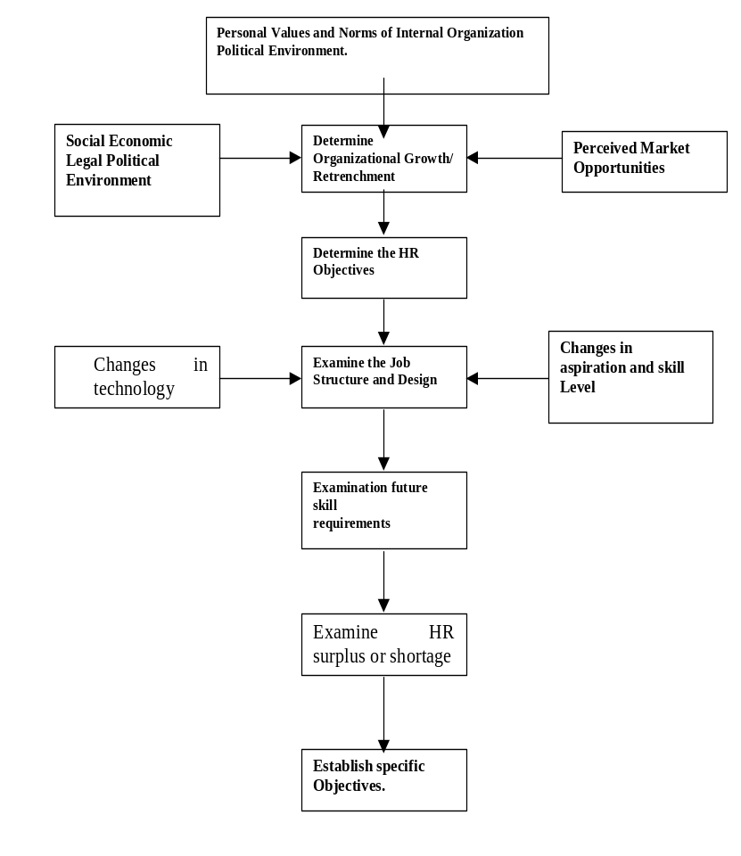
Exhibit 6.1 A Model of Constructing Human Resource Plan

Slide 34
6.9 Recruiting and Selecting Human Resources
What does recruiting consist of?
  Attracting qualified persons to apply for the jobs that are open.
What are the forms of recruiting?
  Internal recruiting: considering present employees as candidates for openings.
  External recruiting: attracting persons outside the organization to apply for jobs.
Copyright © Houghton Mifflin Company. All rights reserved.
14 - <number>

Slide 35
Meaning of Selection
Selection is the process of whittling down the applicant pool by using the various screening tools such as tests, assessment, background and reference checks. Given the pool of candidates that results from the recruitment efforts, selection is the mechanism that determines overall quality of an organization’s human resources.
Copyright © Houghton Mifflin Company. All rights reserved.
14 - <number>

Slide 36
Major Activities Associated with Employment in an Organization
The employment function in any organization may be concerned with some or all of the following activities:
Receiving applications
Interviewing applicants
Administering test to applicants
Conducting background investigations

Slide 37
Arranging for physical examinations
Placing and assigning new employees
Coordinating follow-up of this employees
Exit interviewing of departing employees
Maintaining appropriate records and reports.

Slide 38
6.10 Developing Human Resources
What does training mean?
  Teaching operational or technical employees how to do the job for which they were hired.
What is employee development?
  Teaching managers and professionals the skills needed for both present and future jobs. (see next slide Figure 14.2 for illustration on training)
Copyright © Houghton Mifflin Company. All rights reserved.
14 - <number>

Slide 39
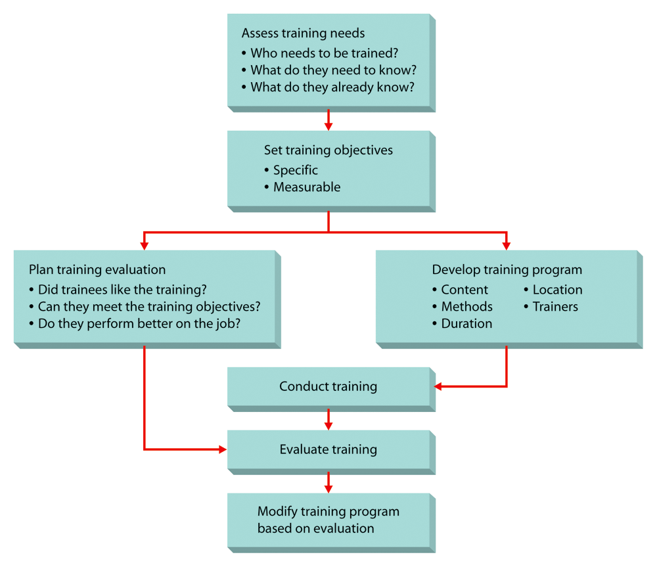
Figure 14.2: The Training Process
Copyright © Houghton Mifflin Company. All rights reserved.
14 - <number>

Slide 40
Selecting Human Resources
Validation, determining the extent to which a selection device is predictive of future job performance
Application
Blanks
Tests
Interviews
Assessment
Centers
Copyright © Houghton Mifflin Company. All rights reserved.
14 - <number>

Slide 41
Assess training needs
Who needs training?
What do they need to know?
What do they already know?
Set training objectives
Specific Measurable
Plan training evaluation
Did trainees like the training?
Can they meet training objectives?
Do they perform better on the job?
Develop training program
Content Location
Methods Trainers
Duration
Conduct training
Evaluate training
Modify training program
based on evaluation
Copyright © Houghton Mifflin Company. All rights reserved.
14 - <number>

Slide 42
6.11 What Is a Performance Appraisal?
A formal assessment of how well an employee is doing his or her job.
There are various form of appraisals such as:
  Behaviorally anchored rating scale (BARS), a sophisticated rating method in which supervisors construct a rating scale associated with behavioral anchors. (see next two slides for Figures 14.3 and 14.4)
Copyright © Houghton Mifflin Company. All rights reserved.
14 - <number>

Slide 43
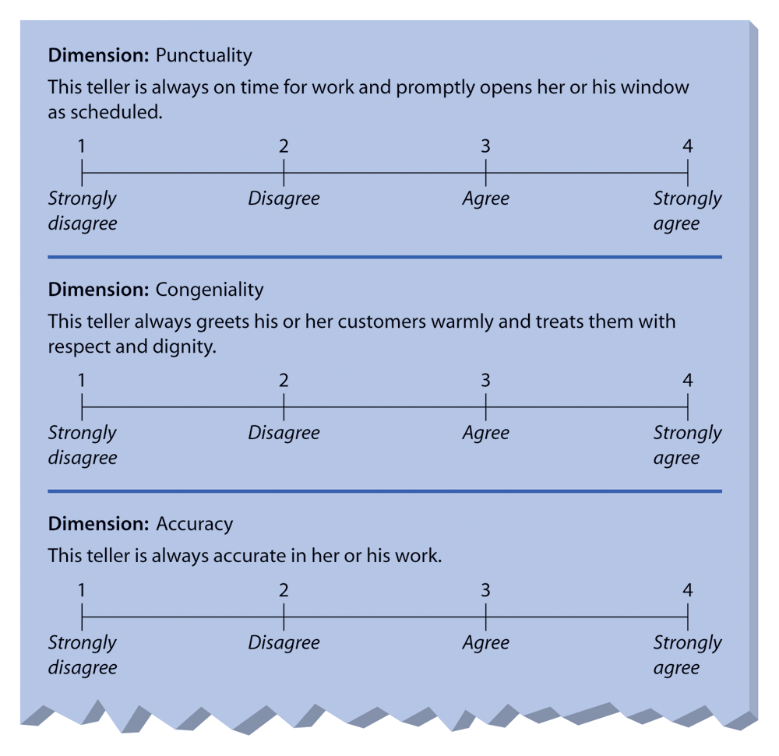
Figure 14.3: Graphic Rating
Scales for a Bank Teller
Copyright © Houghton Mifflin Company. All rights reserved.
14 - <number>

Slide 44
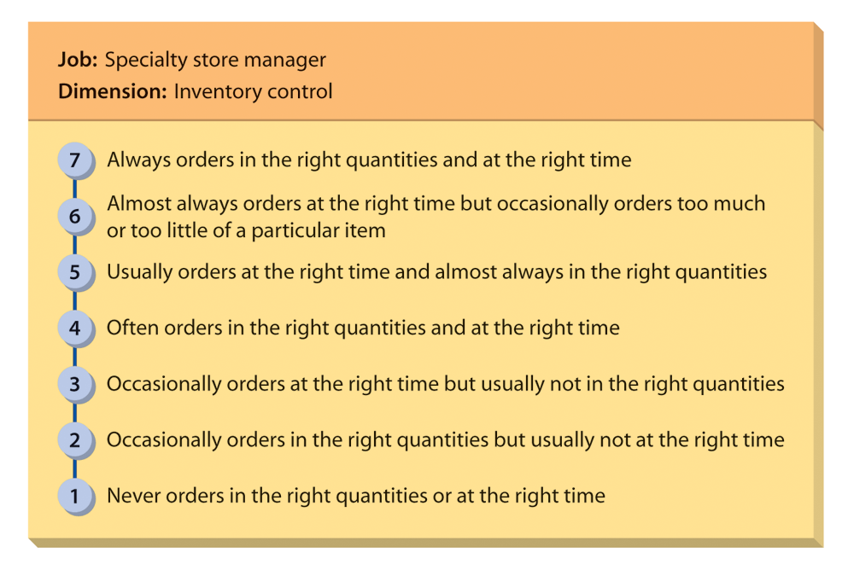
Figure 14.4: Behaviorally
Anchored Rating Scale
Copyright © Houghton Mifflin Company. All rights reserved.
14 - <number>

Slide 45
6.12 Compensation
Compensation is the financial remuneration given to employees by the organization for their work, based on:
Wage-Level
Decision
Wage-Structure
Decision
Individual Wage
Decisions
Copyright © Houghton Mifflin Company. All rights reserved.
14 - <number>

Slide 46
6.13 Can You Define Labor Relations?
The process of dealing with employees when they are represented by a labor union. (see next slide Figure 14.5)
Define the following:
  Collective bargaining
    The process of agreeing on a satisfactory labor contract.
  Grievance procedure
    The means by which a labor contract is enforced.
Copyright © Houghton Mifflin Company. All rights reserved.
14 - <number>

Slide 47
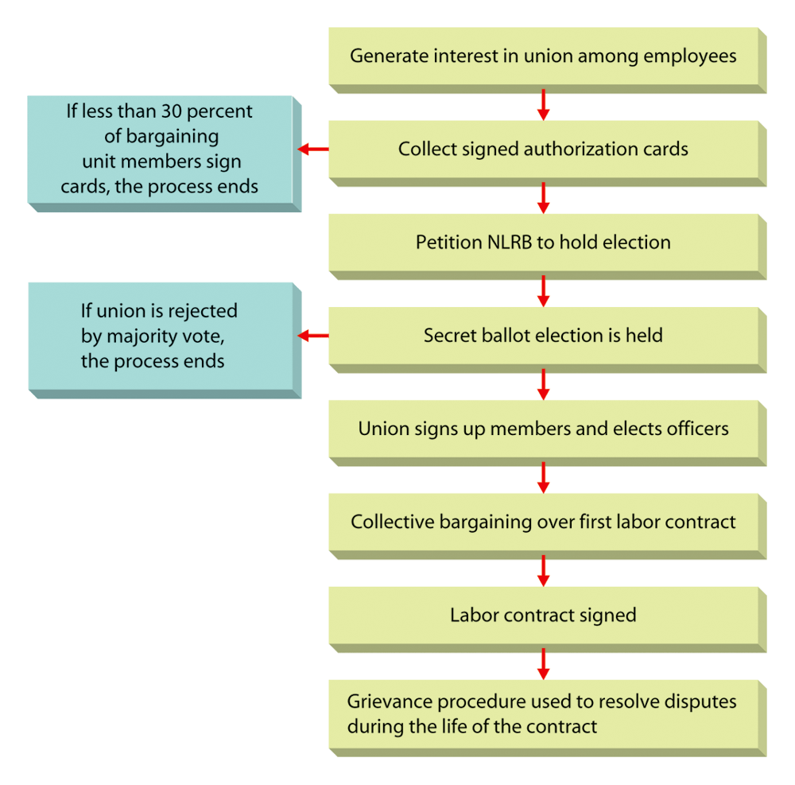
Figure 14.5: The Union-Organizing Process
Copyright © Houghton Mifflin Company. All rights reserved.
14 - <number>

