Slide 1

Computer Graphics
Illumination and Shading

Slide 2
Rendering Pipeline
transformation into
world coordinates
placement of
cameras and
light sources
transformation into
camera coordinates
modelling of
geometry
projection
clipping w.r.t.
view volume
backface
culling
hidden surface
removale (hsr)
rasterization
illumination and
shading

Slide 3
Illumination and Shading
illumination models (the ‘theory’)
  light sources
  light interaction with surfaces
  Phong illumination model
shading (the ‘implementation’)
  using illumination models to render polygonal surfaces
  variants: flat, Gouraud, Phong shading
  efficiency vs. quality

Slide 4
Illumination and Shading
Shading is referred to as the implementation of the illumination model at the pixel points or polygon surfaces of the graphics objects.
Shading model is used to compute the intensities and colors to display the surface. The shading model has two primary ingredients:
  properties of the surface and
  properties of the illumination falling on it.

Slide 5
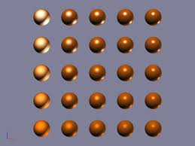
Illumination Models
General Introduction
Phong Illumination Model

Slide 6
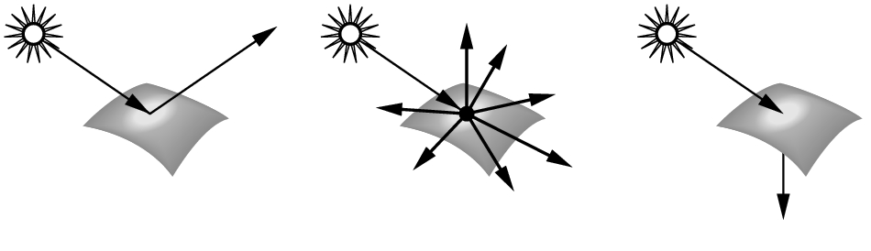
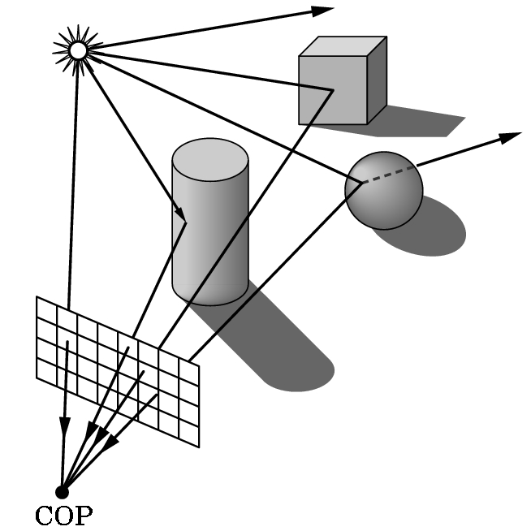
Illumination Models
real world:
  surfaces emit, absorb,
  reflect, and scatter light
  all above depend on surface position and orientation w.r.t. the light source
  light can bounce several times
  between surfaces in a scene
  different types of light sources
  final intensity/color at a point =
  sum of all light paths
  ending at that point

Slide 7
Illumination Models
computer graphics world:
  modeling reflection and refraction is very expensive (integral equation)
  we need approximations (O(N) for N objects)
    simplify light sources
    simplify object materials
    simplify light-vs-object interactions
    hardware acceleration

Slide 8
Illumination Models
global illumination models:
  consider inter-object light interactions
  (light can ‘bounce’ from object to object)
  e.g., radiosity and raytracing
local illumination models:
  only object-light interaction
  Phong illumination model
  implementation for polygonal objects

Slide 9
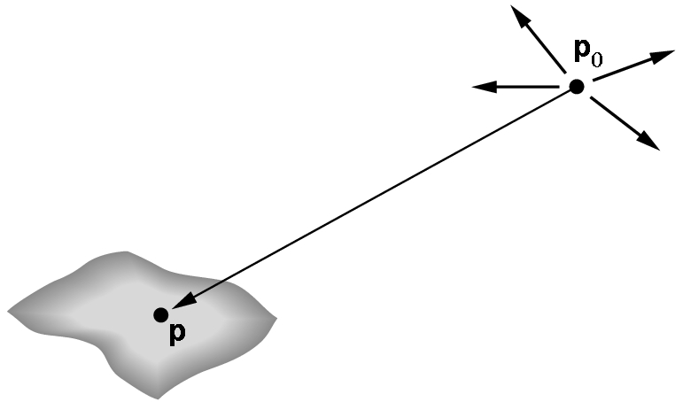
Light Sources in Computer Graphics
point light source:
  has only position and no size
  sends light equally in all directions
light ray
point light
illuminated surface

Slide 10
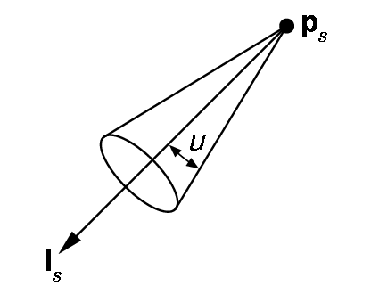
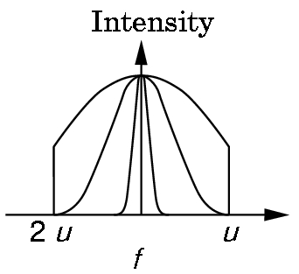
Light Sources in Computer Graphics
spot light source:
  point light source emitting a light-cone with intensity decreasing towards cone border
light ray
light direction

Slide 11
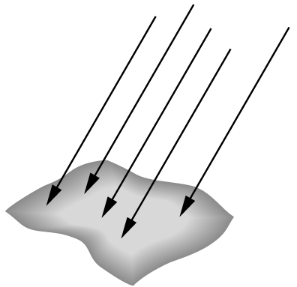
Light Sources in Computer Graphics
directional light source:
  sends directed, parallel light rays,
  has no position (or position is at infinity)

Slide 12
Light Sources in Computer Graphics
light attenuation
  light intensity decreases with distance d
  theoretically: I ~ 1/d²
  CG: I ~ 1/(a+bd+cd²)
light color
  modeled using RGB values
  approximation because light behavior depends on wave length

Slide 13


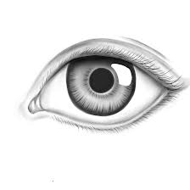
Light Interaction with Surfaces
light comes in at an angle θ (w.r.t. surface normal N)
light goes out around direction R
we look at surface from a direction V
Φ = angle(R,V) gives perceived
brightness
  maximal reflection if Φ = 0
  reflection decreases if Φ > 0
  this is called attenuation
N
θ
R
L
Φ
V
L – vector to light source
N – surface normal vector
R – reflected light ray
V – vector to viewer/observer

Slide 14
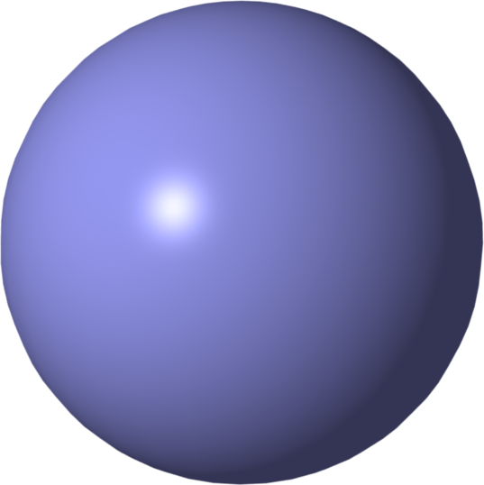
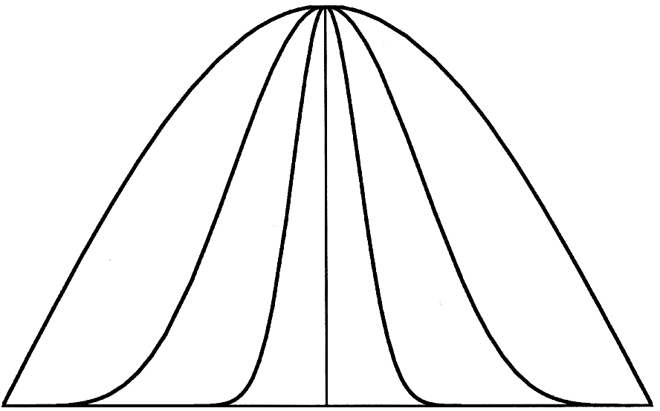
Light Interaction with Surfaces
directed (specular) reflection:
  depends on Φ=angle(R,V)
model: I ~ cos^{e}(Φ)
  metal surfaces: e ≈100..200
  plastic surfaces: e ≈2..10
  perfect mirror: e=∞
N
θ
R
L
Φ
V
e=1
e=2
L – vector to light source
N – surface normal vector
R – reflected light ray
V – vector to viewer/observer
e=5

Slide 15
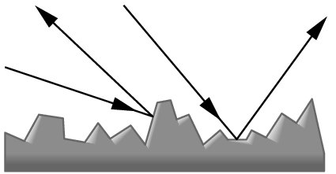
Light Interaction with Surfaces
diffuse reflection:
  rough surfaces (e.g. wood, stone)
  equal reflection in all directions Φ
  perceived intensity depends only on θ
physical model: surface = collection of many randomly oriented micro-facets

Slide 16
Phong Illumination Model (1973)
most common CG model for illumination
(by Bùi Tường Phong): I_{Phong} = I_{a} + I_{d} + I_{s}
ambient light:
  Ambient light is the illumination of an object caused by reflected light from other surfaces.
  needed since local illumination model does not consider ‘light bounces‘
diffuse light:
  light from diffuse reflection
specular light:
  light from directed reflection

Slide 17
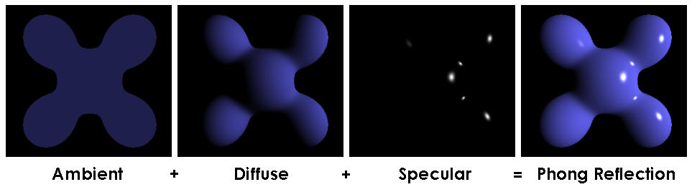
Phong Illumination Model (1973)
Visual illustration of the Phong equation: here the light is white, the ambient and diffuse colors are both blue, and the specular color is white, reflecting a small part of the light hitting the surface, but only in very narrow highlights. The intensity of the diffuse component varies with the direction of the surface, and the ambient component is uniform (independent of direction). A specular highlight is the bright spot of light that appears on shiny objects when illuminated

Slide 18
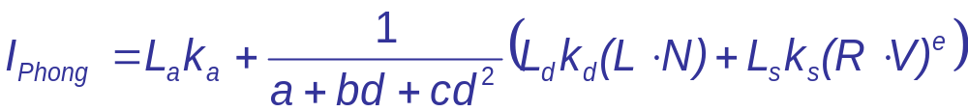
Phong Illumination Model
N
θ
R
L
Φ
V
L – vector to light source
N – surface normal vector
R – reflected light ray
V – vector to viewer/observer
L_{a}, L_{d}, L_{s}: give weights of ambient, diffuse, specular light components
k_{a},k_{d},k_{s}: give color components for the light
(Phong equation applied three times, once for R, then G, then B)

Slide 19
Phong Illumination Model
examples
  L_{a}=0, L_{d}=0.2, L_{s}=0.8: strong specular lighting
  L_{d}=0: no diffuse lighting
  k_{a}^{R}=k_{a}^{G}=k_{a}^{B}: white ambient light
  k_{a}^{R}=1,k_{a}^{G}=0,k_{a}^{B}=0: red ambient light
  k_{d}^{R}=1, k_{d}^{G}=0.6, k_{d}^{B}=0: orange diffuse color
  k_{s}^{R}=k_{s}^{G}=k_{s}^{B}=1: white specular highlight

Slide 20
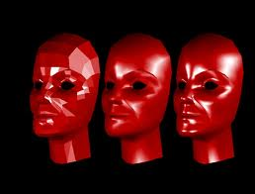
Shading Techniques
Flat, Gouraud, Phong Shading

Slide 21
Shading of Polygonal Models
status: we can compute color at a point
goal: we want to render the whole model
constraints: efficiency and quality
approach: shade all pixels of a polygon using color computation at vertices only
solutions:
  flat shading
  Gouraud shading
  Phong shading (≠ Phong illumination)

Slide 22
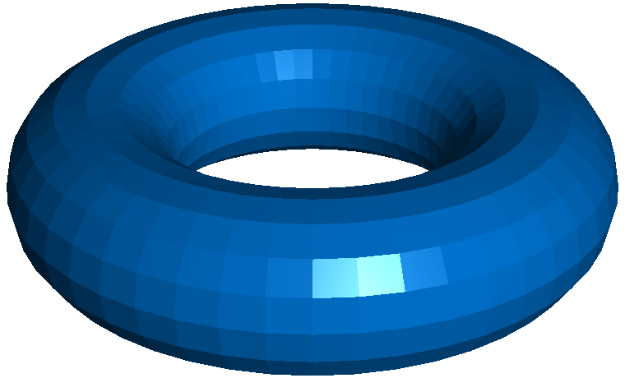
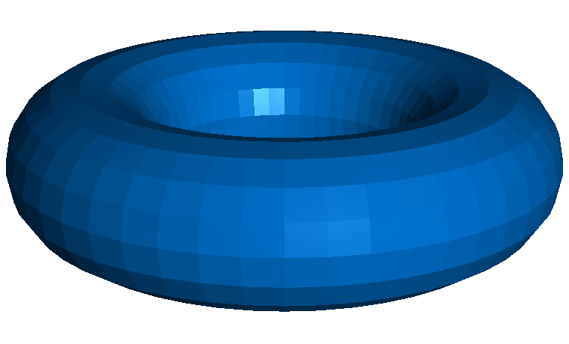
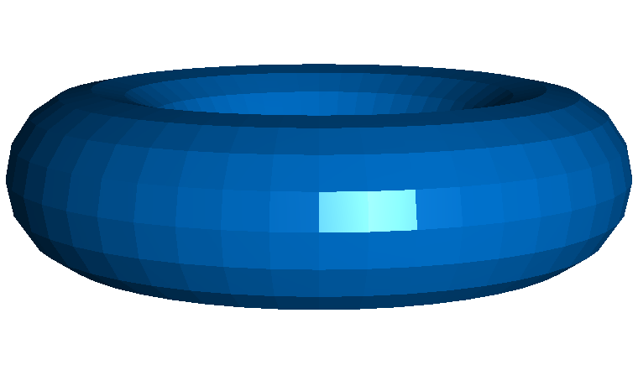
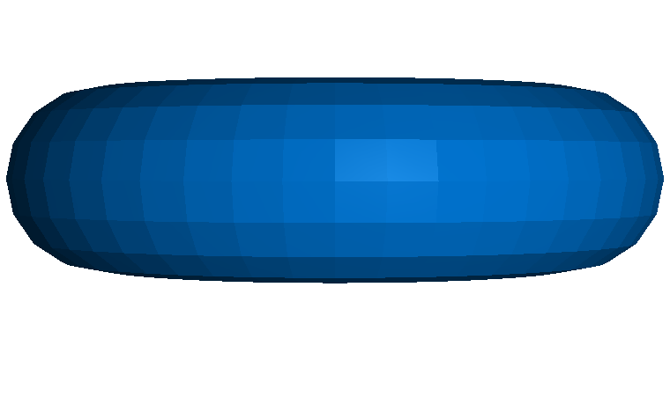
Flat Shading
polygon pixels: same color
no color interpolation
two methods:
  one point per
  polygon
  average of shading
  at polygon’s vertices
low quality: single primitives easily visible
fast computation
  find center c of polygon
  evaluate Phong illumination model at c
  use resulting color for all polygon pixels

Slide 23

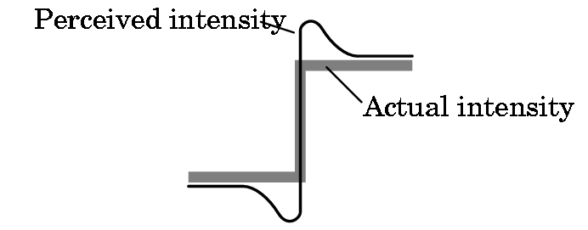
Flat Shading: Edge Perception
discontinuities easily visible and distracting
  contrasts are enhanced by visual system
  false ‘shading edges’ created in the process
Mach band effect

Slide 24
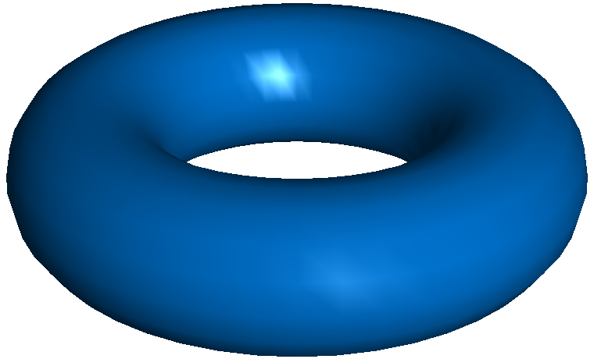
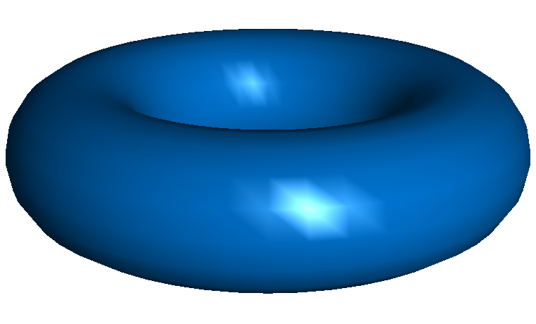
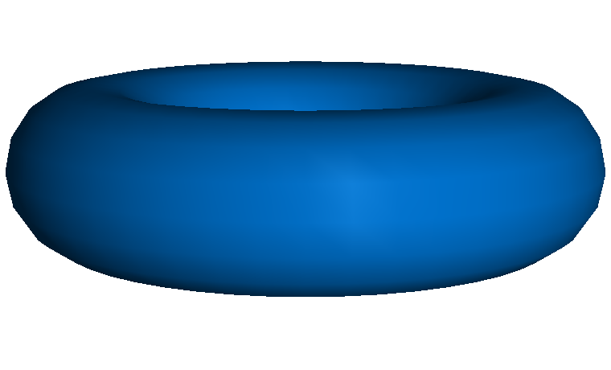
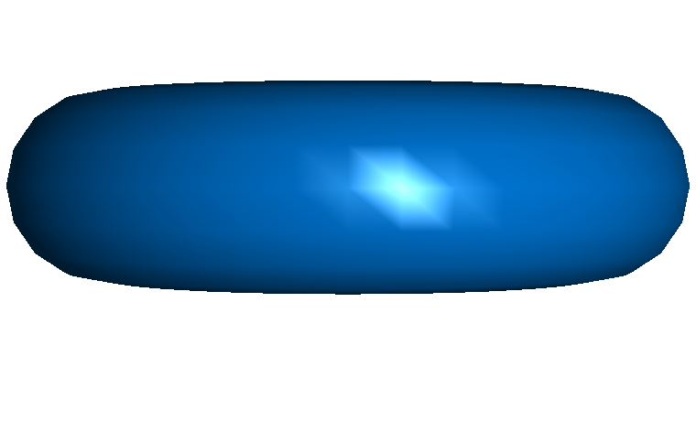
Gouraud Shading (1971)
compute Phong model at all
polygon vertices
linearly interpolate resulting
colors over polygon
Efficient implementation in
graphics hardware:
  together with the Z interpolation…
  …also interpolate a RGB color
highlight problems:
  highlight shapes are odd (show the polygon mesh)
  highlights in the middle of polygons cannot be modeled
  problem reason: our eyes are sensitive to the 2nd derivative of
  illumination, not just the 1st derivative

Slide 25
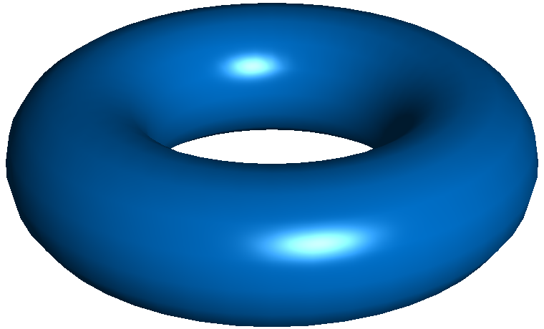
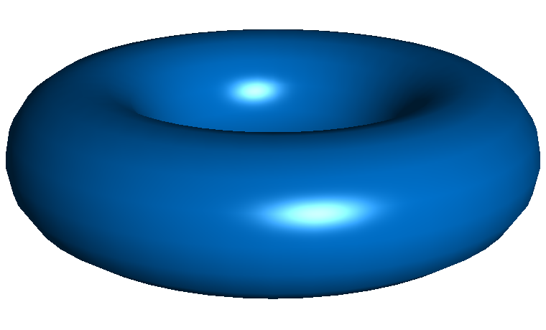
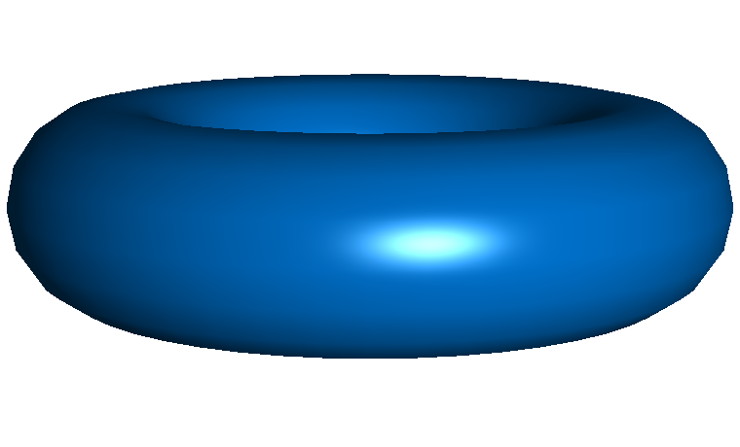
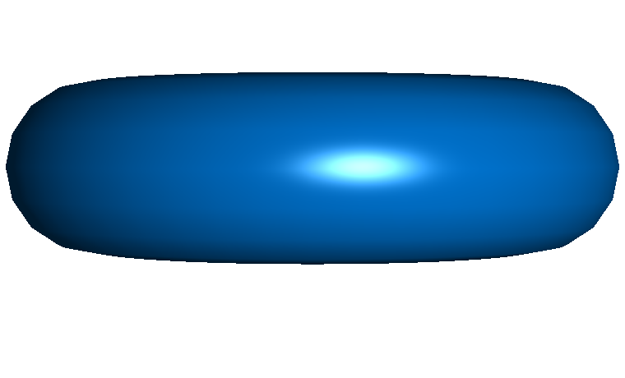
Phong Shading (1973)
linear interpolation of
normals for each polygon pixel
apply Phong model at each
pixel separately
best quality, highlights
are shown correctly
computationally more expensive
  normal (vector) interpolation
  normalization at each pixel required (uses sqrt() function)
problems:
  polygons still visible at object silhouettes
  traditionally not implemented in graphics hardware
  (nowadays not a problem with pixel shaders)

Slide 26
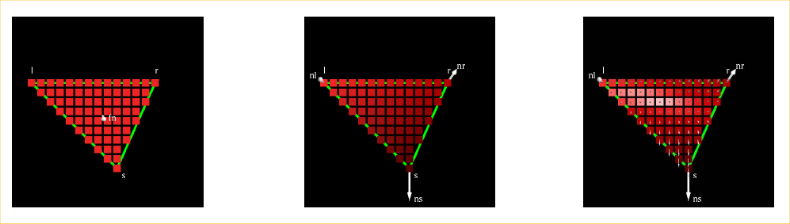
Polygonal Shading: Comparison
comparison on a by-pixel basis:
flat shading
Gouraud shading
Phong shading

Slide 27
Polygonal Shading: Comparison
Flat | Gouraud | Phong
one color value for entire polygon | one color value per vertex & interpolation inside the triangle | vertex normals interpolated and one color value per pixel
I₂
N₂
I₂
N₂
N
N₃
N₃
I
N₁
N₁
I₃
I₃
I₁
I₁

Slide 28
Summary
Phong illumination model: heuristic to compute color at one surface point
  ambient, diffuse, and specular components
  only computes direct (local) illumination
three shading methods to color polygons
  flat, Gouraud, and Phong shading
  not physically based
  speed vs. quality tradeoff
  illumination computation in world coordinates
  (before projection)!

