Slide 1
Maths Preliminaries

Slide 2
How much Math?
Lots of simple linear algebra
Some more advanced concepts
–Homogeneous coordinates
–Ordinary differential equations (ODEs) and their numerical solution
Always in a concrete and visual context

Slide 3
How much Math?
None of the maths is hard, but we need to understand it well in order to be able to understand certain techniques
Today we’ll look at the following:
  Coordinate reference frames
  Points & lines
  Vectors
  Matrices

Slide 4
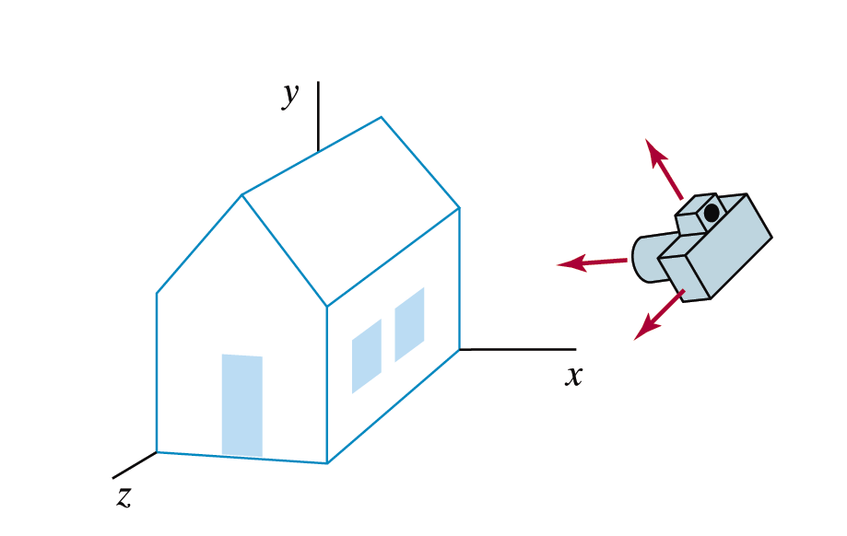

Big Idea
Images taken from Hearn & Baker, “Computer Graphics with OpenGL” (2004)

Slide 5
Coordinate Reference Frames – 2D
When setting up a scene in computer graphics we define the scene using simple geometry
For 2D scenes we use
simple two dimensional
Cartesian coordinates
All objects are defined
using simple coordinate
pairs
y axis
y
P
x
x axis

Slide 6
Coordinate Reference Frames – 2D (cont…)
y
(2, 7)
(7, 7)
7
3
(2, 3)
(7, 3)
x
2
7

Slide 7
Coordinate Reference Frames – 3D
For three dimensional scenes we simply add
an extra coordinate
y axis
y
P
z
x
z axis
x axis

Slide 8
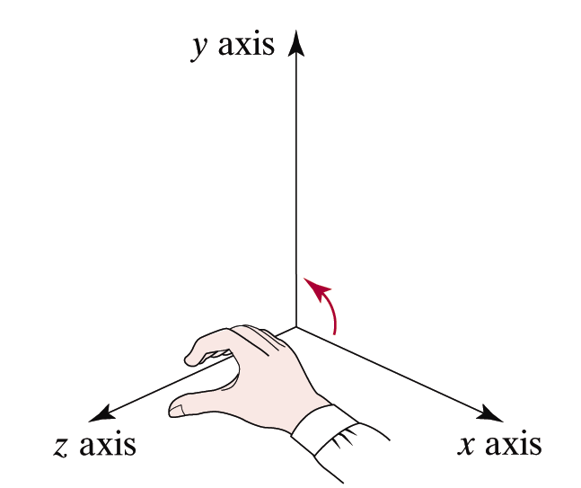
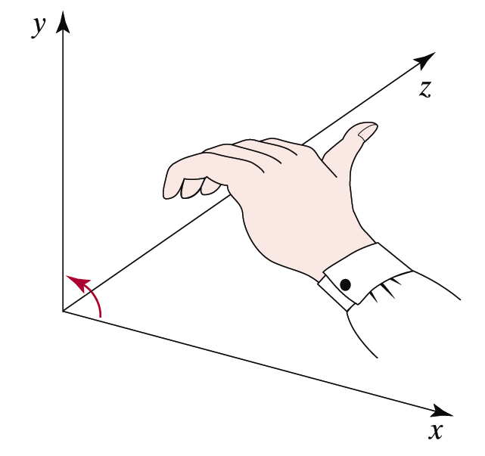
Left Handed Or Right Handed?
There are two different ways in which we can do 3D coordinates – left handed or right handed
We will mostly use the right-handed system
Images taken from Hearn & Baker, “Computer Graphics with OpenGL” (2004)
Right-Hand
Reference System
Left-Hand
Reference System

Slide 9
Points & Lines
Points:
  A point in two dimensional space is given as an ordered pair (x, y)
  In three dimensions a point is given as an ordered triple (x, y, z)
Lines:
  A line is defined using a start point and an end-point
    In 2d: (x_{start}, y_{start}) to (x_{end}, y_{end})
    In 3d: (x_{start}, y_{start} , z_{start}) to (x_{end}, y_{end} , z_{end})

Slide 10
Points & Lines (cont…)
y
(2, 7)
(6, 7)
The line from
(2, 7) to (7, 3)
(2, 3)
(7, 3)
(7, 1)
x

Slide 11
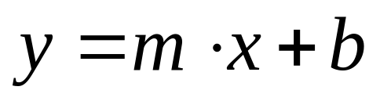
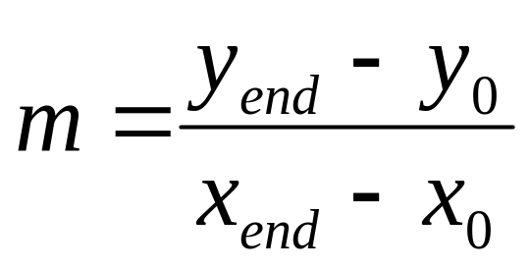
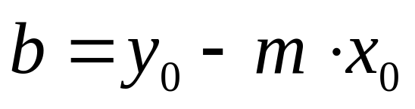
The Explicit Equation of A Line
The slope-intercept
equation of a line is:
where:
The equation of the line gives us the corresponding y point for every x point
y
y_{end}
y₀
x₀
x_{end}
x

Slide 12
The Explicit Equation of A Line
y
y_{end}
Problems:
  accuracy
  (floating point
  computations)
  efficiency
  (multiplications)
  rounding
  sometimes missing pixels or not defined at all
y₀
x₀
x_{end}
x

Slide 13
Vectors
Vectors:
  A vector is defined as the difference between two points
  The important thing is that a vector has a direction and a length
What are vectors for?
  A vector shows how to move from one point to another
  Vectors are very important in graphics - especially for transformations

Slide 14
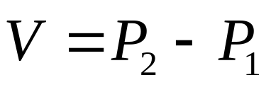
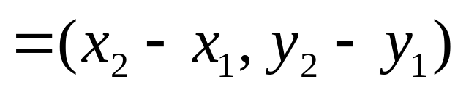
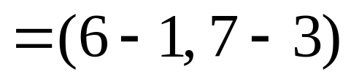
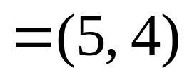
Vectors (2D)
To determine the vector between two points simply subtract them
P₂ (7, 10)
y axis
V
P₂ (6, 7)
P₂ (10, 7)
P₁ (2, 6)
V
V
P₁ (1, 3)
P₁ (5, 3)
x axis
WATCH OUT: Lots of pairs of points share the same vector between them

Slide 15

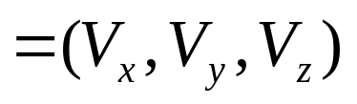
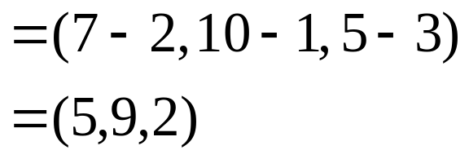
Vectors (3D)
In three dimensions a vector is calculated in much the same way
y axis
P₂
So for (2, 1, 3) to (7, 10, 5) we get
P₁
z axis
x axis

Slide 16
Vector Operations
There are a number of important operations we need to know how to perform with vectors:
  Calculation of vector length
  Vector addition
  Scalar multiplication of vectors
  Scalar product
  Vector product

Slide 17
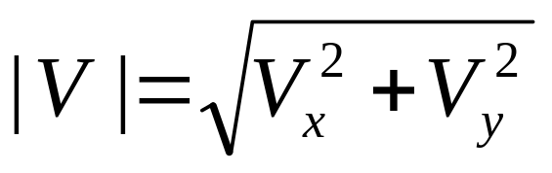
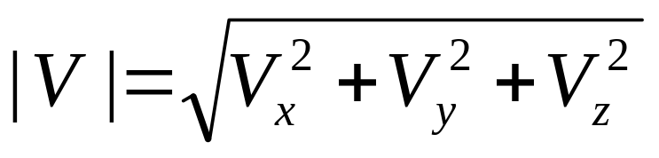
Vector Operations: Vector Length
Vector lengths are easily calculated in two dimensions:
and in three dimensions:

Slide 18
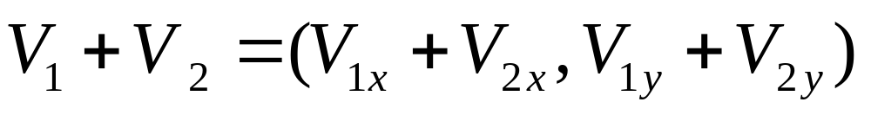
Vector Operations: Vector Addition
The sum of two vectors is calculated by simply adding corresponding components
Performed similarly in three dimensions
y axis
y axis
V₁ + V₂
V₂
V₂
V₁
V₁
x axis
x axis

Slide 19
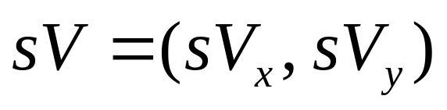
Vector Operations: Scalar Multiplication
Multiplication of a vector by a scalar proceeds by multiplying each of the components of the vector by the scalar
y axis
y axis
(sV_{x}, sV_{y})
(V_{x}, V_{y})
sV
V
x axis
x axis

Slide 20
Other Vector Operations
There are other important vector operations that we will cover as we come to them
These include:
  Scalar product (dot product)
  Vector product (cross product)

Slide 21
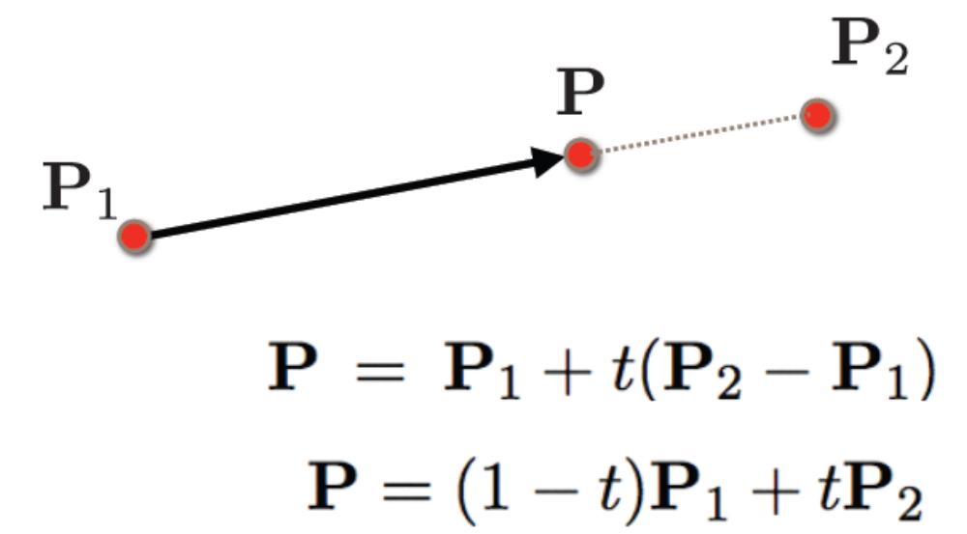
Point on a Line
Equation of a line

Slide 22
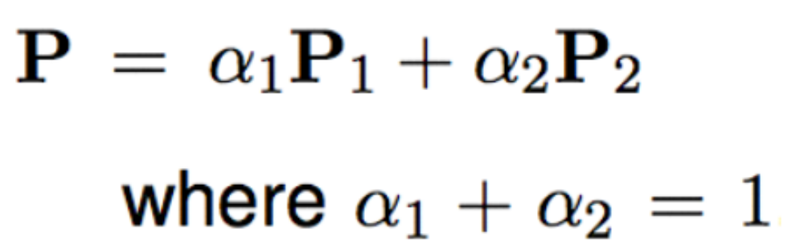
Affine Combination
How to combine points and get other points…

Slide 23
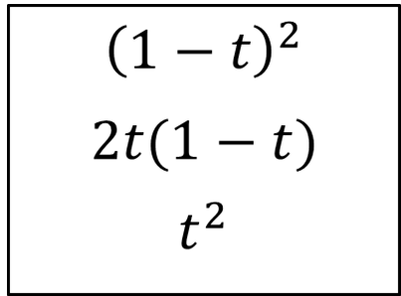
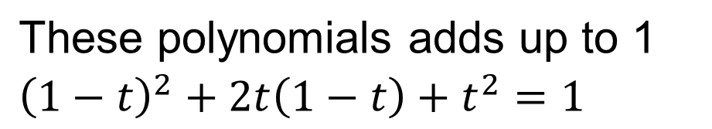

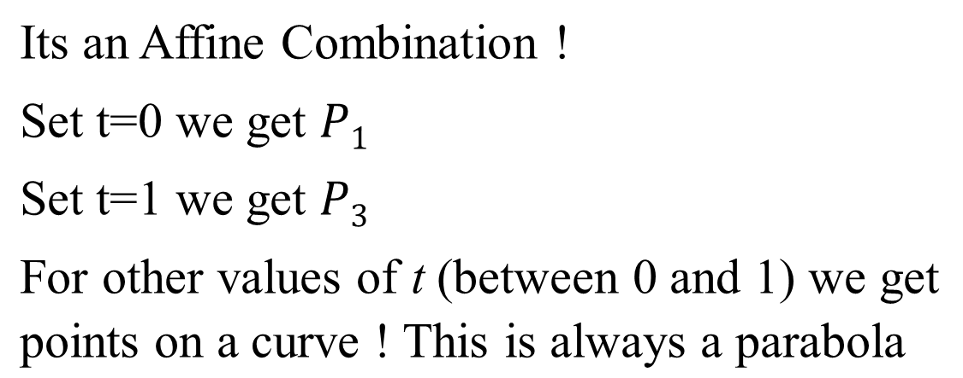


Affine Combinations are COOL !
Lets take the following polynomials

Slide 24
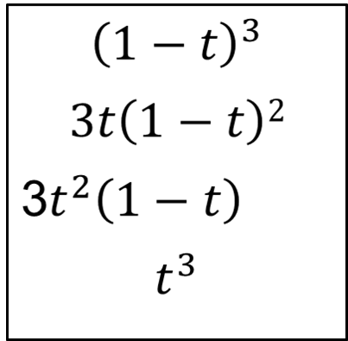








Affine Combinations are COOL !
Lets take the following polynomials
These polynomials also adds up to 1 (check it at home)
Got a Cubic curve for t = 0 to 1 !
We can get any shape of the curve! CAD industry use it a lot

Slide 25
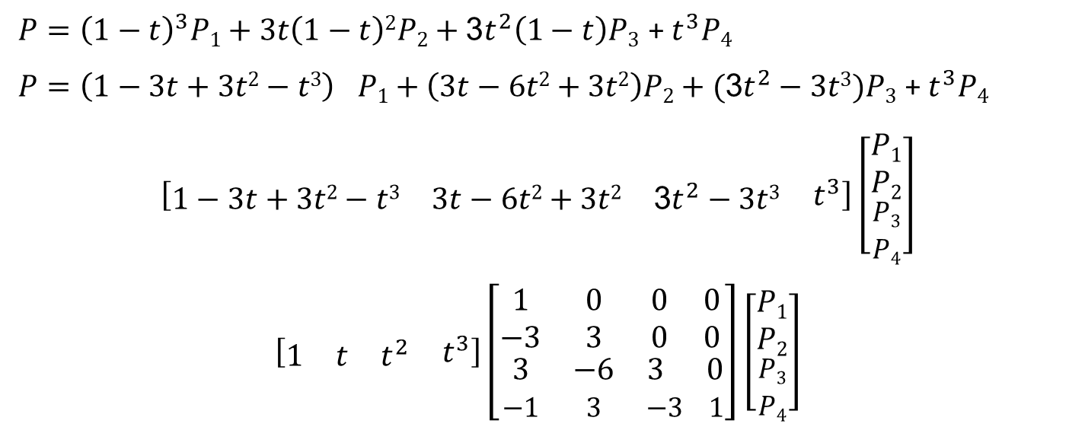
Affine Combinations are COOL !
From Math to Computer
Constant 4 X 4 matrix
For Computer computing with matrices is easy! We will see lots of 4X4 matrices in Computer Graphics! Graphics engine can make it really fast !

Slide 26
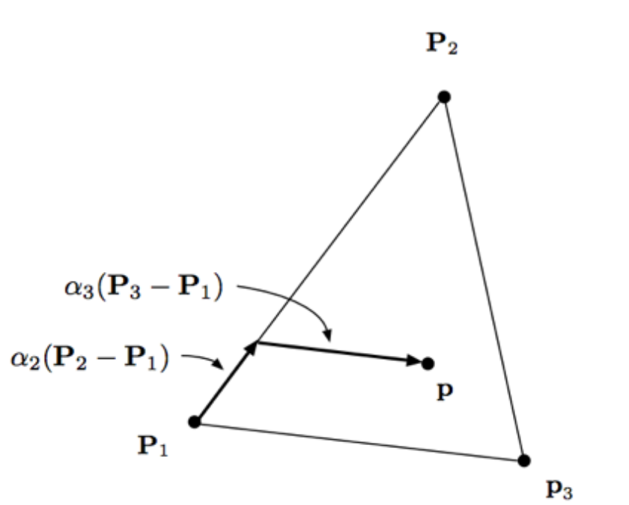

Barycentric Coordinates for Triangles
A coordinate system for Triangles

Slide 27
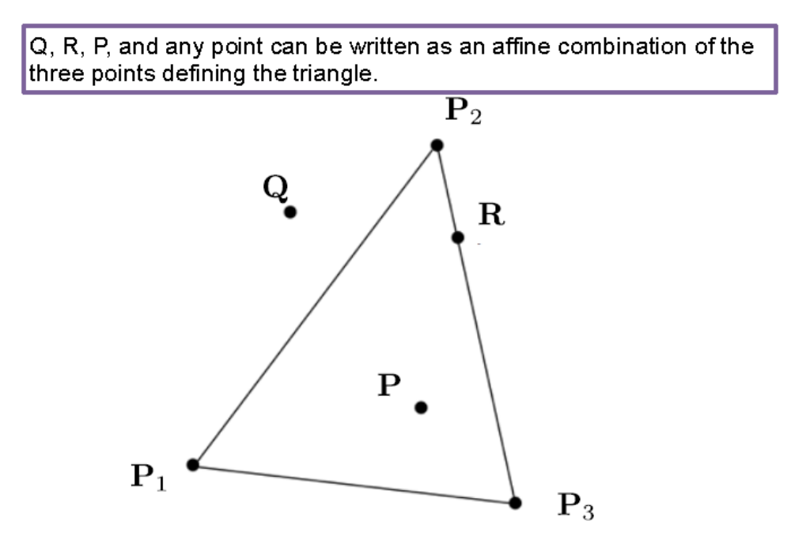
Barycentric Coordinates for Triangles
A coordinate system for Triangles

Slide 28
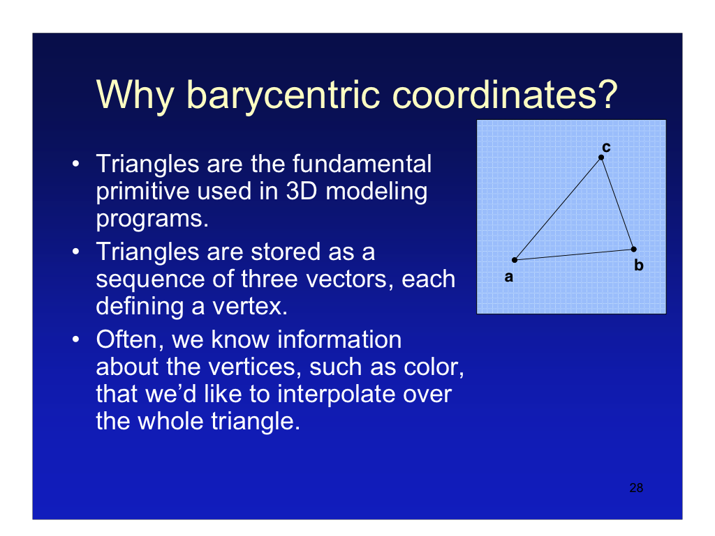

Slide 29
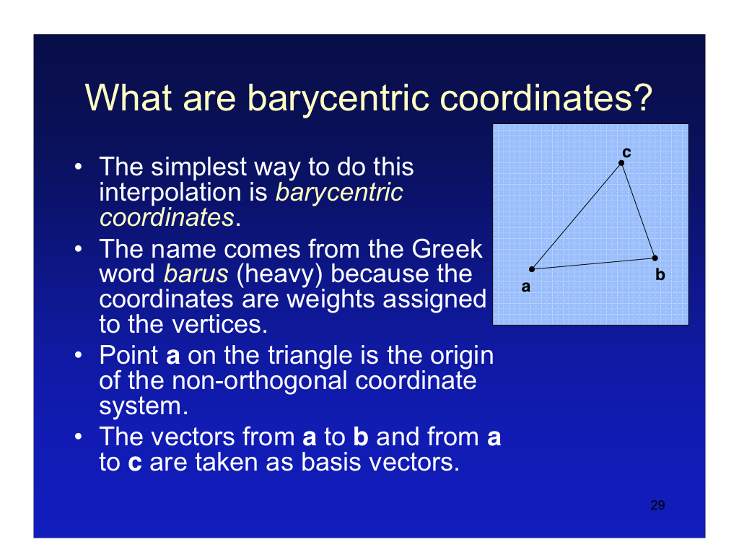

Slide 30
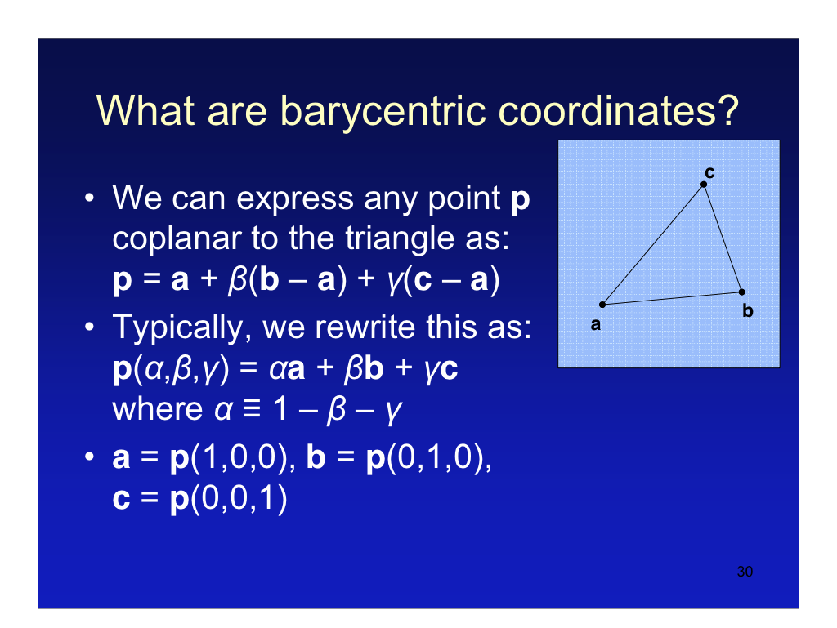

Slide 31
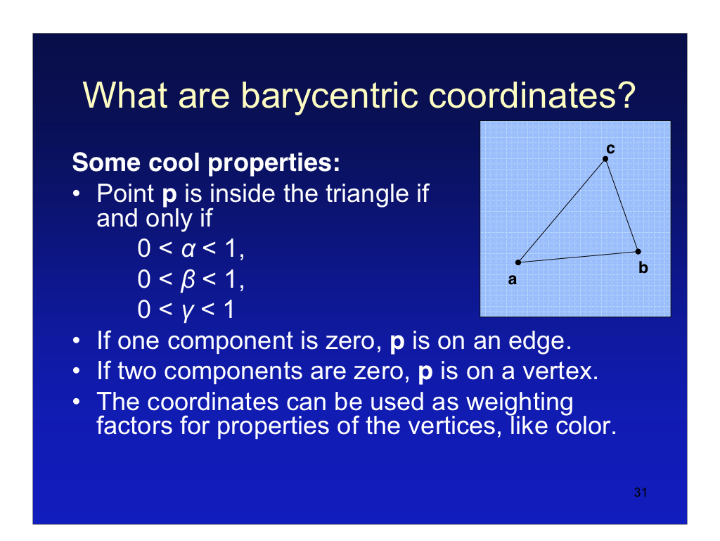

Slide 32

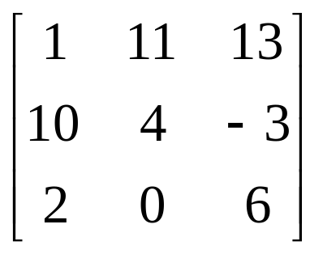
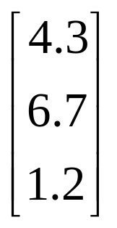
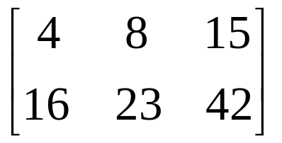

Matrices
A matrix is simply a grid of numbers
However, by using matrix operations we can perform a lot of the maths operations required in graphics extremely quickly

Slide 33
Matrix Operations
The important matrix operations for this course are:
  Scalar multiplication
  Matrix addition
  Matrix multiplication
  Matrix transpose
  Determinant of a matrix
  Matrix inverse

Slide 34
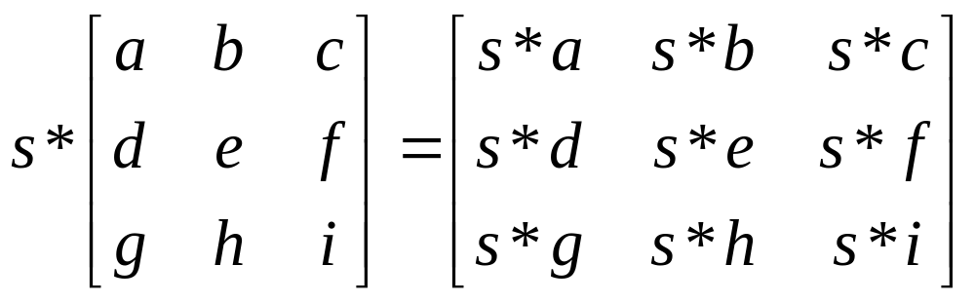
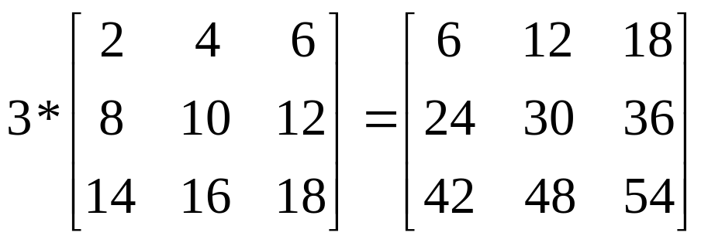
Matrix Operations: Scalar Multiplication
To multiply the elements of a matrix by a scalar simply multiply each one by the scalar
Example:

Slide 35
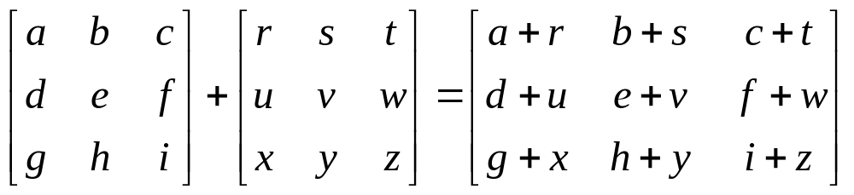
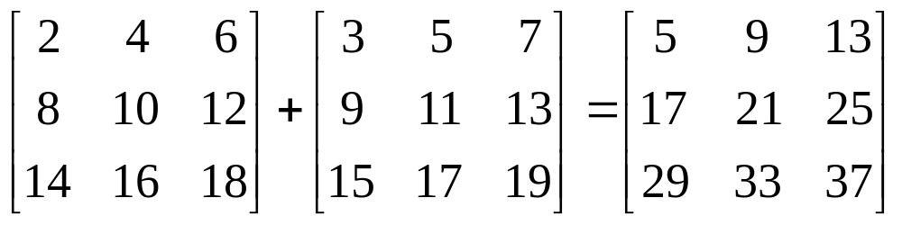
Matrix Operations: Addition
To add two matrices simply add together all corresponding elements
Example:
Both matrices have to be the same size

Slide 36
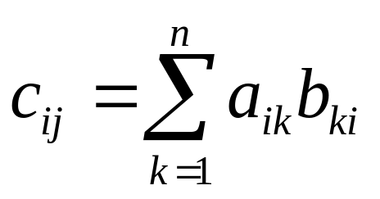
Matrix Operations: Matrix Multiplication
We can multiply two matrices A and B together as long as the number of columns in A is equal to the number of rows in B
So, if we have an m by n matrix A and a p by q matrix B we get the multiplication:
C=AB
where C is a m by q matrix whose elements are calculated as follows:

Slide 37
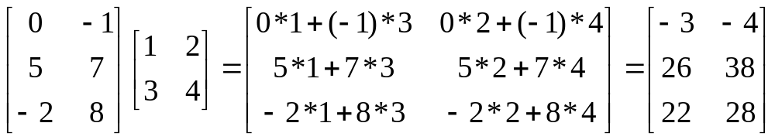
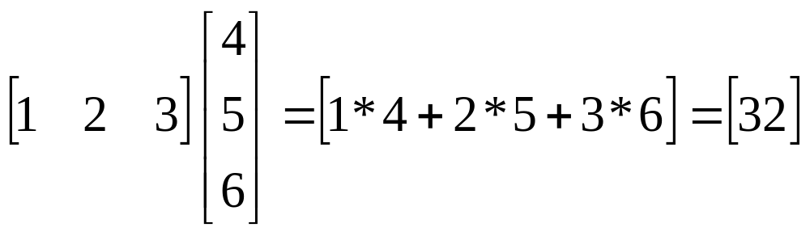
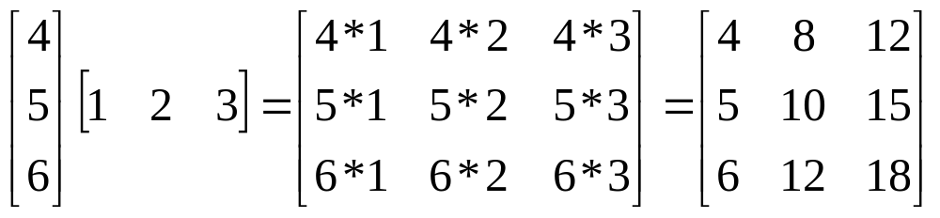
Matrix Operations: Matrix Multiplication (cont…)
Examples:

Slide 38

Matrix Operations: Matrix Multiplication (cont…)
Watch Out! Matrix multiplication is not commutative, so:

Slide 39
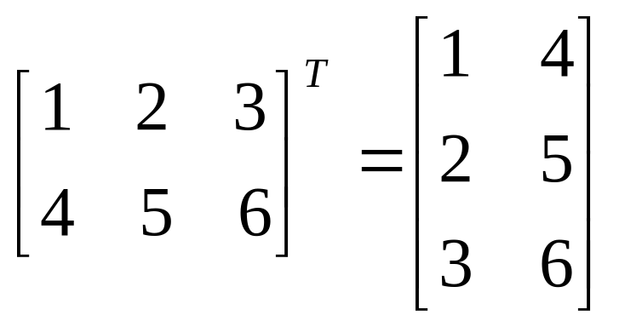
Matrix Operations: Transpose
The transpose of a matrix M, written as M^{T} is obtained by simply interchanging the rows and columns of the matrix
For example:

Slide 40
Other Matrix Operations
There are some other important matrix operations that we will explain as we need them
These include:
  Determinant of a matrix
  Matrix inverse

Slide 41
Summary
In this lecture we have taken a brief tour through the following:
  Basic idea
  The mathematics of points, lines and vectors
  The mathematics of matrices
These tools will equip us to deal with the computer graphics techniques that we will begin to look at, starting next time

Slide 42
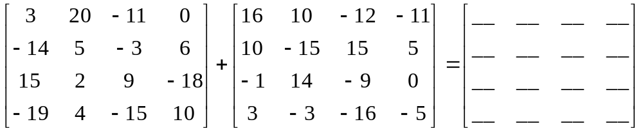
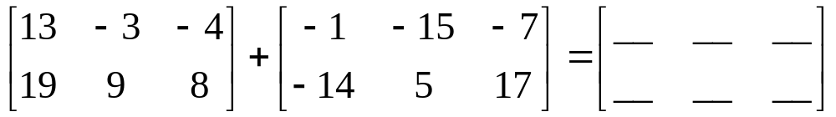
Exercises 2
Perform the following matrix additions:

Slide 43
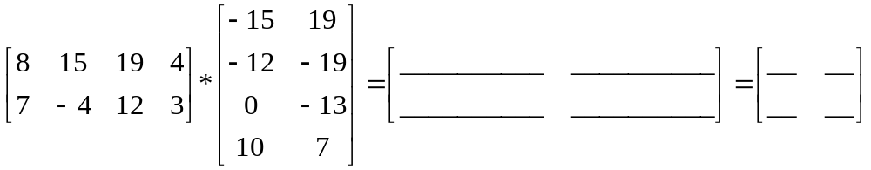
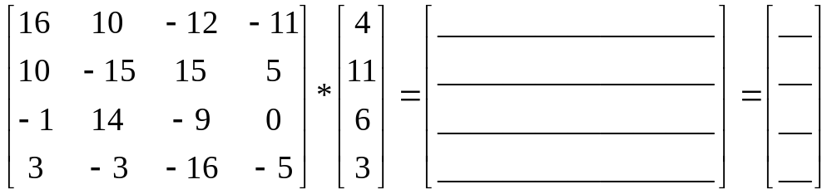
Exercises 3
Perform the following matrix multiplications:

Slide 44
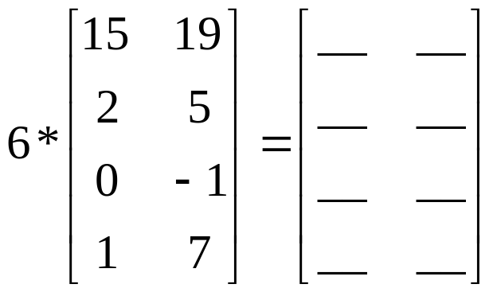
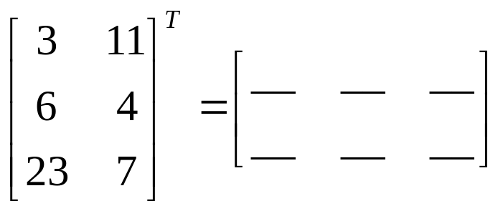
Exercises 4
Perform the following multiplication of a matrix by a scalar
Calculate the transpose of the following matrix

