Slide 1
Curves and Splines

Slide 2
What is a Curve?
A curve is an infinitely large set of points where
Any point has two neighbors (except endpoints and starting points)
Some curves have no endpoints
Either infinite curve
Or, closed curve (like a loop)

Slide 9
Subdivision of a Bezier Curve De Casteljau Construction
Take the middle point of each of the 3 segments
Construct the two segments joining them
Take the middle of those two new segments
Join them
Take the middle point P’’’

Slide 10
Subdivision of a Bezier Curve De Casteljau Construction

Slide 12
the tangent vectors of the two cubic curve segments are equal (both directions and magnitudes) at the segments’ join point

Slide 19
Cubic B-Splines: Basis
These sum to 1, too!

Slide 20
Nonuniform Rational B-Splines - NURBS
NURBS-shapes are not only defined by control points; weights, associated with each control point are also necessary.
NURBS are industry standard tools for the representation and design of geometry. Some reasons for the use of NURBS are, that they:
offer one common mathematical form for both, standard analytical shapes (e.g. conics) and free form shapes;
provide the flexibility to design a large variety of shapes;
can be evaluated reasonably fast by numerically stable and accurate algorithms;
are invariant under affine as well as perspective transformations;
are generalizations of non-rational B-splines and non-rational and rational Bezier curves and surfaces.

Slide 21
Tensor Bézier Patches

Slide 22
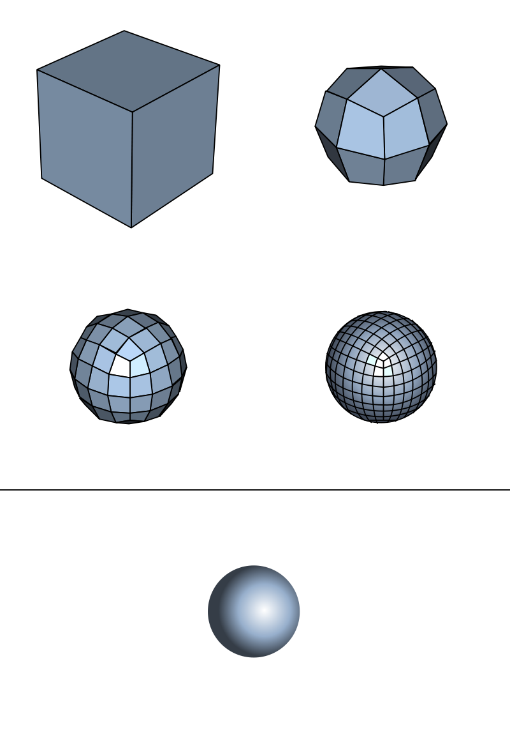
Catmull–Clark subdivision surface

Slide 25
More…
Subvision curves and surfaces
http://www.cs.nyu.edu/~dzorin/sig00course/

