Slide 1
Global Sales Dashboard
Global Superstore Dataset
Data Analyst Internship - Task 3
Power BI

Slide 2
Project Objective
Design an interactive dashboard for business stakeholders.

Slide 3
Business Performance Overview
KPI Highlights
• Total Sales : 13M
• Total Profit : 1M
• Total Orders : 25K
Insights
• APAC generated highest profit.
• Consumer segment contributed maximum sales.
• Sales increased from 2011–2014.

Slide 4
Product & Market Insights
KPI Highlights
• Total Customers : 5K
• Average Discount : 8.13%
• Profit Margin : 11.61%
Insights
• Technology category generated highest profit.
• Office Supplies sold maximum quantity.

Slide 5
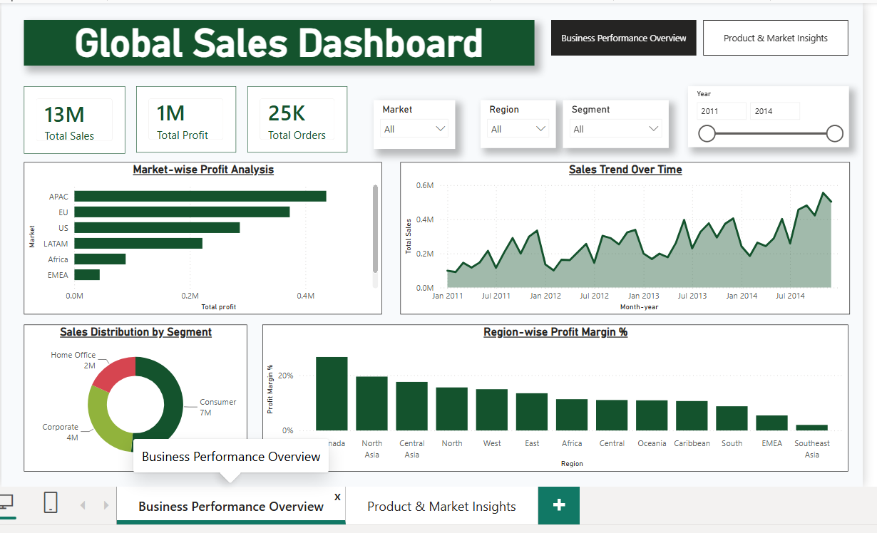
Dashboard Page 1

Slide 6
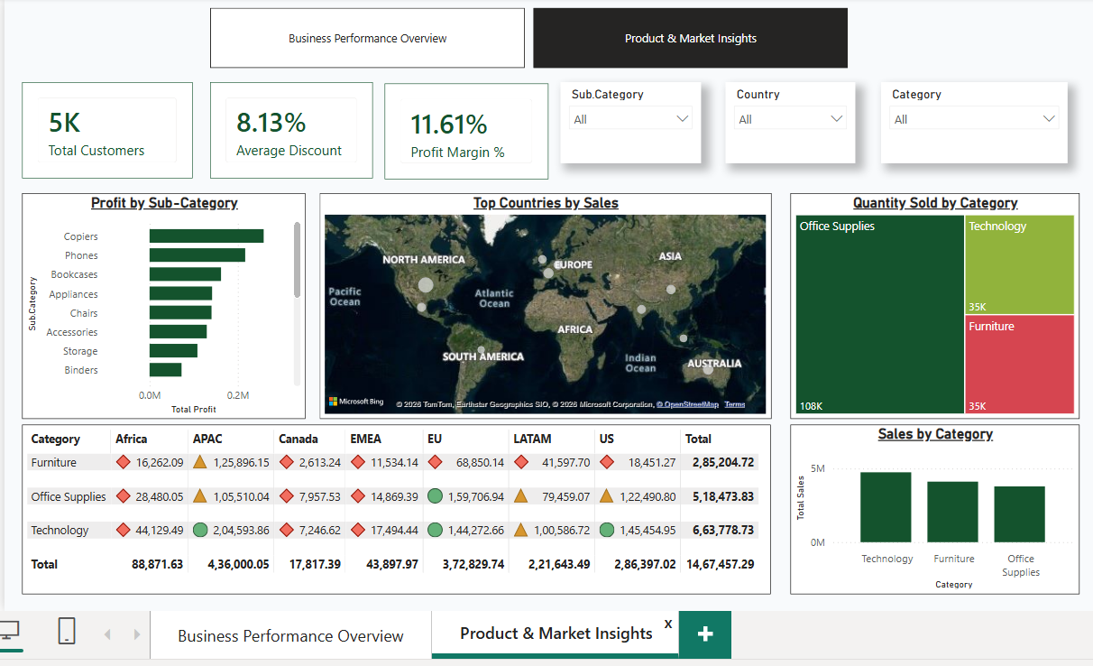
Dashboard Page 2

Slide 7
Conclusion
• Sales and profit showed steady growth.
• APAC and EU markets performed strongly.
• Technology category was the top contributor.
• Focus on high-value customer segments.

