Slide 1

Rashika Suresh
Machine Learning Intern
rashikasuresh5758@gmail.com
+919483374137

Slide 2
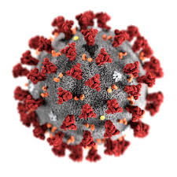
Covid Prediction Using
Simple Linear Regression Model

Slide 3
Data Science
Data science is the field of study that combines domain expertise, programming skills, and knowledge of mathematics and statistics to extract meaningful insights from data.
Data science practitioners apply machine learning algorithms to numbers, text, images, video, audio, and more to produce artificial intelligence systems to perform tasks that ordinarily require human intelligence. In turn, these systems generate insights which analysts and business users can translate into tangible business value.

Slide 4
Machine Learning
Machine learning (ML) is a type of artificial intelligence (AI) that allows software applications to become more accurate at predicting outcomes without being explicitly programmed to do so.
Machine learning algorithms use historical data as input to predict new output values.

Slide 5
Artificial Intelligence
Artificial intelligence (AI) refers to the simulation of human intelligence in machines that are programmed to think like humans and mimic their actions.
The term may also be applied to any machine that exhibits traits associated with a human mind such as learning and problem-solving.

Slide 6
Simple Linear Regression Model
Simple Linear Regression is a linear regression model with a single explanatory variable.
That is, it concerns two-dimensional sample points with one independent and one dependent variable and finds a linear function, that as accurately as possible, predicts the dependent variable values as a function of the independent variable.
The adjective simple refers to the fact that the outcome variable is related to a single predictor.

Slide 7
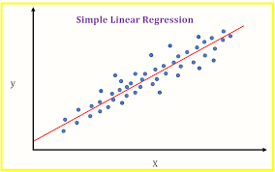

Slide 8

Problem
CoronaVirus Pandemic

Slide 9
Even with the increasing rise in the active cases, lack of awareness among people for safety health measures.
Lack of preparation from communal bodies to face increasing active case reports, deaths.
This steedy rise without foreseen analysis and precautions may affect the normal life of people.

Slide 10
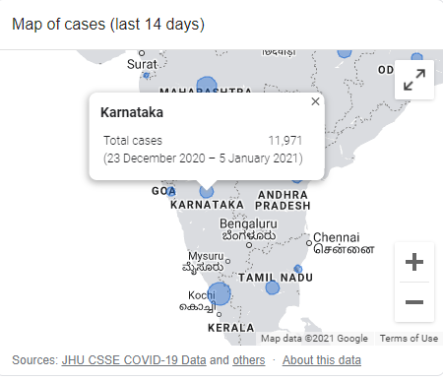

Slide 11
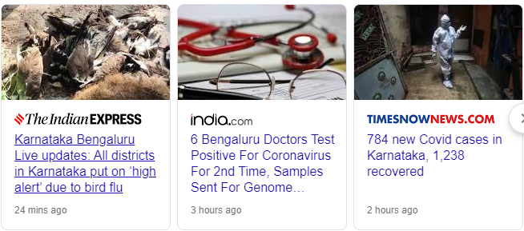

Slide 12
Preventive Measures
Social Distancing
Self Precautions
Avoiding mass in person contacts

Slide 13
Prediction of Covid Using Linear Regression
Dataset consists of
Date
Time
State/Union Territory
Confirmed
Deaths
Cured

Slide 14
Libraries used –
Numpy
Pandas
Matplotlib
Seaborn
Datetime

Slide 15
Working –
Using the above libraries we perform data cleaning and then do an exploratory data analysis.
Divide the dataset again to states and visualize total cured, confirmed and death cases and analyse the trends.
Finally, split the dataset into train and test dataset and train the model and predict the accuracy of its performance, that is the possible outcome in the upcoming days as a precaution.

Slide 16
Conclusion
Using this prediction model, we can know the possible cases that can occur in the upcoming days with better accuracy and how the trends is varying in each state and accordingly both people and government can react to minimize the effects.

Slide 17
