Slide 1

SUMMER INTERNSHIP PROGRAM
WEEK -4
LANGUAGE CHOSSEN- ORACLE

Slide 2
What is Oracle??
In general, a database is a collection of data treated as a unit. A database management system (DBMS) stores, manages and retrieves a large amount of data in a multi-user environment so that many users can access the same data concurrently.
Oracle Database is a robust object relational database that provides efficient and effective solutions for database users such as delivering high performance, protecting users from unauthorized access, and enabling fast failure recovery.

Slide 3
Topic Covered in Oracle
SQL COMMAND
DDL
Create
Alter
Rename
Drop
Truncate
DML
Insert
Update
Delete
TCL
Commit
Rollback
Save point
DCL
Grant
Revoke
DQL
Select

Slide 4
OPERATOR IN ORACLE
Operator | Operation
*, / | multiplication, division
+, -, || | addition, subtraction, concatenation
=, !=, <, >, <=, >=, IS NULL, LIKE, BETWEEN, IN | comparison
NOT | exponentiation, logical negation
AND | conjunction
OR | disjunction

Slide 5
Character or Text Functions:
Function Name | Return Value
LOWER (string_value) | All the letters in 'string_value' is converted to lowercase.
UPPER (string_value) | All the letters in 'string_value' is converted to uppercase.
INITCAP (string_value) | All the letters in 'string_value' is converted to mixed case.
LTRIM (string_value, trim_text) | All occurrences of 'trim_text' is removed from the left of 'string_value'.
RTRIM (string_value, trim_text) | All occurrences of 'trim_text' is removed from the right of 'string_value' .
TRIM (trim_text FROM string_value) | All occurrences of 'trim_text' from the left and right of 'string_value' , 'trim_text' can also be only one character long .
SUBSTR (string_value, m, n) | Returns 'n' number of characters from 'string_value' starting from the 'm' position.
LENGTH (string_value) | Number of characters in 'string_value' in returned.
LPAD (string_value, n, pad_value) | Returns 'string_value' left-padded with 'pad_value' . The length of the whole string will be of 'n' characters.
RPAD (string_value, n, pad_value) | Returns 'string_value' right-padded with 'pad_value' . The length of the whole string will be of 'n' characters.

Slide 6
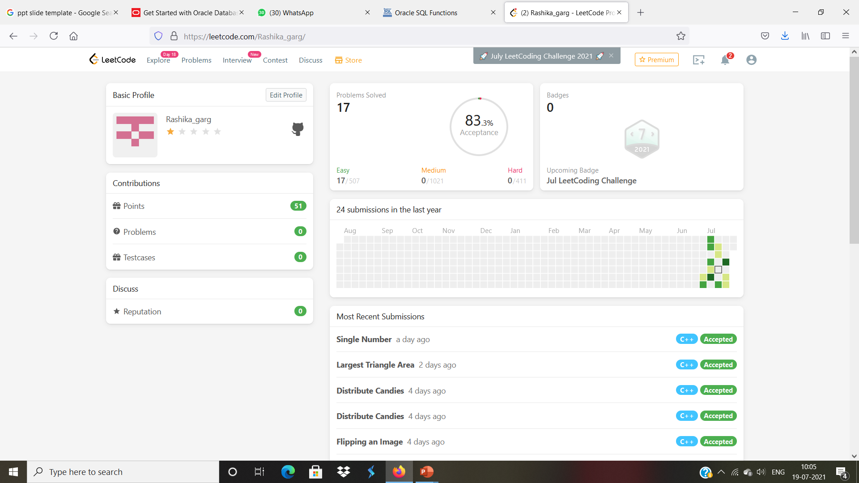
Leetcode Profile ->

Slide 7
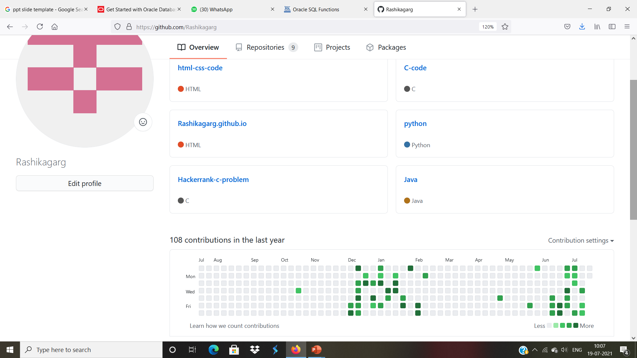
Github Profile ->

Slide 8
Thank u…..

