Slide 1
IBM University Engagement Project Submission
“Exploring the Power of Agentic AI with IBM Granite and IBM Bob”

Slide 2

Project Tile – [PantryPal AI – Smart Recipe Preparation Assistant]
Domain of Project – [Food Technology / Artificial Intelligence ]
Student Name | Recent Passport Photo | Email ID | Mobile number [WhatsApp]
Rashi Katiyar |  | rashie2006@gmail.com | +91 6390513298

Slide 3
Problem Statement -
Problem Statement : Recipe Preparation Agent
The Challenge:
Users often have ingredients available at home but struggle to decide what meals they can prepare with them. Finding suitable recipes can be time-consuming, especially when considering dietary preferences, cooking time, difficulty level, and ingredient limitations.
Many ingredients also go unused, leading to unnecessary food waste. Users need a simple and personalized solution that helps them discover practical recipes using the groceries already available in their pantry.
The Objective
Build a smart Recipe Preparation Assistant that helps users discover suitable recipes using available ingredients and personal preferences. The solution should:
Ingredient-Based Recipe Matching – Recommend recipes based on ingredients available to the user.
Personalized Filtering – Allow users to filter recipes based on dietary preference, cooking time, and difficulty level.
Recipe Library – Provide a collection of 21 recipes with browsing and filtering options.
Recipe Guidance – Provide step-by-step cooking instructions, smart substitutions, and cooking tips.
Voice-Based Input – Allow users to add ingredients using voice input through the Web Speech API.
Personalized Experience – Save favourite recipes and recent searches using Local Storage.
Food Waste Reduction – Help users utilize available pantry ingredients effectively.

Slide 4
Proposed Solution -
Proposed Solution: PantryPal AI – Smart Recipe Preparation Assistant
PantryPal AI is a smart recipe preparation web application designed to help users create delicious meals using ingredients already available in their kitchen.
The system allows users to enter available ingredients and select preferences such as dietary type, cooking time, and difficulty level. The application then matches the user's input with its recipe database and recommends the top 5 most relevant recipes.
Each recipe provides detailed information including ingredients, step-by-step cooking instructions, smart substitutions, and cooking tips. Users can also browse a separate recipe library containing 21 recipes and filter them based on dietary preferences and cooking time.
To improve usability, PantryPal AI also supports voice-based ingredient input using the Web Speech API. Favourite recipes and recent searches are stored using LocalStorage, providing a more personalized experience.
Overall, PantryPal AI offers a simple, practical, and user-friendly solution that helps users save time, make better use of available ingredients, and reduce food waste.
The application also provides recipe instructions, ingredient substitutions, cooking tips, favourites, recent searches, and a separate recipe library with filtering options.
This solution helps users save time, reduce food waste, and make everyday cooking simpler and smarter.

Slide 5
Technology Used
IBM Bob Used for AI-assisted development and building the PantryPal AI website.
HTML5 Used to create the structure and pages of the website.
CSS3 Used for styling, layout, responsive design, and visual appearance.
JavaScript Used for recipe matching, filtering, dynamic content, and user interactions.
Web Storage API (LocalStorage) Used to save favorite recipes and recent searches.
Web Speech API Used to enable voice-based ingredient input.
Google Fonts Used to provide elegant and refined typography.

Slide 6
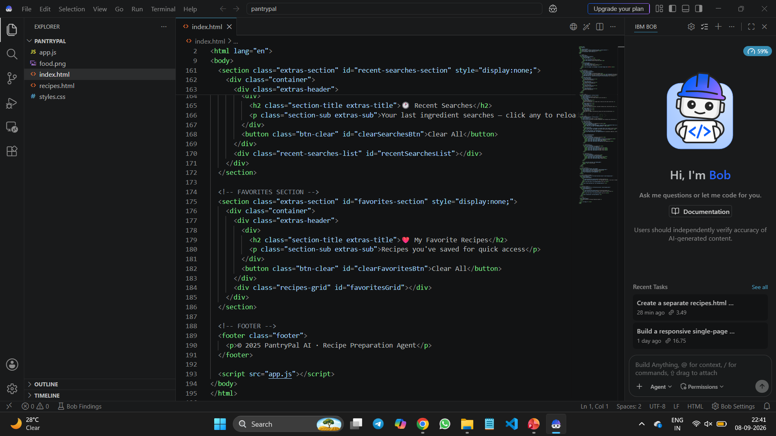
Required Files created using IBM bob -

Slide 7
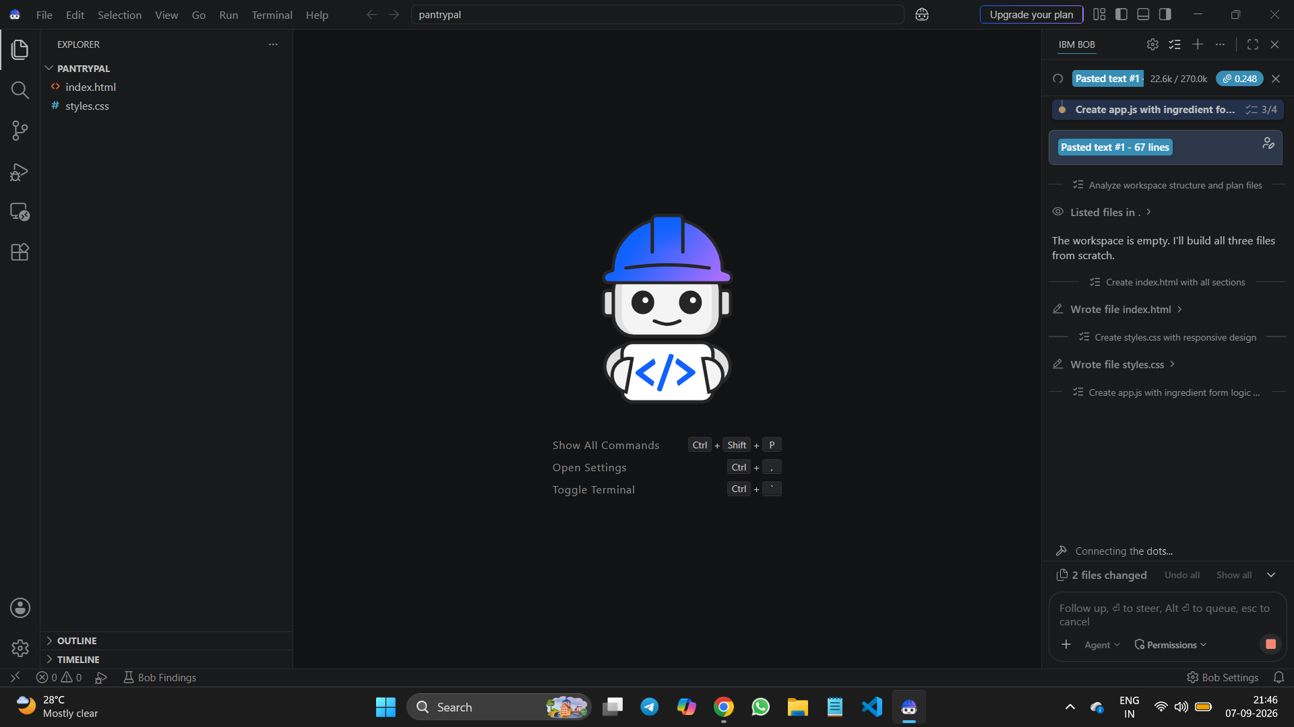
IBM Bob Screenshots:

Slide 8
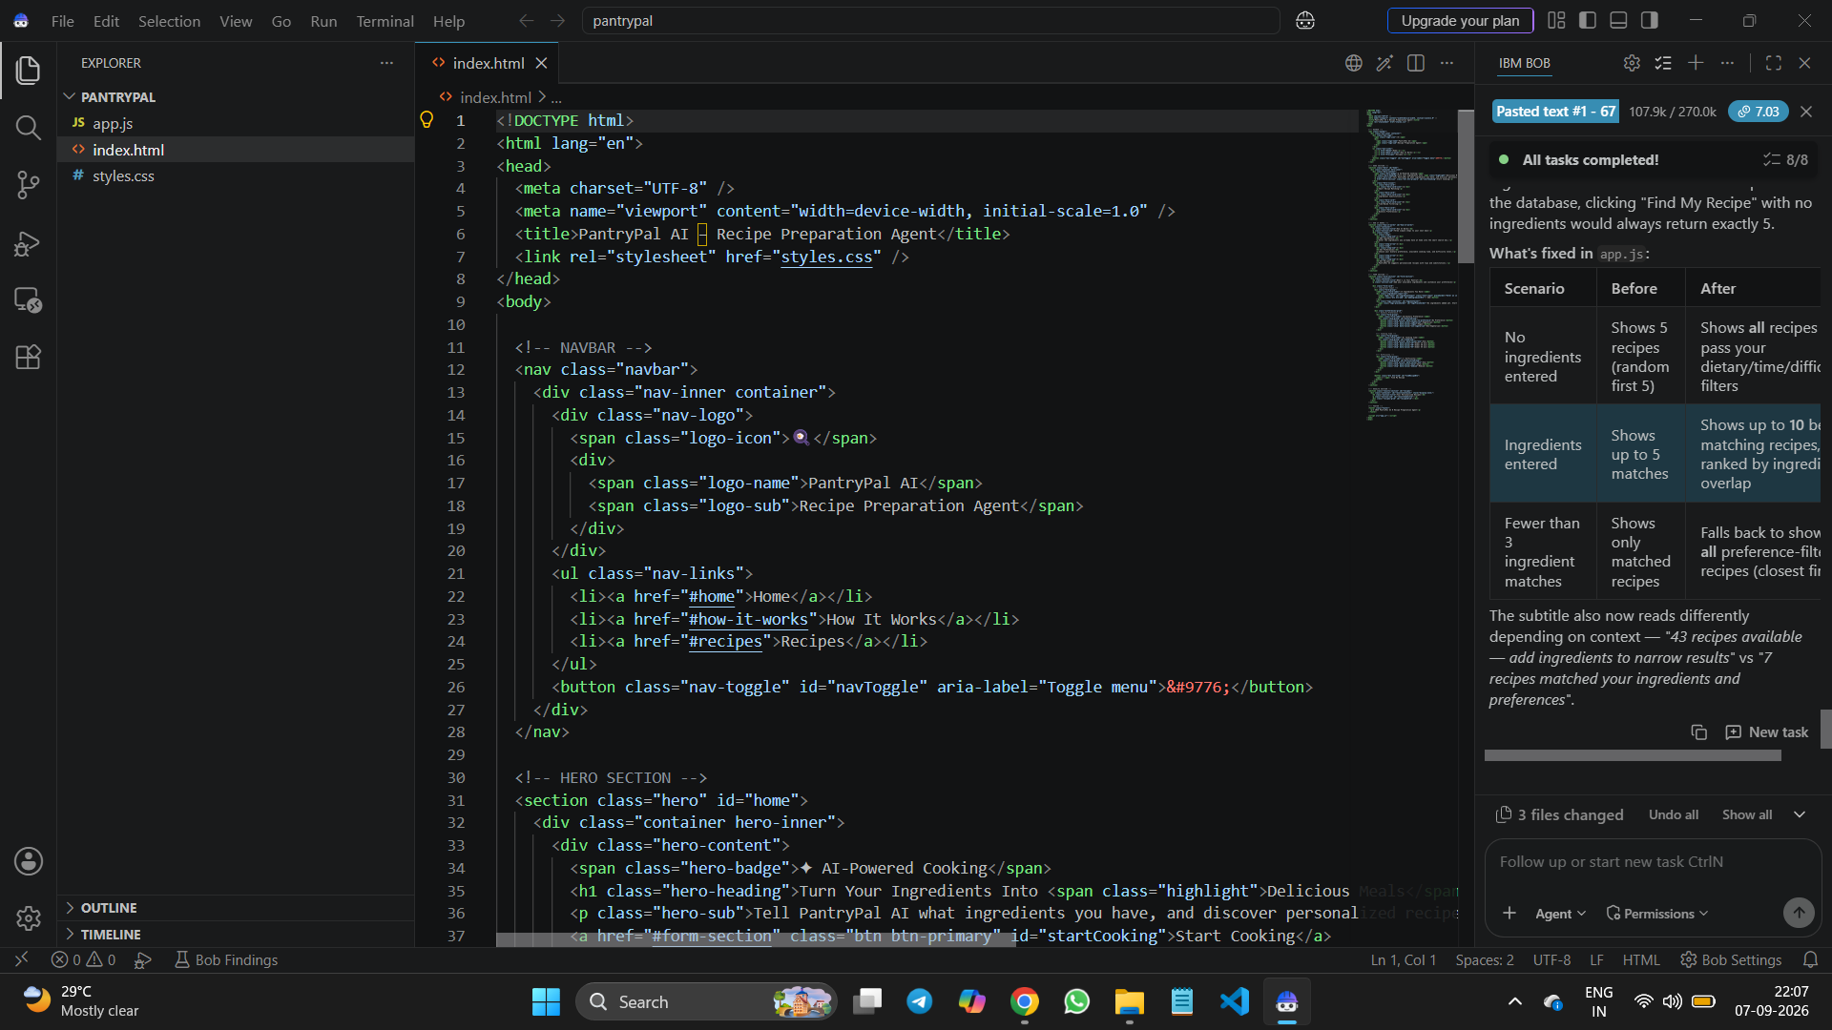

Slide 9
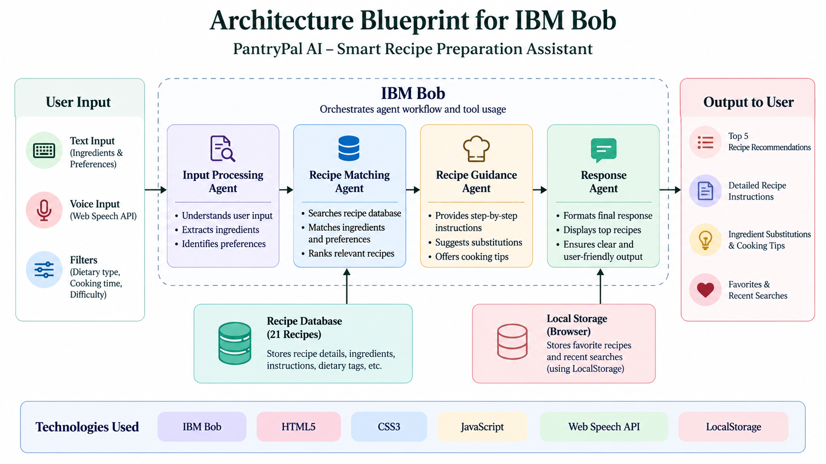
Architecture blueprint for IBM bob:

Slide 10

Role of Agentic AI in the solution
Role of Agentic AI in PantryPal AI
Agentic AI helps organize the solution into intelligent tasks that support users throughout their recipe preparation journey.
Input Understanding – Processes user-provided ingredients, voice input, and preferences to understand their cooking requirements.
Recipe Matching – Analyses the available ingredients and selected filters to identify the most suitable recipes.
Recipe Guidance – Supports the cooking process by providing step-by-step instructions, ingredient substitutions, and useful cooking tips.
Personalized Response – Delivers relevant recipe recommendations based on dietary preference, cooking time, difficulty level, and available ingredients.

Slide 11
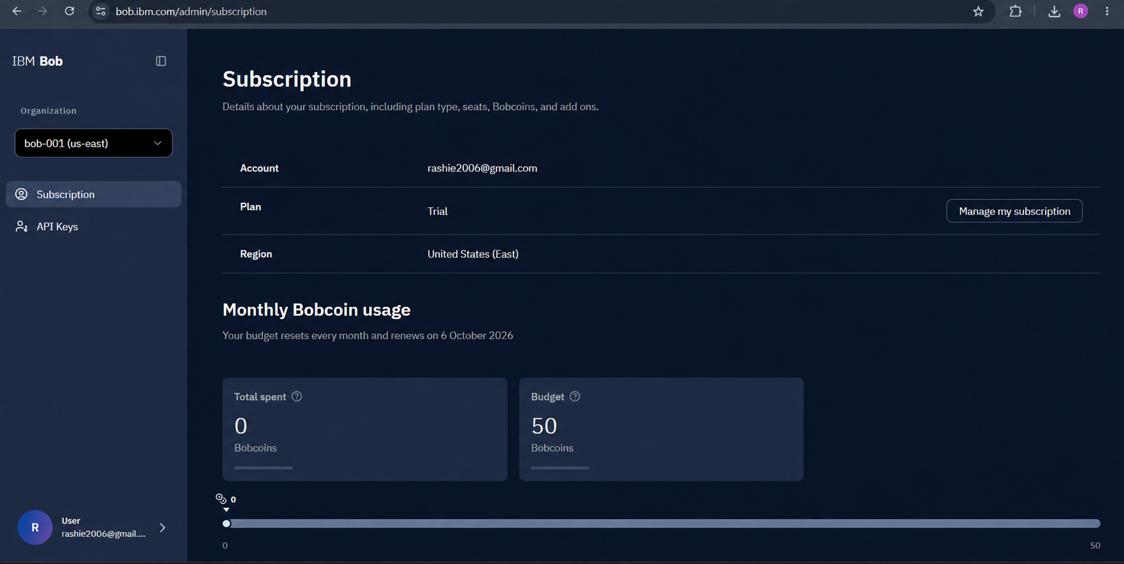
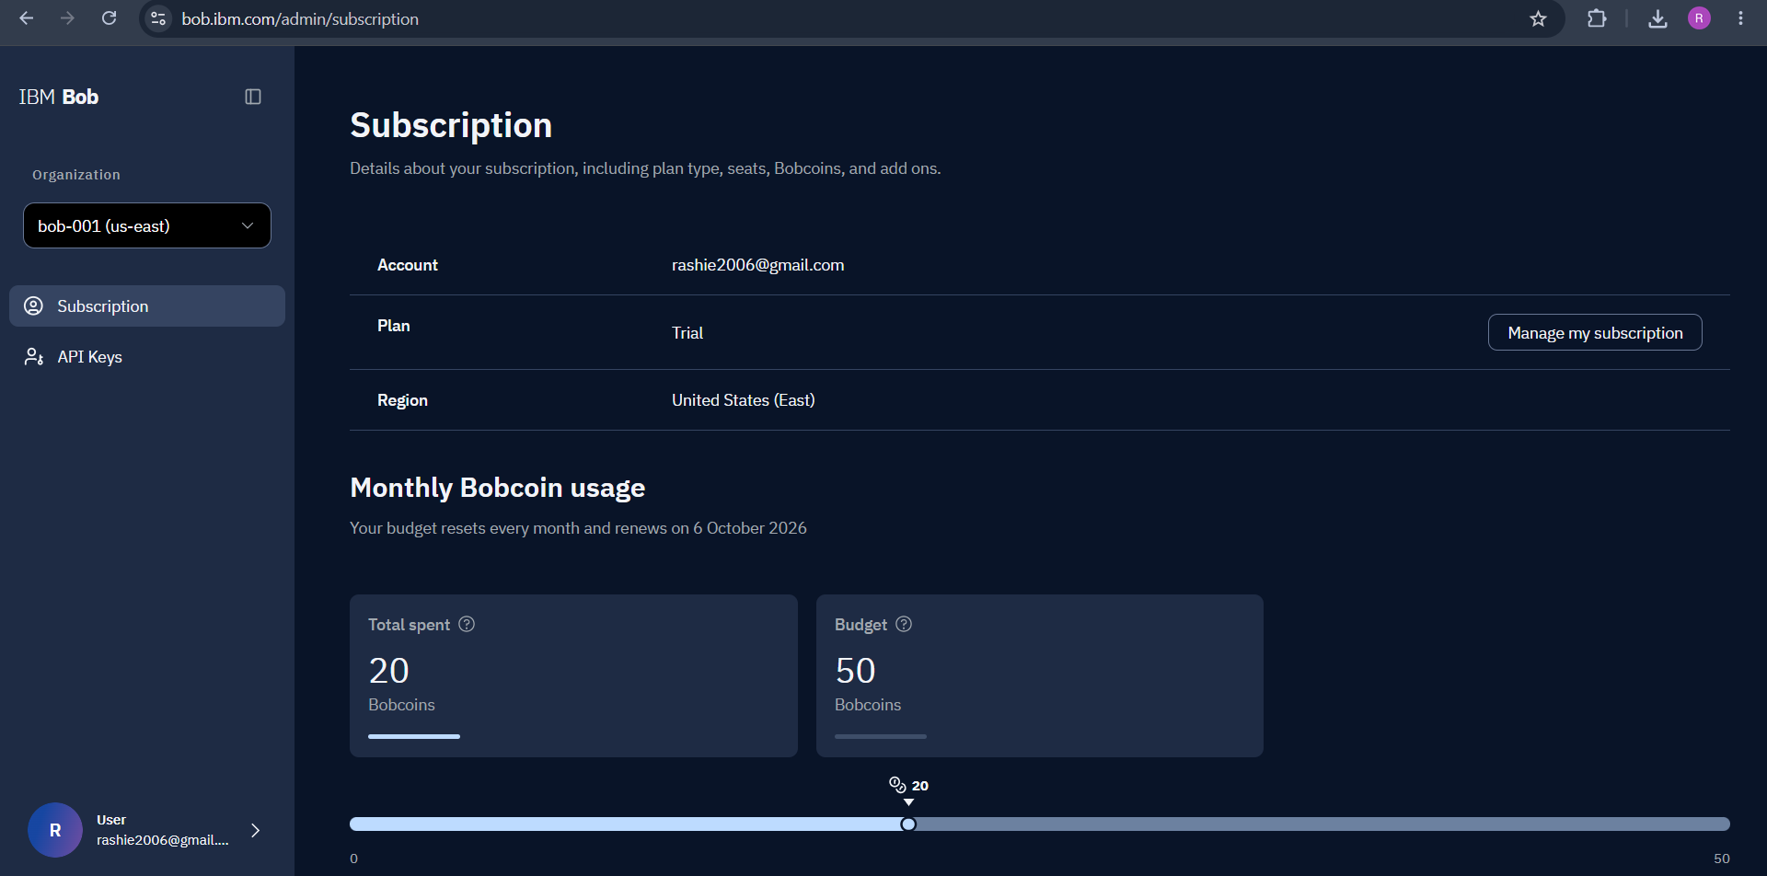
Token Usage
20 bob coins are used
Before Prompt
After the Prompt
·
·
·

Slide 12
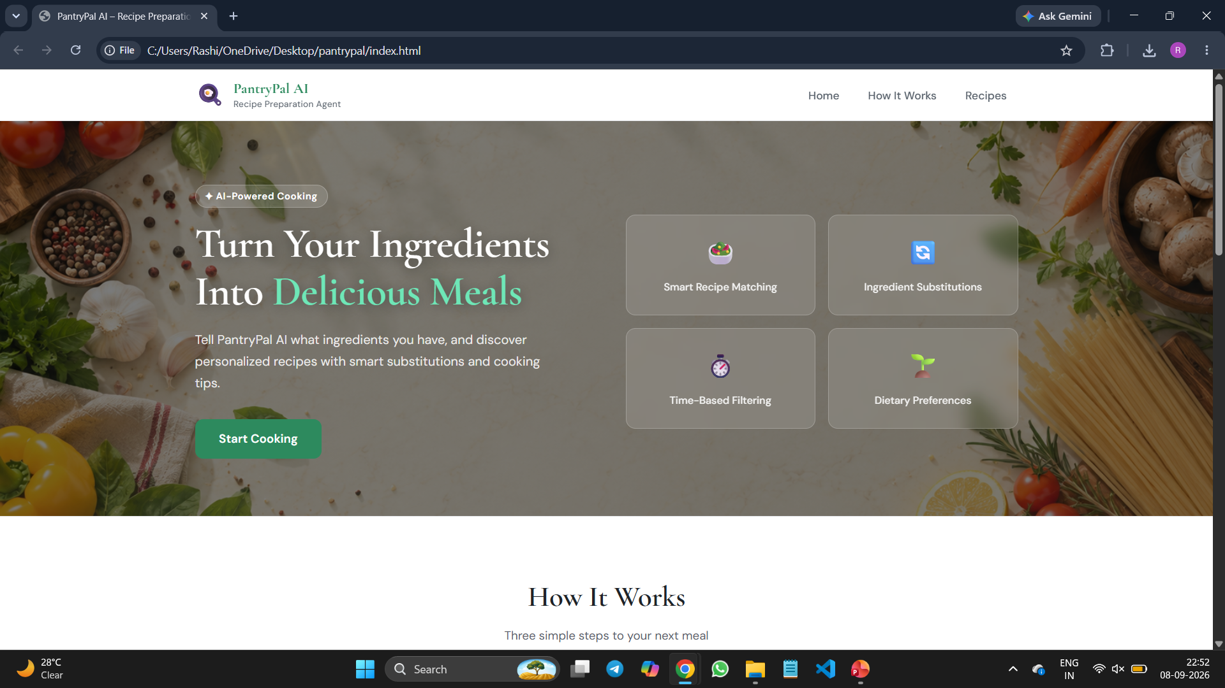
Project Output Screenshot
Please put IBM Bob output screenshots with 2-3 prompts.
You can take 2-3 more slides for each screenshot
·
·
·

Slide 13
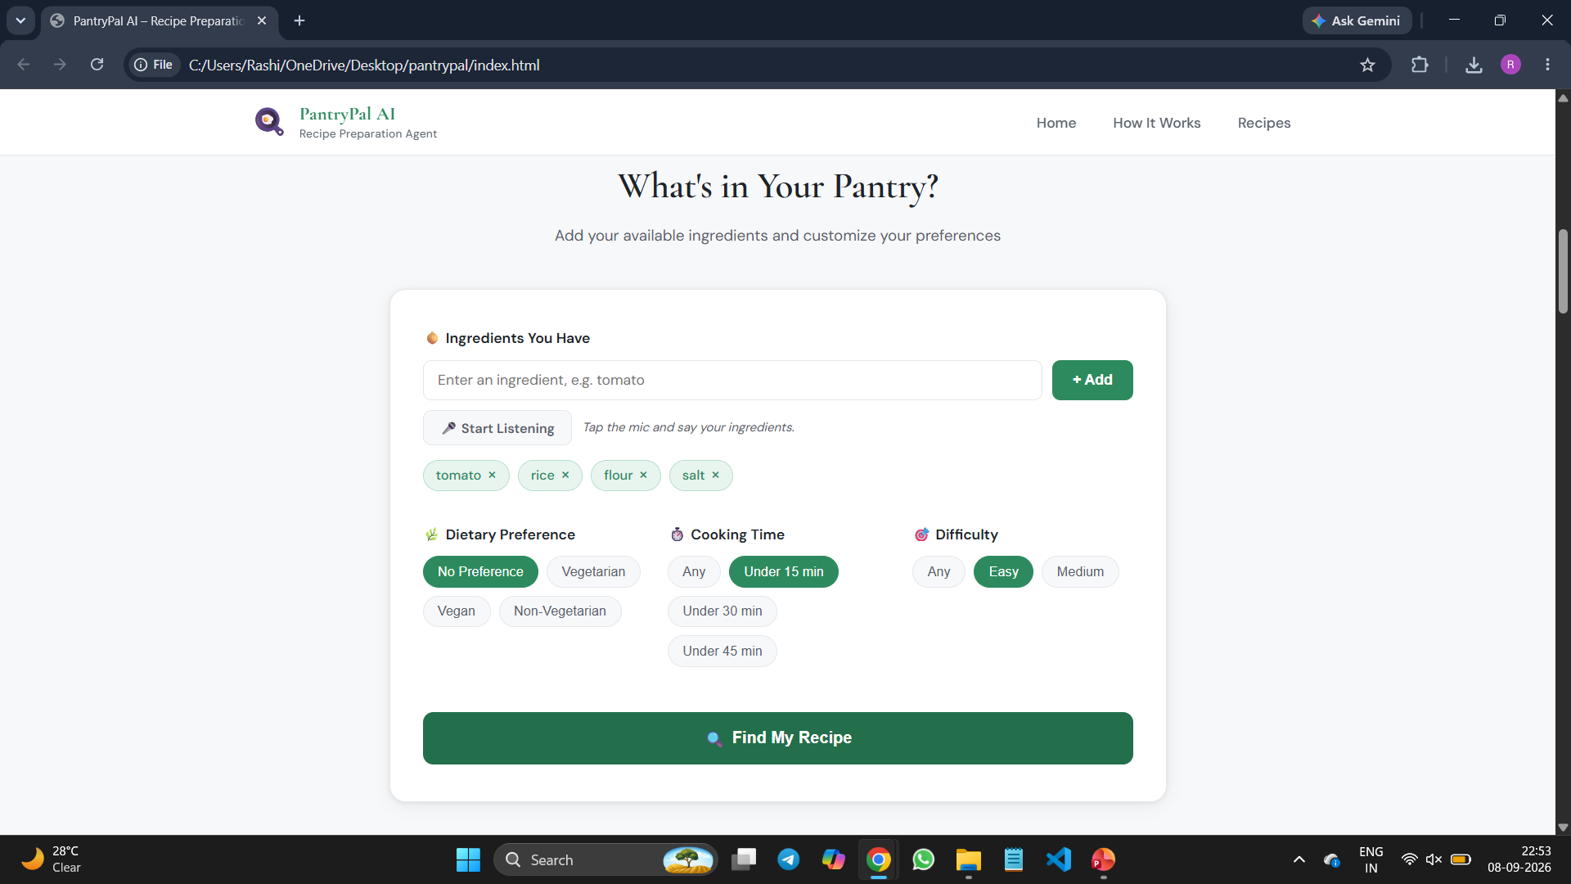
Project Output Screenshot
Please put IBM Bob output screenshots with 2-3 prompts.
You can take 2-3 more slides for each screenshot
·
·
·

Slide 14
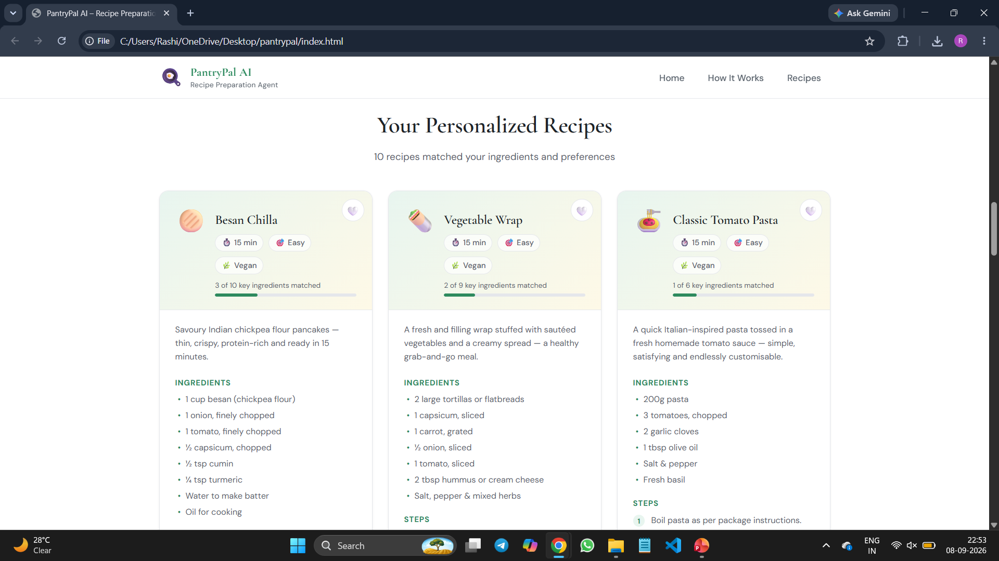
Project Output Screenshot
Please put IBM Bob output screenshots with 2-3 prompts.
You can take 2-3 more slides for each screenshot
·
·
·

Slide 15
Novelty and Uniqueness
PantryPal AI stands out by combining ingredient-based recipe discovery with personalized cooking preferences in a simple and user-friendly application.
Cook with What You Have – Recommends recipes based on ingredients already available to the user, helping reduce food waste.
Personalized Recipe Matching – Considers dietary preference, cooking time, and difficulty level while suggesting recipes.
Voice-Based Ingredient Input – Allows users to add ingredients through voice input using the Web Speech API.
Smart Cooking Guidance – Provides step-by-step instructions, ingredient substitutions, and cooking tips.
Personalized User Experience – Supports favorite recipes and recent searches using LocalStorage.
This makes PantryPal AI a practical, personalized, and convenient solution for smarter everyday cooking.

Slide 16
Git Hub Link
Github repo link:
https://github.com/Rashikatiyar/PantryPal
Working project link:
https://rashikatiyar.github.io/PantryPal/
·
·
·

Slide 17
Future Scope
AI Model Integration – Integrate a real AI model to provide more personalized and dynamic recipe recommendations.
Larger Recipe Database – Expand the recipe collection with more cuisines and meal categories.
Image-Based Ingredient Recognition – Allow users to upload images of ingredients for automatic identification.
Nutritional Information – Provide calorie and nutritional details for recipes.
User Accounts – Enable users to save preferences, favorites, and cooking history across devices.
Meal Planning – Add weekly meal planning and smart grocery suggestions.
PantryPal AI can be further developed into a complete intelligent cooking assistant with advanced AI-powered personalization and automation.
·
·
·

Slide 18
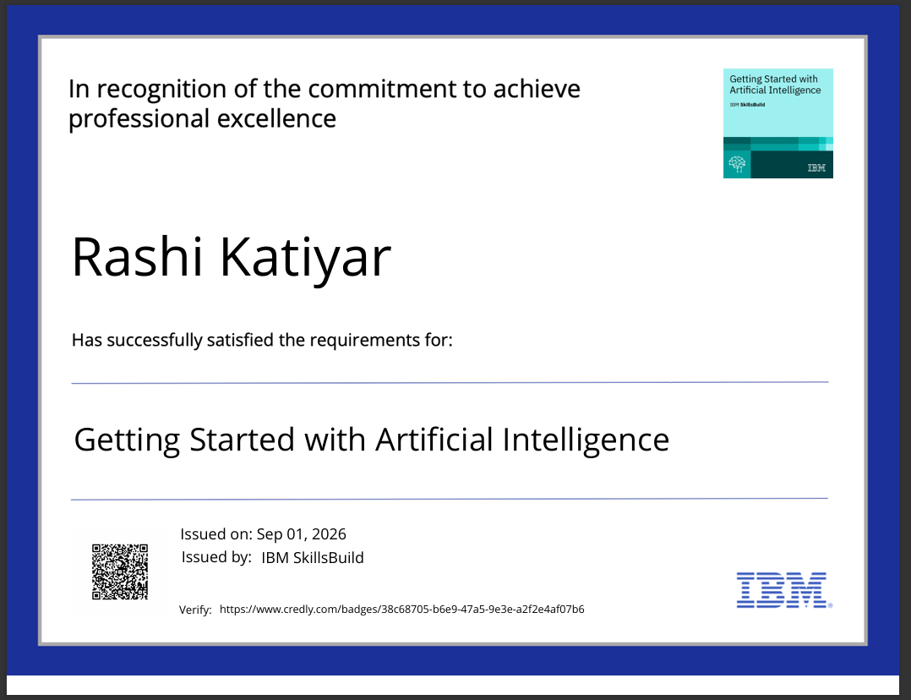
Certificates Earned:
(Getting Started with Artificial Intelligence)

Slide 19
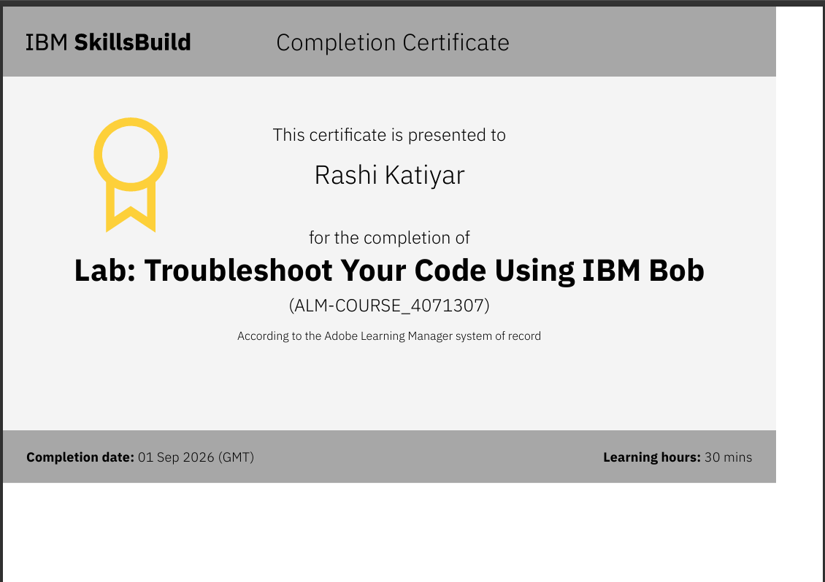
Certificates Earned:​
IBM BOB Certificate

Slide 20


