Slide 1
2023 CISCO Ariel University Security Challenge
Rashi Pachino
Noah Weiss

Slide 2
The Background: API
What is an API?
Application Programming Interface
A way for two or more computer programs to communicate with each other
Rest APIs

Slide 3
The Challenge
DATASET:
Benign and malicious labeled HTTP requests and responses
API ATTACKS
SQL Injection
Cookie Injection
Log4J
Log Forging
RCE
Directory Traversal
XXS

Slide 4
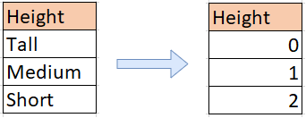
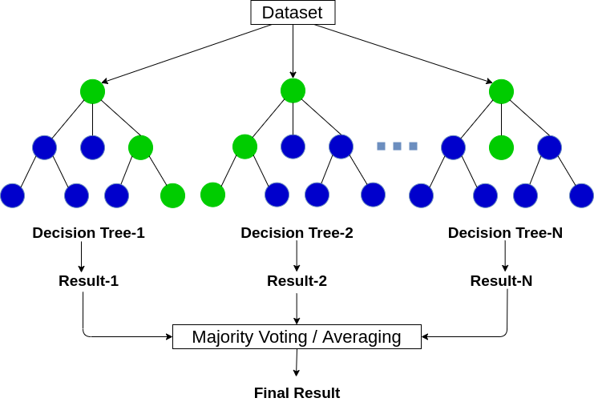
Our Model
Label Encoder
Random Forest

Slide 5
Data Exploration and Featurization
“Torture the data, and it will confess to anything.” — Ronald Coase

Slide 6
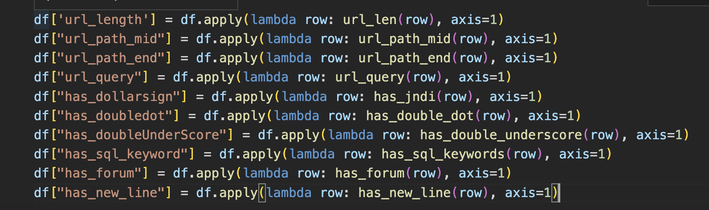
Features
Add custom features
Based on nature of attacks

Slide 7
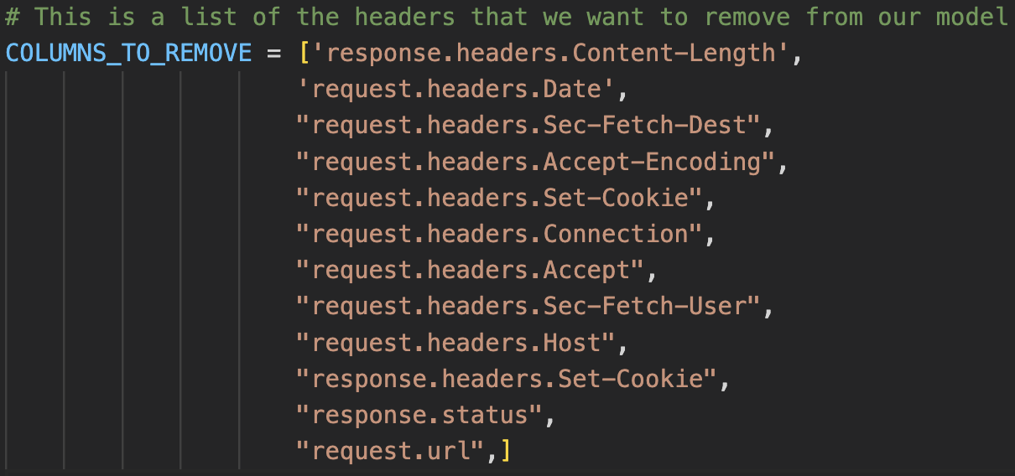
Features
Drop irrelevent features
Based on correlation heatmap

Slide 8
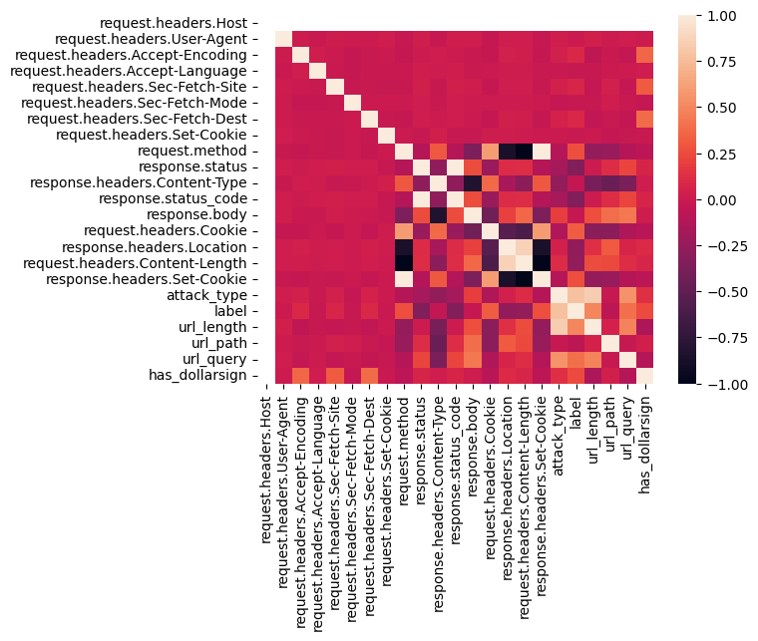
Correlation Heatmap

Slide 9
Results
 | Recall | Accuracy | Precision | F1
Dataset 1 Label | 1.0 | 1.0 | 1.0 | 1.0
Dataset 2 Label | 1.0 | 1.0 | 1.0 | 1.0
Dataset 3 Label | 1.0 | 1.0 | 1.0 | 1.0
Dataset 3 Attack Type | 1.0 | 1.0 | 1.0 | 1.0
Dataset 4 Label | 1.0 | 1.0 | 1.0 | 1.0
Dataset 4 Attack Type | 1.0 | 1.0 | 1.0 | 1.0

Slide 10
Live Demo

Slide 11
Thank you!
Rashi Pachino
Noah Weiss
Ariel University 2023

