Slide 1


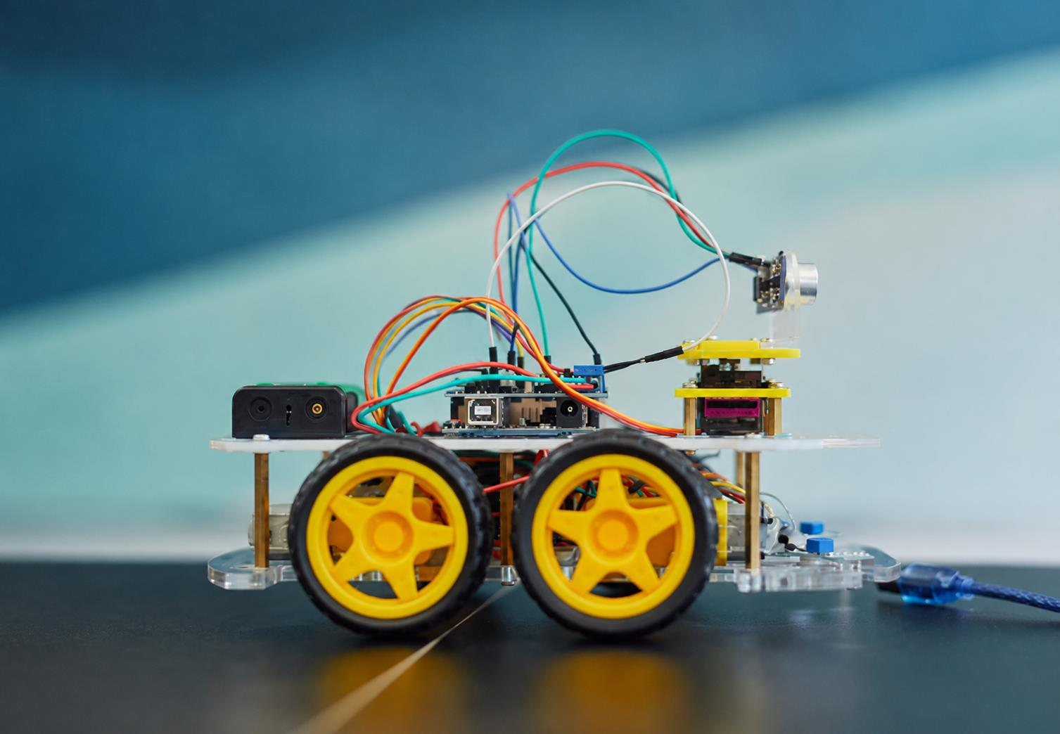

HOCHSCHULE
HAMM-LIPPSTADT
AUTONOMOUS
ARDUINO CAR
PROJECT
The Autonomous Driving System (ADS) is a semester project for the System Engineering & Prototyping module at Hochschule Hamm-Lippstadt. It focuses on developing a robotic vehicle that can follow a line and avoid obstacles autonomously.
Prototyping and Systems Engineering
Amina Boudali · Naved Afridi Rashiq · Tzuen Lin · Farwah Tanseem.

Slide 2
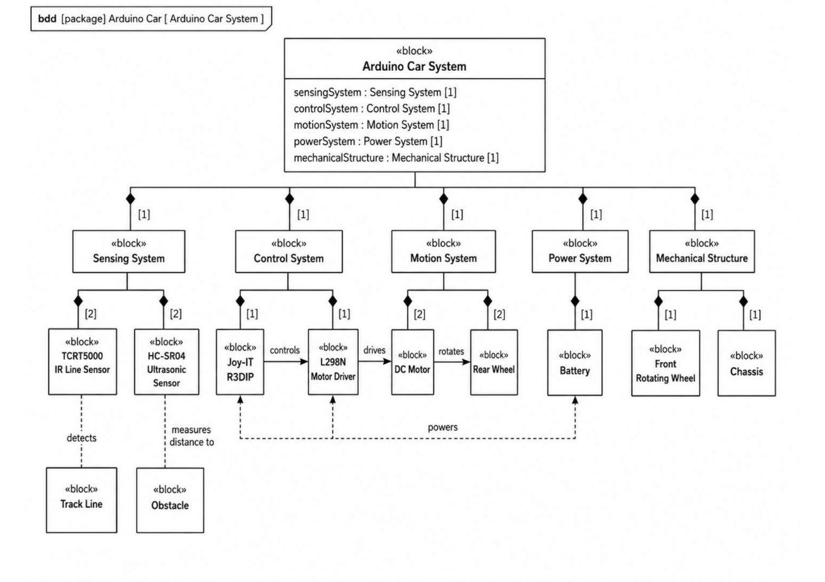
HOCHSCHULE
HAMM-LIPPSTADT
SYSTEM ENGINEERING
ASPECTS
01
Sensing system: line and obstacle detection
02
Control system: Arduino decision-making
03
Motion system: motor driver and DC motors
04
Power system: battery supply
05
Mechanical structure: chassis and 3D-printed holders

Slide 3
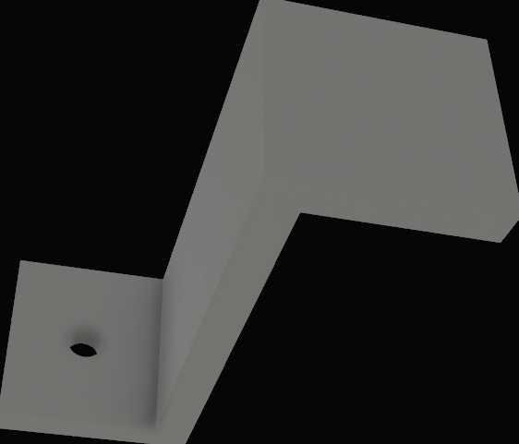
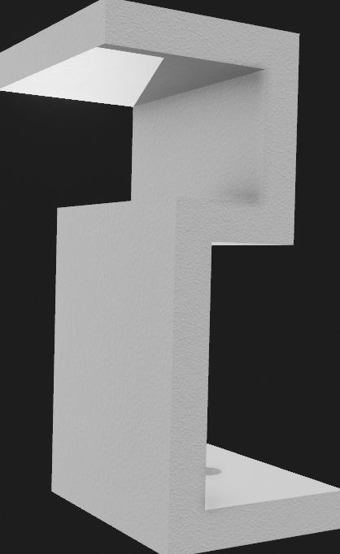
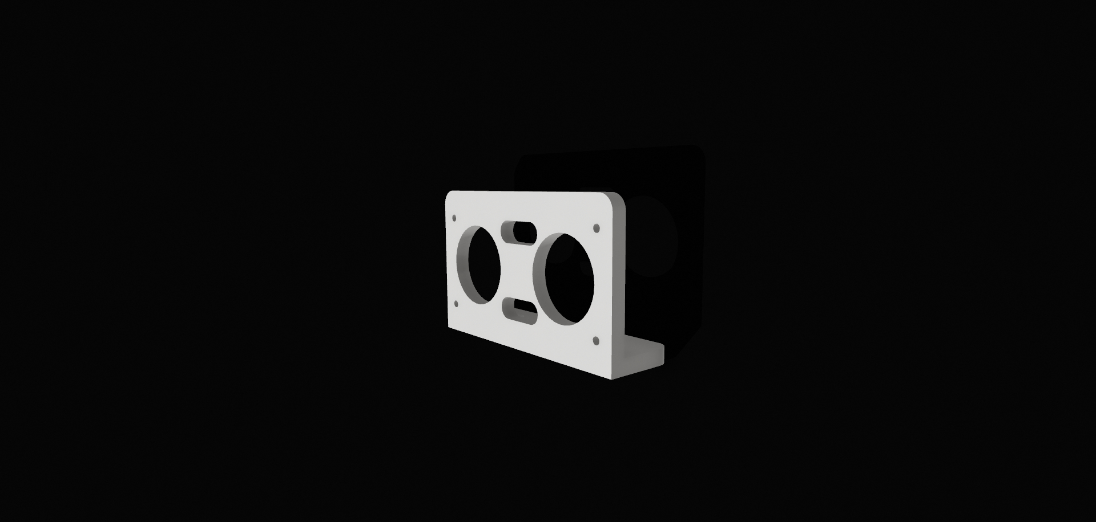
HOCHSCHULE
HAMM-LIPPSTADT
Design Approach
Design Goal
Balancing printing time, electrical routing, and mechanical stability
Battery Holder
Ultrasonic Sensor Mount
Minimal footprint, saves space for other parts;
let's battery slide in/out easily.
Rock-solid, no wobble; clear sensor eyes for accurate echo/trigger.

Slide 4
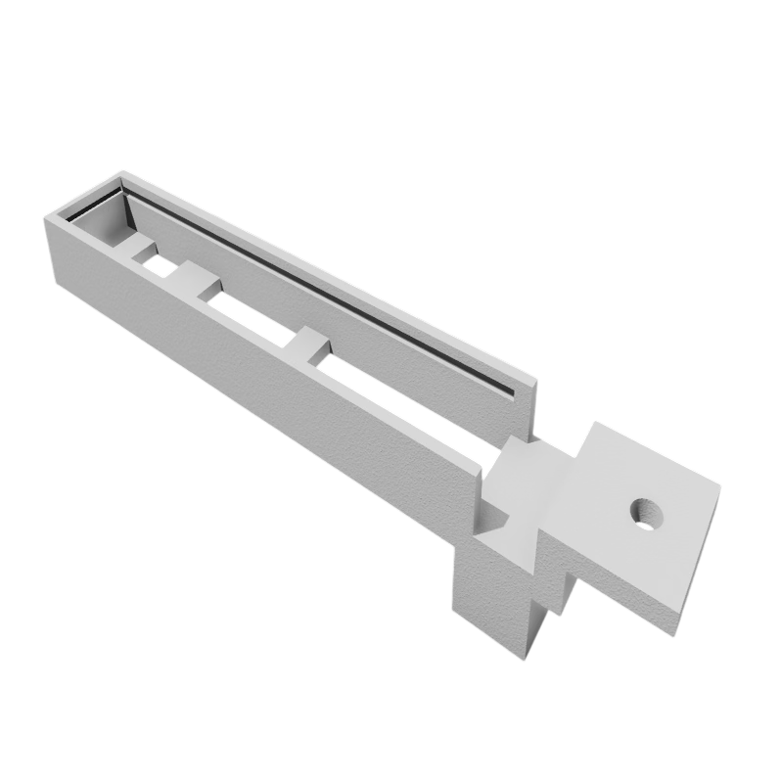
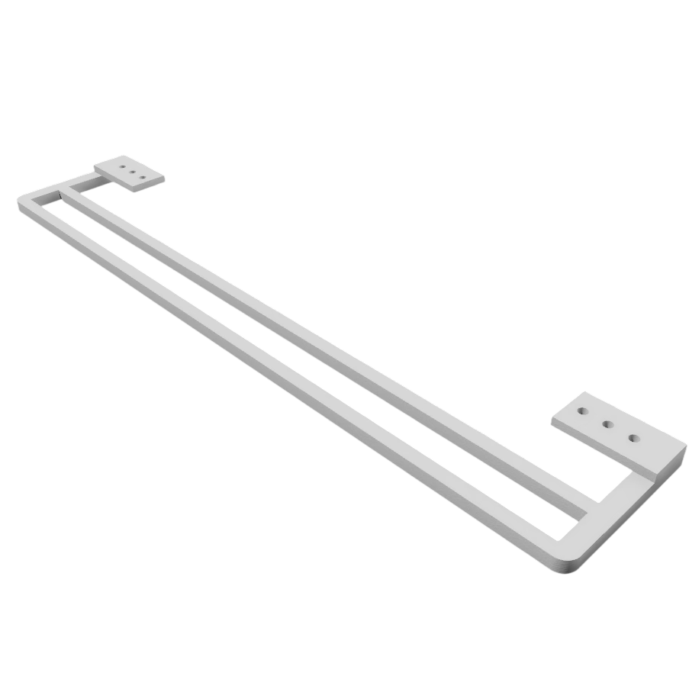
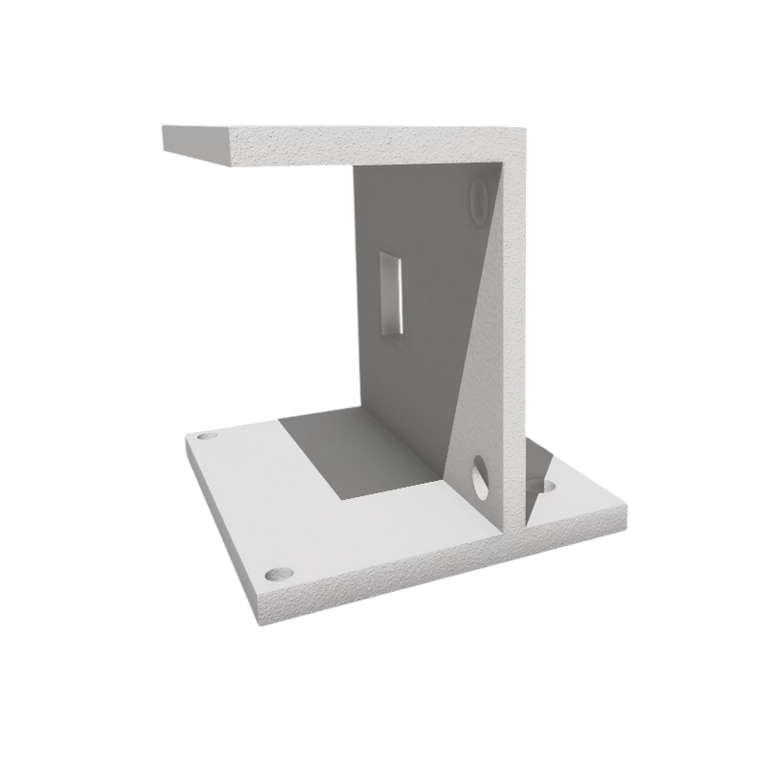
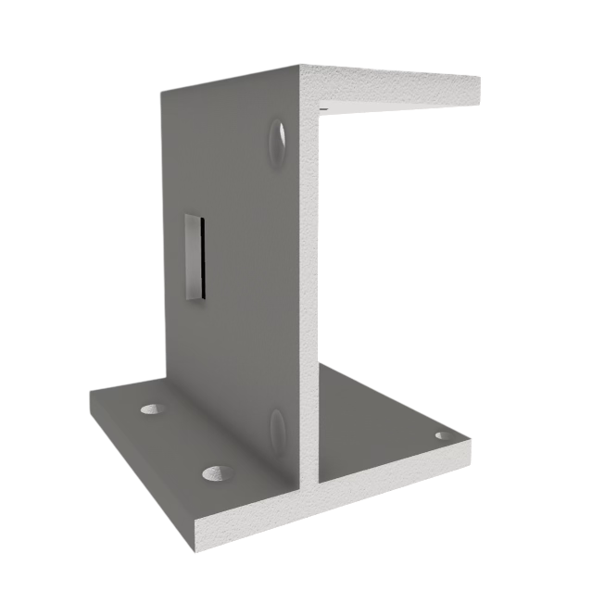
HOCHSCHULE
HAMM-LIPPSTADT
Design Approach
IR Sensor Holder
Motor Holder
Adjustable width/height/position for perfect alignment during testing.
Height matched to wheels; secure fit prevents motors from falling.
Problems we faced many times:
Holder is unable to provide adequate support that allows objects to move freely.

Slide 5
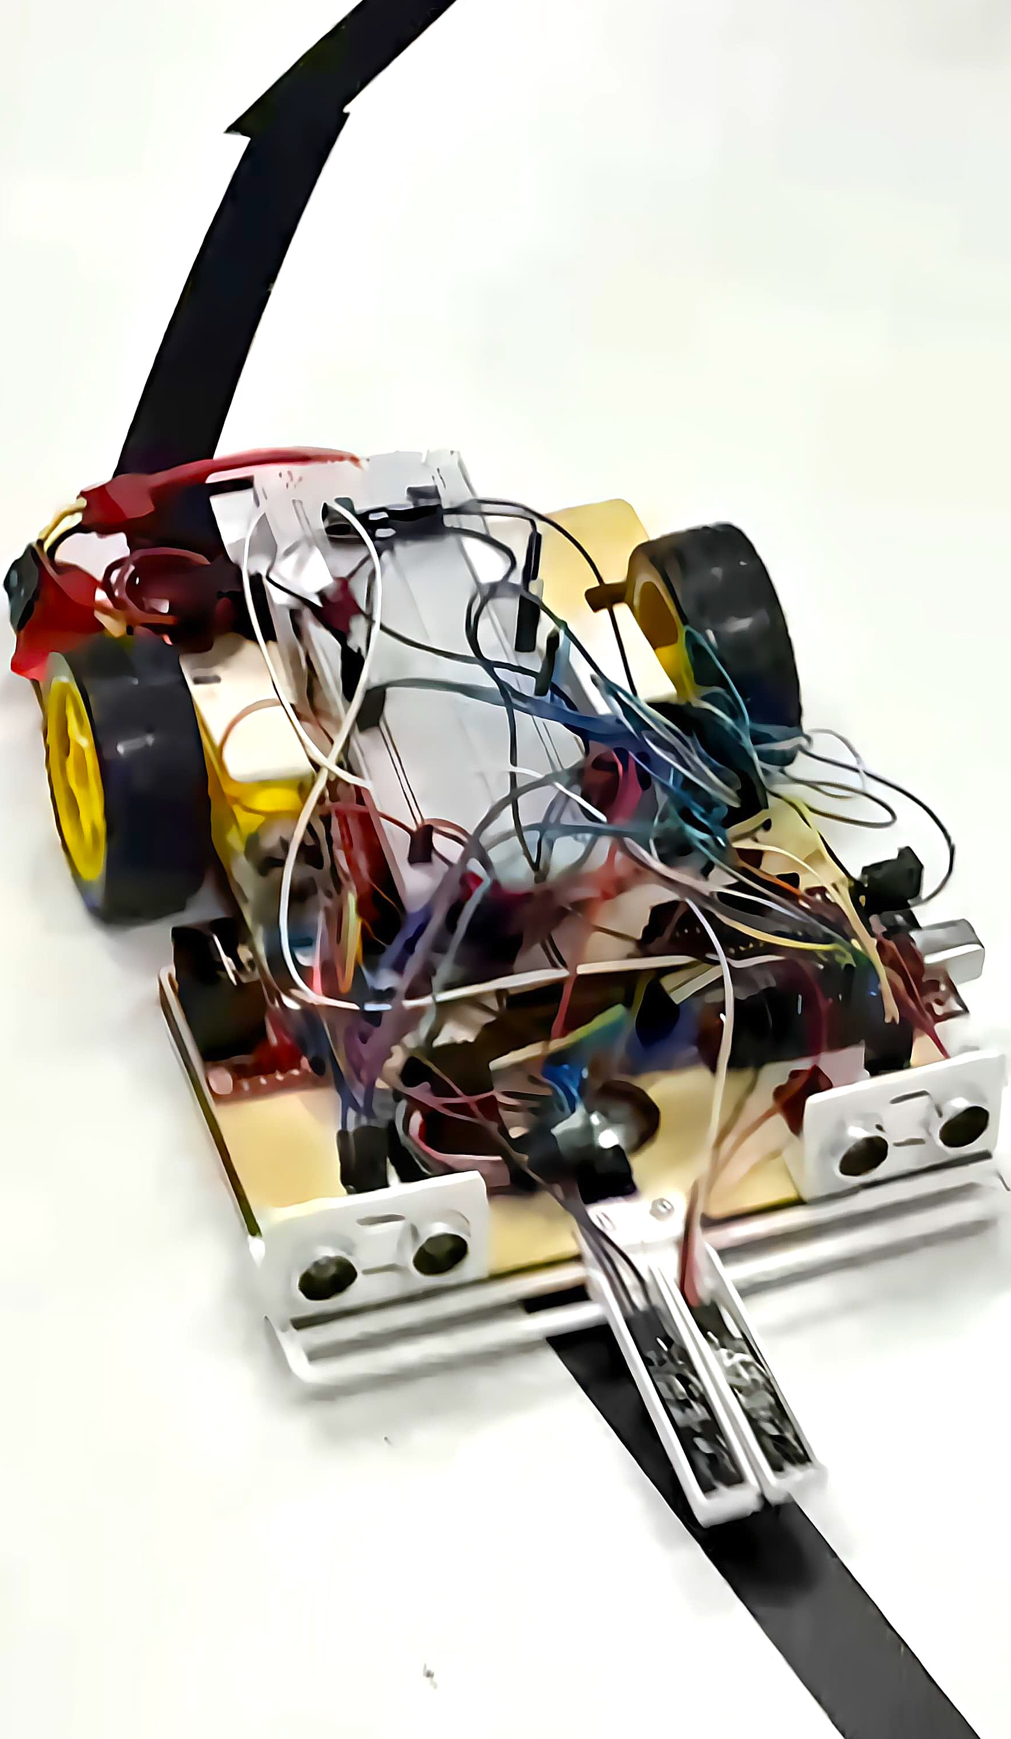
HOCHSCHULE
HAMM-LIPPSTADT
Hardware Setup & Integration
Design Goal
Optimized sensor performance and system layout for accuracy, reliability, and maintainability.
IR Sensors — Placed Close Together
Narrow sensor spacing enables accurate line-edge detection and rapid path correction.
Ultrasonic — Placed Far Left / Far Right
Wider sensor spacing provides broader obstacle coverage while reducing echo interference.

Slide 6
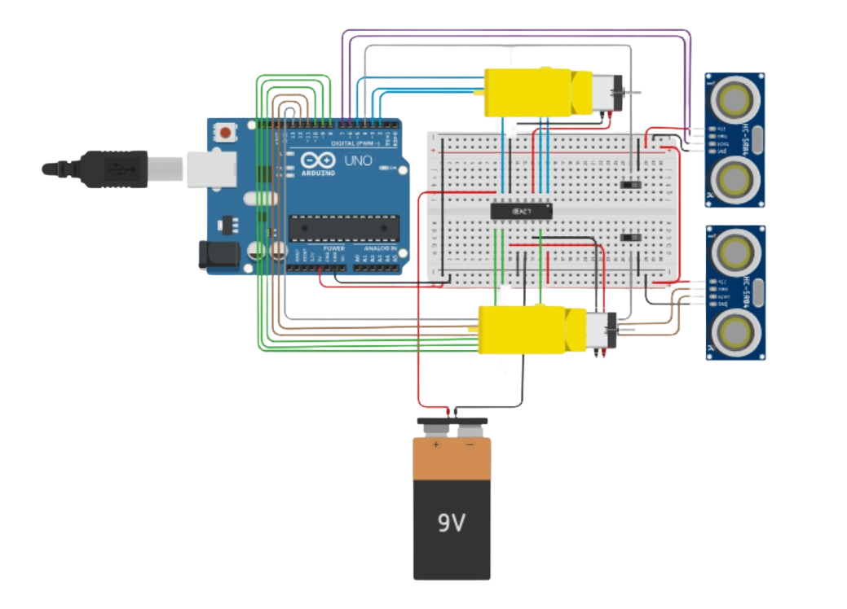
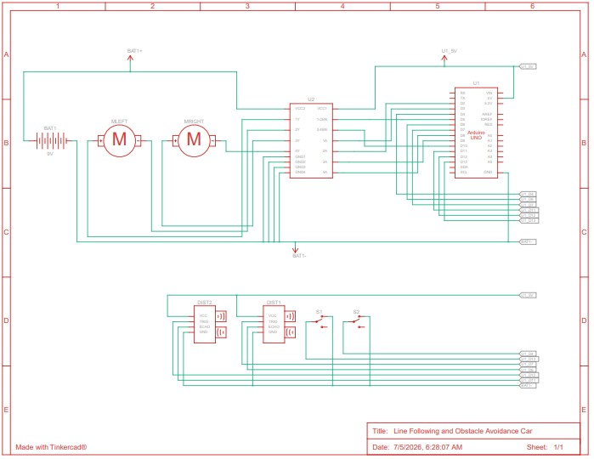
HOCHSCHULE
HAMM-LIPPSTADT
Simulation Results
Tinkercad prototype used to test the robot logic
Similar components to the real hardware setup
Some components were replaced due to simulation limits
Helped validate the logic before final code and hardware testing
Tinkercad prototype
Circuit sketch

Slide 7
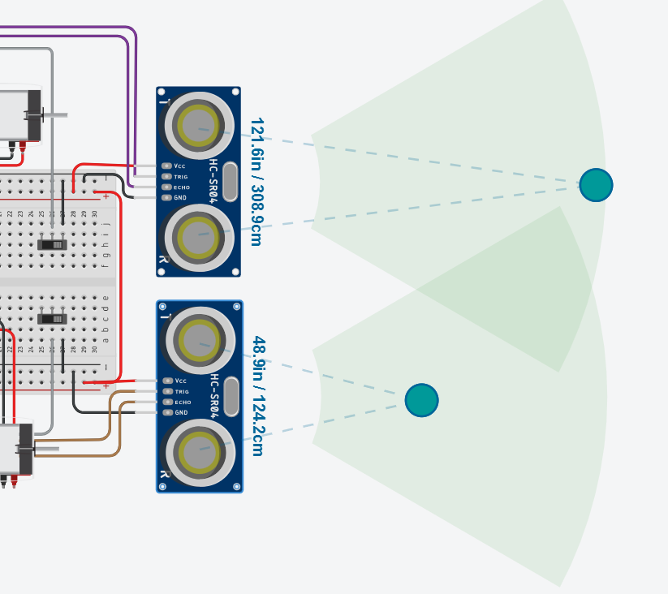
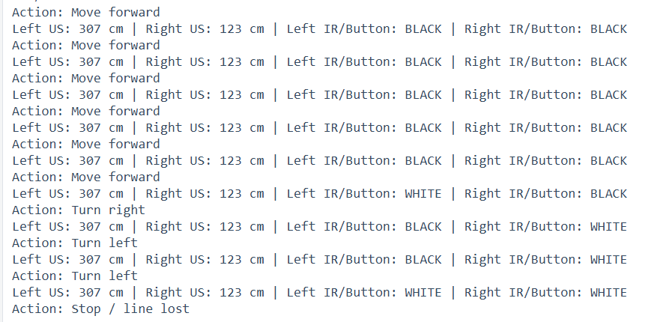
HOCHSCHULE
HAMM-LIPPSTADT
Sensor Readings

Slide 8
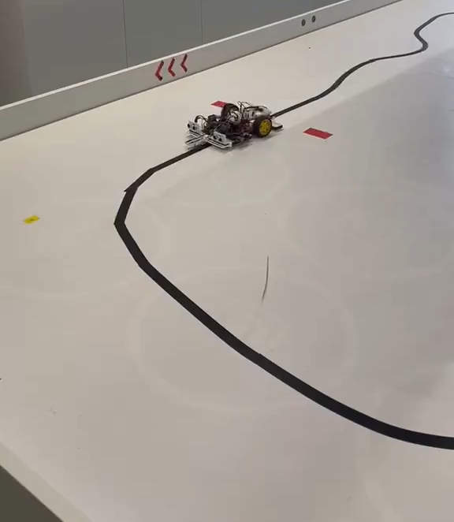
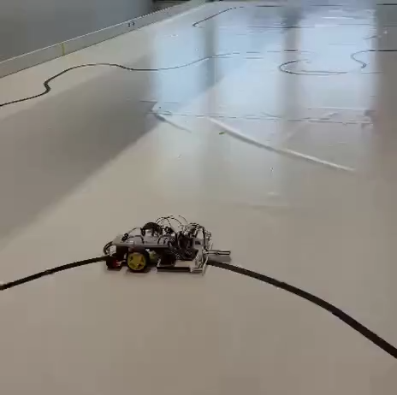
HOCHSCHULE
HAMM-LIPPSTADT
Testing Videos
Code Implementation,
Testing and Evaluation
Line Following Logic
Black-line tracking with sensor cases, differential speeds, and memory-based realignment
1
Read sensors
2
Choose case
3
Adjust motors
4
Realign
3 sensor cases
Failure video:
Jerking / unstable correction
White + White
Line not detected → use memory and search in the last known direction
White + Black / Black + White
One sensor detects the edge → differential speeds curve the car back
Black + Black
Both sensors see the line → keep the car moving stable and straight
i
Extra tuning: the IR potentiometer was adjusted to match the actual line width and surface contrast.
Improved video:
Smooth line following
Notes:
Presentation script:
I am explaining only the line-following logic, not the exact private tuning details. The car follows the black line using two IR sensors. The logic is based on three simple cases.
First, white and white means neither sensor sees the black line. In that case, the car uses its last known line position and searches in that same direction to find the line again.
Second, white and black, or the mirrored black and white case, means the car is on the edge of the line. Here I correct the direction using differential motor speeds. One motor runs slower and the other runs faster, so the car curves back toward the line instead of making a harsh movement.
Third, black and black means both sensors are over the line. The car should stay stable and continue forward.
The important recovery part is memory. The car stores where it last saw the black line. If the line is lost, it does not randomly turn; it searches back in the same direction to realign.
I also had to adjust the potentiometer on the IR module because the sensor threshold depends on the actual line width and surface contrast. Without this adjustment, the sensor can switch too early or too late, which causes unstable movement.
The first video shows the failure case where the car jerks. The second video shows the improved behavior with smoother correction, memory-based recovery, and proper sensor threshold adjustment.

Slide 9
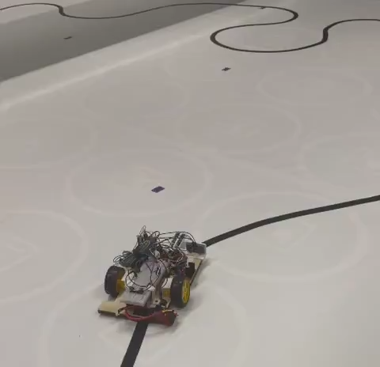
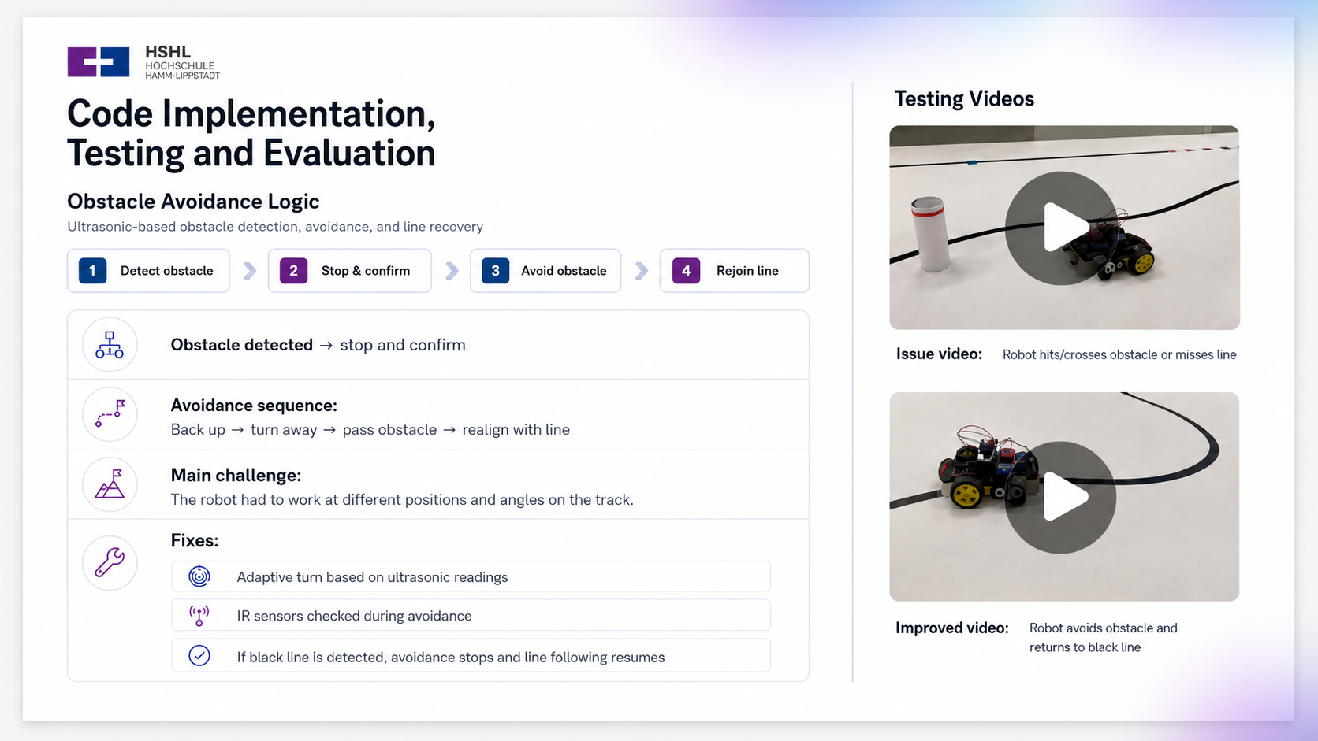
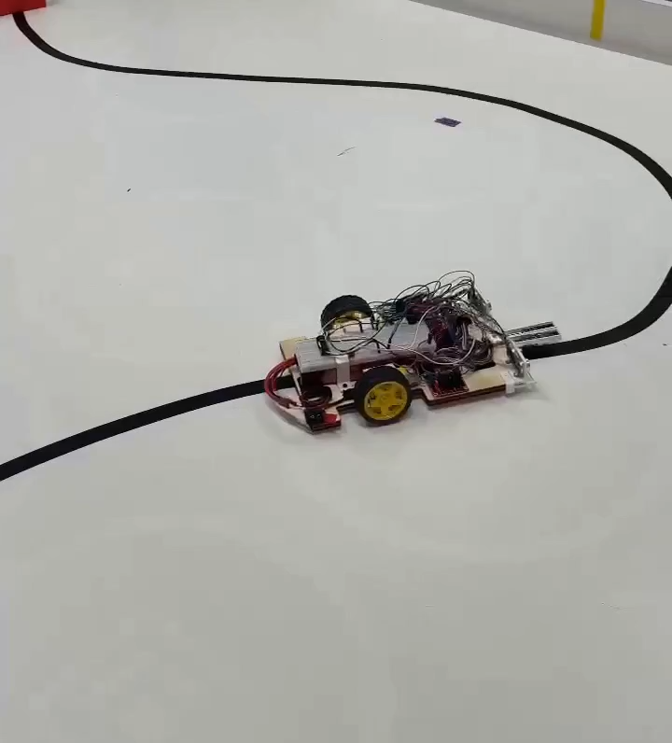
HOCHSCHULE
HAMM-LIPPSTADT
Testing Videos
Code Implementation,
Testing and Evaluation
Obstacle Avoidance Logic
Obstacle detection, avoidance sequence, and line recovery using ultrasonic and IR sensor feedback
1
Detect obstacle
2
Stop & confirm
3
Avoid obstacle
4
Recover the line
Obstacle detected → stop and confirm
Failure video:
Inaccurate avoidance
Avoidance sequence:
Back up → turn away → pass obstacle → realign with line
Main challenge:
The robot had to work at different positions and angles on the track.
Fixes:
Adaptive turn based on ultrasonic readings
IR sensors checked during avoidance
Improved video:
Smoother rejoin & avoidance
If black line is detected, avoidance stops and line following resumes
Notes:
Presentation script:
I am explaining only the line-following logic, not the exact private tuning details. The car follows the black line using two IR sensors. The logic is based on three simple cases.
First, white and white means neither sensor sees the black line. In that case, the car uses its last known line position and searches in that same direction to find the line again.
Second, white and black, or the mirrored black and white case, means the car is on the edge of the line. Here I correct the direction using differential motor speeds. One motor runs slower and the other runs faster, so the car curves back toward the line instead of making a harsh movement.
Third, black and black means both sensors are over the line. The car should stay stable and continue forward.
The important recovery part is memory. The car stores where it last saw the black line. If the line is lost, it does not randomly turn; it searches back in the same direction to realign.
I also had to adjust the potentiometer on the IR module because the sensor threshold depends on the actual line width and surface contrast. Without this adjustment, the sensor can switch too early or too late, which causes unstable movement.
The first video shows the failure case where the car jerks. The second video shows the improved behavior with smoother correction, memory-based recovery, and proper sensor threshold adjustment.

Slide 10
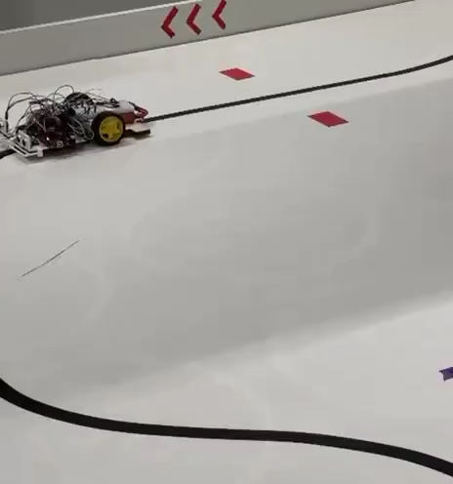
HOCHSCHULE
HAMM-LIPPSTADT
Code Implementation,
Testing and Evaluation
Testing Video
Reverse Logic
01
Memory-based trigger: The code saves when the first obstacle is avoided, so every later obstacle starts the reverse routine.
02
Turn-back sequence: Stop and confirm → back up →
slow 180° turn → detect black line.
03
Main challenge: The robot had to rejoin the line
without overshooting or missing it.
04
Key fixes: Slower 180° turn, delayed line check,
black-line confirmation, and short stabilization
before line following resumes.
Reverse test: robot turns back and rejoins the line.​

Slide 11

HOCHSCHULE
HAMM-LIPPSTADT
THANK YOU FOR JOINING US
Questions?
We are happy to answer any questions about the project.

