Slide 1

ANGULAR
Get awareness of angular front end technology

Slide 2
WHAT IS ANGULAR?
Angular emerged for the primary purpose of simplifying web and mobile app development by combining end-to-end tooling, declarative templates and other features like dependency injection.
Angular is a front-end web development platform that operates as a JavaScript framework.
Angular 6 is still pleasing the masses. In the Stack overflow of 2018 Angular was ranked as the second most-used technology for developers.

Slide 3
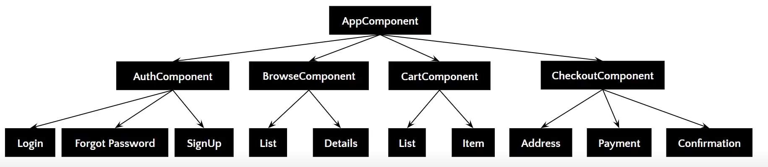
TECHNOLOGY COMPONENTS

Slide 4
FEATURES OF COMPONENTS
Components are typically custom HTML elements, and each of these elements can instantiate only one component.
A TypeScript class is used to create a component.
The decorator accepts a metadata object that gives information about the component.
A component must belong to the Ng Module in order for it to be usable by another component.
Components control their runtime behavior by implementing Life-Cycle hooks.

Slide 5
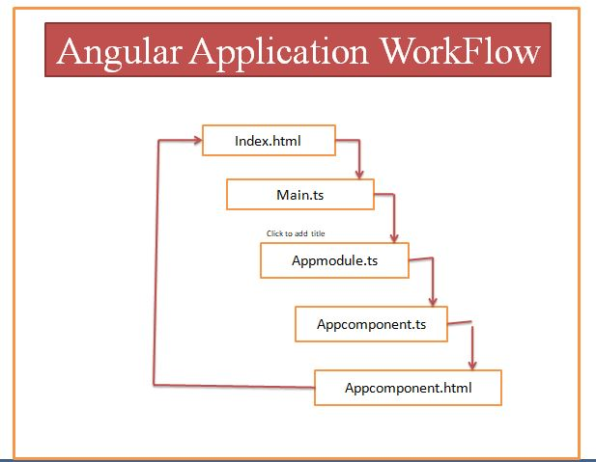
WORKFLOW

Slide 6
ADVANTAGES
Faster Development Process
Readable and Testable Code
More Lightweight Web Applications
Efficient Problem-Solving Patterns
Excellent Material Design Library

Slide 7
DISADVANTAGES
Angular is quite big and fairly complicated. There are many ways to do the same thing.
The lifecycle methods in Angular are very complex. It takes time to understand them.
The directives are useful in DOM manipulation, but creating them is difficult.
Angular documentation is not fully sufficient, which makes it a bit difficult to learn Angular.

Slide 8
THANK YOU

