Slide 1
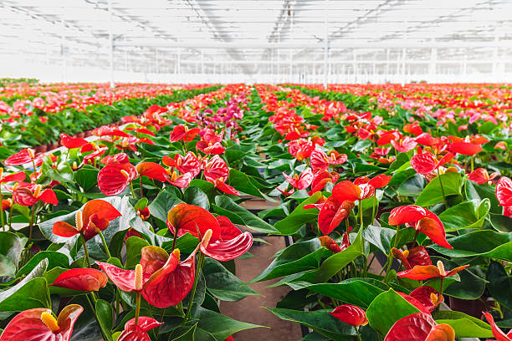
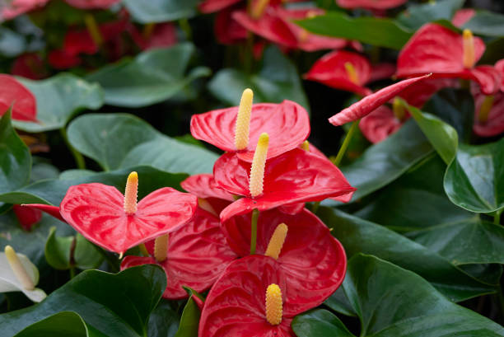

An Intelligent
Decision Support System for
Sustainable Anthurium Farming
Specialization : Information Technology
Group ID : 25-26J-357

Slide 2
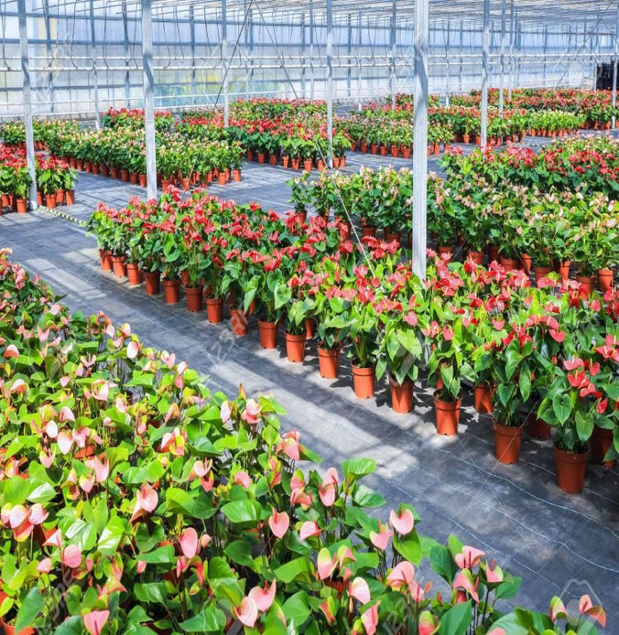

Introduction
Even though Anthurium farming is a profitable floriculture venture in Sri Lanka - despite its value, the sector struggles with disease outbreaks, climate sensitivity, inefficient practices, and volatile market demand.
This project proposes a smart, mobile-based system using machine
learning to detect diseases early, offer treatment advice, forecast microclimates, and analyze market trends.
The goal is to boost efficiency, reduce losses, improve quality, and
promote sustainable Anthurium cultivation.
Our project proposes on ML and IoT for bringing out the outcomes of
predictions and suggestions.
The system will predict required weather and soil conditions, most
accurate market trends and the solutions for sustainable farming.
‹2›

Slide 3



WEATHER DETECTONG
&
WATERING SHEDULE SUGGETION MODULE
IT22109958| Soysa H. R. T.
Specialization : Information Technology
IT22109958 | Soysa
‹3›

Slide 4
PROBLEM
SOLUTION
No publicly available dataset specifically designed for training watering schedule models for Anthurium farming.
Watering practices are often based on experience rather than data-driven insights, leading to overwatering or under watering.
USER REQUIREMENTS
Accurate recommendations for daily watering time (e.g., morning or evening).
Clear guidance on water quantity per plant based
on weather conditions.
Identification of low-risk and high-risk watering days.
Simple, mobile-friendly presentation suitable for
Sri Lankan farmers.
IT22109958 | Soysa H.R.T.
Knowledge-Guided Model Development
In the absence of a labeled dataset,
agricultural research literature is used to understand how temperature, humidity, rainfall, and soil moisture affect Anthurium water requirements.
Weather-Driven Watering Logic
A rule-based and data-assisted model is developed to generate optimal watering time and water level recommendations based on current and forecasted weather conditions.
Expert Knowledge Validation Collected rules and thresholds are validated and refined through expert
knowledge, including agricultural officers, floriculture experts, and experienced Anthurium farmers.
1/8/2026
‹4›

Slide 5
Design Contribution and User Feedback
Design Excellence / Contribution
Integration of a Weather API–based detection and 7-day forecasting system tailored for anthurium farming conditions.
Development of a weather-driven watering time and water level scheduling module aligned with daily and
forecasted conditions.
Use of agricultural research and expert knowledge to design watering rules in the absence of a labeled irrigation dataset.
User Feedback on Prototype
Weather forecasts and daily condition indicators are easy to understand and help farmers plan activities in advance.
7-day weather visualization improves confidence in watering and farm
management decisions.
Watering time and quantity recommendations reduce overwatering and water wastage, especially during rainy or high-humidity days.
IT22109958 | Soysa H.R.T.
‹5›

Slide 6

Market Analysis
&
Price Prediction Module
IT22117564| Peiris W.V.D
Specialization : Information Technology
IT22117564 | Peiris W.V.D
‹6›

Slide 7
PROBLEM
Low predictive accuracy due to reliance on single- algorithm price forecasting models.
Absence of a crop-specific digital market analysis and price prediction platform for anthurium floriculture in Sri Lanka.
Lack of a standardized quantitative index to represent market trends and volatility in floriculture markets.
Non-existence of sustainability-aware predictive market intelligence that converts price forecasts into actionable decision signals .
USER REQUIREMENTS
Accurate daily price predictions for anthurium based on historical and market data.
Clear presentation of market trends and price fluctuations across different markets.
Easy-to-understand recommendations indicating optimal, sustainable selling periods and high risk selling periods.
User-friendly, mobile-accessible platform designed for Sri Lankan anthurium farmers.
SOLUTION
Fusion-Based Price Prediction Framework
A two-stage fusion model is developed to combine temporal price dynamics with market-specific features, improving the accuracy of daily anthurium price predictions.
Dedicated Market Analysis and Prediction System for Anthurium Farming
A crop-specific digital platform is designed to provide integrated price forecasting and market analysis tailored to the Sri Lankan anthurium floriculture sector.
Sustainability-Aware Market Intelligence Index A predictive market intelligence layer is introduced to generate a market trend index and actionable decision signals, enabling stable and sustainable selling strategies.
IT22117564 | Peiris W.V.D
1/8/2026
‹7›

Slide 8
Design Contribution and User Feedback Design Excellence / Contribution
Fusion-based price prediction model improving accuracy.
Unified market analysis and price forecasting system for anthurium farming. Sustainability-aware market intelligence and trend index.
Farmer-friendly recommendations with high interpretability.
Scalable design adaptable to future crops and markets.
User Feedback on Prototype
Dashboard visualizations are easy to understand and help farmers make informed decisions without guesswork.
Fusion-based predictions outperform single-algorithm models, by giving confidence
in planning and sales strategies.
Can identify optimal selling times, reducing losses and maximizing revenue. Continuous market index tracking allows early detection of price fluctuations and emerging demand patterns.
Intuitive interface and visualizations enable non-technical users to access advanced
analytics quickly and easily.
IT22117564 | Peiris W.V.D
1/8/2026
‹8›

Slide 9

Soil Control Monitoring Module
IT22131188| Gamage P.U
Specialization : Information Technology
IT22131188 | Gamage P.U
11//88//22002266
<9>

Slide 10
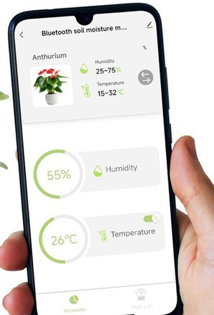
PROBLEM
Farmers mostly check soil manually, so real-time soil changes are missed.
Many systems react to one sensor reading, causing over- irrigation.
Existing systems are not designed specifically for Anthurium.
Farmers cannot easily see which locations are suitable or risky for cultivation.
Sensor errors and short-term changes are not filtered, damaging roots and nutrients.
.
USER REQUIREMENTS
Monitor soil moisture, temperature, humidity, and NPK in real time.
Understand soil condition specifically for Anthurium plants. See soil condition on a map using GPS.
Get clear warnings before taking irrigation actions. Use a simple mobile app instead of raw numbers. Avoid false alerts caused by temporary sensor errors.
SOLUTION
IoT Soil Monitoring System
An ESP32 device collects soil and environmental data in real time.
Data is sent to the backend using MQTT.
GPS-Based Soil Mapping
Each soil reading includes GPS location.
Farmers can see good, warning, and bad soil areas on the map.
ML Support
Past soil data is used to understand soil behavior. ML helps classify soil health and trends.
Final decisions are kept safe and controlled.
IT22131188 | Gamage P.U
‹10›

Slide 11
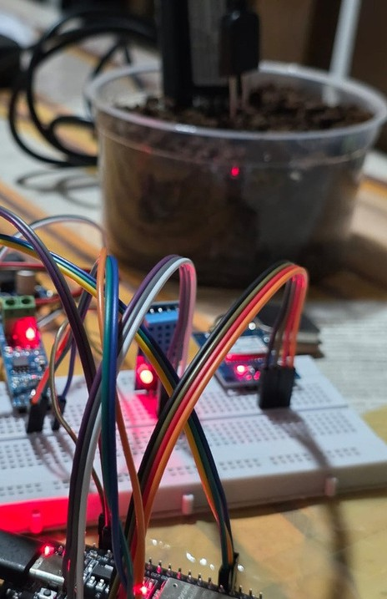
Design Contribution and User Feedback Design Excellence / Contribution
Designed dashboard for real-time soil monitoring in Anthurium farming.
Implemented map-based visualization to display soil condition using GPS-tagged sensor data. Developed a reading details view showing soil, environmental, and nutrient values clearly.
Implemented an add new reading interface to manually or system-triggered soil data entry.
Introduced clear soil health indicators (Healthy / Unhealthy) for easy interpretation. Integrated IoT backend data with the dashboard using MQTT and server-side processing.
User Feedback on Prototype
Map view helps users quickly identify soil condition by location.
Soil health status and numerical values are easy to understand without technical knowledge.
Reading popup provides all important soil information in one place.
Dashboard layout is clean and simple, suitable for monitoring multiple locations. Overall system improves awareness of soil conditions for Anthurium cultivation.
IT22131188 | Gamage P.U
‹11›

Slide 12

Anthurium Disease Detection
IT22274434| De Silva W.S.A
Specialization : Information Technology
IT22274434 | De Silva W.S.A
‹12›

Slide 13
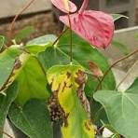
PROBLEM
.
SOLUTION
Difficulty in early identification of Anthurium diseases
Lack of expert knowledge among farmers
Manual inspection is time-consuming and error-prone
Delayed treatment causes crop damage and yield loss
Limited access to agricultural specialists, especially in rural areas
Incorrect treatment selection increases costs and plant mortality
AI-based mobile disease detection system
Upload or capture plant images for instant analysis
Automatic identification of Anthurium diseases
Provides symptoms, causes, and treatment methods
Displays estimated recovery time
Helps farmers make quick and accurate decisions
Reduces crop loss and improves plant health and productivity
USER REQUIREMENTS
Users should be able to capture or upload plant images
The system should detect Anthurium diseases accurately
The app should display disease details and causes
Users should receive treatment recommendations
The system should show estimated recovery duration
Users should be able to view past detection history
IT22274434 | De Silva W.S.A
‹13›
USER REQUIREMENTS

Slide 14
Design Contribution and User Feedback Design Excellence / Contribution
Designed an intelligent dashboard for real-time Anthurium disease detection and monitoring.
Implemented image-based analysis to identify plant using uploaded or captured photos.
Developed a detection result view displaying disease name, confidence level, and affected plant part clearly.
Implemented an image upload interface supporting camera capture and gallery selection for disease detection.
Introduced clear plant health indicators (Healthy / Diseased) for easy interpretation by users.
Integrated the AI disease detection model with the mobile application using server-side processing for real-time prediction results.
User Feedback on Prototype
Users can rate detection accuracy
Users can provide comments or suggestions
Users can report wrong disease identification
Users can share treatment success or failure
Feedback helps improve AI model performance
Feedback enhances user experience and reliability
IT22274434 | De Silva W.S.A
‹14›

Slide 15

Commercialization
First market analysis & price prediction app for Anthurium in Sri Lanka. Potential for subscription-based model for farmers and exporters.
Can be integrated with e-commerce or online marketplaces for direct selling. Opportunities for partnerships with agricultural cooperatives and government programs. Scalable to include other floriculture crops in the future.
Provides data-driven insights that attract agritech investors and stakeholders.
Initial Cost
Development cost mainly for app, database, sensors and model integration.
Low maintenance cost due to automated data collection and predictions.
Target Market
Anthurium farmers (small, medium, and large scale). Floriculture traders, exporters, and market analysts.
Customer Profile
Non-technical users seeking actionable market insights.
Users wanting to maximize profit and reduce manual guesswork. Early adopters in sustainable farming and digital agriculture solutions.
‹15›

Slide 16

THANK YOU!
‹16›

