Slide 1


Project Domain-BFSI
PREDICTIVE MODELING FOR INSURANCE CLAIM PROBABILITY BASED ON COMPREHENSIVE CAR POLICY FEATURES AND SAFETY RATINGS

Slide 2
Problem Statement
Developing a predictive model that assesses the claim probability for car insurance policies.
The objective would be to understand the factors that influence claim frequency and severity in the period of six months and enable insurance companies to better assess risk and determine appropriate premiums for policyholders.
Data Structure
There are total 44 columns (dimensions) and 58592 rows in our dataset.

Slide 3
Exploratory Data Analysis (EDA)
Information of the columns & their datatypes : df.info()
Duplicate value counts of the dataset: df.duplicated().sum()
Missing value/Null values of the dataset: df.isnull().sum()
Understanding dataset variables: df.columns
Getting information about the variables which are of numeric datatype:
df.describe()
After performing all the above steps the following is interpreted:
All the data is of correct datatype.
There are no duplicate values present in the dataset.
There is no missing data/null/nan values in the dataset.
There are no outliers.

Slide 4
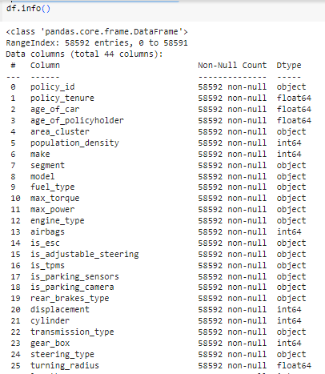
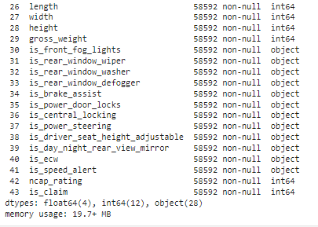
Information of the columns & their datatypes
* The above info shows that there is no missing data/null/nan values in our dataset & all the data is of appropriate datatype

Slide 5
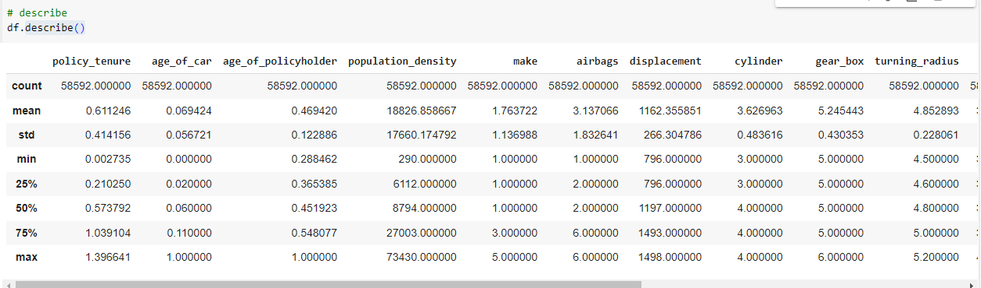
From the above, it appears that the data for the first 3 columns viz. policy_tenure, age_of_car & age_of_policyholder is scaled.
* Feature Scaling is a technique to standardize the independent features present in the data in a fixed range.

Slide 6

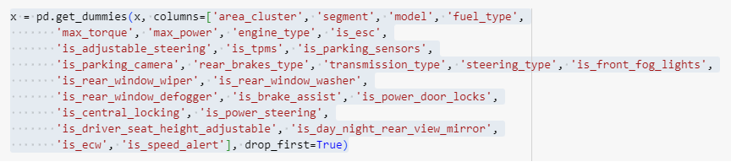
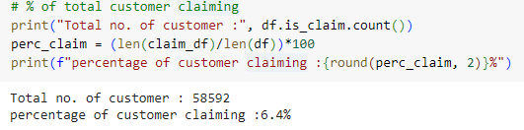
Steps to be performed:
Identifying the target variable : Target variable is ‘is_claim’
Dividing the data into 2 parts viz. Dependent variable & Independent variables, based on which target(dependent) variable needs to predicted.
As there are many columns having object datatype, we need to convert it into numbers/binary vectors by using one hot encoder.
Checking whether dataset is balanced or not : The dataset is highly imbalanced as seen from below

Slide 7
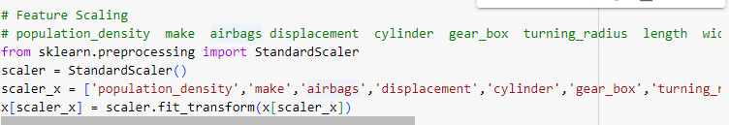
Feature Scaling
The data which is of numerical datatype needs to be scaled. The following columns are scaled using Standard Scaler.
population_density
make
airbags
displacement
cylinder
gear_box
turning_radius
length
width
height
gross_weight
ncap_rating

Slide 8
Feature Engineering
Feature Engineering is the process of creating new features or transforming existing features to improve the performance of a machine-learning model. It involves selecting relevant information from raw data and transforming it into a format that can be easily understood by a model. The goal is to improve model accuracy by providing more meaningful and relevant information.
Here, many categorical columns were present in our dataset. After checking the relevance of the columns (using RandomForestClassifier(), GradientBoostingClassifier() & DecisionTreeClassifier()), it was noticed that the following 4 columns had negligible relevance, hence dropped from the dataset.

Slide 9
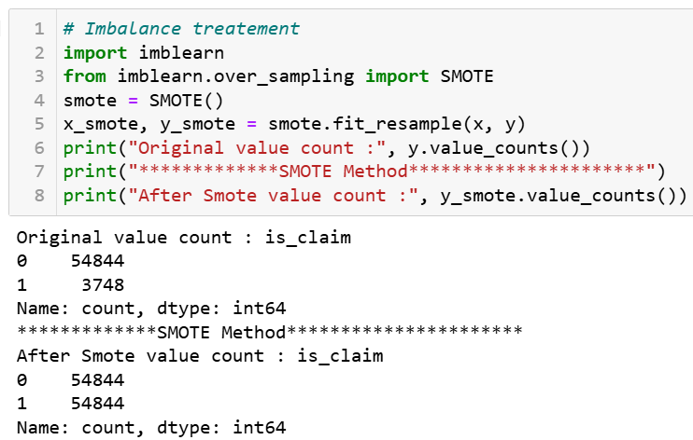
Imbalance treatment
As the data is highly imbalanced, we need to balance it in order to avoid incorrect predictions.
Here SMOTE technique from oversampling module is used to treat the imbalance data (stratify also does the same function).

Slide 10
Splitting of Data:
75% of data is used for training and 25% for testing
Model Building :
It is a classification problem, as we have to predict whether the customer will claim the insurance or not.
Here, 2 different models are used for this data :
RandomForest Classifier
XGBoost Classifier
Stacking Method
Evaluation metrics like Precision, Recall and F-1 Score are used here to evaluate the performance of this classification algorithm.

Slide 11
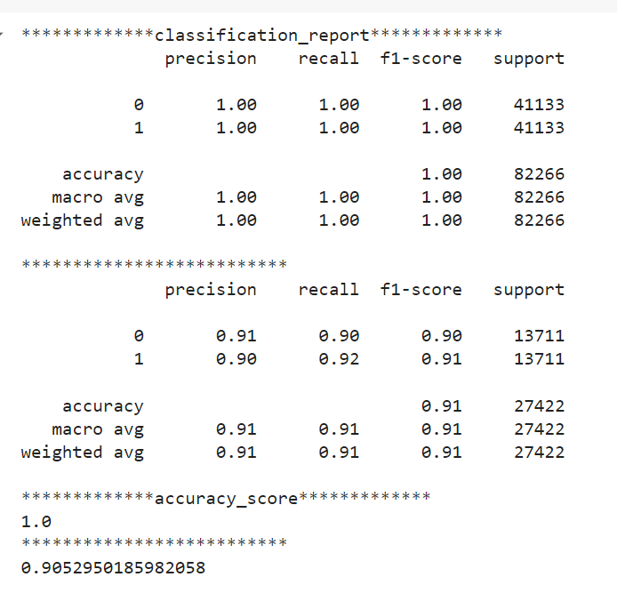
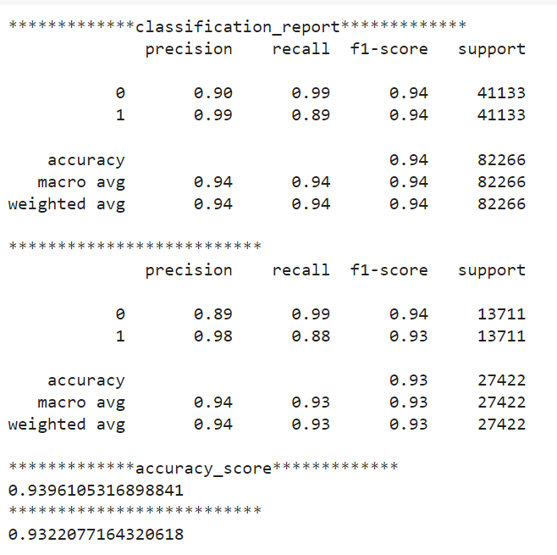
The evaluation metrics of all the models is shown below:
Random Forest
(ii) X G Boost

Slide 12
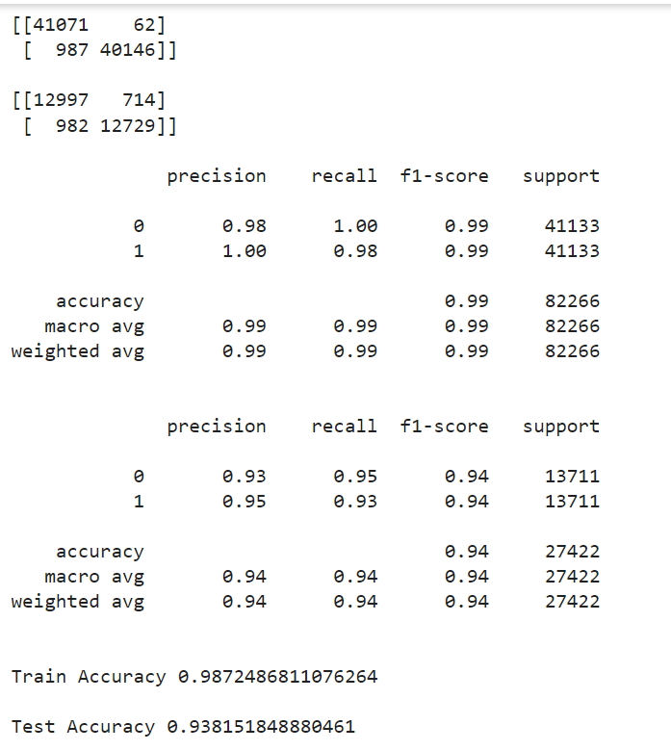

(iii) Stacking Method
Confusion matrix

Slide 13
Out of all the 3 models, Stacking method seems to have best performance with training accuracy of 98.72% and test accuracy of 93.81%. Hence, it can be relied upon for predictions.
THANK YOU

