Slide 1
NEURAL NETWORK CLASSIFIER Image Classification on Caltech-101
Team Members : Shireesha, Shravani, Rashmi
Course name : COMP841- Practical AI
Course instructor : Nicholas Noboa
Date : 19 Dec 2023

Slide 2
AI System Overview
Neural Network classifier
Caltech-101, Image Classification
VGG16
Dataset Link : Caltech 101

Slide 3
Theoretical Background
Convolutional Neural Networks
VGG16 Model Architecture
Data Augmentation

Slide 4
Development and Evaluation
1. Data pre-processing and Splitting
2. Data Augmentation and Normalization
3. Model Architecture
4. Custom Model Head
5. Model Compilation
6. Training
7. Evaluation
8. Prediction on a single Image

Slide 5
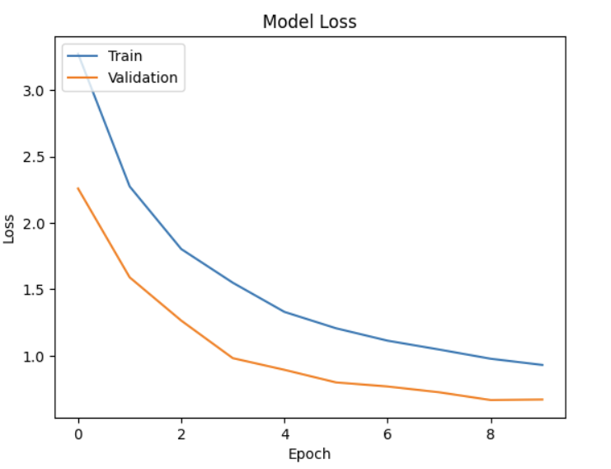
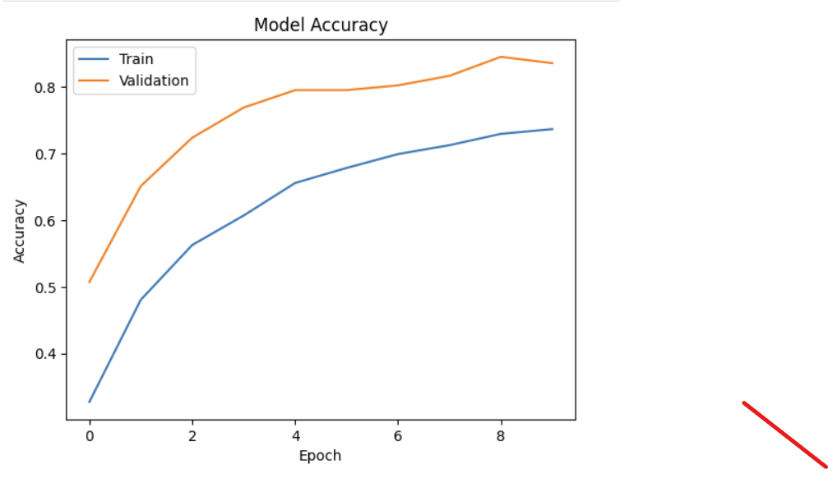
Accuracy and Loss
MODEL ACCURACY:
MODEL LOSS
Figure2
Figure1

Slide 6
Demonstration
GitHub :
https://github.com/2023-fall-comp-741-841/project-m3-team3/blob/main/src/image_classifier.ipynb

Slide 7
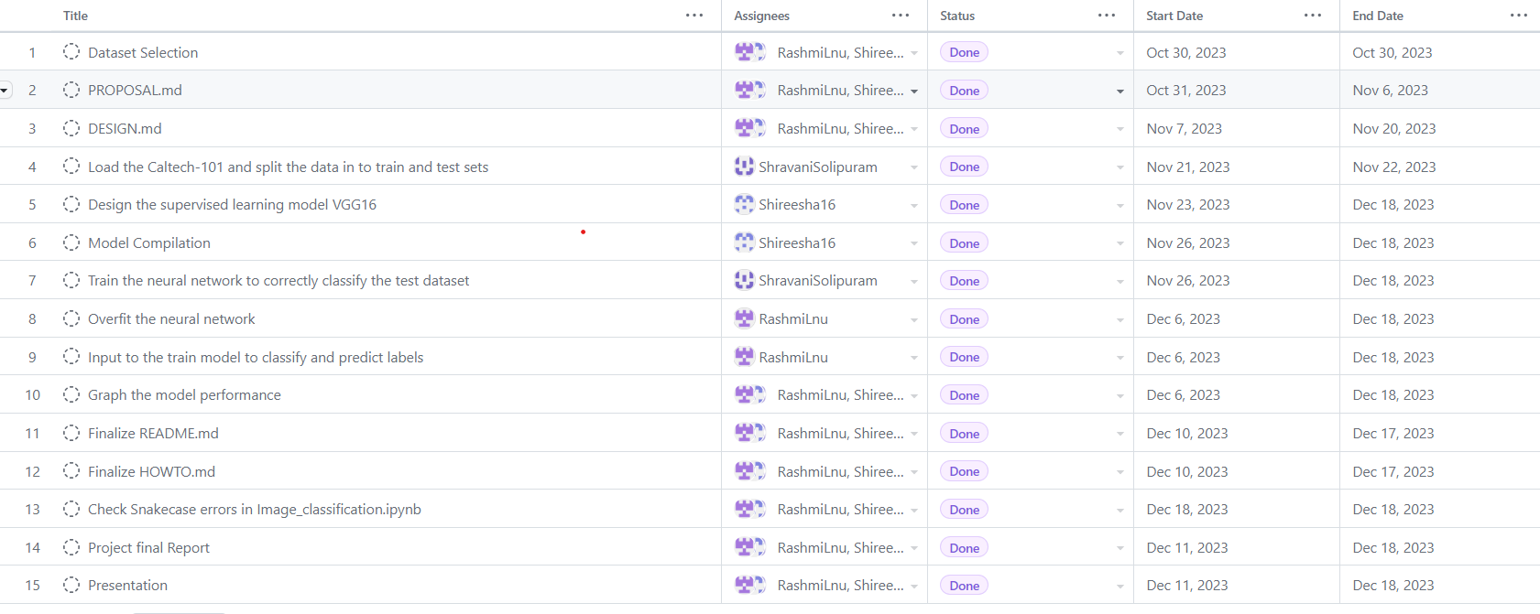
Project Management
Figure3

