Slide 1
UNDERSTANDING NGINX
A High-Performance Web Server and Reverse Proxy

Slide 2
Nginx Process
It is an open-source, fast, lightweight and high-performance web server that can be used to serve static files.
NGINX has considered as the popular web server behind the Apache web server and Microsoft's IIS.
NGINX provides various services such as reverse proxy, load balancer, and rate limit network services. Reverse proxying is useful if we have multiple web services listening on various ports and we need a single public endpoint to reroute requests internally. This would allow us to host multiple domain names on port 80 while using a combination of different NodeJS, Go and java to power separate web services behind the scenes.
Nginx divided its job into the worker process and worker connections. Here, worker connections are used to manage the request made and the response obtained by users on the web server; at the same time, these requests are passed to its parent process which is called the worker process.

Slide 3
Nginx receives the HTTP POST request from the client, applies the rewrite rules and modifies the request URL. Nginx forwards the modified request to the destination server. The destination server processes the forwarded request. The destination server generates an HTTP response. Nginx receives the HTTP response from the destination server. It eventually relays the HTTP response back to the client.

Slide 4
Nginx Configuration
The Nginx configuration files, including nginx.conf, are used to define the server's behavior and settings. nginx.conf is the main configuration file that includes global, HTTP, and server block settings, while additional files can be included for better organization using the include directive.
Key Nginx configuration directives, such as server, location, proxy_pass, and root, are used to define server-wide and location-specific settings, allowing you to customize virtual hosts, URL routing, reverse proxying, and document root directories
Inside the http block in your Nginx configuration file, use server blocks to define virtual hosts. Each server block represents a different website or application and is identified by a server_name directive.
Within each server block, use location blocks to specify how Nginx should handle requests based on URL paths, including directives for proxying, setting the document root, or applying other specific configurations.
This allows you to configure multiple websites (virtual hosts) and define how Nginx processes requests for different URL paths within each of them.

Slide 5
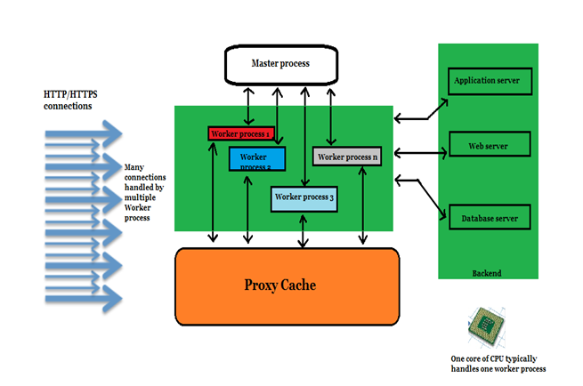
Architecture

Slide 6
Pros and Cons
Pros:
High performance
Scalability
Flexibility
Cons:
Complex for beginners
Specific use cases where Nginx cannot be used
E.g: Server-side scripting languages

